Slide 1



Frank Stupple
Notes:
General notes:
Frank Stupple volunteered as a rifleman in 9th (County of London) Battalion, The London Regiment (Queen Victoria’s Rifles) in 1915.
He was at Gommecourt on the first day of the Battle of the Somme. He was injured twice in his military career, and entitled to wear two ‘wound stripes’. His second injury was a gunshot wound to the right arm. This ‘Blighty one’ ensured he was sent back to England, and he recuperated in Felthorpe Hall in Norwich.
Frank’s younger brother, Thomas, also served in the war, as part of the Machine Gun Corps, but he was killed in action on 11 April 1918.

Slide 2
This PowerPoint presentation contains a selection of images and archives which students can use to explore the story of one British soldier in the First World War. In the main, the materials come from the Collection of the National Army Museum (NAM). Occasionally these are supplemented by materials from outside the NAM to provide context.
These images can be used to build up a picture of an individual soldier’s experience of service in the First World War. These images can encourage literacy and visual literacy. Suggestions for questions you might discuss with your students are included in the notes.
Unless otherwise stated in the notes, the images can be freely used for non-commercial purposes within the classroom. You can use the entire presentation or choose individual images for use in other non-commercial contexts. When using individual images in other contexts, please always retain the attribution statements provided in this document (e.g. NAM. 2002-10-84-7).
By downloading this document and using these images you agree to these terms of use, including your use of the attribution statement specified for each object by NAM.

Slide 3
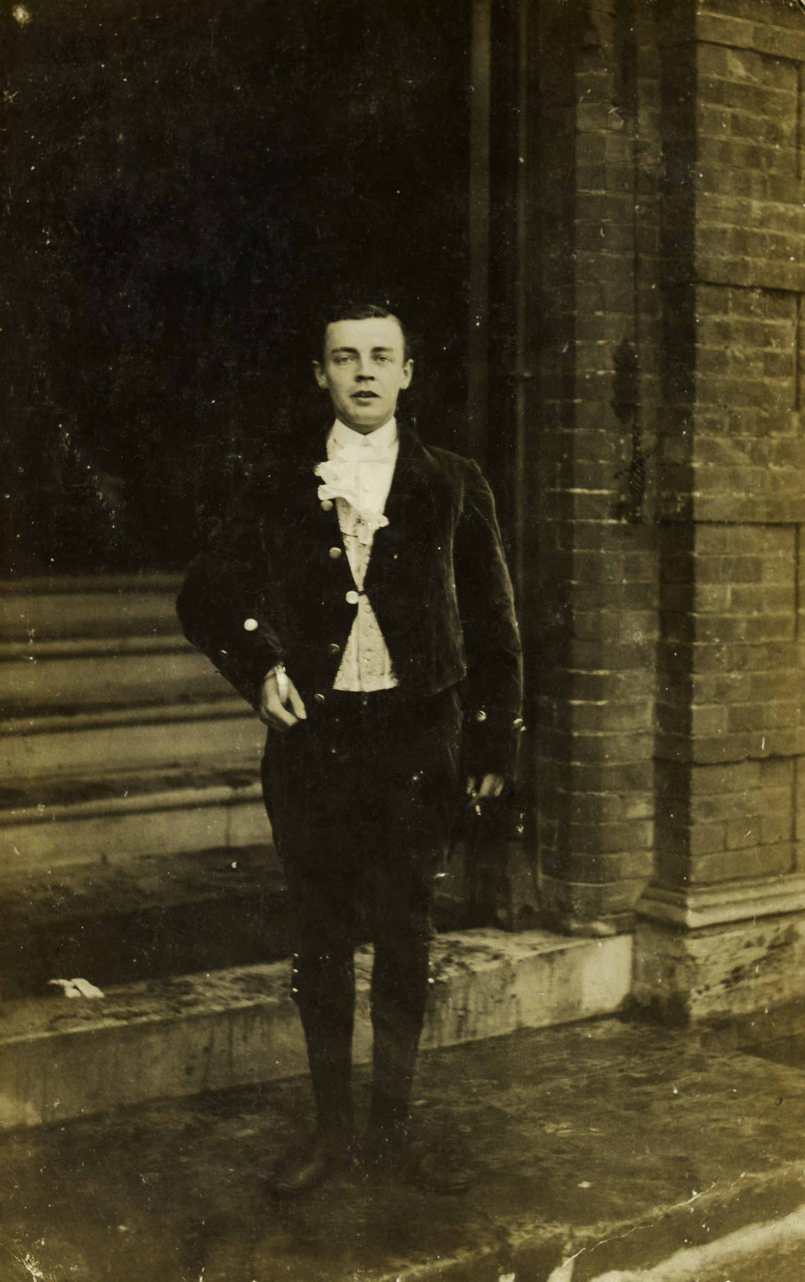
Notes:
Frank Stupple poses for a photograph while dressed as a ‘page’ in a velvet suit at the Boxing Day celebrations at Felthorpe Hall, Norfolk, 1917. Visible, emerging from his right sleeve, is the supporting cage which prevented his arm from going ‘floppy’.
NAM. 2002-10-84-7
General notes:
Frank’s records at the National Army Museum mostly refer to his injury and his time at Felthorpe Hall where he recovered. It is recommended that students be encouraged to work ‘backwards’ from this picture to see if they can build up the story to show how Frank got to this point.
This picture shows Frank as he is recovering from his second injury in the First World War, a gunshot wound to the right arm. This prevented his return to the war, and resulted in a permanent disability in the right arm.
Questions you might ask:
What do you notice about this man?
How old do you think he is?
When do you think the picture was taken? Is the clothing ‘of the time’? Why not?
Is he dressed as a soldier? Why not?
What do you notice about his arm?

Slide 4
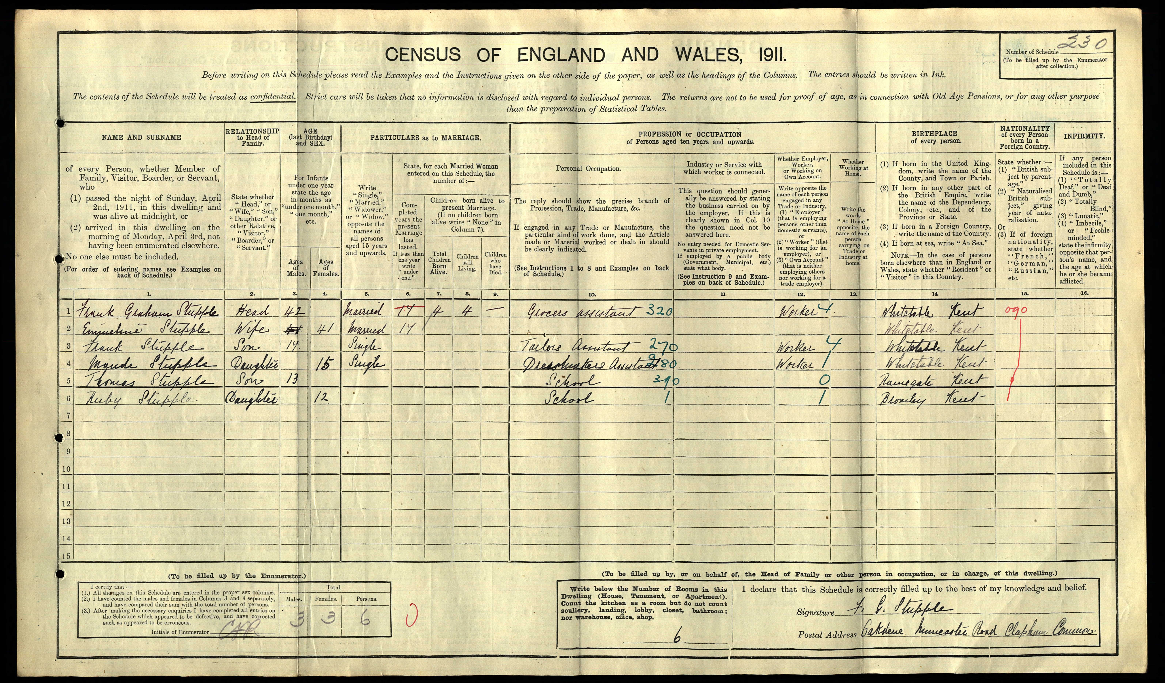
Notes:
Frank is recorded as a tailor’s assistant in the 1911 census, at the age of 17. His younger brother, Thomas, still at school aged 13, also volunteered for the war when he came of age.
Questions you might ask:
How old is Frank?
Who else is in his family?
How old is Frank’s younger brother?
Would Frank’s father have been eligible to fight in the war?
What is Frank’s occupation? What skills or attributes might you need to do this job?
Source Information:
Ancestry.com. 1911 England Census [database on-line]. Provo, UT, USA: Ancestry.com Operations, Inc., 2011.
Original data: Census Returns of England and Wales, 1911. Kew, Surrey, England: The National Archives of the UK (TNA), 1911.
Data imaged from the National Archives, London, England. The National Archives gives no warranty as to the accuracy, completeness or fitness for the purpose of the information provided. Images may be used only for purposes of research, private study or education. Applications for any other use should be made to the National Archives, Kew, Richmond, Surrey TW9 4DU.

Slide 5
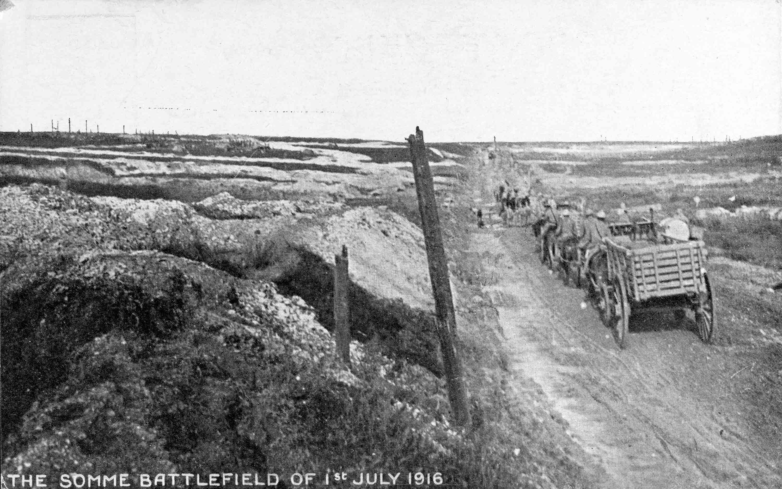
Notes:
The battlefield on the first day of the Battle of the Somme, 1 July 1916
NAM. 1988-07-20-7
Questions you might ask:
What does the caption say?
Why is it formatted in this way? Have you seen anything like this in another setting? What does the fact this image is made into a postcard say about how the war is represented back on the ‘Home Front’?
What do students understand about the Battle of the Somme? How does this image differ from their perceptions? Does this give any clue as to when the picture was taken?

Slide 6
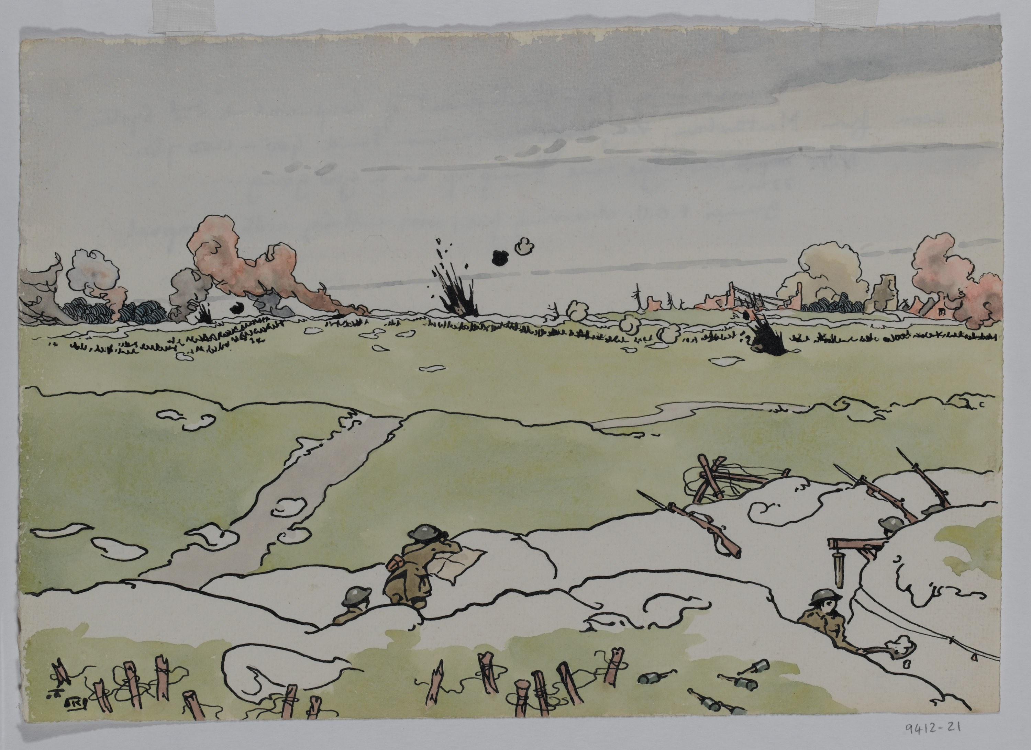
Notes:
Somme July 1916 - Bombardment of Longueval on '2nd system' seen from Montauban
Pen and ink and watercolour by Lt Richard Barrett Talbot Kelly MBE, MC, RI (1896-1971), Royal Field Artillery, 1916
NAM. 1994-12-21-1
Artist’s Copyright
General notes
This picture shows some of the features of life in the trenches, as well as the expanse of land between opposing trenches, known as no-man’s land. Quickly sketched in are the black lines of barbed wire, and the explosions of shells which were meant to break these wire lines and allow easier passage for attacking troops.
Shrapnel shells are filled with a small amount of explosive, and a large numbers of metal ball bearings. These shells explode, sending the small metal balls flying in all directions. Despite their use here as ‘wire cutters’ they were more effective against humans.
To the front right of the picture, a soldier can be seen clearing through the trench with a shovel. Just behind him is a 77mm shell case suspended from a cord. The empty shell case served as a gas gong, and could be struck with a piece of metal to attract attention and get all the soldiers in the area to don their protective equipment.
In the centre front of the picture an artillery observer uses binoculars and a map to ensure the large guns are dropping their shells accurately on the enemy defences. Also clearly seen are the soldiers’ Short Magazine Lee Enfield rifles, known as SMLEs, with their bayonets fixed.
Questions you might ask:
What can you see in the picture?
What are people doing in the picture?
What do you notice about the landscape (including the buildings?)
How does a shrapnel shell work? What other types of shell were used? Why would they need to use explosives on the wire?
What other weapons can you see in the picture?
What are the soldiers wearing on their heads? Why?

Slide 7
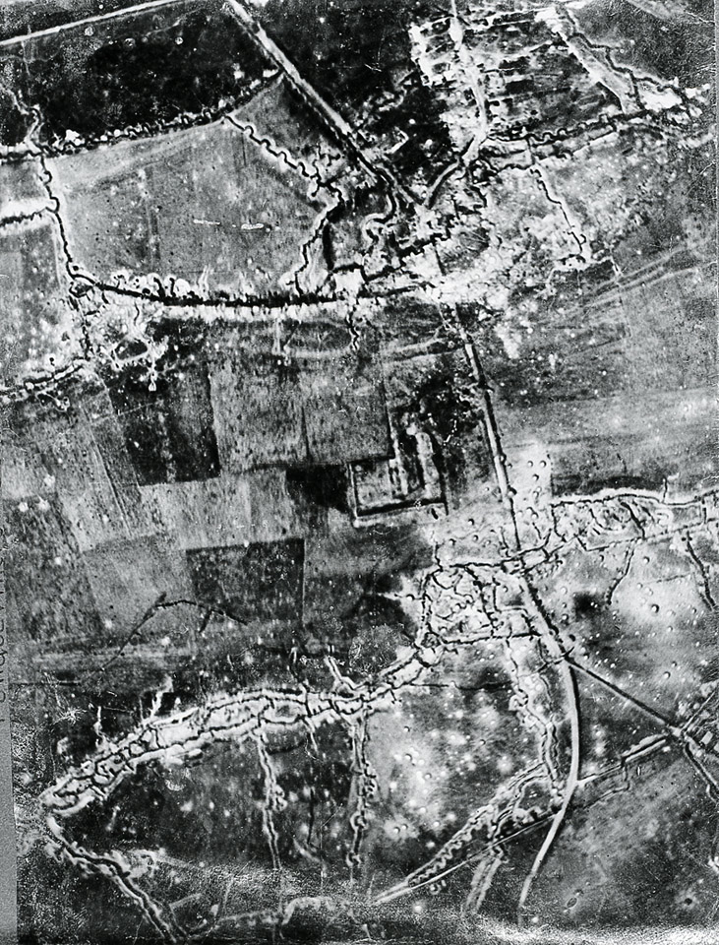
Notes:
Aerial photograph of the Fonquevilliers [sic] - Gommecourt Road, c1916
NAM. 2002-02-902-50
General notes:
This aerial photograph shows the trench network where Frank was based.
You can clearly see the two opposing front line trenches, but also the vast network of support and communications trenches behind these. Note the patchwork of colours on the ground which show the land’s former use as farmland, but also its relative preservation at this time. Note also the roads which existed.
Particularly evident at the top of the image is the zig-zagging nature of the trenches. Trenches were designed in this way particularly to reduce the blast from artillery shells travelling down the full length of the trenches. By creating a reinforced wall, the impact was absorbed. This meant that a shell dropping in one section of the trench would only cause fatalities and casualties in that area.
Questions you might ask:
What can you see in this picture? What does it show you?
Where was it taken from?
What was the land used for previously?
What do you notice about the trench networks?
Why are the trenches not straight lines?
What might the relatively straight lines have been before?

Slide 8
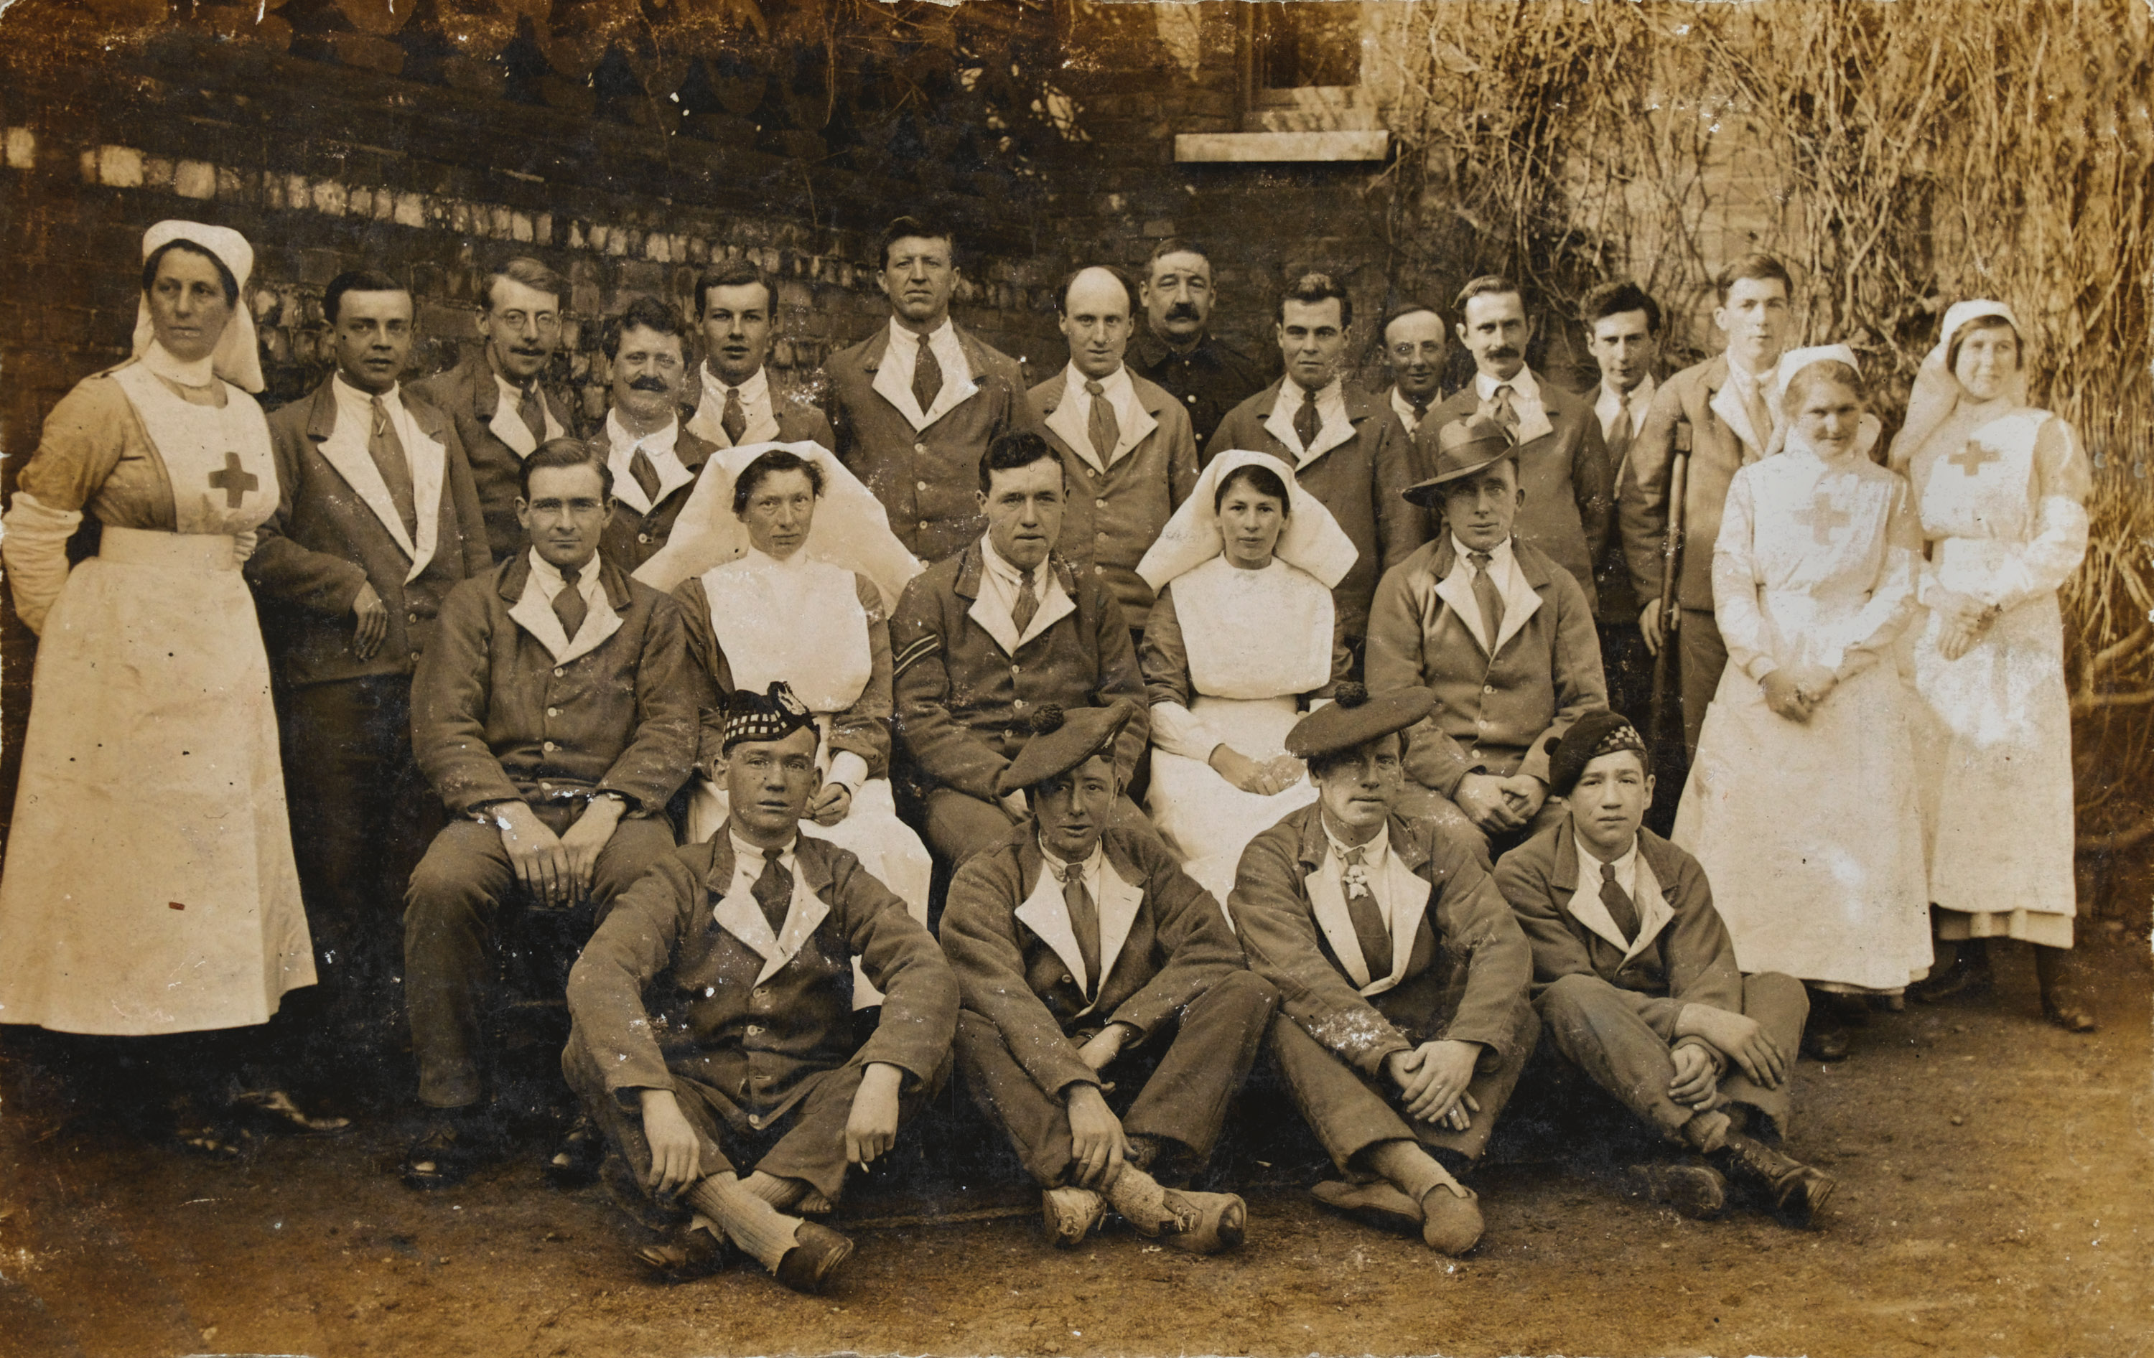
Notes:
Nurses and convalescent soldiers at Felthorpe, 1917
NAM. 2002-10-84-09
General notes:
The soldiers here are all wearing the uniform known as ‘hospital blues’. It was a royal blue wool fabric, with white lapels. They are wearing a mix of boots, shoes and slippers, and the different hats worn by their respective regiments. All of the men have been injured seriously enough to have been sent back to England for recovery.
The two nurses in the middle have the uniform of professional nurses, so possibly represent the Queen Alexandra’s Imperial Military Nursing Service. The women on the edges of the group are Red Cross Volunteers. All the women are wearing aprons and white sleeve covers which they could wash separately to their clothes in order to keep hygienic and well-presented.
If the men were able to return to the front, they could be sent back either to their original unit, or another, as demand served. In Frank’s case, without the use of his right arm, he was declared unfit to serve.
Questions you might ask:
Why would the soldiers still need to wear a uniform in hospital? (this uniform was also worn on day trips out when they were well enough to leave the hospital)
Why would they not wear the same uniform of soldiers who were fit for duty?
Why are they wearing different hats? Can you guess where some of the men come from? Why might they have not been sent straight home?
Why do they have different shoes on?

Slide 9
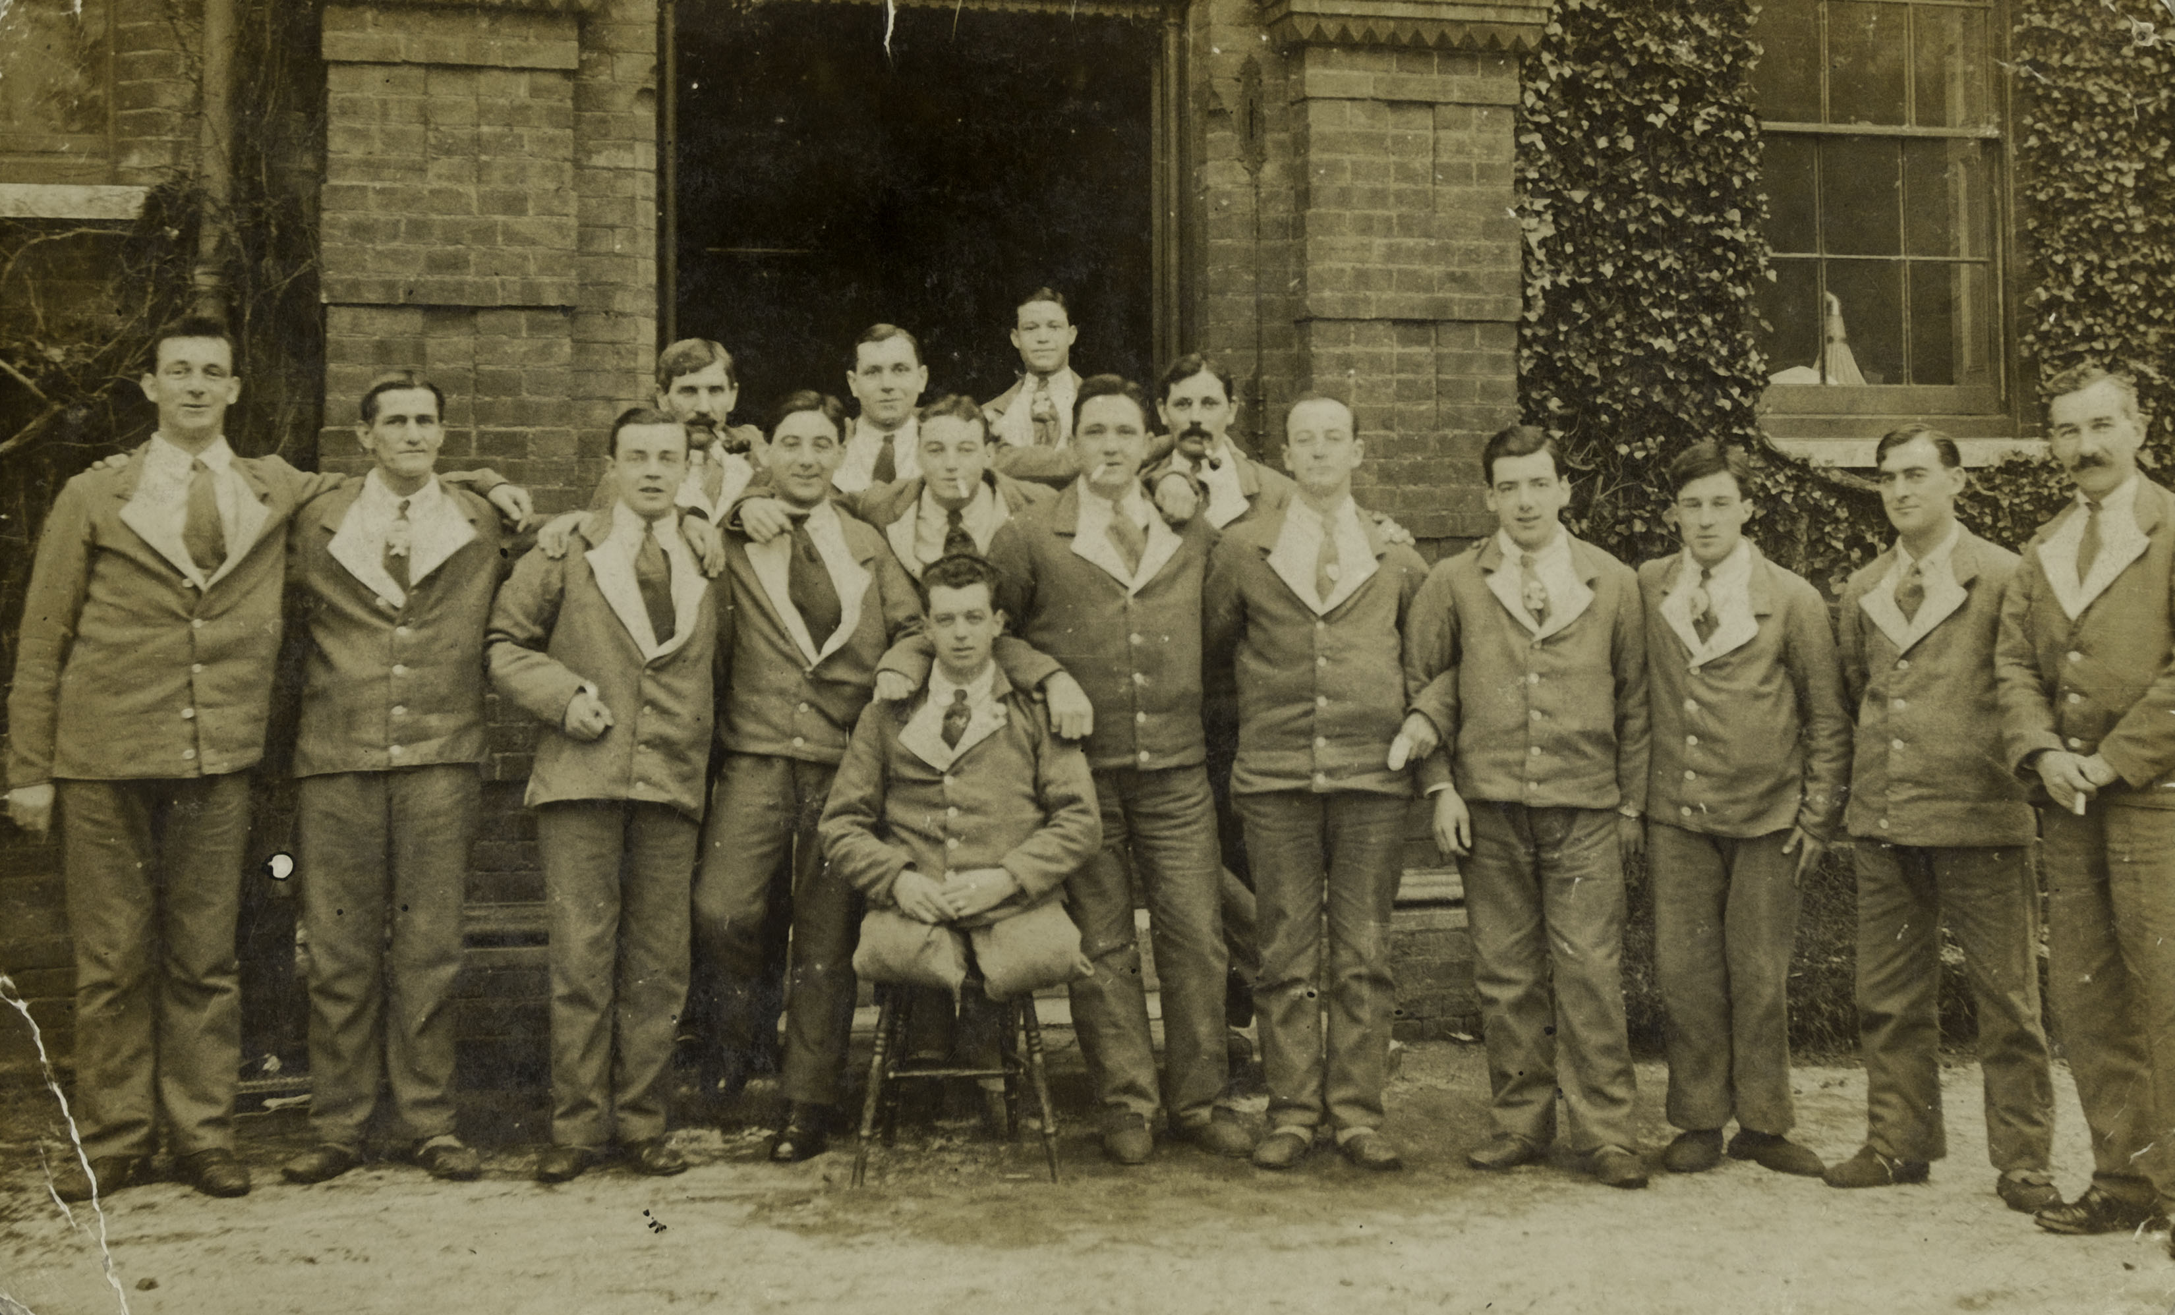
Notes:
Convalescent soldiers at Felthorpe, 1917
NAM. 2002-10-84-11
General notes:
Frank Stupple and friends pose for the camera outside Felthorpe Hall, Norfolk.
They are all, again, wearing their hospital blues, and most of them are wearing slippers. Although not all wounds are immediately visible, each one of these men has been wounded seriously enough to be sent back to England for recovery.
Questions you might ask:
Why do you think it might be important for soldiers to be in hospital together? (The same idea is still found in some military hospital wards today, although we no longer have dedicated military hospitals).
What emotions would you say they are feeling?
What would happen to these men if they could not return to fighting?
What do you think should be done for men who have been injured in the fighting? Who is responsible for this?

Slide 10
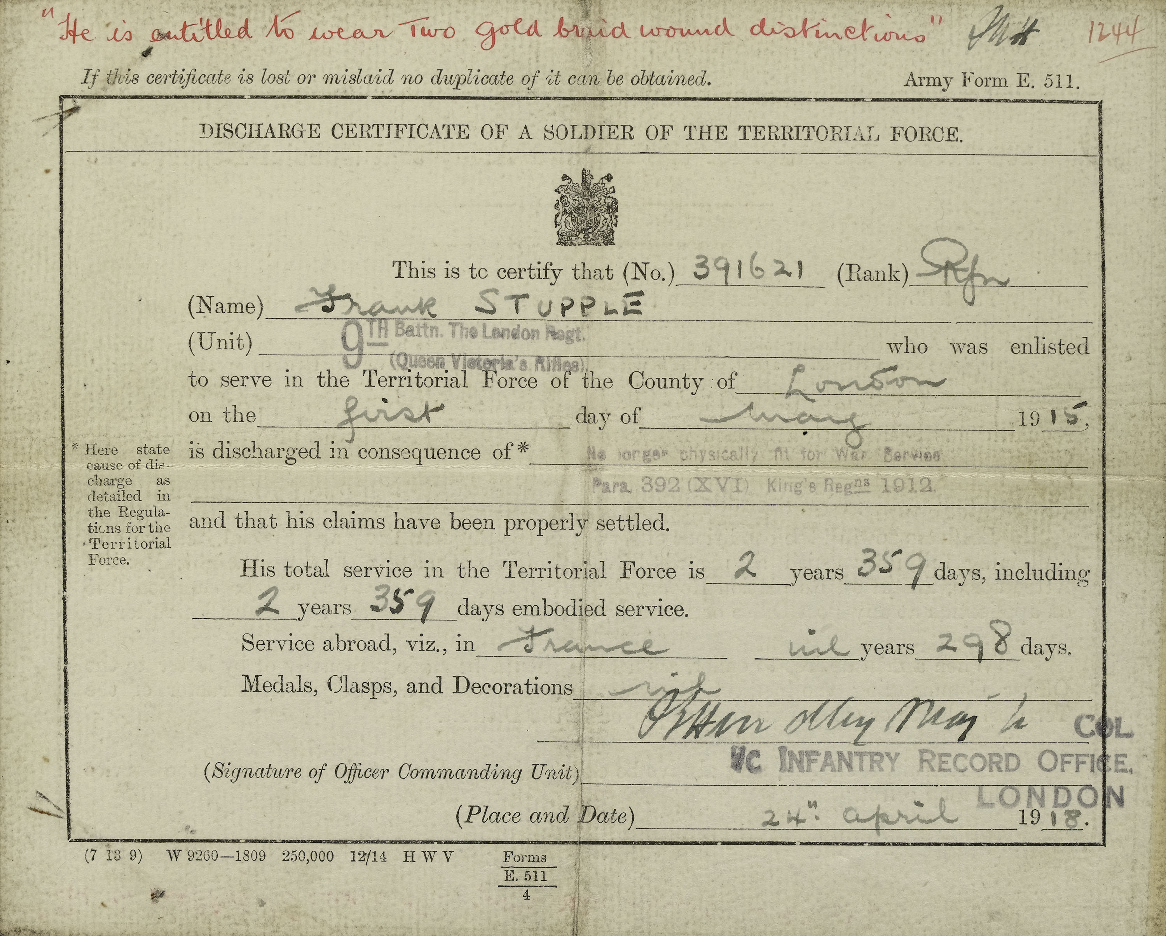
Notes:
Army Form E511 Discharge Certificate of a Soldier of the Territorial Force, stating discharge in consequence of no longer being physically fit for war service, 24 April 1918
NAM. 2001-07-1184-2
General notes:
This certificate shows when Frank was officially signed off from service.
Questions you might ask:
When did he join? When was he able to leave?
How long did he serve? How much of that time was actually spent in ‘Service Abroad’ (fighting, or in the trenches, or in rest preparing to fight)? See next source for more information.
What might Frank have done with the other time?
Did Frank win any medals?
How might Frank’s injuries affect his future life?

Slide 11
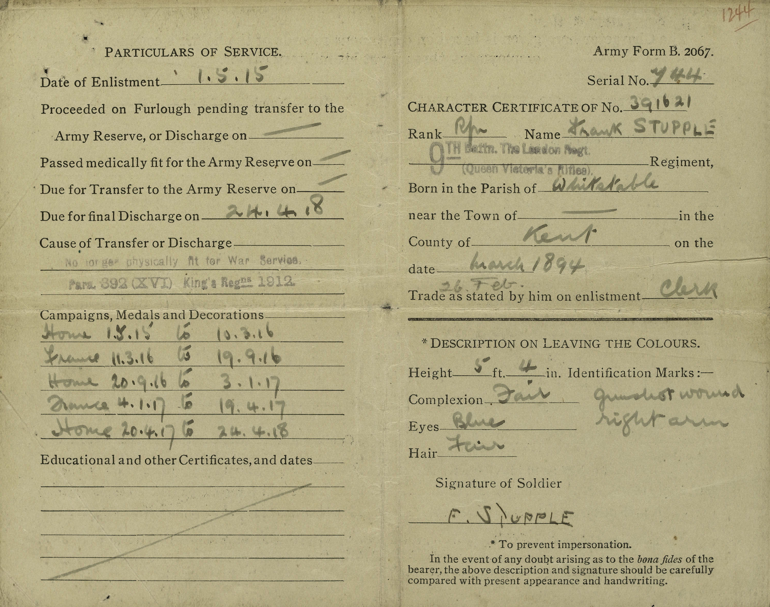
Notes:
Army Form B2067 Character Certificate, 24 April 1918 [front]
NAM. 2001-07-1184-3
Questions you might ask:
Why was Frank at ‘Home’ three times in his service? The first was for training, but what about the second and third times?
What does Frank think he looks like?
What special feature has been listed as a special “Identification Mark”?
Look carefully at Frank’s signature. This is the only thing he has written on this form. Does it look like he was ‘comfortable’ writing it? Why might this be?
Look at Frank’s trade on enlistment. This job would have involved a lot of writing. Will Frank be easily able to return to this job?

Slide 12
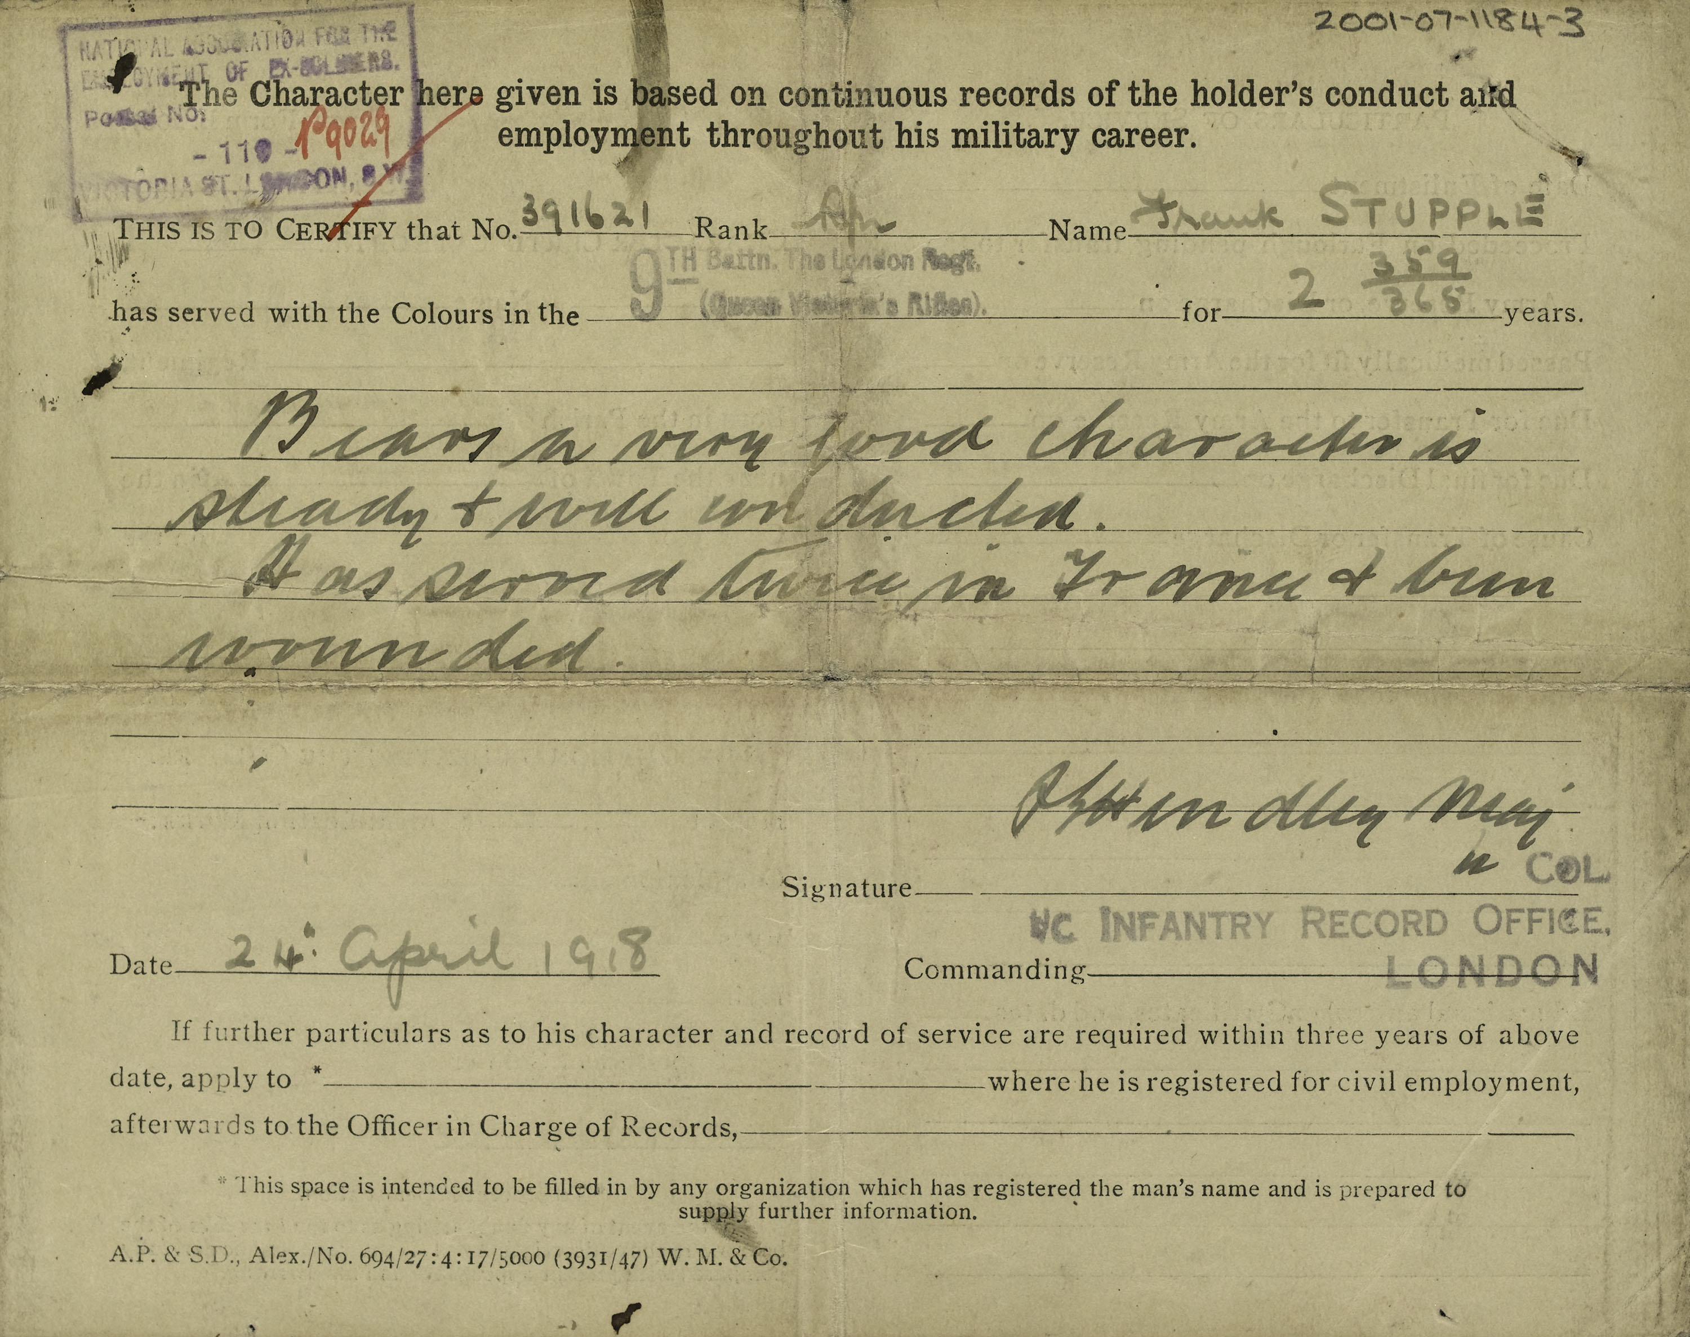
Notes:
Army Form B2067 Character Certificate, 24 April 1918 [back]
NAM. 2001-07-1184-3
Transcript:
Bears a very good character is steady and well conducted.
Has served twice in France and been wounded.
Questions you might ask:
This certificate is Frank’s reference after his nearly three years in the Army.
Why would this certificate have been useful for Frank’s future?

Slide 13
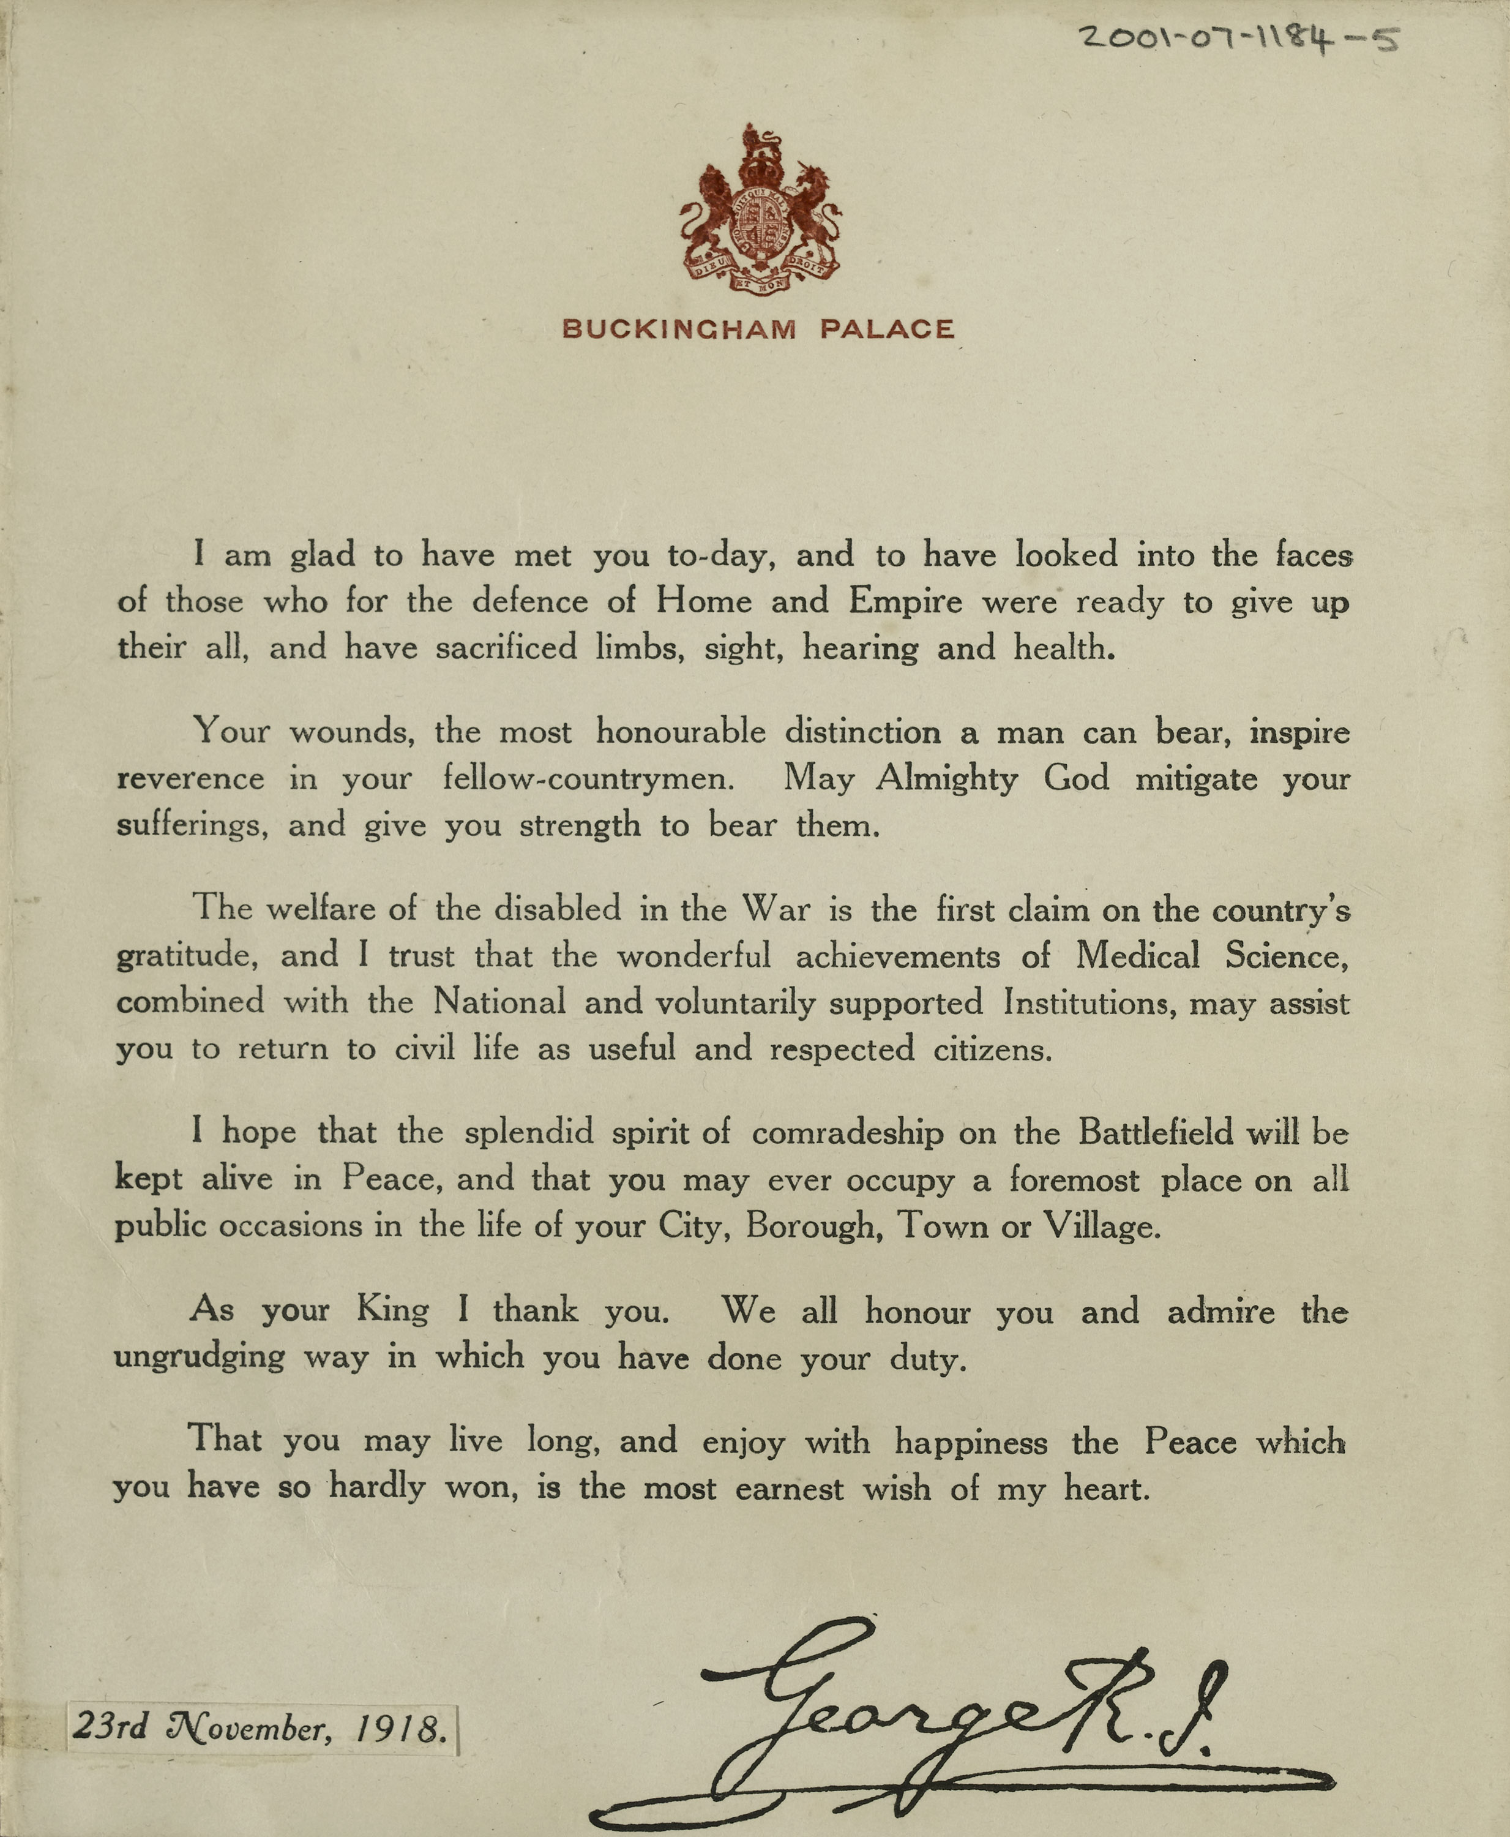
Notes:
Printed message bearing the facsimile signature of King George V, issued on the occasion of a meeting of the King with wounded and disabled soldiers, 23 November 1918
NAM. 2001-07-1184-5
General notes:
The Silver War Badge was instituted with effect from 12 September 1916. The badge, mounted as a brooch, was awarded to soldiers who sustained a wound, or contracted illness or disability in the course of the war which necessitated their being invalided out. Each badge had a number on the back. The reason for issue was to stop men of military age who were not wearing uniform being harassed, accused of cowardice and shown the ‘White Feather’.
About 1,150,000 badges were issued with certificates. A roll of the recipients of the War Badge can be found at the National Archive, Kew.
Questions you might ask:
King George sent this letter to the injured men he had met on 23 November 1918. Read it carefully.
What does he hope will happen to injured soldiers?
Who is going to help them?
How does he want them to be treated in society?
Do you agree with his statement that war wounds were the “most honourable distinction a man can bear”?
Why would injured soldiers want to wear the Silver War Badge ?

Slide 14
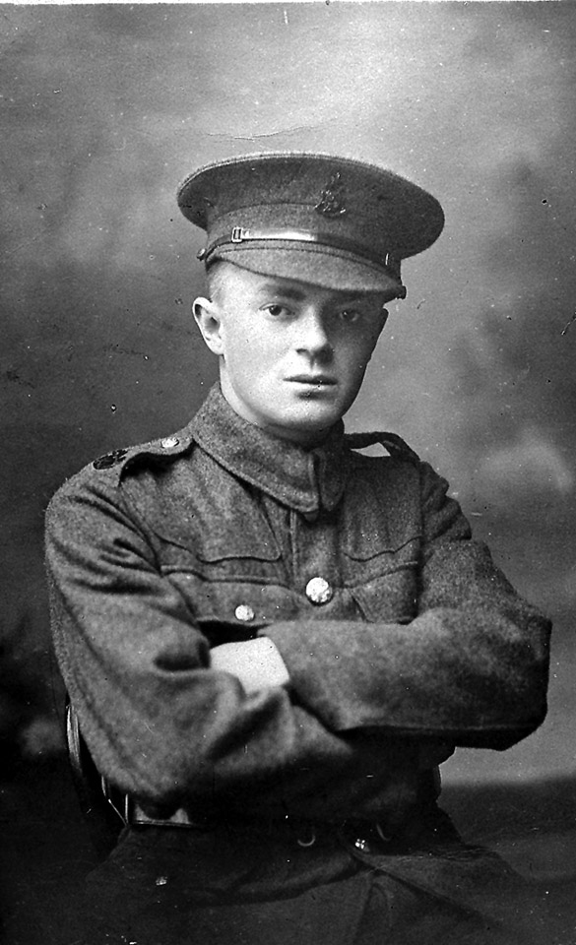
Notes:
Portrait of Private Thomas Stupple, Machine Gun Corps, killed in action, Western Front, 11 April 1918
NAM. 2001-07-1186-1
General notes:
Frank survived the war, but was permanently injured. However, his family’s involvement in the war continued. His younger brother Thomas also joined the Army, and was killed in action.
A relative of Frank’s wife, possibly her brother, Driver E Liffen of the Royal Field Artillery, was also killed in action.
Questions you might ask:
What impact would these incidents have had on the family?
Refer back to the census at the beginning. How old was Thomas in 1911? How old would he have been when he died?

