Slide 1

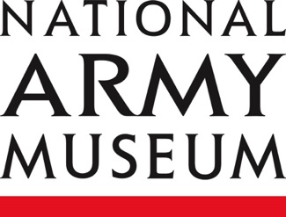
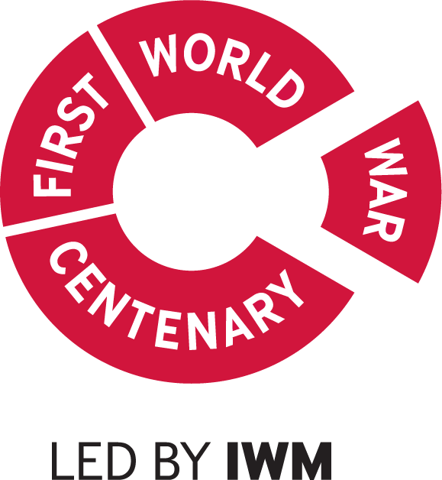
Khudadad Khan
Notes:
General notes:
Khudadad Khan VC was born on 20 October 1888 in a village called Dab (now Chakwal) in what is now Pakistan.
Khudadad was a sepoy in the 129th Duke of Connaught’s Own Baluchis, British Indian Army. The battalion formed part of the Indian Corps which was sent to the Western Front in October 1914 to reinforce the British Expeditionary Force (BEF) there.
Khan and his colleagues worked to defend against the German drive to the Belgian coast, suffering heavy casualties. On 31 October 1914, while serving with the machine-gun detachment of his regiment, Sepoy Khan came under intense enemy attack. With the British officer in charge of the detachment wounded, and one of their two guns destroyed by a shell, he continued to fire on the enemy. Even after all others in his detachment were killed, Khan held the German advance until reinforcements could arrive. Overrun by the enemy, he then managed to crawl back to his regiment despite serious wounds. His colleagues were all killed, and he was wounded. Khan was subsequently awarded the Victoria Cross, the highest award for gallantry given in British service. King George V presented Khan with his cross in January 1915.
After his recovery, Khudadad returned to service, and remained in the Indian Army long after the First World War, rising to the rank of subadar – the equivalent of lieutenant in the British Army.
A statue commemorating him is located outside the Army Museum in Pakistan, as his birth village is now within the borders of that nation.
He died on 8 March 1971, aged 82.

Slide 2
This PowerPoint presentation contains a selection of images and archives which students can use to explore the story of one British soldier in the First World War. In the main, the materials come from the Collection of the National Army Museum (NAM). Occasionally these are supplemented by materials from outside the NAM to provide context.
These images can be used to build up a picture of an individual soldier’s experience of service in the First World War. These images can encourage literacy and visual literacy. Suggestions for questions you might discuss with your students are included in the notes.
Unless otherwise stated in the notes, the images can be freely used for non-commercial purposes within the classroom. You can use the entire presentation or choose individual images for use in other non-commercial contexts. When using individual images in other contexts, please always retain the attribution statements provided in this document (e.g. NAM. 2005-08-66-1).
By downloading this document and using these images you agree to these terms of use, including your use of the attribution statement specified for each object by NAM.

Slide 3
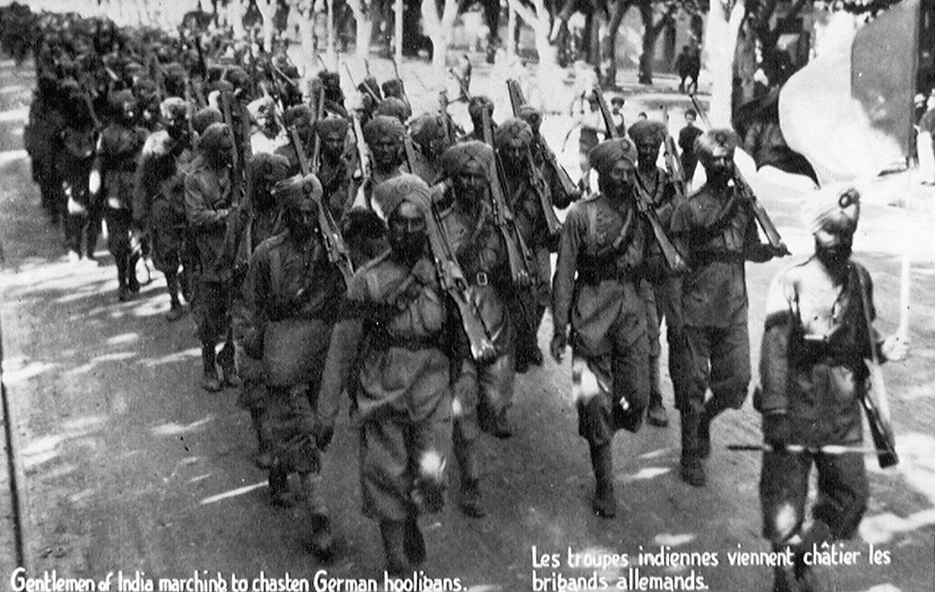
Notes:
Postcard of troops of a Sikh Regiment marching down a road lined with trees, France, c1914
NAM. 1983-10-275-1
Transcript:
‘Gentlemen of India marching to chasten German hooligans.’
General notes:
The Indian Expeditionary Force (IEF) were called in to support British troops on the Western Front in September 1914. After their arrival in Marseilles, they were moved to the Ypres Salient, and were in action by October 1914.
They experienced many difficulties on the Western Front, including dealing with the winter weather and being led by officer replacements who lacked the requisite language skills (many of their original officers had become casualties). The Indians were, however, the largest volunteer-only force to serve in the conflict.
Questions you might ask:
Why were soldiers from India so keen to volunteer?
Why was their service so vital to the British Expeditionary Force?

Slide 4
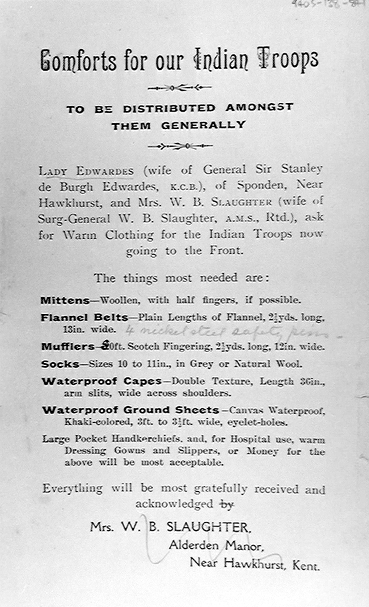
Notes:
Printed leaflet, 'Comforts for our Indian Troops', c1914
From a collection of papers of the family of General Sir Stanley de Burgh Edwards
NAM 1994-05-138-841
General notes:
This paper reveals one of the key difficulties experienced by the Indian Expeditionary Force (IEF) on their arrival on ‘The Continent’.
Indian troops had never before served as far north as those who reached the Western Front in October 1914, and they had difficulty in coping with the weather of a Flanders winter. In order to ease their suffering, an appeal was launched for warm, waterproof clothing.
Questions you might ask:
Why was this equipment required?
Who should be acquiring it? Do you feel it is the role of an independent charity to organise this?
Did soldiers of the IEF experience any other shortages?

Slide 5
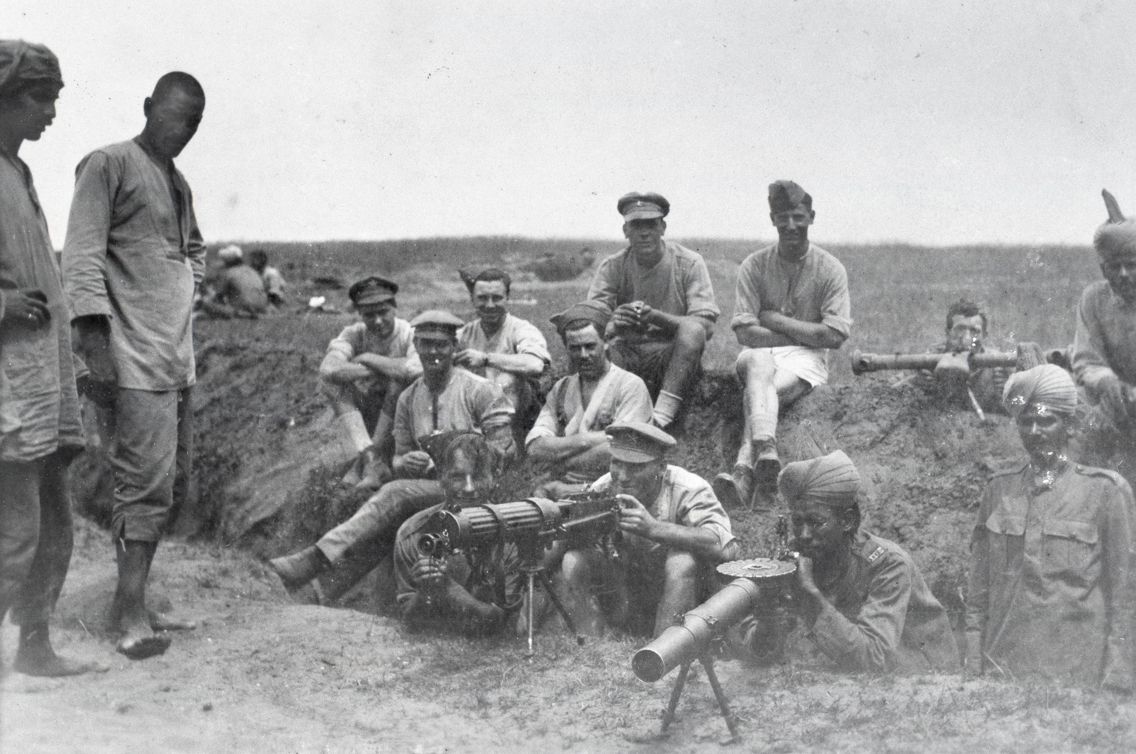
Notes:
British and Indian machine gunners with a Vickers machine gun, Lewis gun and range-finder, 1917
From one of five photograph albums compiled by Lieutenant Kindom
NAM. 1983-03-41-2-23
General notes:
By the end of 1918 the British had deployed 112,000 combat troops in the Mesopotamia theatre. The vast majority of the ‘British’ forces in this campaign were recruited from India.
Although this picture is not specifically related to Khudadad Khan’s service, it shows the relationship between British and Indian troops, and the numbers involved in machine-gun teams.
Khudadad was trained to fire a Vickers machine gun, which is visible in the centre of the picture, mounted on a small tripod. Machine guns needed a team of six-to-eight men to keep them working.
If mounted on the larger tripod, the two parts of the gun weigh over 30 kilograms. It could fire 450-600 bullets a minute. The bullets were the same calibre as that of the British rifle, the Short Magazine Lee Enfield, .303.
The Vickers was ‘belt fed’, with belts of 250 rounds, weighing around 10kg each. Apparently some operators recommended not filling each 20th slot on the belts to reduce the risk of the weapon overheating. Water was used to cool the weapon down.
The weapon to the right is a Lewis gun, resting on a bipod.
It is likely the men to the very left of the picture are members of the Labour Corps – not brought in to fight, but to provide labour near the front or in support. It was officially formed in January 1917. Many of its 300,000-plus members (by the Armistice) were injured officers and men who were not fit for combat, but the numbers were swelled by drawing in men from China, Egypt, India and South Africa.
Questions you might ask:
Why are so many men in this picture?
Why would so many men be required to keep this weapon working?
Why were machine guns such a valuable weapon?
What different uniforms can you see?

Slide 6
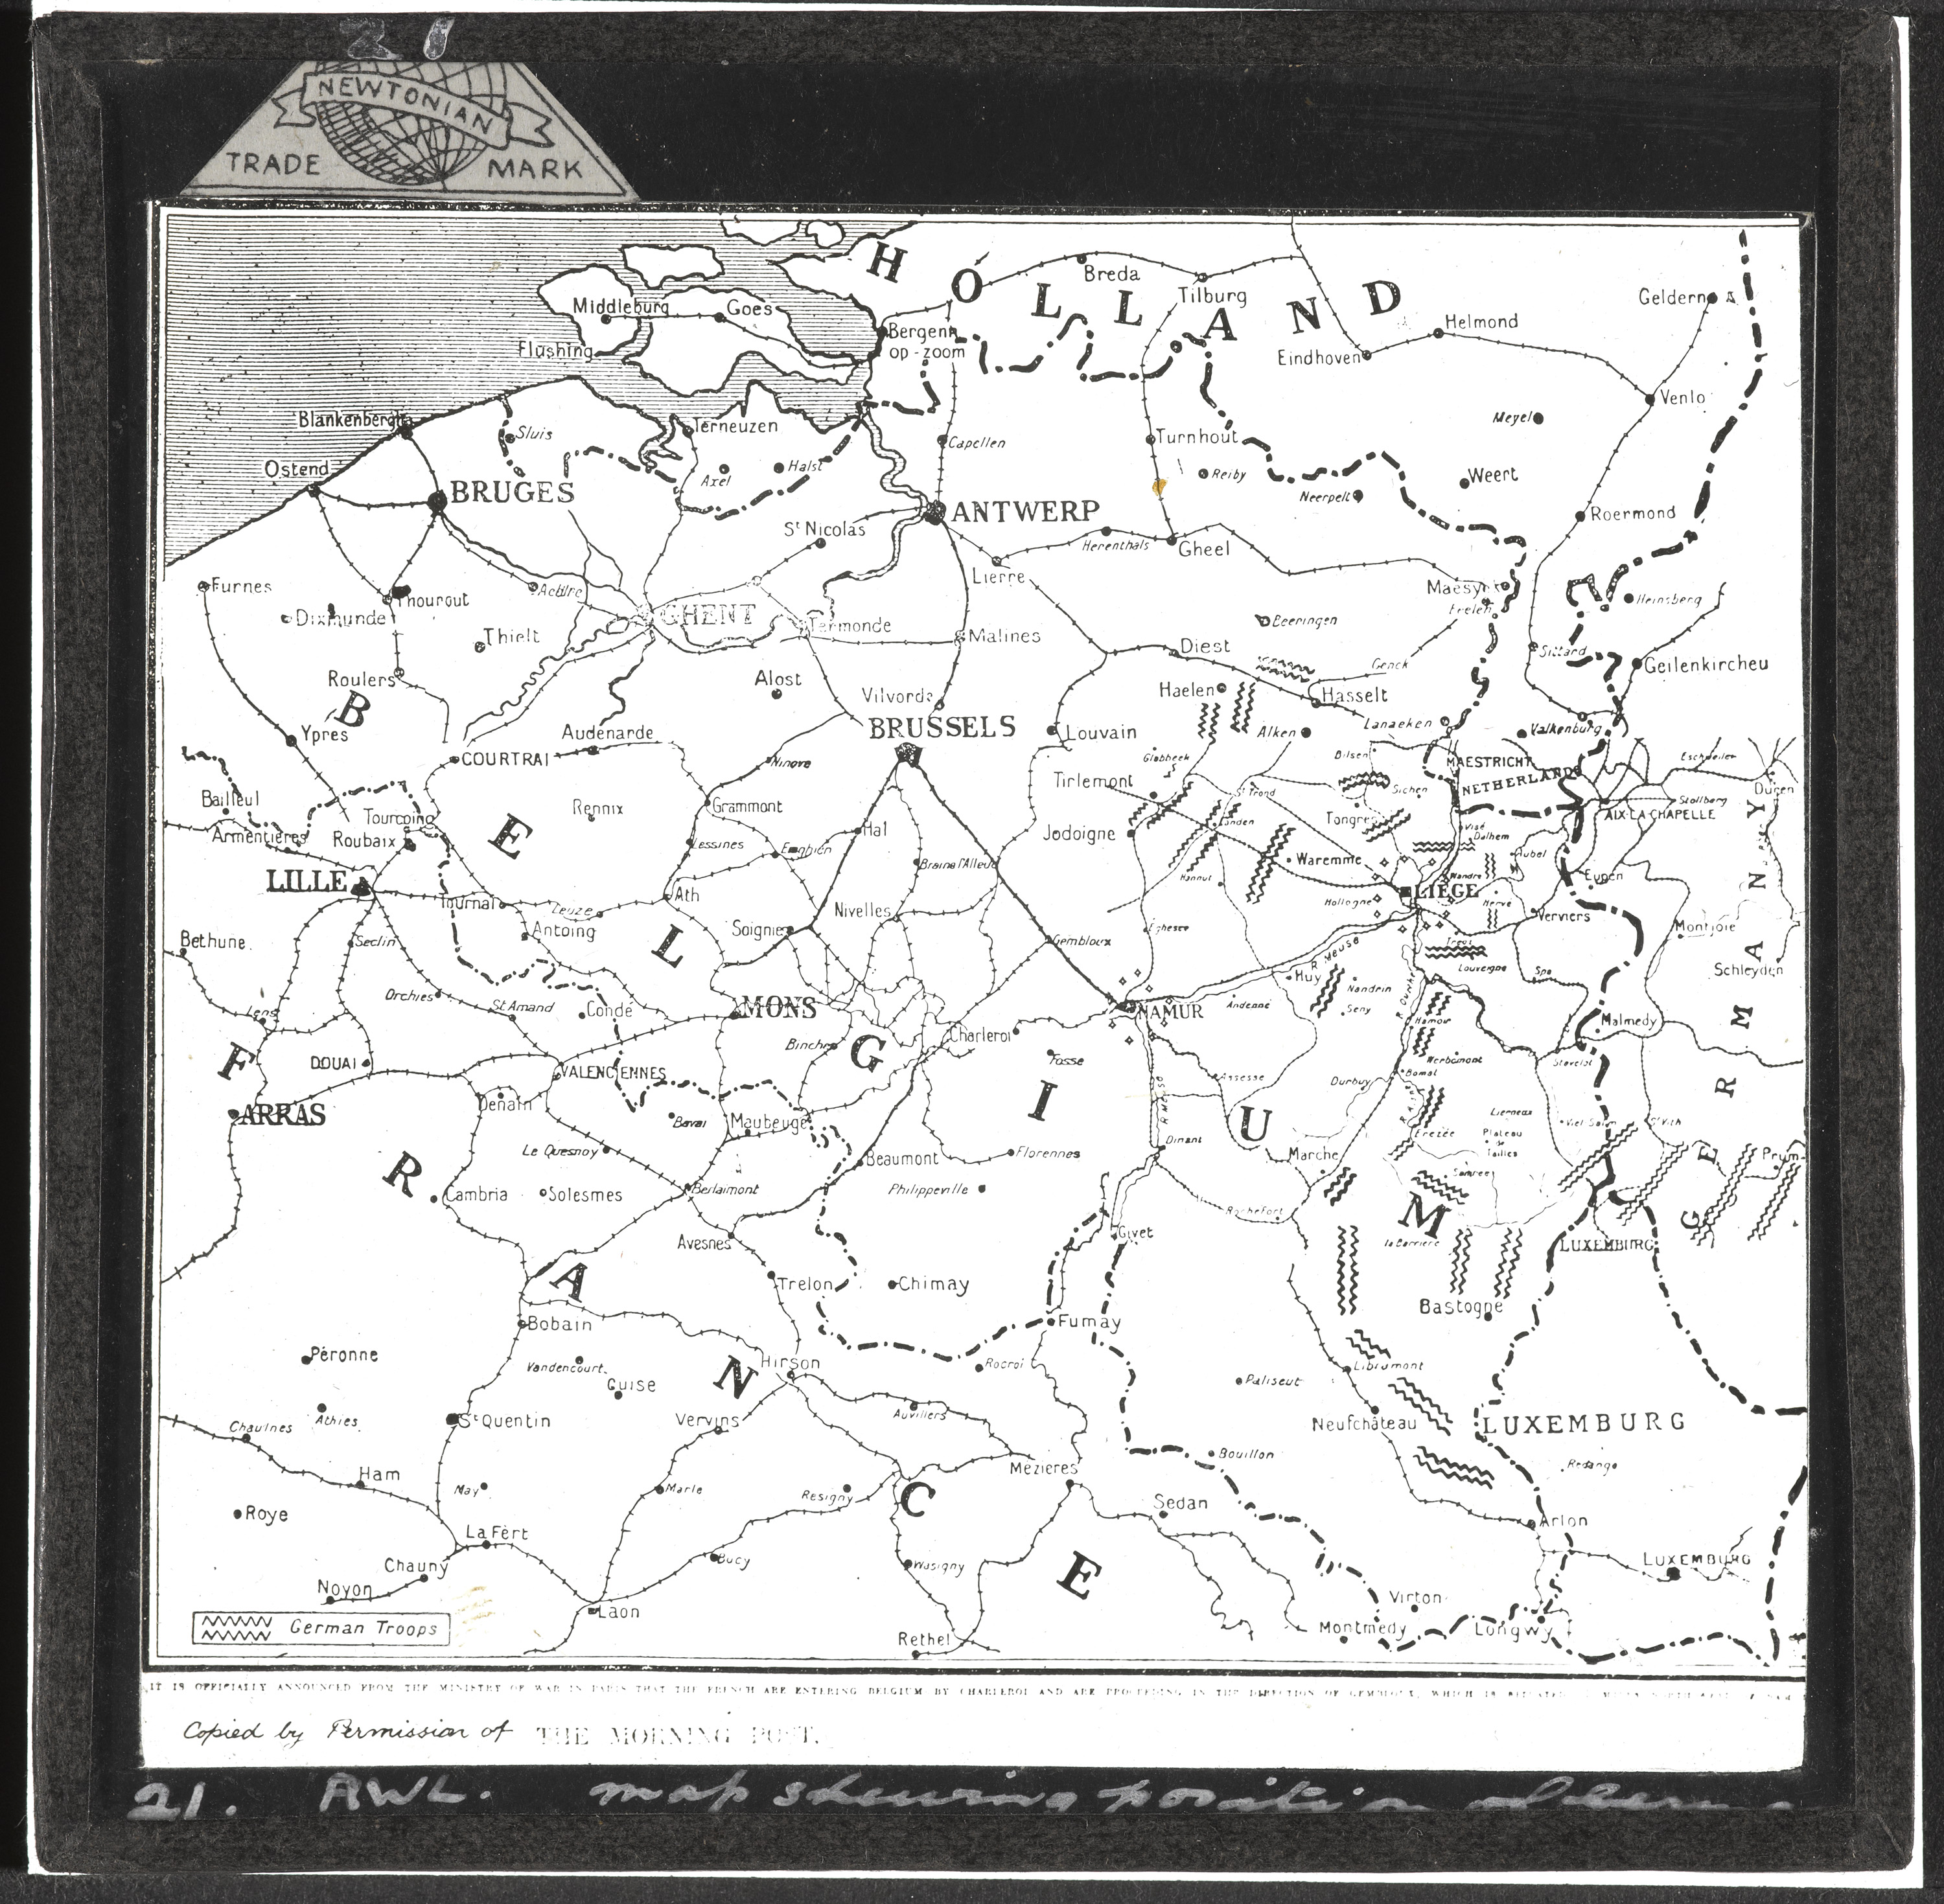
Notes:
Map of Belgium and northern France, c1914
From a box of 70 lantern slides associated with the German invasion of Belgium, 1914
NAM 1978-11-157-19-19
General notes:
Lantern slides were an important source of information sharing during the First World War. The NAM holds many in its Collection. These could be used for training and information-giving. This particular map shows the movement of German troops through Belgium.
Khudadad Khan won his VC at Hollebeke, near Ypres, during the First Battle of Ypres. The fierce resistance the German troops faced there stalled them long enough for Allied reinforcements to be sent in. Effectively they were stopped from reaching the ports.
Questions you might ask:
Where was Khudadad serving when he was awarded the Victoria Cross for gallantry?
Why might defence of Hollebeke near Ypres have been strategically important?
Why were lantern slides used? Who would use them? What are today’s equivalents?

Slide 7
Notes:
Front page of ‘The Daily Mirror’, 26 January 1915
NAM. 1974-07-83
Transcript:
This is Sepoy Khudadad, of the 129th Duke of Connaught’s Baluchis. He was the first Indian soldier to win the coveted honour of the ‘VC’ through gallantry on the field of battle. He worked a gun single-handed although wounded. All his comrades were killed.
General notes:
The Baluchis are the indigenous peoples of Baluchistan, which is split between the Pakistani province of Baluchistan and Iranian Baluchistan. The majority of the Baluch people reside in the Baluchistan province of Pakistan. At the time of the First World War, however, what is now Pakistan was part of British India.
Khudadad worked his gun as long as was possible against the German advance. He was left for dead by the enemy, but crawled back to his own trenches under cover of darkness. His gallantry in remaining at his post led to his recommendation for the Victoria Cross (VC).
It has been suggested that Khudadad’s turban is not as neatly formed as would have been usual because he has clearly been injured in the arm or hand (his hand is bandaged).
The Victoria Cross was introduced by Queen Victoria in 1856 to recognise gallantry in the Crimean War. Since then it has been awarded 1,357 times to 1,354 recipients. Originally Indian troops were not eligible for the award because when it was introduced they were under the control of the Honourable East India Company. However, they were finally made eligible in 1911.
Questions you might ask:
What is the significant word in the headline?
Why is this event so significant?
Why do you think Khudadad fought as he did?
What do you notice about Khudadad’s appearance? Is there any evidence of his injury?
Is he wearing his VC? What might this suggest about when the picture was taken?
Why was this the first time an Indian soldier was awarded the Victoria Cross?

Slide 8
Notes:
London Gazette, 7 December 1914
NAM. 1974-07-83
Transcript:
4050 Sepoy Khudadad, 129th Duke of Connaught’s Own Baluchis.
On 31st October, 1914, at Hollebeke, Belgium, the British Officer in charge of the detachment having been wounded, and the other gun put out of action by a shell, Sepoy Khudadad, though himself wounded, remained working his gun until all the other five men of the gun detachment had been killed.
General notes:
As part of 7th Indian (Ferozepore) Brigade, the 129th Baluchis arrived in France from Egypt during September 1914.
Questions you might ask:
Who else was awarded the VC at the same time?
Why are these events gazetted? Does it still happen today?

Slide 9
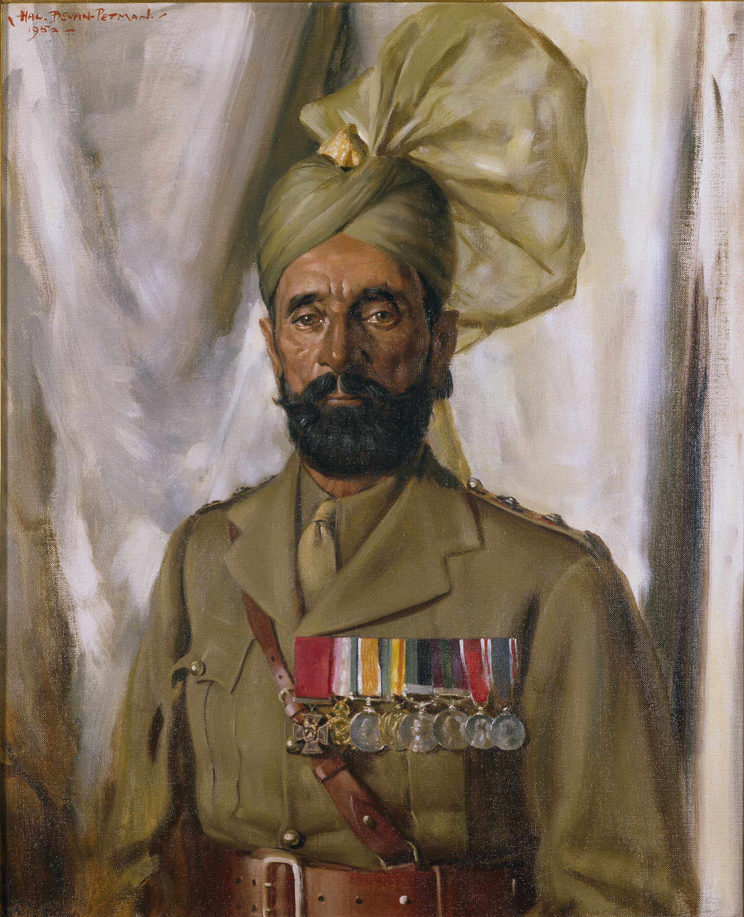
Notes:
Subadar Khudadad Khan VC (1888-1971), 10th Baluch Regiment, c1935
Oil on canvas by Henry Charles ‘Hal’ Bevan-Petman (1894-1980), c1935
NAM 1956-02-273-1
General notes:
Khudadad Khan was the first Indian to win the Victoria Cross after eligibility for the award was extended in 1911 to Indian officers and men of the Indian Army. In common with half of the men in his regiment, the 129th Duke of Connaught's Own Baluchis, Khudadad Khan was a Pathan from north-west India.
The Victoria Cross is the highest award for gallantry. It was instituted to cover the period of the Crimean War in 1854-56, and continues to be awarded today. It is open to all ranks in the Services, and is only awarded for the very highest acts of bravery in the battlefield.
Questions you might ask:
Where does Khan wear his VC? Why?
Does the medal look as you would expect it to? Why/why not? What could be the significance of its lack of real monetary value?
How many years after the First World War was this picture painted?
What does this suggest about Khan’s further career?
How has his appearance changed in that time?
What could having a portrait painted reveal about your status or significance?

