Slide 1


Slide 2
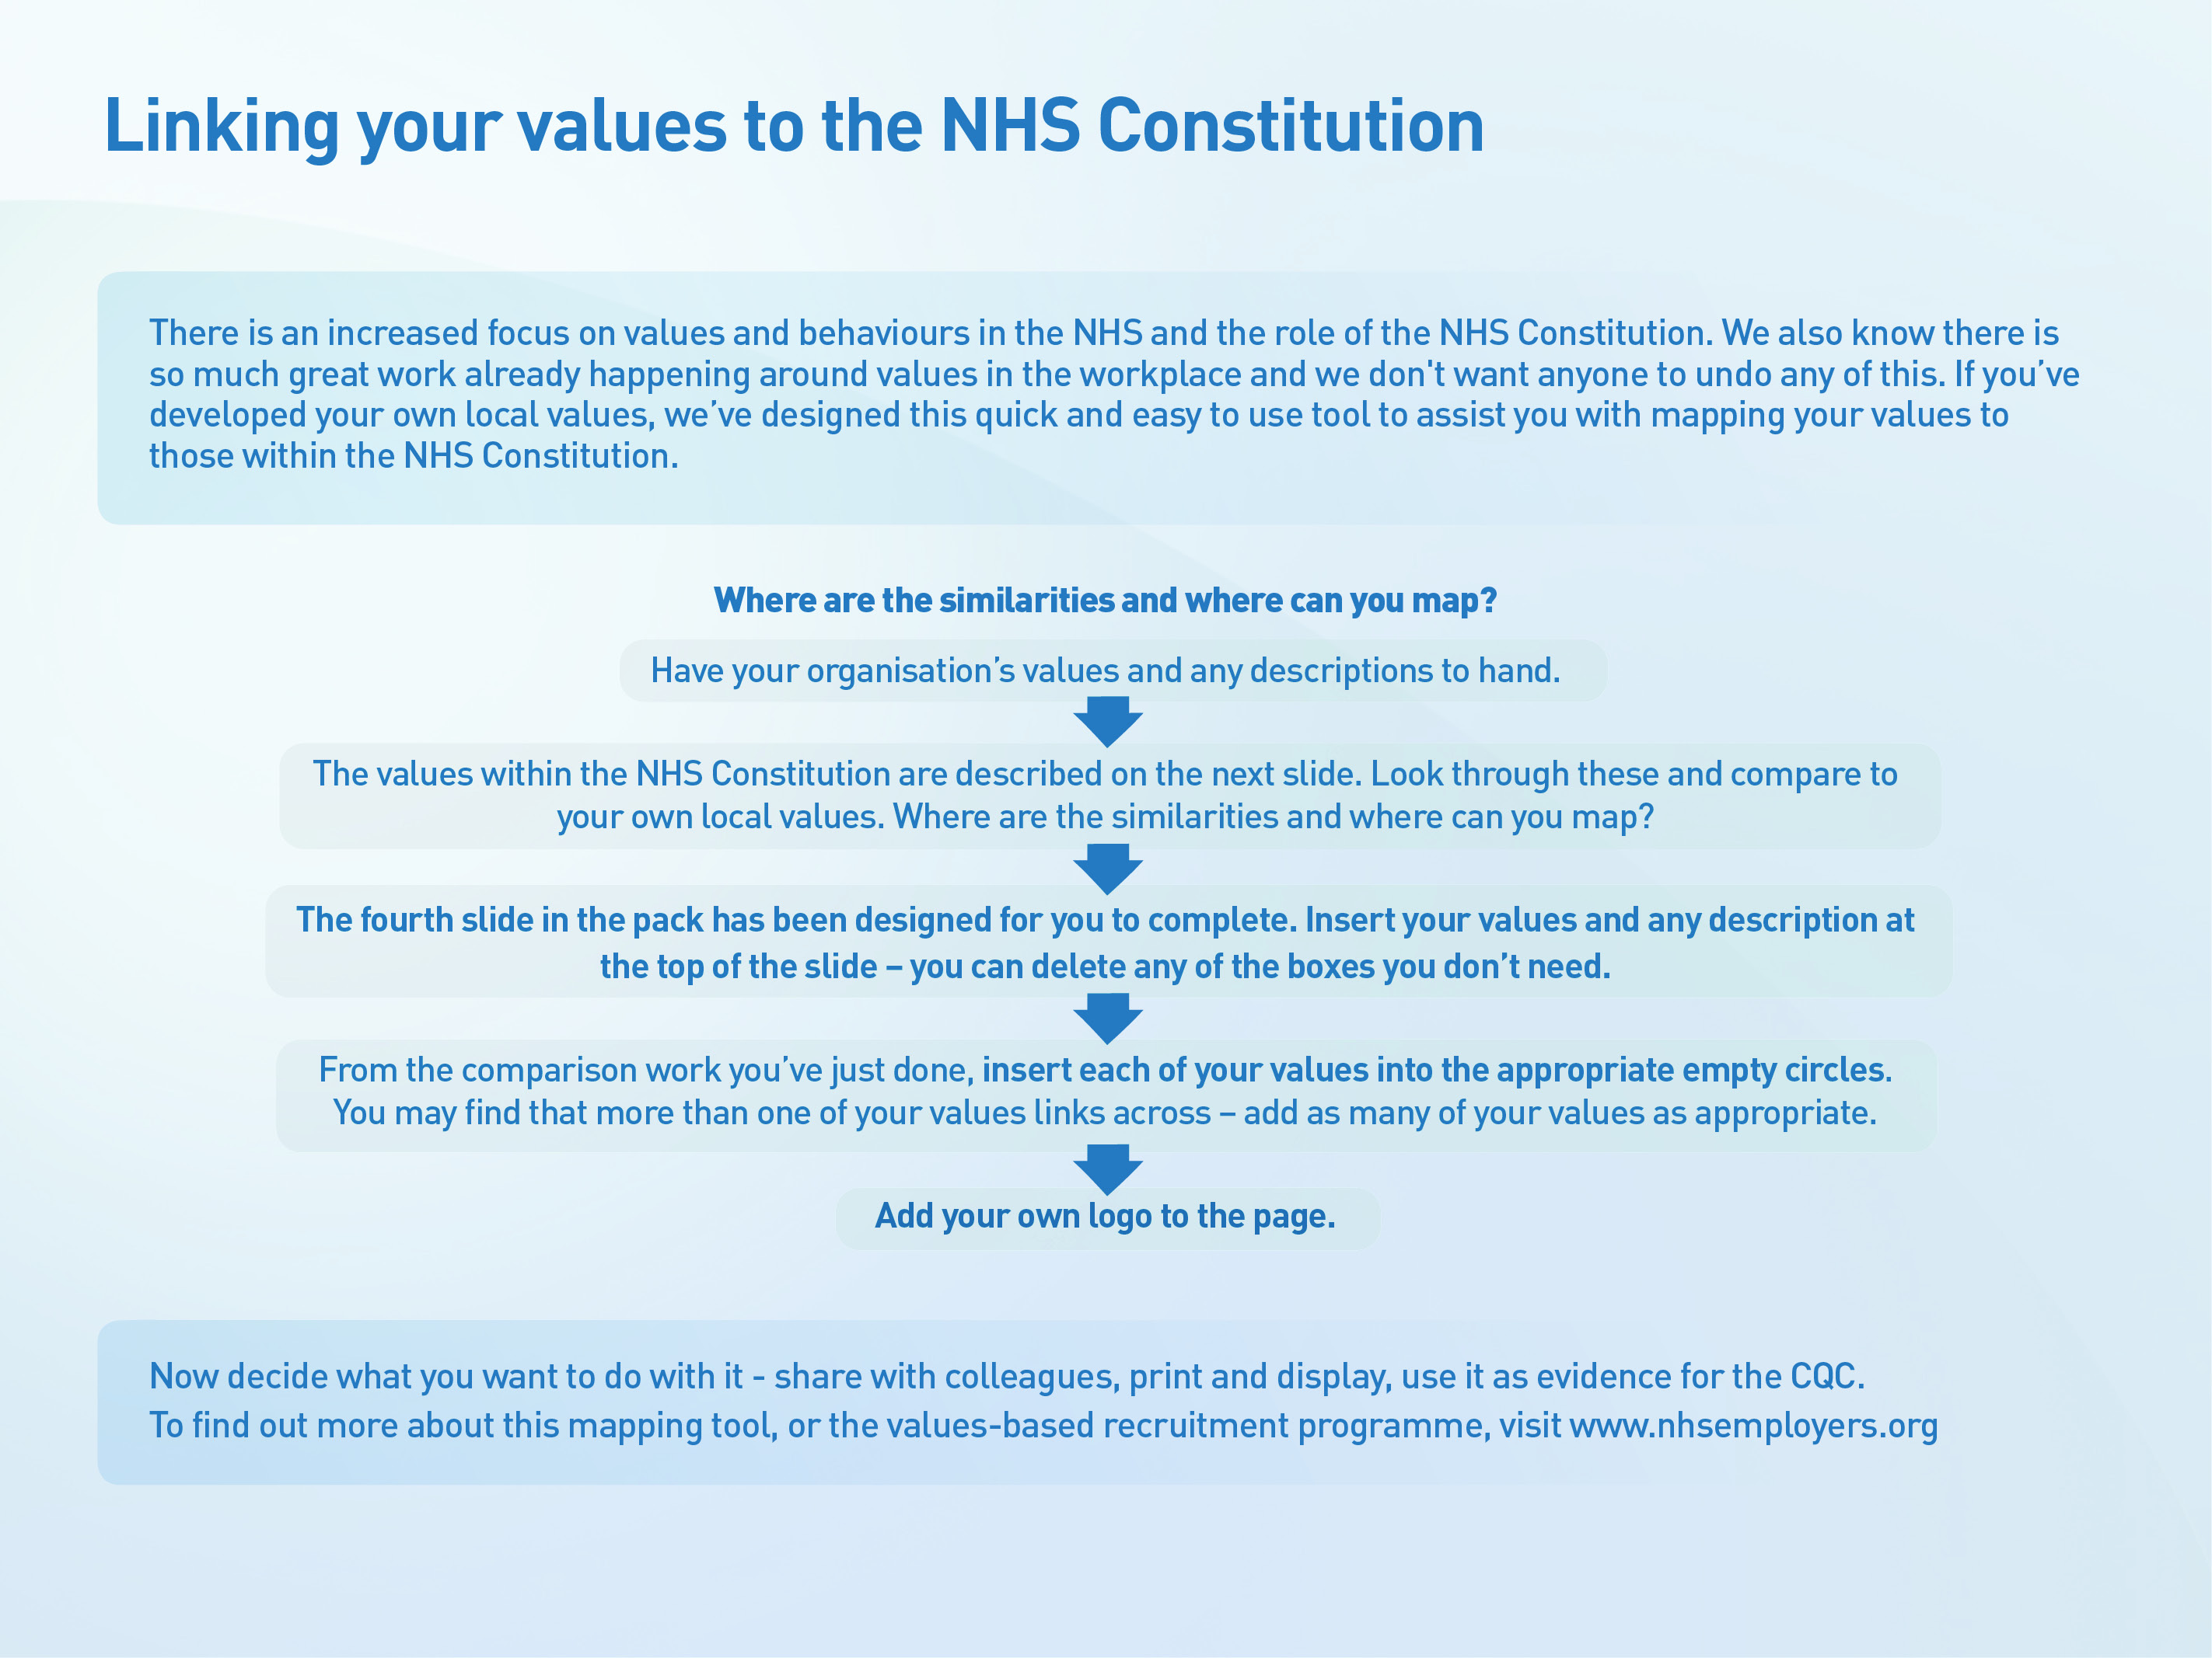

Slide 3


Slide 4

















Our Values
ADD YOUR LOGO HERE
Insert values here
Insert values here
Insert values here
Insert values here
Insert values here
Insert values here
Insert your appropriate values here
Insert your appropriate values here
Insert your appropriate values here
Insert your appropriate values here
Insert your appropriate values here
Insert your appropriate values here

