Slide 1
Blinatumomab for previously treated B-precursor acute lymphoblastic leukaemia
[ID804]
For public (redacted)
1st Appraisal Committee meeting
Background and clinical effectiveness
Committee A
Lead team: John Watkins, Nerys Woolacott, Pam Rees
ERG: Warwick Evidence
NICE technical team: Thomas Palmer, Eleanor Donegan, Janet Robertson
9 March 2017

Slide 2
Key decision points
What is the prognosis for Philadelphia-chromosome-negative relapsed or refractory ALL?
What is current standard of care for ALL? Is allo-SCT the only cure?
The TOWER trial compared blinatumomab with clinicians choice. Is FLAG-IDA the most relevant comparator in clinical practice? Is clofarabine a relevant comparator for some people?
Where does blinatumomab fit into the current treatment pathway? Is it most likely to be for first relapse, and for how many cycles? Can it be used in the outpatient setting?
How generalisable are the results of the clinical trials (which excluded people who had first relapse after 12m)?
Blinatumomab was associated with an OS benefit of 3.7 months and may be used as a bridge to transplant. What is the potential that blinatumomab alone to produce a durable long term effect?

Slide 3
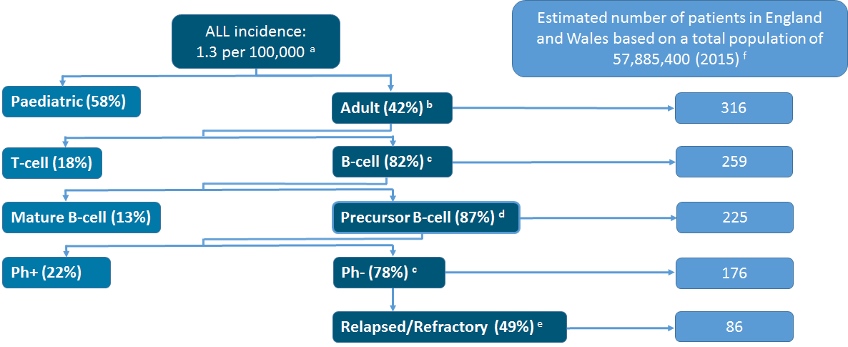
Philadelphia-chromosome-negative relapsed or refractory B-precursor acute lymphoblastic leukaemia

Slide 4
Current management
Currently no NICE guidelines on treatment of ALL
  TA408 recommends pegaspargase for untreated ALL
  TKI inhibitors only used for treating Ph+
Treatment of ALL grouped into three main phases:
  remission–induction
  intensification / consolidation
  continuation/ maintenance (including allogeneic stem cell transplant – a potentially curative option)
Relapsed ALL currently treated by combination chemotherapy with poor response and considerable toxicity
Most common regimen used for relapsed/refractory ALL is fludarabine, cytarabine and GCSF based combination chemotherapy with or without idarubicin (FLAG-IDA)
Clofarabine-based regimens sometimes used
  MA for monotherapy in paediatric patients only
  Significant off-label use in clinical practice
  CDF transition funding will remain in place until a commissioning decision is taken by the CDF ‘off label process’
Blinatumomab an alternative to these “salvage” therapies

Slide 5
Patient Issues 1 (Leukaemia CARE)
64% of ALL patients are diagnosed following an emergency presentation
Adult patients with relapsed ALL have “an appalling prognosis”:
  Over 90% will die from their disease usually within a few months;
  Conventional chemotherapy: poor response & considerable toxicity;
  With currently available options, the 5yr overall survival rate for relapsed patients < 10%
Allogeneic stem cell transplant + salvage chemo: ~ 25% survival at 5 yrs.
Need further treatment options for patients unable to tolerate aggressive chemotherapy.
Huge emotional impact on patients and their families

Slide 6
Patient Issues 2 (Leukaemia CARE)
Blinatumomab’s benefits for a difficult to treat patient population include:
  Improved remission rates and prolonged survival;
  Potential ‘bridge to transplant’;
  A ‘treatment-free’ period;
  Allowing patients to receive therapy as outpatients due to lower toxicity;
  A “normal” life for patients and family

Slide 7
Technology
Details of the technology | Blinatumomab (BLINCYTO®, Amgen)
Marketing authorisation | Adults with Philadelphia-chromosome-negative relapsed or refractory B-precursor acute lymphoblastic leukaemia European marketing authorisation was granted in November 2015 (on a conditional basis given the lack of available randomised controlled trial evidence at the time of approval)
Mechanism of action | Blinatumomab is a T-cell engager antibody targeting CD19 and the CD3/T cell receptor When blinatumomab binds to both the cancer cell and T-cell, the T-cell is recruited and activated to destroy the cancer cell
Administration | Continuous intravenous infusion for up to 96 hours at a dosage of 9 µg/day (starting dose; days 1–7) or 28 µg/day (subsequent doses) Each cycle of treatment is 28 days of continuous infusion Patients may receive 2 cycles of treatment, separated by a 14 day treatment-free interval Patients who achieve complete remission may receive up to 3 additional cycles of consolidation treatment Hospitalisation is recommended for initiation at a minimum for the first 9 days of the first cycle and the first 2 days of subsequent cycles
Acquisition cost (excluding VAT) | List price £2,017 per 38.5 µg vial The company has proposed a simple PAS which has been approved by the DoH

Slide 8
Decision problem
 | Final NICE scope |  | Company decision problem
Population | People with Philadelphia-chromosome-negative relapsed or refractory B precursor acute lymphoblastic leukaemia |  | Adults – MA does not include children
Intervention | Blinatumomab
Comparator | Fludarabine, cytarabine and GCSF based combination chemotherapy, with or without idarubicin Clofarabine-based combination chemotherapy Best supportive care (including palliative care) |  | Fludarabine, cytarabine and GCSF based combination chemotherapy with idarubicin (FLAG-IDA)
Outcomes | Overall survival Event-free survival Relapse-free survival | Treatment response rates Time to and duration of response | Rate of stem cell transplant Adverse effects Health-related quality of life
Subgroups | People for whom allo-SCT is considered an appropriate treatment option |  | People who have not received prior salvage therapy

Slide 9
Clinical effectiveness
Notes:
No notes on this page.

Slide 10
Blinatumomab Clinical Evidence -TOWER
Design | Open-label, multicentre phase 3 RCT
Location (sites) | 101 sites in 21 countries (5 sites in the UK = 5.2% of enrolled patients)
Population | Patients were eligible if they were adults with R/R Ph- B-precursor ALL and were: Refractory to primary induction therapy or salvage therapy In untreated first relapse with first remission duration < 12 months In untreated second or greater relapse In relapse at any time after allo-SCT Following intensive combination chemotherapy as initial treatment or subsequent salvage therapy
Intervention and comparator | Patients randomised (2:1 ratio) to either blinatumomab or one of 4 standard of care chemotherapy regimens: FLAG ± anthracycline based regimen (xxxxx) High-dose methotrexate based regimen (xxxx) Clofarabine or clofarabine based regimen (xxxxx) HiDAC based regimen (xxxxx)
Primary outcome measures | OS
Secondary outcome measures | Complete remission (CR), duration of CR, minimum residual disease remission, post baseline allo-SCT, HRQoL, safety

Slide 11
TOWER Results
 |  | Blinatumomab (N=271) | SOC Chemotherapy (N=134)
Overall survival | OS duration, median months (95% CI) | 7.7 (5.6, 9.6) | 4.0 (2.9, 5.3)
 | Hazard ratio (95% CI) | 0.71 (0.55, 0.93)
Complete remission | CR/CRh*/CRi, % (95% CI) | 43.9 (37.9, 50.0) | 24.6 (17.6, 32.8)
 | CR, % (95% CI) | 33.6 (28.0, 39.5) | 15.7 (10.0, 23.0)
Event free survival | Events, n (%) | xxx xxx | xxx xxx
 | Hazard ratio (95% CI) | 0.55 (0.43, 0.71)
Allo-SCT | Post-baseline % (95% CI) | 24.0 xxx xxx | 23.9 xxx xxx
MRD among responders | % (95% CI) | 76.3 xxx xxx | 48.5 xxx xxx
Grade ≥ 3 treatment-related AEs | Events, n (%) | xxx xxx | xxx xxx
AE, adverse event; CI, confidence interval; CR, complete remission; CRh*, complete remission with partial haematological response; CRi, complete remission with incomplete haematological response; MRD, minimal residual disease remission

Slide 12

Kaplan–Meier plot of overall survival (TOWER)

Slide 13
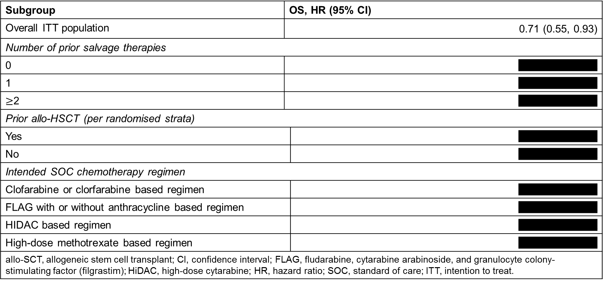
TOWER pre-specified subgroup analyses of overall survival
Subgroup | OS, HR (95% CI)
Overall ITT population | 0.71 (0.55, 0.93)
Number of prior salvage therapies
0 | xxxxxxxxxxxxxxx
1 | xxxxxxxxxxxxxxx
$≥$2 | xxxxxxxxxxxxxxx
Prior allo-HSCT (per randomised strata)
Yes |  | xxxxxxxxxxxxxxx
No |  | xxxxxxxxxxxxxxx
Intended SOC chemotherapy regimen
Clofarabine or clorfarabine based regimen |  | xxxxxxxxxxxxxxx
FLAG with or without anthracycline based regimen |  | xxxxxxxxxxxxxxx
HIDAC based regimen |  | xxxxxxxxxxxxxxx
High-dose methotrexate based regimen |  | xxxxxxxxxxxxxxx
allo-SCT, allogeneic stem cell transplant; CI, confidence interval; FLAG, fludarabine, cytarabine arabinoside, and granulocyte colony-stimulating factor (filgrastim); HiDAC, high-dose cytarabine; HR, hazard ratio; SOC, standard of care; ITT, intention to treat.

Slide 14
Blinatumomab non-randomised clinical evidence
 | Study MT103-211 | Historical comparator (Study 20120310)
Design | Phase 2, single-arm, multicentre, open-label study | Retrospective pooled analysis of historical data available from 1990 to 2013 for 1139 adult patients (694 patients with data on CR and 1112 patients with OS data)
Population | Patients were eligible if they were adults with R/R Ph- B-precursor ALL and were: Primary refractory after induction Relapsed within 12 months of first remission Relapsed within 12 months of allo-SCT No response to or relapse after salvage therapy | Patients were eligible if they were adults with R/R Ph- B-precursor ALL and were: In first relapse or salvage treatment after a first remission duration of ≤ 12 months Refractory to initial treatment, R/R after first or later salvage, or R/R disease within 12 months of allo-SCT
Intervention | Blinatumomab | One of four SOC chemotherapy regimens (similar to regimens prescribed in the SOC chemotherapy arm in TOWER)
Primary outcomes | Proportion of patients achieving CR/CRh* within the first two cycles (i.e., 12 weeks) of blinatumomab treatment | Complete remission (CRsg: with or without full haematological recovery depending on study group)
Secondary outcomes | OS, RFS, EFS, CR, CRh*, post-baseline allo-SCT | OS, RFS, post-baseline allo-SCT

Slide 15
Comparative analysis – propensity score analysis
Company used weighted analysis to compare patients in Study MT103-211 with the historical cohort
Two approaches were used to address differences in patient characteristics across studies
In the reweighted analysis patients were stratified based on known prognostic factors (e.g. age, prior allo-SCT and prior salvage therapy)
In the propensity score analysis, patient characteristics (e.g. age, prior allo-SCT, prior salvage therapy) were also used to weight the estimates using inverse probability of treatment weighting methodology
 | Historical cohort (Study 20120310) N=1112 | Blinatumomab (Study MT103-211) N=189
Weighted analysis (combined weighted estimate)
Median OS, months (95% CI) | 3.3 (2.8, 3.6) | 6.1 (4.2, 7.5)
CRsg/CR/CRh*, % (95% CI) | 24 (20, 27) | 43 (36, 50)
Propensity score analysis
OS, HR (95% CI) | 0.54 (0.40, 0.73)
CR/CRh* vs. CRsg, OR (95% CI) | 2.68 (1.67, 4.31)
ª CRsg (historical cohort) and CR/CRh* (MT103-211) CI, confidence interval, CR, complete remission; CRh*, complete remission with partial haematological recovery, CRsg, complete remission with or without full haematological recovery depending on study group in historical cohort, OS, overall survival, OR, odds ratio, HR, hazard ratio

Slide 16
ERG critique of clinical effectiveness – TOWER (1)
The trial as a whole was large and generally of good quality, with clear and appropriate approach to outcome selection and trial statistics and included patients generalisable to those in England
TOWER was not powered to undertake subgroup analyses
In TOWER, dropout was imbalanced between arms (and was higher in the standard of care chemotherapy arm, 18.7% vs 1.5%), though this did not affect balance on known demographic characteristics
Data presented for TOWER drew from interim analyses, and thus the study data presented are not at full maturity (although CR/CRh*/CRi data are)

Slide 17
ERG critique of clinical effectiveness – TOWER (2)
xxxx of patients in the blinatumomab arm received more than the five cycles of blinatumomab described in the marketing authorisation
xxxx of patients in the standard of care chemotherapy arm received blinatumomab subsequently
TOWER was an open-label trial
Consolidation criteria used in TOWER to determine if further treatment after two cycles is appropriate does not match precisely the consolidation criteria in the marketing authorisation
It is unclear the degree to which the standard of care chemotherapy arm in TOWER is an appropriate substitute for FLAG-IDA, the scoped comparator

Slide 18
ERG Critique of clinical effectiveness - Study MT103-211
The ERG did not regard the single-arm trial per se as relevant and thus focused on the comparison between the single-arm trial and the historical cohort
Note that magnitude of effectiveness comparable to TOWER
In the non-randomised comparison provided, the definition of complete remission was inconsistent between the blinatumomab arm and the standard of care chemotherapy natural history comparator, and was heterogeneous within the standard of care arm
Populations in Study MT103-211 and the historical comparator are non-equivalent
Matched weighting analysis presented by company -the arms were not significantly different once matched except for on region
Note that the company did not provide evidence of covariate balance using the remission analyses

