Slide 1
Lead team presentation
Fulvestrant for untreated hormone-receptor positive locally advanced or metastatic breast cancer
1st Appraisal Committee meeting
Clinical Effectiveness
Committee A
Lead team: Rachel Hobson and Pamela Rees
ERG: Southampton Health Technology Assessment Centre
8th August 2017
Committee and public slides and handouts

Slide 2
Key issues: clinical effectiveness
What are the current treatment options for people with hormone-receptor positive, human epidermal growth factor receptor negative, locally advanced or metastatic breast cancer who have received no prior (including adjuvant) endocrine therapy?
Who would receive an aromatase inhibitor (AI) in current clinical practice, and who would receive tamoxifen?
Would fulvestrant be of particular value for any specific group (e.g. people unable to have AIs or unable to tolerate any oral endocrine therapies)?
What are the committee’s conclusions on the clinical trials and clinical results for fulvestrant?
  quality, inclusion criteria and risk of bias in the trials
  the results of fulvestrant vs anastrozole in FIRST compared to FALCON for progression-free survival and overall survival
Direct trial data is only available to compare with anastrozole and the company carried out an indirect comparison with letrozole and tamoxifen; in clinical practice are the AIs usually regarded as having a class effect?

Slide 3
Breast cancer: hormone-receptor positive, locally advanced or metastatic
Breast cancer arises from the tissues of the ducts or lobules of the breast
  Locally advanced: describes tumours that are larger than 5 cm in size, or have grown into the skin or muscle of the chest or nearby lymph nodes
  Metastatic: describes disease that has spread to another part of the body, such as the bones, liver, or lungs
Endocrine (hormone) receptor positive breast cancer is the most prevalent form of the disease – about 70% are oestrogen-receptor positive (ER+)
15 to 25% of breast cancers are human epidermal growth factor-receptor positive (HER2+) which tend to grow more quickly than breast cancers that do not express HER2 – usually treated with targeted therapies such as trastuzumab
Common symptoms: swelling of all or part of a breast, breast or nipple pain, nipple retraction and/or discharge, thickening of nipple or breast
Prevalence: 46,083 people diagnosed (2015), and approximately 9,753 deaths from breast cancer in England (2015)
  Approximately 13% of women with invasive breast cancers have locally advanced or metastatic disease when they are diagnosed

Slide 4
Fulvestrant (Faslodex)
UK marketing authorisation | Treatment of oestrogen-receptor positive, locally advanced or metastatic breast cancer in postmenopausal women: not previously treated with endocrine therapy (indication of interest for appraisal, CHMP positive opinion adopted June 2017) with disease relapse on or after adjuvant anti-oestrogen therapy, or disease progression on anti-oestrogen therapy (not recommended under NICE technology appraisal 239)
Class of drug | Selective Oestrogen Receptor Degrader (SERD): oestrogen receptor (ER) antagonist that binds to the ER in a competitive manner with affinity comparable to that of oestradiol and downregulates the ER protein in human breast cancer cells
Administration and dosage | 500mg given intramuscularly into the buttocks as two 5 mL injections, one in each buttock on days 1, 15, 29 and once monthly thereafter (until disease progression)
Cost | The current list price per pack of 2 × 5-mL (250-mg) prefilled syringes is £522.41 Total expected acquisition cost for an average course of treatment is £15,841 plus administration and monitoring costs of £2,458 (source: company model based on an average length of treatment of approx. 30 months)
Note; endocrine therapies are not centrally funded by NHS England and therefore ineligible for a CDF consideration

Slide 5
Treatment pathway
Imaging and pathological assessment to determine receptor status and visceral metastases
Life threatening disease: chemotherapy
Postmenopausal, non life-threatening, ER+ and HER2 -, advanced disease
Offer endocrine therapy if previously received no prior endocrine therapy or if previously treated with tamoxifen: Aromatase inhibitors
Palbociclib*
Ribociclib*
Fulvestrant
If aromatase inhibitors are inappropriate: Tamoxifen
Fulvestrant
*ongoing appraisals

Slide 6
Patient Views (1)
Living with metastatic breast cancer is difficult to come to terms with for both patients and family
  “I have gone from being the person that was there to help other people, to being an ill, disabled person; a condition, a diagnosis."
Emotional aspect: fear, uncertainty, living from “scan to scan”, unable to plan long-term
Symptoms: pain, fatigue, nausea, poor appetite and sleep difficulties
People with metastatic breast cancer face limited treatment options. People want:
  treatments that will halt progression, extend life for as long as possible and have few or manageable side-effects
  to be able to continue with their day-to-day activities as much as possible, be that going to work, parenting and social responsibilities and activities

Slide 7
Patient Views (2)
Aromatase inhibitors provide an alternative to chemotherapy, a better quality of life and additional survival
Fulvestrant provides another first-line option that may provide longer survival
  “For me it has advantages over chemotherapy in that it allowed me to lead a relatively normal life.”
Evidence shows that fulvestrant is as effective and safe as current treatment and has a similar side-effect profile to aromatase inhibitors
  many people treated with fulvestrant experience only mild side effects, which are tolerable. These include nausea and hot flushes
Some people may find the method of administration and frequent trips to hospital or primary care for the injections problematic

Slide 8
Clinical expert view (1)
Current treatments are aromatase inhibitors (for disease without visceral or high volume of visceral involvement):
  these are more effective than tamoxifen in locally advanced or metastatic breast cancer.
  Letrozole and anastrozole are almost indistinguishable in terms of efficacy and toxicity
  adherence to current oral treatments is poor – 25% do not take oral treatment in the adjunctive setting. An intramuscular injection may be more acceptable
Fulvestrant is not frequently used because it is not yet licensed in this proposed setting but has been used where oral treatments are not tolerated
  used as a second or third line hormone therapy depending on local commissioning arrangements
  may help people who may find compliance with daily medicine difficult -supervised monthly IM treatment will aid compliance

Slide 9
Clinical expert view (2)
FALCON study shows that fulvestrant is well tolerated – similar profile to anastrozole
There is a clear PFS advantage over standard treatment
It is anticipated that an overall survival benefit will be seen
Fulvestrant will be prescribed, and the cancer monitored, in secondary care but the intramuscular injection could be administered in either primary or secondary care
  the treatment is safe with few complications and has high patient acceptability
  more capacity may be needed to meet the requirements for administration but this is not a major issue as the number of patients presenting will be small
  no additional monitoring would be required

Slide 10
Decision problem
 | NICE scope and company’s submission
Population | Post-menopausal people with locally advanced or metastatic hormone receptor-positive breast cancer, who have not received endocrine therapy
Comparator(s) | Aromatase inhibitors (such as anastrozole and letrozole) If aromatase inhibitors are not tolerated or are contraindicated: Tamoxifen
Outcomes | overall survival progression free survival response rate adverse effects of treatment health-related quality of life
Subgroups | people with visceral disease people with non-visceral disease

Slide 11
Randomised controlled trials: fulvestrant 500mg
Trial | Population | Comparator | Primary outcome | Key secondary outcomes
FIRST phase II, open-label, multicentre non-inferiority (Asia, Europe, North and South America, South Africa) N=233 enrolled, 205 randomised | Postmenopausal women with HR+, advanced BC: 75% had no previous endocrine therapy HER2 status –positive:19%; negative: 47% unknown: 34% | anastrozole (1mg tablet daily) | Clinical benefit rate (CBR) | Time-to-progression (TTP) Overall survival (OS)
FALCON* phase III, double-blind, multicentre, superiority study (Europe, North and South America) N=524 enrolled, 462 randomised | Postmenopausal women with ER+ and/or PR+ BC: no previous endocrine therapy HER2 negative | anastrozole (1mg tablet daily) | Progression-free survival (PFS) | OS
*number of participants from the UK unknown; please note the definition of TTP is similar to PFS so the results can be assumed to be comparable

Slide 12
Key baseline characteristics
Patient demographic and disease characteristics | FIRST |  | FALCON
 | Fulvestrant (n=102) | Anastrozole (n=103) | Fulvestrant (n=230) | Anastrozole (n=232)
HER2 status (%)
Positive | 18.6 | 18.4 | 0 | <1
Negative | 47.1 | 47.6 | 100 | 100
Unknown | 34.3 | 34.0 | 0 | 0
Site of disease (%)
Any visceral disease | 47.1 | 56.3 | 59 | 51
Prior endocrine therapy (%)
None | 71.6 | 77.7 | 99.1 | 99.6
Completed ≤12 months prior to randomisation | 1.0 | 0 | 1 | <1
Completed >12 months prior to randomisation | 27.5 | 22.3

Slide 13
Results: intention-to-treat (ITT)
Trial | PFS / TTP (95% CI) | OS (95% CI)
FIRST | TTP: HR 0.66 (0.47, 0.92) P value 0.01 Median TTP F: 23.4 months vs A: 13.1 months (10.3 month gain) | HR 0.70 (0.50, 0.98)* P value 0.041 Median OS F: 54.1 months vs A: 48.4 months (5.7 month gain)
FALCON | PFS: HR 0.797 (0.637, 0.999) P value 0.0486 Median PFS F: 16.6 months vs A: 13.8 months (2.8 month gain) | HR 0.875 (0.629, 1.217)** P value 0.427
*OS data was mature at time of data cut-off of follow-up analysis (approx. 65% of events reached) **OS data were immature at time of interim analysis (31% of events reached) therefore a median could not be calculated TTP, time-to-progression; OR, odds ratio; PFS, progression-free survival; OS, overall survival; HR hazard ratio; F, fulvestrant; A, anastrozole OR >1 favour fulvestrant; HR <1 favours fulvestrant ; P value <0.05 is statistically significant

Slide 14
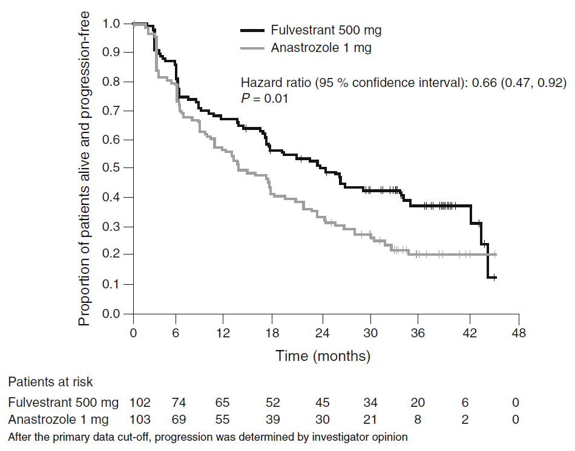
FIRST: Kaplan–Meier TTP

Slide 15
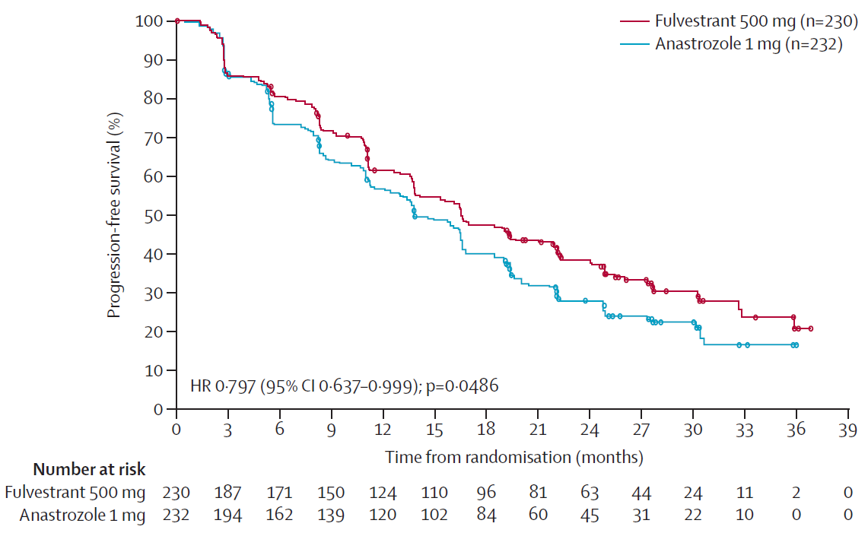
FALCON: Kaplan–Meier PFS

Slide 16
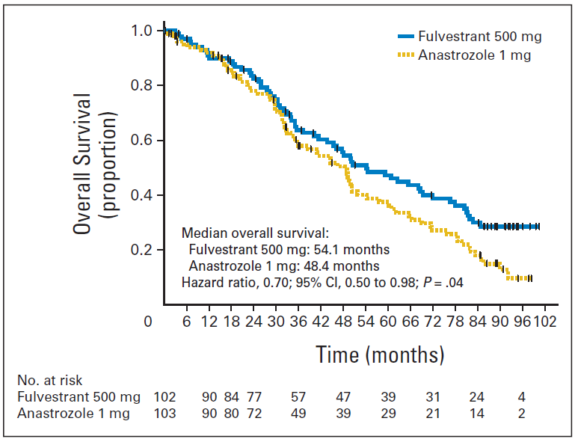
FIRST: Kaplan–Meier OS
OS at cut-off of follow-up analysis (approx. 65% of events reached)

Slide 17
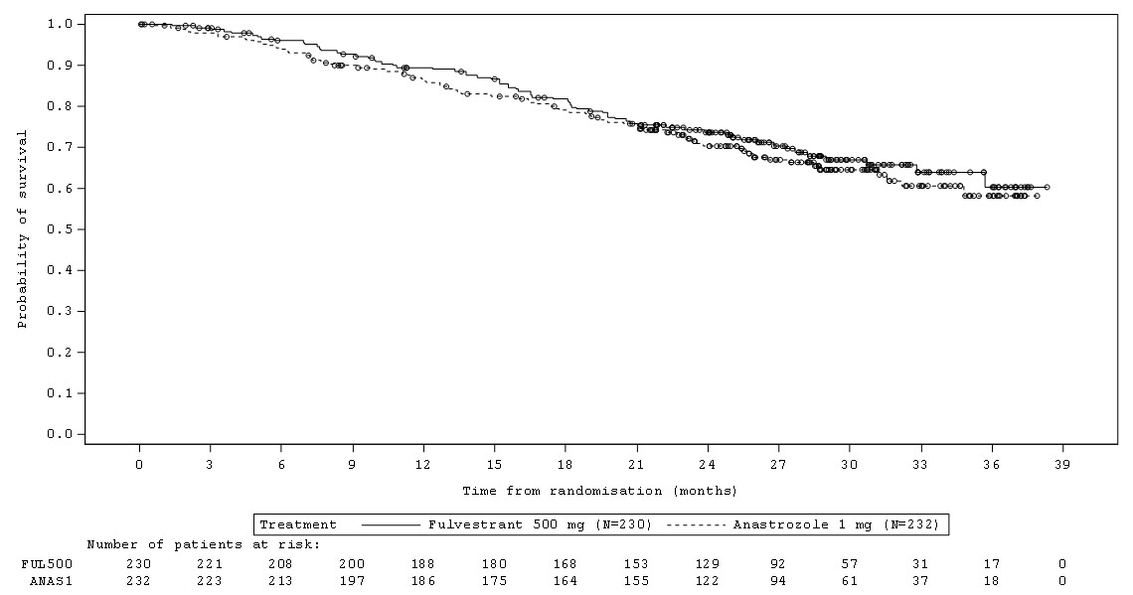
FALCON: Kaplan–Meier OS
OS immature at time of PFS analysis (31% of events reached)

Slide 18
Comparisons to letrozole and tamoxifen
Direct evidence was only available for a comparison with anastrozole
Therefore, the company carried out an indirect treatment comparison (ITC) comparing fulvestrant with letrozole and tamoxifen
The ITC is presented in the cost effectiveness section

Slide 19
Adverse events (AEs) & health-related quality of life (HRQoL)
Common AEs FIRST: cardiac failure and decreased appetite– fulvestrant arm
At final OS analysis (approx. 65% events reached) there were 23.8% serious AEs reported in the fulvestrant arm and 3% were related to death, but only 2% were considered to have a causal relationship to fulvestrant
Common AEs FALCON: arthralgia, fatigue and nausea– both trial arms
At the time of PFS data cut-off 13% reported a serious AE in the fulvestrant arm but <2% were causally related to the study drug
Discontinuations
FIRST: 3% due to AEs in the fulvestrant arm vs 2.9% in the anastrozole arm
FALCON: 7% due to AEs in the fulvestrant arm vs 4.7% in anastrozole arm
No deaths considered casually related to treatment in either study
HRQoL – only reported in FALCON
Data collected using Functional Assessment of Cancer Therapy Questionnaire for Breast Cancer (FACT-B) and EuroQol 5 dimensions questionnaire (EQ-5D)
Overall, HRQoL was maintained and similar in both treatment groups

Slide 20
ERG comments: clinical effectiveness (1)
Trials were well conducted and of good quality but there is potential for FIRST to be at high risk of bias due to absence of blinding
The ERG points out 2 important differences between the baseline characteristics in the trials:
  more people in FIRST had previous endocrine therapy (99.4% endocrine-naïve in FALCON; 74% in FIRST). Population in FALCON was endocrine-naïve to avoid reducing the efficacy of anastrozole in the control group through exposure to prior adjuvant endocrine therapy
  19% of people had HER2+ breast cancer in FIRST but people with HER2+ were excluded from FALCON. HER2+ breast cancer is more aggressive and spreads more quickly so less favourable outcomes would be expected in the FIRST trial

Slide 21
ERG comments: clinical effectiveness (2)
ERG’s clinical experts considered the PFS increase of 2.8 months for fulvestrant vs anastrozole in FALCON not to be clinically meaningful
  TTP is greater in FIRST (10.3 months) – difference could be due to:
  Study design – no blinding in FIRST but a blinded independent review was conducted on the primary endpoint (ERG are unclear whether this was carried out on the other endpoints too)
  FALCON study publication suggests that an enhanced effect with fulvestrant may be seen in people with non-visceral disease compared to those with visceral disease – the publication concludes that further observations are needed
OS data are immature in FALCON but the OS benefit is likely to be lower than in FIRST because the PFS gain was lower than in FIRST
  ERG note that although OS for FIRST was statistically significant it was not a pre-specified outcome and some people did not contribute data to the outcome (n=35)

Slide 22
Key issues: clinical effectiveness
What are the current treatment options for people with hormone-receptor positive, human epidermal growth factor receptor negative, locally advanced or metastatic breast cancer who have received no prior (including adjuvant) endocrine therapy?
Who would receive an aromatase inhibitor (AI) in current clinical practice, and who would receive tamoxifen?
Would fulvestrant be of particular value for any specific group (e.g. people unable to have AIs or unable to tolerate any oral endocrine therapies)?
What are the committee’s conclusions on the clinical trials and clinical results for fulvestrant?
  quality, inclusion criteria and risk of bias in the trials
  the results of fulvestrant vs anastrozole in FIRST compared to FALCON for progression-free survival and overall survival
Direct trial data is only available to compare with anastrozole and the company carried out an indirect comparison with letrozole and tamoxifen; in clinical practice are the AIs usually regarded as having a class effect?

