Slide 1
Lead team presentation
Eribulin for treating locally advanced or metastatic breast cancer after one prior chemotherapy regimen
Public observers
1st Appraisal Committee meeting
Background and Clinical Effectiveness
Committee A
Lead team: Andrew England, Nerys Woolacott, Pamela Rees
Assessment Group: Liverpool Reviews and Implementation Group
NICE technical team: Anna Brett, Eleanor Donegan
2 November 2017

Slide 2
Key decision points
What are the current treatment options? Is there high unmet need?
Is capecitabine the most appropriate comparator?
Are the people in study 301 generalizable to patients in England for whom eribulin would be considered?
Do the results show eribulin is effective compared with capecitabine?
What is the committee’s view of the relationship between progression-free and overall survival?

Slide 3
Background
Eribulin for treating locally advanced or metastatic breast cancer after two prior chemotherapy regimens in the advanced setting (subgroup 2 in the company submission) was recommended in TA 423 (published December 2016)
Subgroup 1 in the company submission included a subgroup analysis of patients with HER2-negative disease that had progressed after one prior chemotherapy regimen in the advanced setting: focus of this appraisal.
The company were given opportunity to submit new evidence / an updated analysis for this appraisal, but declined
Consultees and commentators given opportunity to update or replace their statements, but no revised statements have been received

Slide 4
Locally advanced or metastatic breast cancer
‘Locally advanced’ breast cancer describes tumours larger than 5cm that involve skin, muscle of the chest or nearby lymph nodes
‘Metastatic’ describes disease that has spread to another part of the body, such as bones, liver or lungs
46,417 people diagnosed with breast cancer in England in 2014
Approximately 13% of people with breast cancer have locally advanced or metastatic disease at diagnosis
Around 35% with early or locally advanced disease will progress to metastatic breast cancer
5-year survival rate for metastatic breast cancer in England is 15%
Company estimate there are approximately 2,660 patients with locally advanced or metastatic breast cancer that has progressed after one prior chemotherapeutic regimen for advanced disease

Slide 5
Patient perspective
Source: Breast Cancer Now
“Why me? Why my children?” The impact of metastatic breast cancer.¹
Physical symptom burden of the cancer and the treatment.
Little recent progress in treatment for HER2-negative disease.
Current treatment options are limited and could become more so.
More treatment options needed – disease progression is currently inevitable and risk of resistance is increasing.
Patients want a good quality of life as well as a longer life.
Eribulin is well tolerated by most patients and has been shown to extend life.
Eribulin improves symptoms such as pain control.
The willingness to accept side effects varies between patients.
¹ Breast J. 2013 May-Jun, 19(3): 285–292.)

Slide 6
Eribulin (Halaven)
Eisai
Mechanism of action | Synthetic analogue of halichondrin.B, which inhibits tubulin polymerisation. This disrupts the assembly and formation of microtubules, stopping cancer cell division.
Marketing authorisation | For the treatment of adult patients with locally advanced or metastatic breast cancer who have progressed after at least 1 chemotherapeutic regimen for advanced disease. Prior therapy should have included an anthracycline and a taxane in either the adjuvant or metastatic setting unless these treatments were not suitable.
Administration | Intravenously, over 2 to 5 minutes on days 1 and 8 of 21-day cycle
Dose | 1.23 mg/m² (ready made solution)
Stopping | Anticipated number of repeat courses of treatment: 6 Dose delay or reduction for grade 3 or 4 adverse events
Cost (list price) | £361 per 2 ml vial (eribulin mesilate equivalent to 0.88 mg eribulin), £541.50 per 3 ml vial (1.32 mg) Patient access scheme approved by Department of Health, which provides simple discount to list price

Slide 7
How is HER2-negative disease treated?
Early disease – Adjuvant chemotherapy
Chemotherapy (anthracycline +/- taxane / taxane)
Endocrine therapy
Advanced disease
Newly diagnosed advanced disease
HR-positive
HR-positive; prior chemotherapy (1st treatment)
HR-positive
immediately life-threatening or
significant visceral organ involvement
HR-negative
Endocrine therapy
Everolimus?
1st line chemotherapy
Anthracycline
2nd line chemotherapy
3rd line chemotherapy

Slide 8
What is the likely place of eribulin in the current treatment pathway?
1st line
Advanced disease: an anthracycline (doxorubicin) OR a taxane (docetaxel)
Metastatic disease: gemcitabine with paclitaxel TA116
2nd line
Capecitabine
CG81
Vinorelbine
CG81
Eribulin?
3rd line
Eribulin
TA423
Vinorelbine
CG81
Capecitabine
CG81
4th line
Gemcitabine
Eribulin
TA423

Slide 9
Decision problem
Comparison of NICE scope and company submission
NICE scope | Company submission
Population Adults with locally advanced or metastatic breast cancer that has progressed after 1 prior chemotherapeutic regimen for advanced disease (anthracycline and a taxane, unless these treatments were not suitable) | Population HER2-negative patients with locally advanced or metastatic breast cancer, whose disease has progressed after 1 prior chemotherapy regimen in the advanced setting. Company: 85% locally advanced/metastatic breast cancer is HER2-negative; which is not eligible for targeted therapies so unmet clinical need; eribulin indicatedin this group ERG agrees
Comparators Capecitabine Vinorelbine Gemcitabine | Comparators Capecitabine ERG agrees main comparator Vinorelbine included in sensitivity analysis Gemcitabine not included: not recommended (CG81) and not routinely used ERG agrees
Outcomes: Overall survival; Progression-free survival; Response rate; Adverse effects of treatment; Health-related quality of life

Slide 10
Key trial
Study 301
Design | Phase III, open-label, multi-centre, randomised controlled trial
Population | 1,102 patients with locally advanced or metastatic breast cancer that have received up to 3 prior chemotherapy regimens (<2 for advanced disease) including an anthracycline and a taxane but not capecitabine
Intervention | Eribulin (as per licensed dosing regimen) n=554
Comparator | Capecitabine n=548
Primary outcomes | Overall survival Progression-free survival
Secondary outcomes | Objective response rate Health-related quality of life Adverse effects
Follow-up | 5 years
Subgroups | HER2 status and geographical region
Subgroup 1 | The remit of this appraisal is people who have progressed after one prior chemotherapy regimen in the advanced setting. The company base case is the HER2-negative subgroup only

Slide 11
Study 301 Subgroup 1
Inclusion criteria
Patients with HER2-negative disease
Patients who had received only one prior chemotherapeutic regimen for advanced and/or metastatic disease
  patients who had not received a prior chemotherapeutic regimen for advanced and/or metastatic disease (i.e. first-line treatment for LABC/MBC) excluded
  patients who had received 2 or more (i.e. third line or later treatment for LABC/MBC) excluded
Company note: 1 regimen = Any single-agent therapy, and any combination of cytotoxic, hormonal, biological targeted agents, and/or humanized antibodies, scheduled as a preplanned treatment, given concomitantly, sequentially, or both. Planned neoadjuvant chemotherapy (to debulk the tumour prior to surgical intervention) plus postoperative adjuvant chemotherapy also considered 1 regimen.
ERG note: all patients in Subgroup 1 had received a chemotherapy regimen in the advanced/metastatic setting

Slide 12
Patient characteristics
Subgroup 1 (HER2-negative disease; 1 prior therapy)
 | Eribulin (n=186) | Capecitabine (n=206)
Median age (range) | 55 years (31 to 74 years) | 52 years (30 to 80 years)
Geographic region North America, Western Europe, Asia Eastern Europe Latin America, South Africa | 46 (24.7%) 99 (53.2%) 41 (22.0%) | 56 (26.9%) 112 (54.4%) 38 (18.4%)
ER status Positive Negative | 104 (55.9%) 82 (44.1%) | 116 (56.3%) 87 (42.2%)
Triple negative (ER/PR/HER2) | 73 (39.2%) | 72 (35.0%)

Slide 13
Trial results – progression-free survival
Subgroup 1 (HER2-negative disease; 1 prior therapy)
 | Eribulin (n=186) | Capecitabine (n=206)
Progression-free survival (investigator-assessed)
Median | ************* | *************
Hazard ratio | **************************************
Proportion of patients who progressed or died | ******** |  | ********
Proportion of patients experiencing non-fatal progression episode | 81.3% |  | 76.1%

Slide 14
Progression-free survival
Subgroup 1 (HER2-negative disease; 1 prior therapy)

Slide 15
Trial results – overall survival
Subgroup 1 (HER2-negative disease; 1 prior therapy)
1 prior therapy; HER2 negative | Eribulin (n=186) | Capecitabine (n=206)
Overall survival
Median | ************* | *************
Hazard ratio | **************************************

Slide 16
Overall survival
Subgroup 1 (HER2-negative disease; 1 prior therapy)

Slide 17
Adverse effects
Study 301
General (safety population) | Eribulin (n=544) | Capecitabine (n=546)
Any adverse event | 512 (94.1%) | 494 (90.5%)
Any serious adverse event | 95 (17.5%) | 115 (21.1%)
Fatal serious adverse event | 26 (4.8%) | 36 (6.6%)
Any treatment-related serious adverse event | 7.7% | 8.1%
Adverse event leading to discontinuation | 43 (7.9%) | 57 (10.4%)
Common adverse events (subgroup 1) | Eribulin (n=184) | Capecitabine (n=205)
Neutropenia Alopecia Asthenia/fatigue Nausea Peripheral neuropathy | 98 (53.3%) 64 (34.8%) 58 (31.5%) 38 (20.7%) 30 (16.3%) | 30 (14.6%) 6 (2.9%) 52 (25.4%) 43 (21.0%) 10 (4.9%)

Slide 18
Symptom burden; Quality of life
Adverse events more common with eribulin compared with capecitabine: neutropenia; leucopenia; pyrexia; peripheral neuropathy; alopecia
Adverse events more common with capecitabine compared with eribulin: diarrhoea; palmar-plantar syndrome
Health-related quality of life assessed in Study 301 using EORTC QLQ-C30 (European Organisation for Research and Treatment of Cancer Quality of Life Questionnaire)
Results available for all patients with HER2-negative disease but not specifically for Subgroup 1
Median Global Health Status/Quality of Life scores similar in both arms

Slide 19
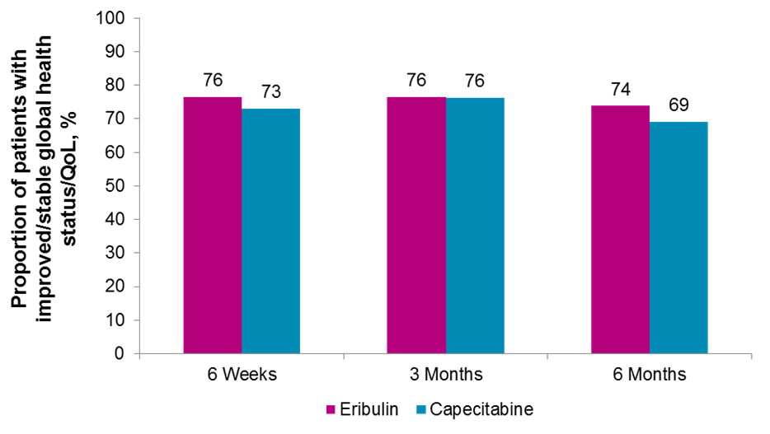
Quality of life
Study 301 (HER2-negative disease)
Global Health Status
287
210
186
289
105
102

Slide 20
ERG’s critique
Clinical effectiveness
Capecitabine is the most appropriate comparator
Study 301 generally well designed and conducted with low risk of bias
Post-hoc subgroup analyses have reduced statistical power
Health-related quality of life data should be treated with caution because of small proportion of patients completing the questionnaire
Trial results show:
  Statistically significant overall survival benefit for eribulin compared with capecitabine in HER2-negative disease after 1 prior therapy
  No statistically significant difference in progression-free survival for eribulin compared with capecitabine in HER2-negative disease after 1 prior therapy

Slide 21
Key decision points
What are the current treatment options? Is there high unmet need?
Is capecitabine the most appropriate comparator?
Are the people in study 301 generalizable to patients in England for whom eribulin would be considered?
Do the results show eribulin is effective compared with capecitabine?
What is the committee’s view of the relationship between progression-free and overall survival?

