Slide 1
Demystifying Policy Requirements
Fleet Suppliers
22 October 2025

Slide 2
Introductions
Copy of the slides will be made available on the PSSV webpage
Questions to be asked at the end of each presentation
Upcoming fleet agreements:
  RM6381 Vehicle hire solutions
  RM6392 Vehicle lease, fleet management and salary sacrifice car schemes
  RM6382 Purchase of standard and specialist vehicles

Slide 3
Agenda
Time | Topic | Speakers
14.00 - 14.05 | Joining and introduction | David Pyle, Crown Commercial Service
14.05 - 14.35 | Social value introduction Driving for better business | Charlene Maginnis, Crown Commercial Service Jim Magner, National Highways
14.35 - 15.00 | Financial viability risk assessments | Mark Pepperell, Crown Commercial Service
15.00 - 15:30 | Carbon reduction plans | Marta Hyder, Crown Commercial Service
15:30 - 15.40 | Prompt payment | Tom Garbutt, Crown Commercial Service
15.40 - 15:55 | Cyber essentials | David Pyle, Crown Commercial Service
15.55 - 16.00 | Closing remarks | David Pyle, Crown Commercial Service

Slide 4
Social value
Charlene Maginnis
Jim Magner

Slide 5




What is social value?
the additional value in the delivery of a product or service contract where a wider community or public benefit can be created - extending beyond the value of the contract itself.
responsible employment practices
diversity & inclusion initiatives
apprenticeships & volunteering
SMEs/VCSEs in supply chains
environmental benefits

Slide 6
PPN 002 terminology
Missions / Themes
The overarching objective – alignment with the Government’s five missions required by the National Procurement Policy Statement
Outcomes
The outcome we’re trying to achieve, in support of the overarching government Mission
Model Award Criteria (MACs)
The activities delivered under the contract which support delivery of the intended outcomes, and therefore the overarching Mission
Notes:
Firstly, it should be noted that CCS is an executive agency of Cabinet Office, which means we must follow the Central Government Model. I will explain a bit about the new model now so we have a common understanding.
The social value model is broken down into Missions, Outcomes and Model Award Criteria.
Missions are the overarching objectives – aligning with the Government’s five missions required by the National Procurement Policy Statement. Outcomes are the results the public sector is trying to achieve, in support of that overarching government Mission. And finally Model Award Criteria are the individual activities delivered under the contract which support delivery of the intended outcomes, and therefore the overarching Mission.
While many social value models and policies apply across the public sector, including the Wellbeing Goals in Wales or Community Benefits in Scotland, the important thing to note is that they all contain outcomes which support sustainable procurement and sustainable development goals. And it’s these outcomes that I want to focus on now.

Slide 7
PPN 002 outcomes
Kickstart economic growth
Break down barriers to opportunity
Fair Work
Employment and training for those who face barriers to employment
Skills for growth
Resilient, innovative & flexible supply chains
Creating a pipeline of opportunities for the contract workforce, reducing barriers to entry for under-represented groups
Make Britain a clean energy superpower
Sustainable procurement practices
Build an NHS fit for the future
Increasing productivity through physical and mental wellbeing: in the supply chain and communities in the relevant area
Take back our streets
Support the reduction in crime
Notes:
Many of you as suppliers, and many users of the agreement will be familiar with the old PPN06/20 Social Value model. So I thought it would be helpful to outline the differences or similarities in the two models. Chiefly, it’s around the re-mapping of the outcomes to align with the Government’s 5 missions. Covid-19 related outcomes came out, and some new ones around reduction in crime have been brought in, but they are largely similar. The majority of outcomes sit under the first mission, kickstarting economic growth.
As I said previously, many of the outcomes are similar, and will be similar to other outcomes in different models around the country, so buyers will be asking you to deliver proportionate social value activities against relevant outcomes in their call off contracts under CCS framework agreements. In each framework, CCS will highlight the relevant Social Value themes and check your commitment to delivering initiatives in support of these, for buyers at call off. Buyers will then test your proposals for specific social value activities at call off, which you will be expected to deliver against.
But beyond that, at framework level, we see an opportunity to support broader socio-economic and environmental benefits through the Driving for Better Business programme. I’ll hand over to Jim, who will talk you through this progamme.

Slide 8

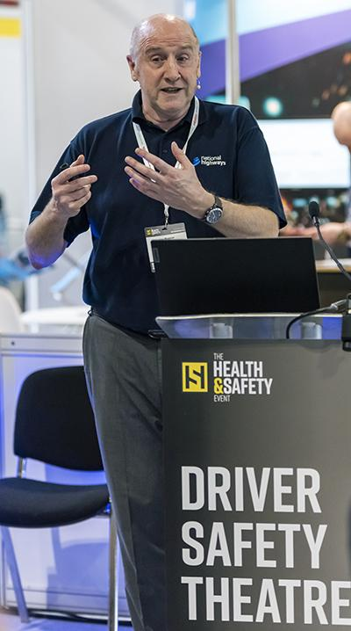


The need to manage
work-related road risk -
Crown Commercial Services
Jim Magner
Programme Development Manager

Slide 9





Around 20 million vehicles are used for work
COMPANY
CARS
Over 700,000
COMPANY
VANS/LCVs
Almost 5 million
TRUCKS
& HGVs
Over 600,000
GREY
FLEET
14 million+ ?
POWERED
2 WHEELERS
Unknown ?
You have a legal duty of care to ensure any business operations that involve driving don’t put employees or other road users at risk

Slide 10
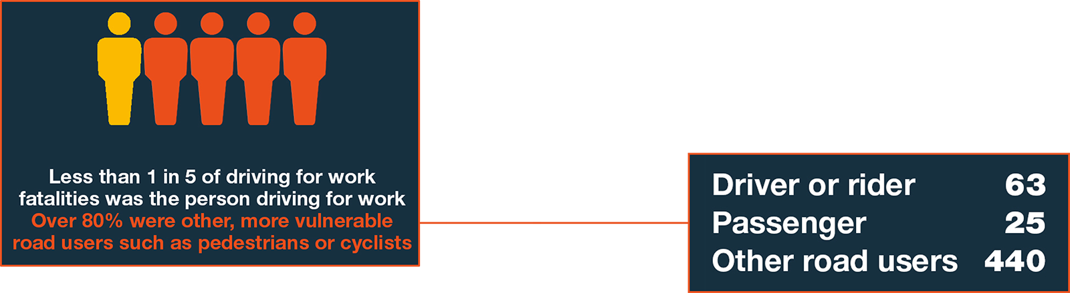


Comparing with other workplace fatalities
Sources: Department for Transport, HSE

Slide 11



Over 500
Fatalities
involving someone
driving for work
Over 35,000
Injured
involving someone
driving for work
Source: Department for Transport
Odds of winning the National Lottery Jackpot?
1 in 45 million !!
Odds of being involved in an injury collision while driving for work?
1 in 570 !!

Slide 12







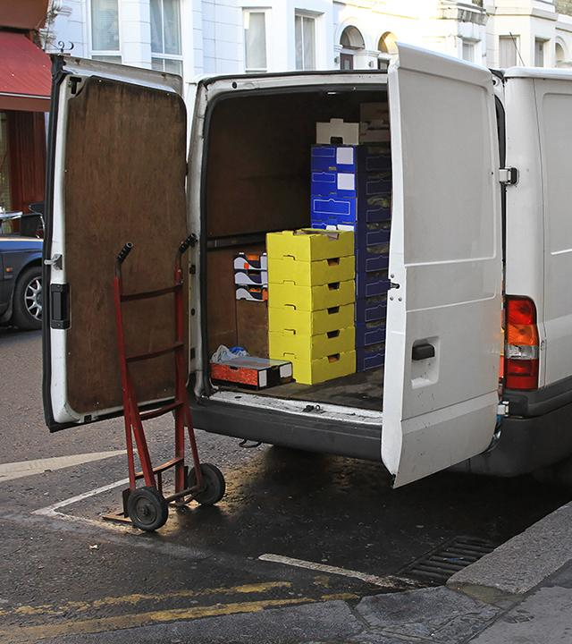

Where can risk occur?
Your drivers
Fitness to drive
Vehicle roadworthiness
Arriving for work
Loading the vehicle
Work instructions
On the journey
At the customer
In an emergency

Slide 13
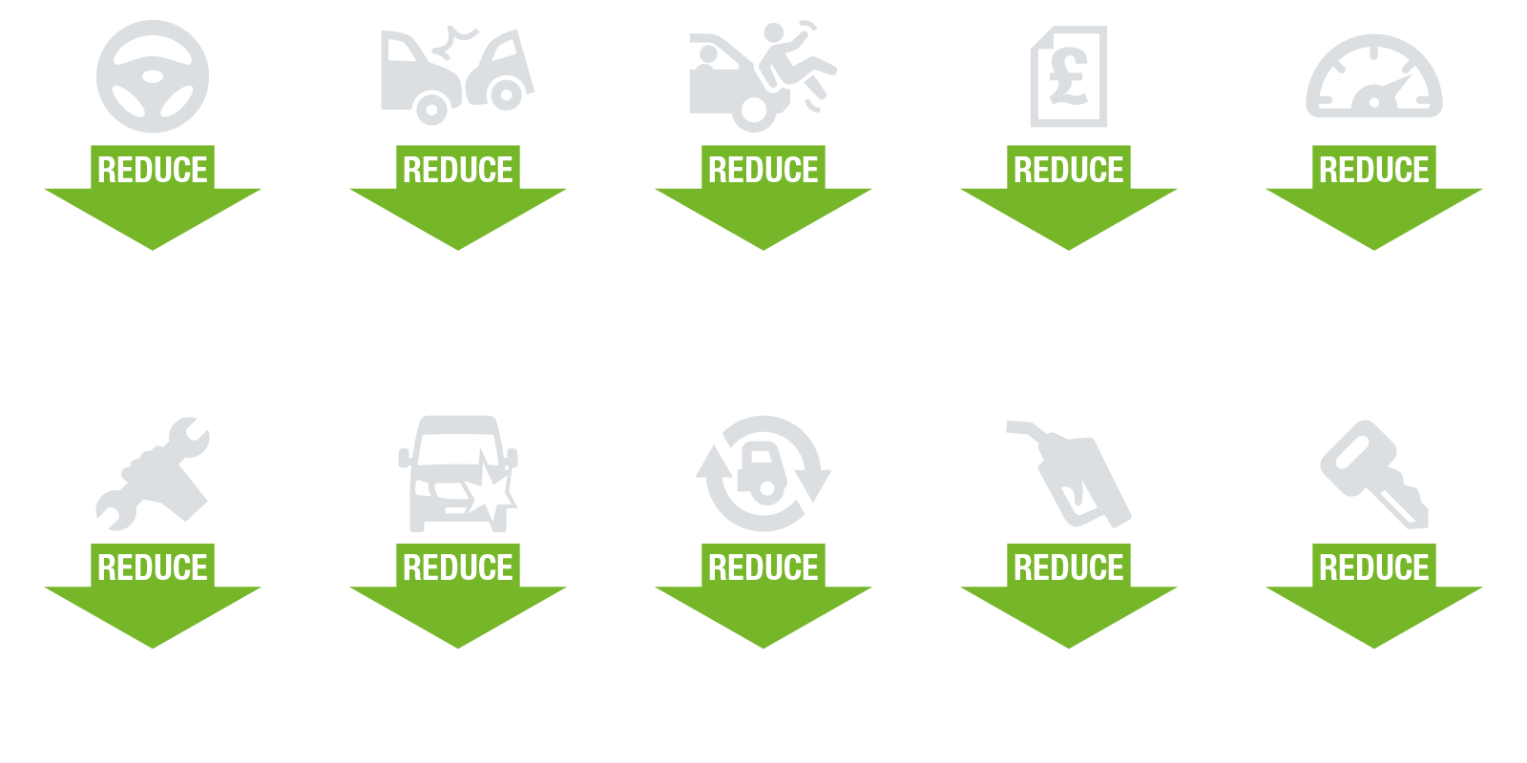
It just makes good sense!

Slide 14

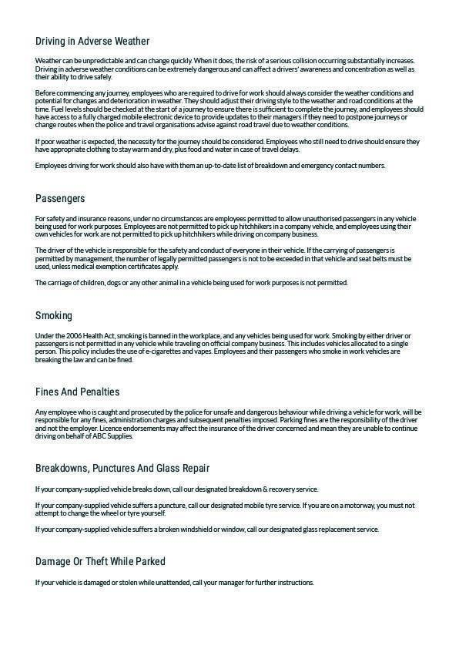
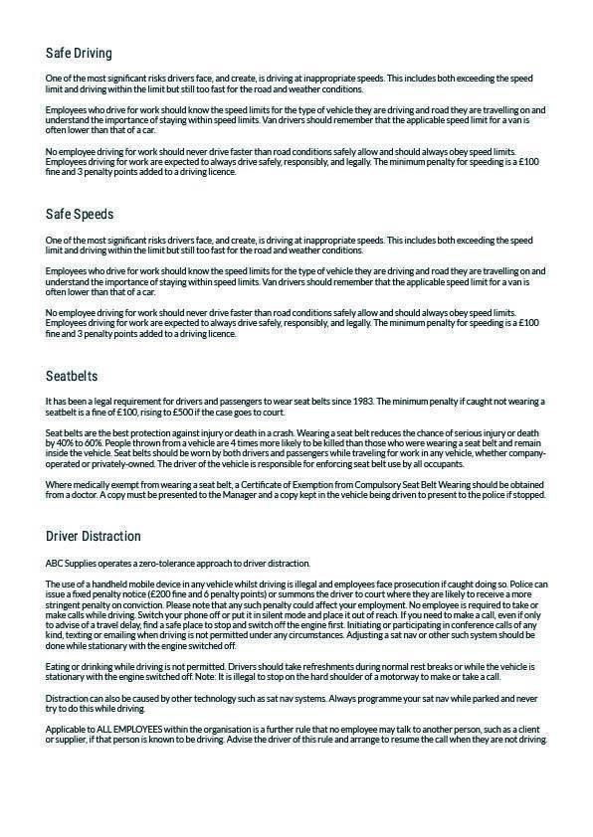
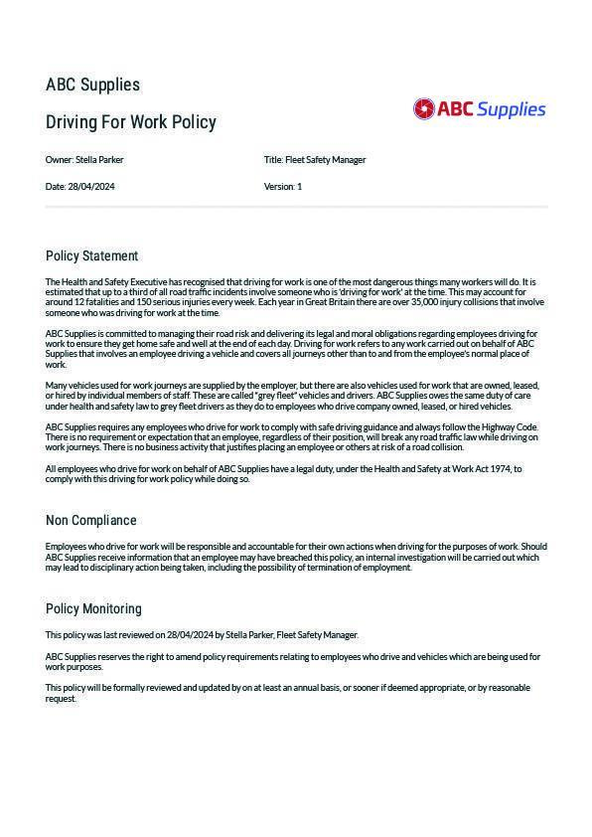
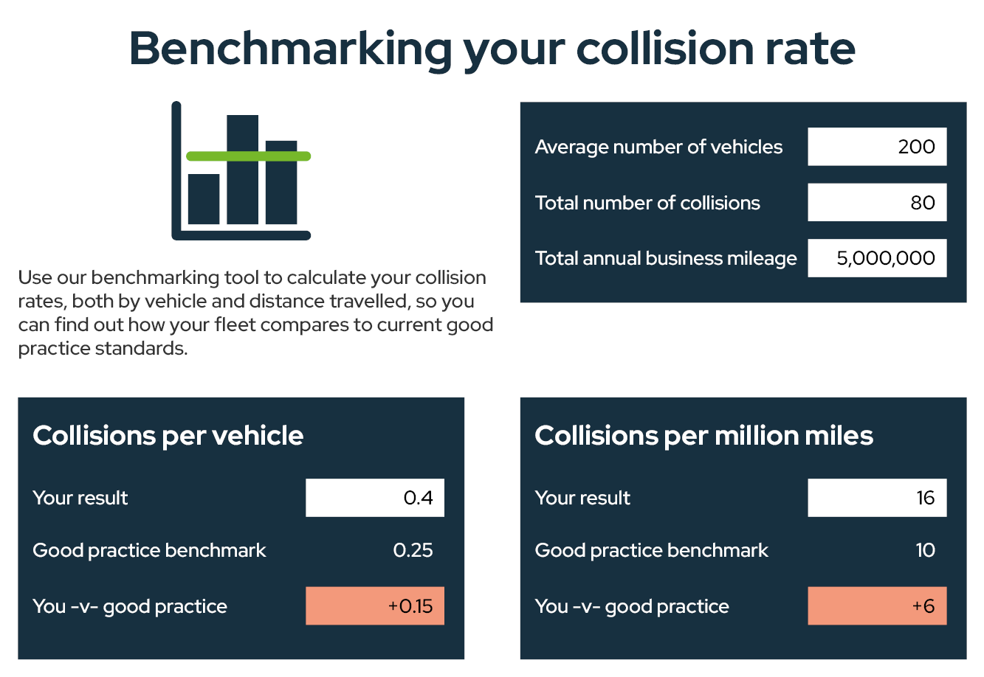
Free resources for CCS contractors
Understanding + solutions = Higher levels of compliance
Online DfW policy builder
Driving for work
risk management gap analysis
Compliance vs good practice
Online benchmarking of collision rates

Slide 15
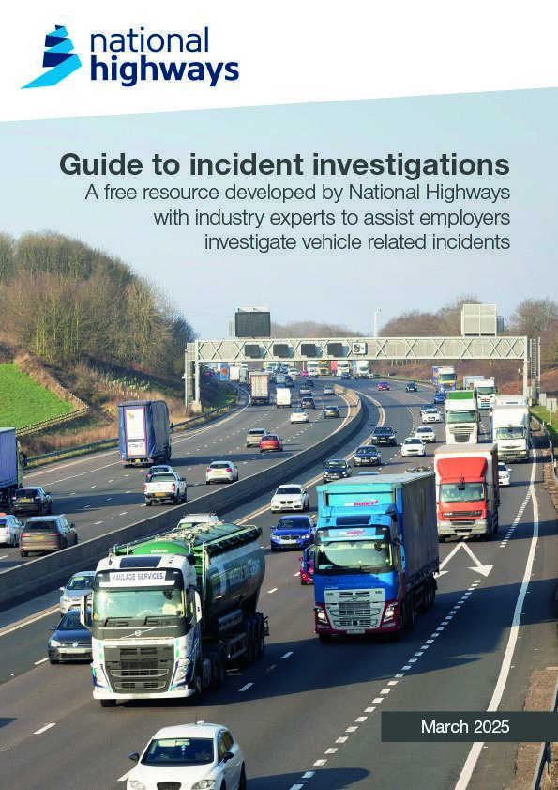
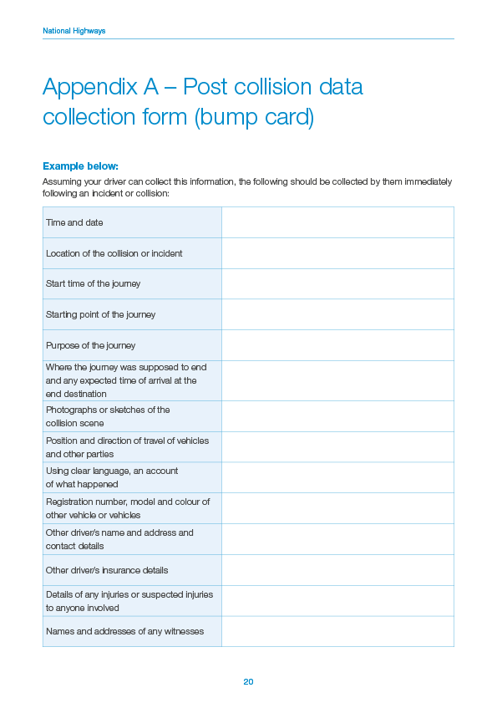

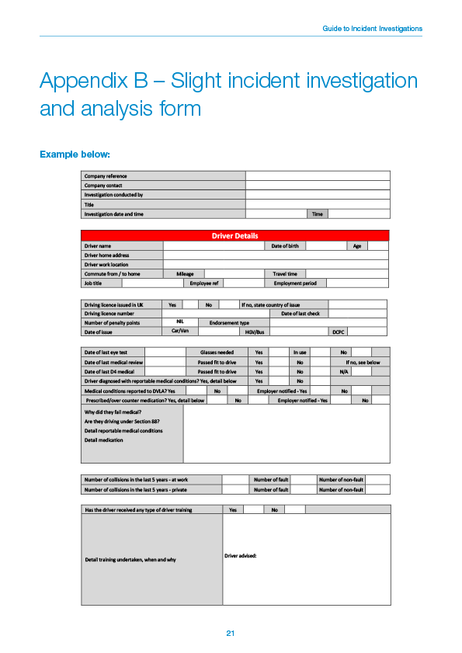
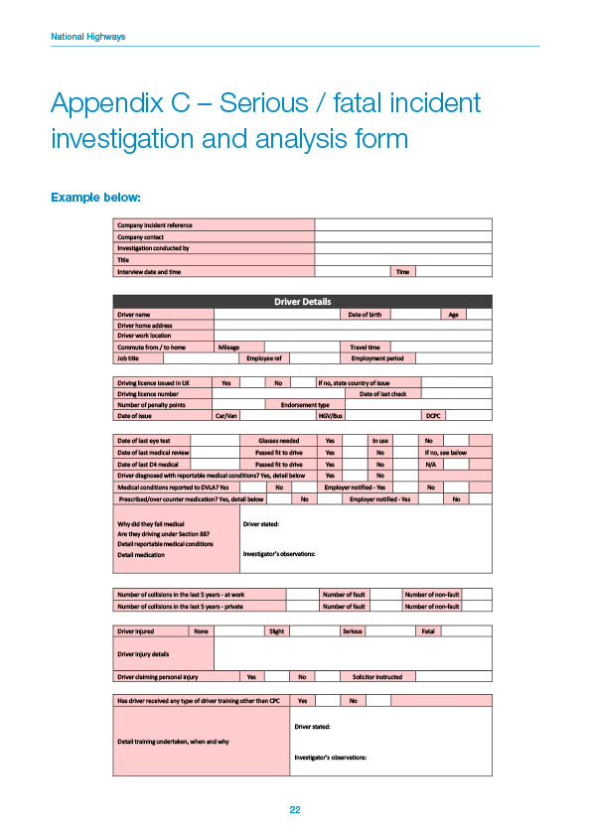
Free resources for CCS contractors
Understanding + solutions = Learnings from incident investigation
Incident investigation guide
20 pages + templates + case studies
developed in collaboration with
Currently being
expanded

Slide 16
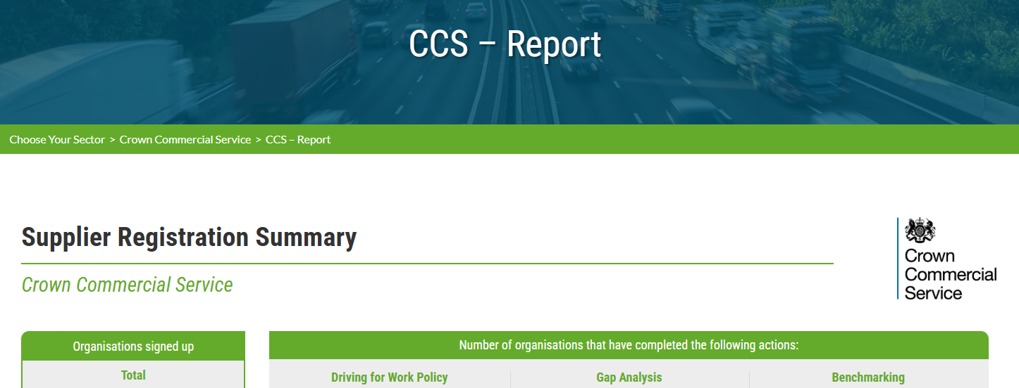
Remember, 3 key areas

Slide 17
Key next Steps:
Register via the CCS link
Crown Commercial Service - Driving for Better Business
Confirm your Driving for Work Policy status
Complete the Gap Analysis
Benchmark your incidents
Engage with your CCS contact

Slide 18
Financial viability risk assessments
Mark Pepperell

Slide 19

What is a Financial Viability Risk Assessment?
This session will cover:
Context - The Playbooks
Financial Information collected
Financial Metrics and Bidder Narrative
Evaluation of an FVRA

Slide 20


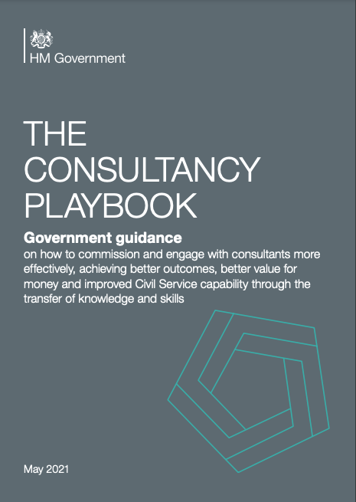
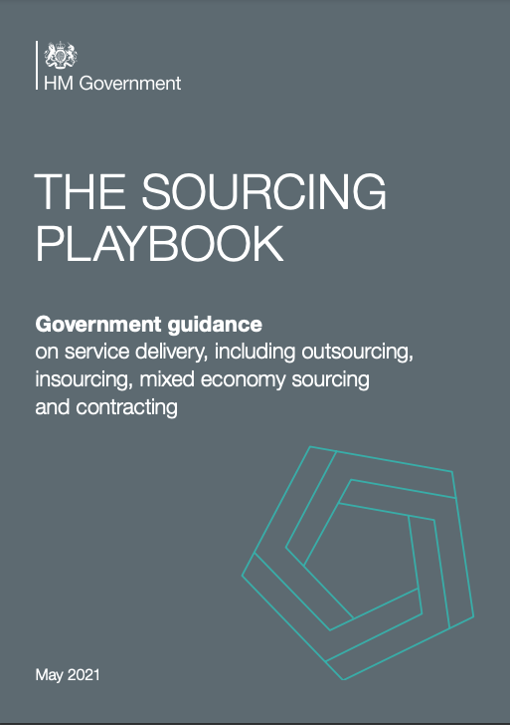
Playbooks - Economic & Financial Standing (EFS)
The sourcing playbook has 11 key policy reforms
Requirement for Pilots
Publication of Commercial Pipelines
Risk Allocation
Market Health & Capability Assessments
Pricing & Payment Mechanisms
Project Validation Reviews
Resolution Planning
Delivery Model Assessments
Key Performance Indicators
Should Cost Modelling
Assessing Economic & Financial Standing

Slide 21
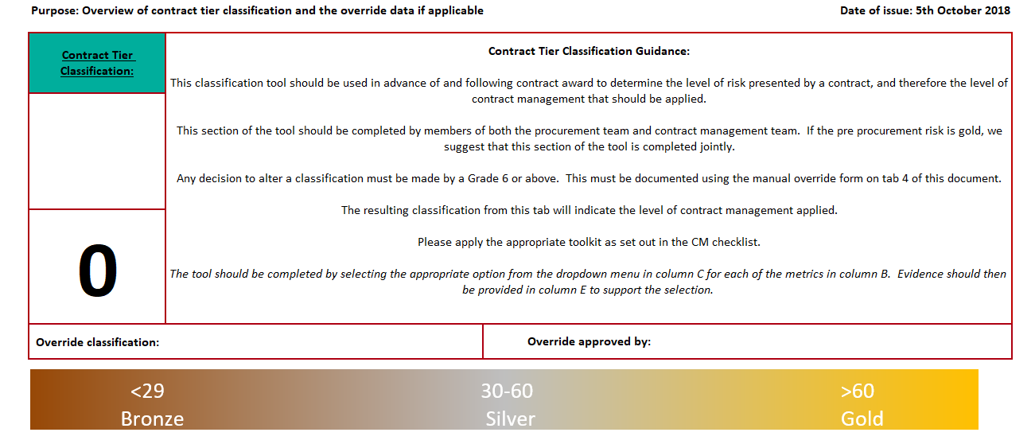

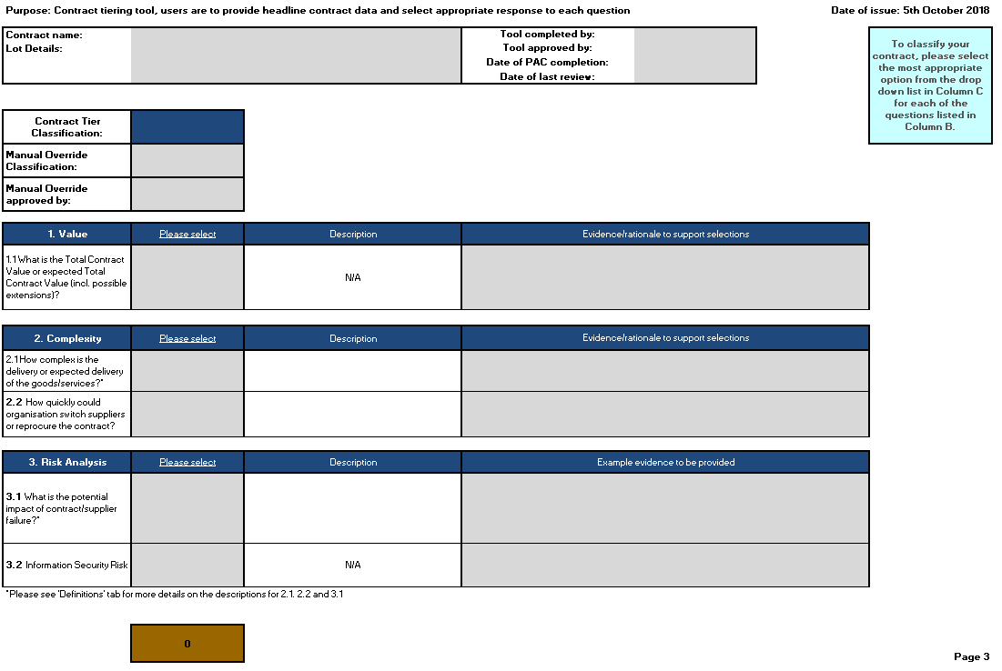
EFS - Risk Tiering
Commercial Finance engage with Category throughout the CAAAB process to identify the risk appetite and design EFS selection criteria.
Tiering Tool
Bidders sifted against D&B threshold
Fewer Metrics
Lower Metric Thresholds
All bidders
subject to assessment
Increased Metrics
Higher Metric Thresholds
All bidders
subject to assessment
Increased Metrics
Higher Metric Thresholds
Value
Complexity
Reprocurement
Impact of Failure
Sensitivity of Information

Slide 22
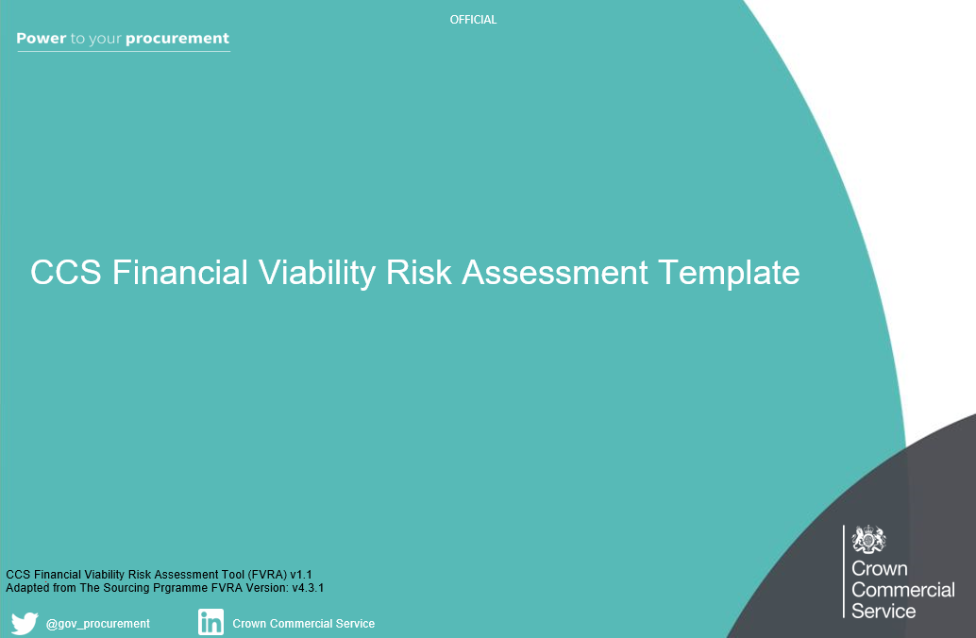

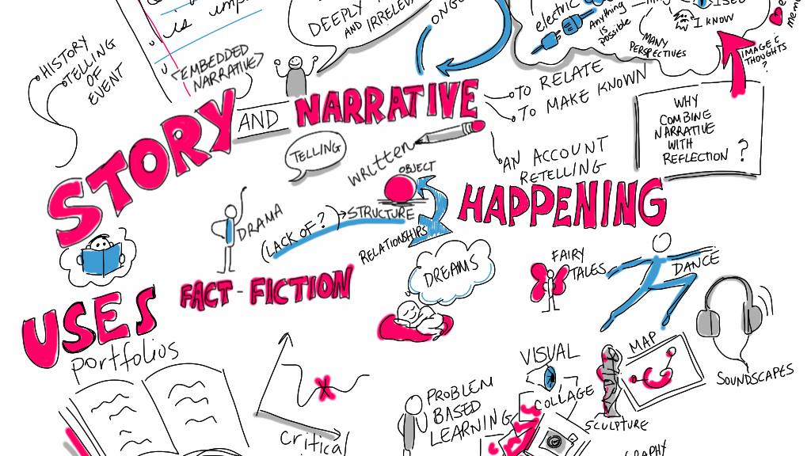
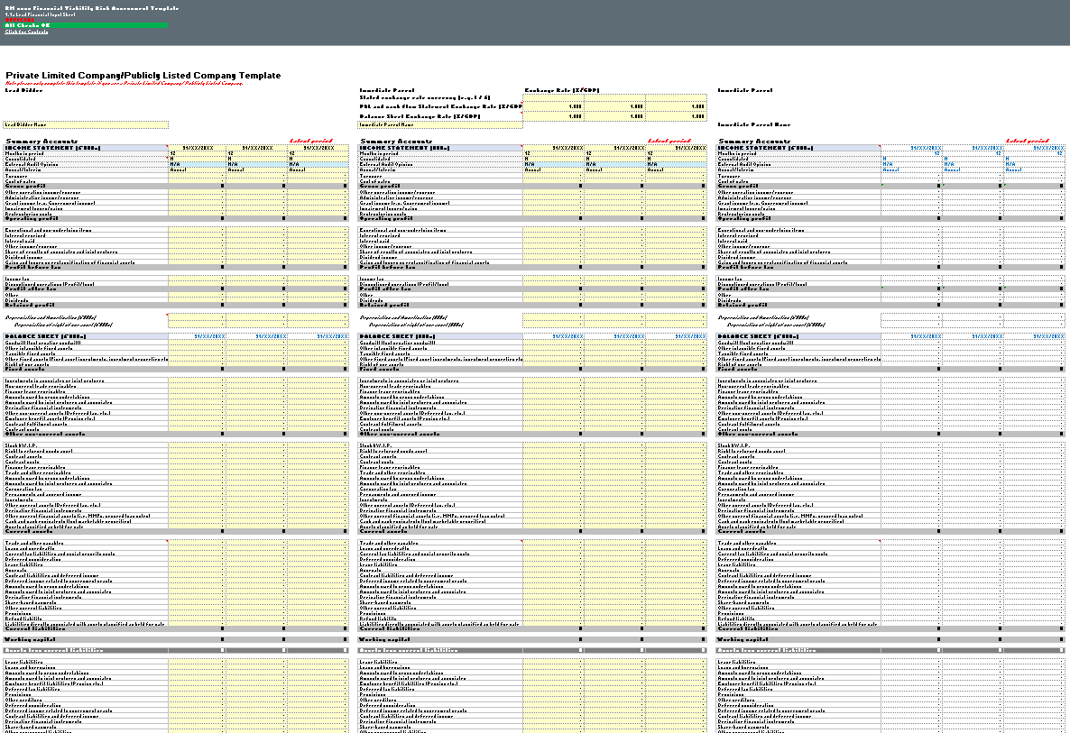
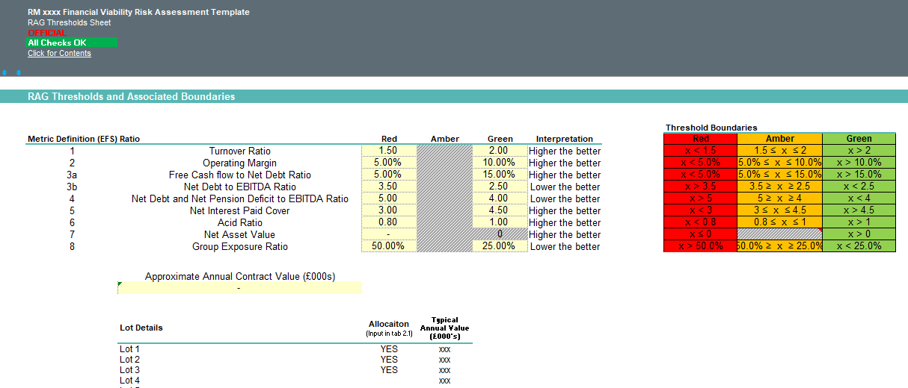



Playbooks - The FVRA Tool
The Financial Viability Risk Assessment (FVRA) tool is the prescribed tool for assessing financial risk.
Financial metrics and expectations clearly communicated
Bidders can provide commentary to mitigate RAG outcomes
Bidders Populate Tool
Bidders see initial outcome before submission
Can review upto 3 entities

Slide 23
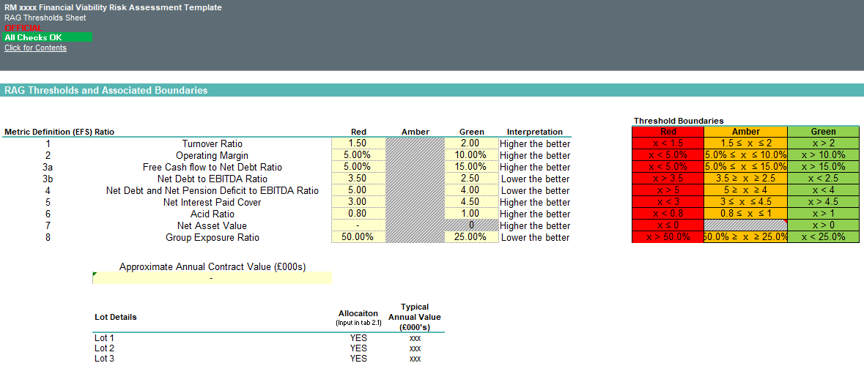
FVRA - Ratios and Thresholds
The FVRA uses defined financial metrics with recommended thresholds, thresholds have different recommendations for sectors, i.e construction.

Slide 24

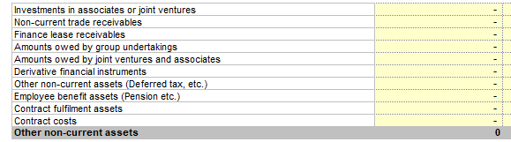
FVRA - Input
The FVRA collects detailed financial information for use in analysis.

Slide 25
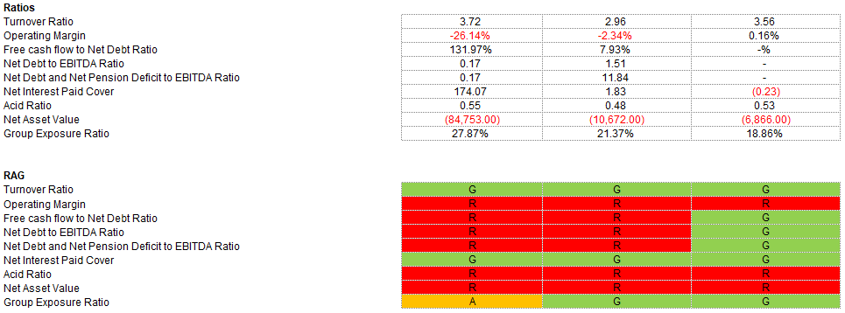
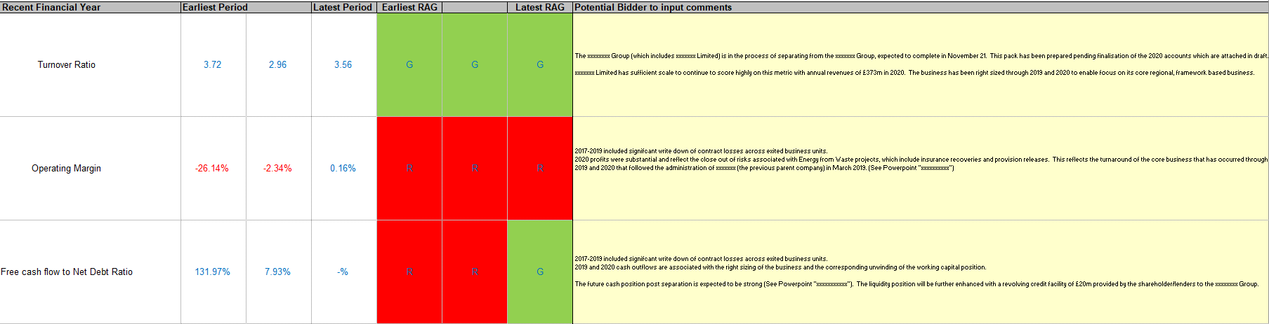
FVRA - Bidder mitigating commentary

Slide 26
FVRA - Output
The analysis can result in one of three outcomes
The financial risk is within an Acceptable amount.
The bidder should continue though the tender process
Acceptable
There is some material risk, however it may be mitigated.
Clearly state the suggested mitigation, typically a Guarantor.
Other approaches may include open book accounting, scheduled cashflow reporting or other information sharing relevant to the risk
Acceptable with Mitigating Actions
The financial risk assessed is to high for the procurement.
The bidder shall not proceed through the remainder of the tender, mitigations will not be considered.
Unacceptable

Slide 27



Tips for completing an FVRA
It's your tender, demonstrate your financial health with a comprehensive FVRA
FVRA Submission
If the FVRA is not submitted this will result in a non-compliant tender
Supporting Information
Remember to provide information to support figures entered into your FVRA
Bidder Commentary
Make sure to use the opportunity to provide additional narrative against the metric outputs

Slide 28
PPN 006
Carbon Reduction
Plans
Marta Hyder

Slide 29

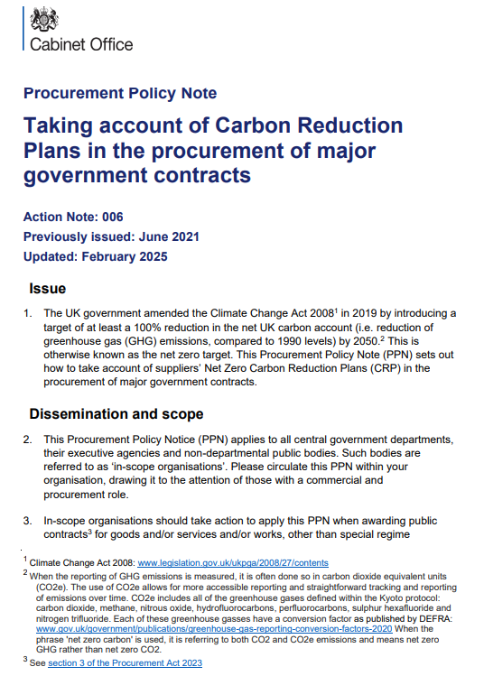

Procurement Policy Note (PPN) 006
Resources available on the PPN 006 website.
PPN 006 live 24th February 2025
previously PPN 06/21
Procurement Policy Note 006
Technical Standards on Creating your CRP
Guidance on Adopting and Applying
Carbon Reduction Plan Template

Slide 30

Scopes 1,2,3 required for your Carbon Reduction Plan:
Scope 1: ENERGY
Scope 2: ELECTRICITY
Scope 3: SUPPLY CHAIN

Slide 31


Scope 1 - Energy - Direct Emissions
Direct emissions from companies owned assets or controlled sources. Include on-site Energy sources like Natural Gas, Fuel and Refrigerants, Combustion in Boilers and Furnaces.
Emissions from all company Fleet vehicles (vans, trucks, cars, helicopters) - increasingly reducing as alternative fuels enter market

Slide 32

Scope 2 - Electricity - Indirect Emissions
Scope 2 Indirect GHG emissions arise from the purchase of Energy. Primarily in the form of Electricity &, Cooling
These are generated off-site and purchased by your company. They are indirect because they are produced by someone else, but you use them.

Slide 33

Scope 3 - Supply Chain - Upstream and Downstream
Scope 3 is all about how a product or service gets to you, and subsequently what is done with it thereafter.
These emissions are not under your direct control, hence why not easily actionable.
A way to reduce these emissions is to work with your Supply Chain to change how they manufacture (for example, Green Steel), or find an alternative supplier who may make something differently (i.e Paper Bags instead of Plastic)

Slide 34
Practical Scope 3 Examples: Precursor to your CRP
4. Upstream transportation and distribution (U)
Measure of the emissions associated with getting products and services purchased by your company to your facilities, sites or offices by a Third-Party (i.e. not you directly)
5. Waste generated in operations (U)
Waste in tns/kg from your facilities in the year - Normally provided by waste contractor
6. Business Travel (U)
Tube, Bus, Train, Air travel* - Normally tracked through expenses / commercial - Not commuting
7. Employee Commuting (U)
Travel from home to workplace (bus, car, train) - include days per week and number of people
9. Downstream transportation and distribution (D)
Of products sold by your company and how they arrive with the end user including retail and storage
Notes:
https://assets.publishing.service.gov.uk/media/67b334c67c070e71525f5818/PPN_006_Technical_standard_for_Completion_of_Carbon_Reduction_Plans.pdf - arrange numbers as per technical standards

Slide 35

We understand that reporting Scope 3 categories
may be challenging…
You must report against all Scope 3 categories defined in the Technical Standards. The relevant narrative is needed when any of them is not applicable or in the process of being measured.
You are free to use any category out of the total of 15.
Working From Home is reported under Employee Commuting
One overall number is acceptable (for example 1,000tns CO₂e) although breakdown into categories is highly encouraged.
.
Check the below guidance:
Technical standard for Completion of Carbon Reduction Plans
Greenhouse Gas Protocol - Technical Guidance for Calculating Scope 3 Emissions

Slide 36
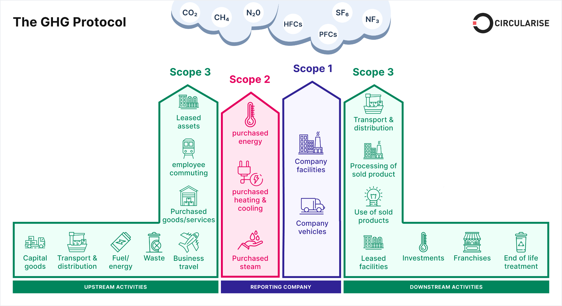
PPN: 006 Scope and Emissions
DOWNSTREAM activities: Arise from use and disposal of said product or service
UPSTREAM activities: Arise from business products or services getting to market
Additional resources
Variety of GHG Tools
GHG Protocol for Scope 1, 2 and 3

Slide 37

Transparency
Narrative
Principles of a Compliant CRP
Diligence
Perspective
Accountability

Slide 38
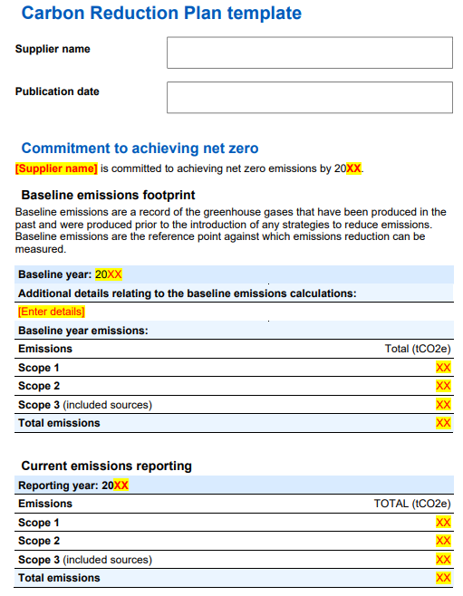
Your Publication date must be within 12 months to enter the procurement process.
Your commitment to achieving Net Zero by 2050 (or earlier).
Baseline emissions are the emissions calculated for the first time, before any improvements and reductions solutions.
Current emissions is a complete 12 month cycle.
Should be within no more than 18 months to enter the procurement process.

Slide 39
Your Publication date must be within 12 months to participate in tender
Start and end months are for all reporting periods must be aligned.
Your commitment to achieving Net Zero by 2050 (or earlier).
Baseline emissions are the emissions calculated for the first time, before any improvements and reductions solutions.
Your baseline and current reporting year can be the same, if this is your first year of reporting or if you decided to rebaseline
Current emissions is a complete 12 month cycle.
Should be within no more than 18 months to enter the procurement process.
Be honest - for various reasons it may happen that your current emissions are higher

Slide 40
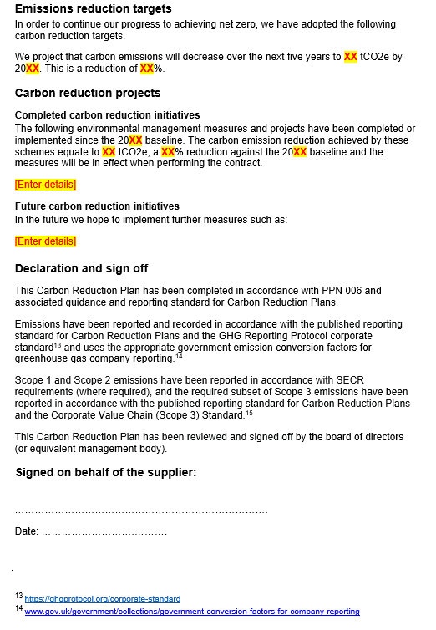
Reduction targets you think you can achieve. You may want to define intermediate targets.
Measures and projects that you have put in place your ongoing initiatives and future ambitions.
Narrative is key!
Signed off by a Director (or equivalent senior leadership), and dated along with the full name and position of the signatory. Doesn’t need to be a “wet” signature.
Recommendation: Your CRP shouldn’t exceed 10 pages

Slide 41
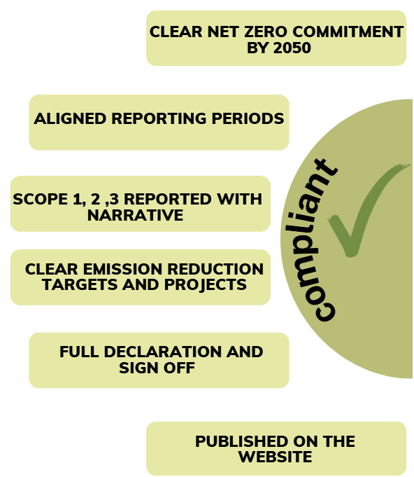
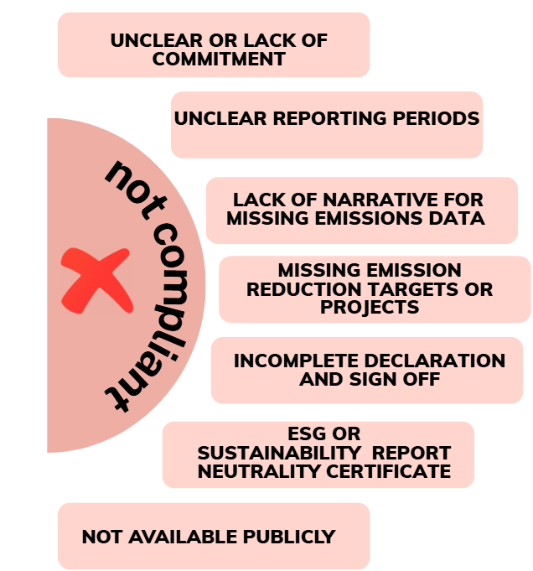

Slide 42
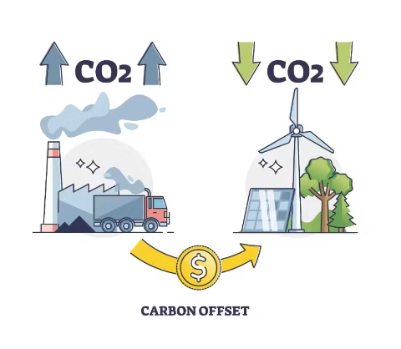
Carbon Offsetting / Neutrality
The need of the Climate is to reduce Carbon, to move away from Fossil Fuels, and to re-shape our economy to changing to cleaner and greener ways of working, for example Renewable Energy
For this reason therefore, we do not accept Carbon Offsets as being equivalent to actually reducing Carbon
Carbon Offsetting credits and Carbon Neutral certificates are not the same as actually reducing Carbon through the Carbon Reduction Plan process

Slide 43



Carbon Reduction Schedule
Procurement Policy Note 016 Carbon Reduction Contract Schedule
Its purpose is the reduction of contract-level GHG Emissions and supporting the UK
government's commitment to achieve the Net Zero Target by 2050.
Optional Carbon Reduction Schedules are now included in our new agreements
Customers can produce industry and contract specific objectives to monitor and reduce emissions throughout the life of the contract.
Customers can include wider sustainability requirements
Check the example contract template here
Please ensure to refer to the actual framework you wish to bid on as the template is always adapted for the market.

Slide 44

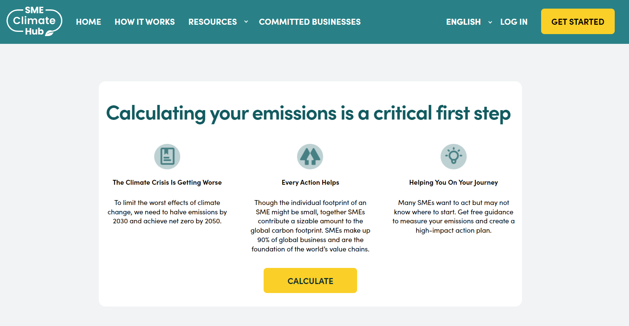
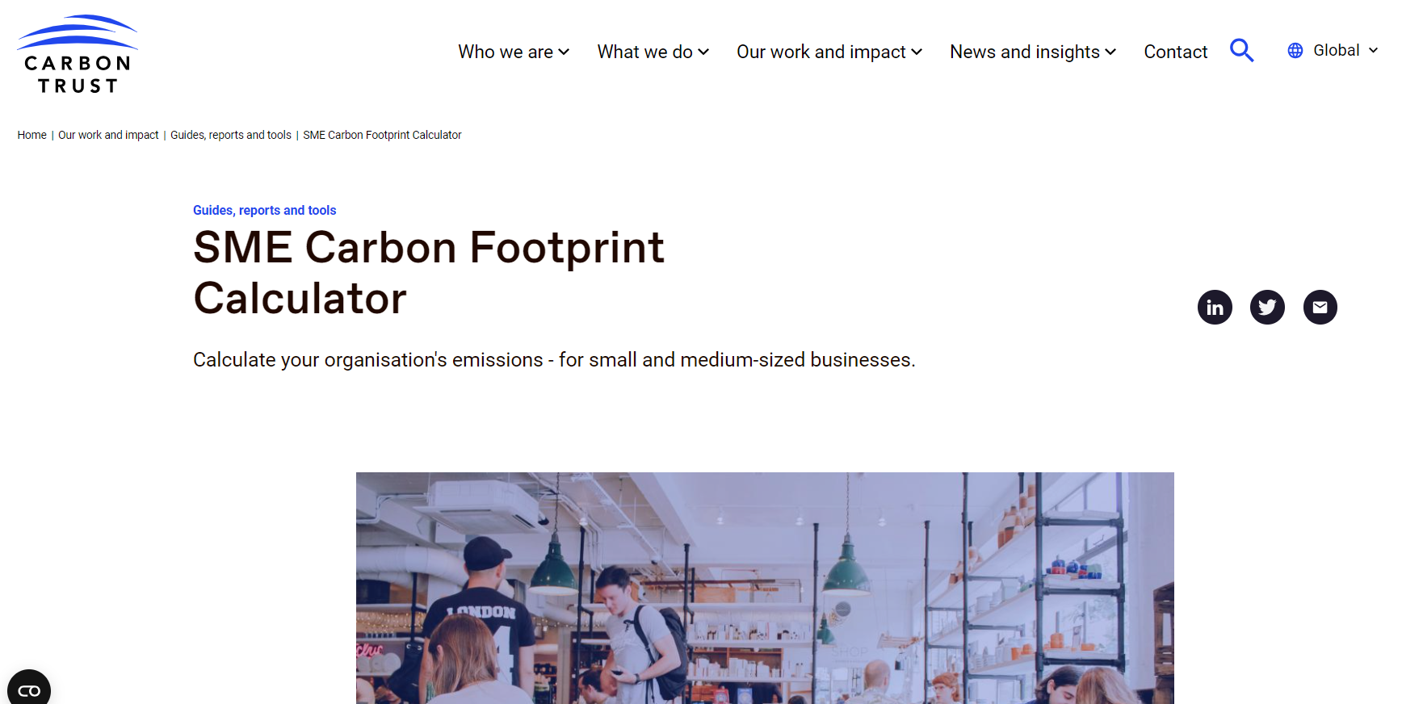
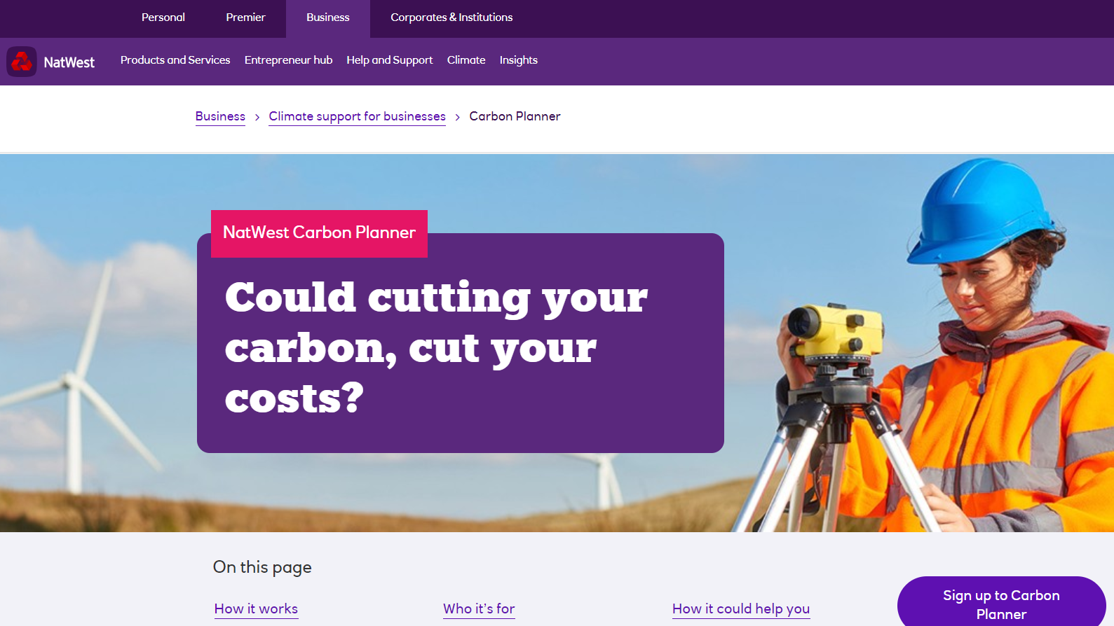
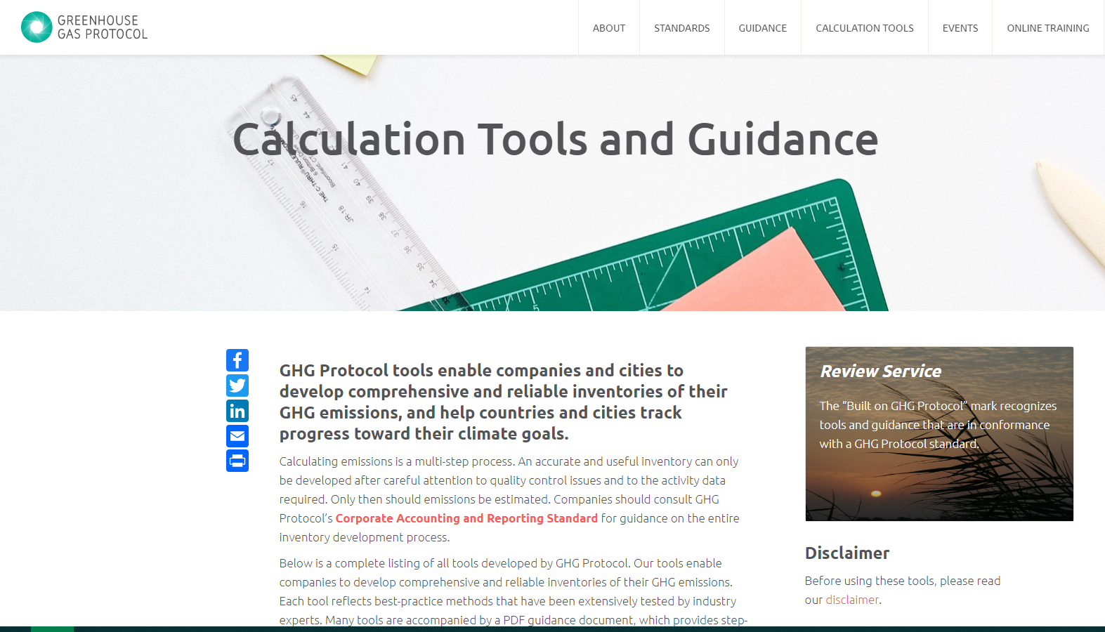
UK Business Climate Hub
https://businessclimatehub.uk/
SME Climate Hub
Aimed at SME’s
Developed with Google
Carbon Trust
Aimed at SME’s
Includes Scopes 1+2
NatWest Carbon Planner
Aimed at all UK Businesses
Developed with 2,000 organisations
GHG Protocol Calculator
Aimed at large businesses and government
Excel spreadsheets and sector differences

Slide 45



Thank you
Marta Hyder
marta.hyder@crowncommercial.gov.uk
CRP Mailbox
CRP@crowncommercial.gov.uk

Slide 46
Prompt
Payment
Tom Garbutt

Slide 47
Prompt Payment Policy
Procurement Act 2023:
Clauses 68 and 73 automatically imply the requirements to include 30 day payment terms into any contract and subcontract used to deliver goods or services to the public sector - For CCS this is found in the Public Sector Contract.
Invoices must be paid within 30 days from the point of receipt, in line with private sector reporting.
Public sector organisations must publish their payment performance on an annual basis.
Payment Compliance Notices must be published every six months detailing compliance with paying invoices within 30 days from receipt.
Notes:
The Procurement Act 2023 came into effect on February 24th 2025 and features updated clauses that automatically imply 30 day payment terms into all public sector contracts, and subcontracts for goods or services. CCS implements this in all contracts used for our frameworks, including our standard T&Cs - the Public Sector Contract (PSC for short).

Slide 48
PPN 015 came into effect and replaced PPN 10/23 on 24th February 2025. It must be included in the Selection Questionnaire for any contract valued above £5m per annum, including frameworks with expected call-offs exceeding this value.
It requires suppliers to demonstrate they have effective payment systems by:
1. Paying at least 95% of their invoices within 60 days of receipt, or pay at least 90% of invoices within 60 days and submit a detailed action plan on how they will improve.
2. Paying all of their invoices within an average of 55 days.
A supplier must provide evidence it has met both of these criteria during at least one of the two previous six-month reporting periods, otherwise they will be unable to bid for government contracts. Evidence may be provided using Payment Practice Reports published under the Reporting on Payment Practices and Performance Regulations 2017.
PPN 015
Notes:
PPN 018 came into effect on October 1st 2025 and applies to frameworks advertised on or after this date. PPN 018 is unique from other PPNs in that it states that ‘advertised’ refers to the publication of a UK2 or UK3 notice. As the UK2 notices for the Fleet frameworks this session relates to were published before October 1st 2025, PPN 015 will still apply instead of PPN 018 and its updated requirements.

Slide 49
Cyber
essentials
David Pyle

Slide 50
What is cyber essentials?
Cyber Essentials is a Government-backed scheme launched in 2014 by the National Cyber Security Centre and accredited by IASME. The main goals of Cyber Essentials are to:
improve cyber hygiene
raise awareness
protect supply chains
set a baseline standard
Cyber Essentials was created in response to:
the growing threat of cyber attacks, including malware, ransomware, phishing and hacking
the need for a standardised framework UK organisations can follow to protect sensitive data
government interests in ensuring that its contractors/suppliers meet minimum security standards to protect national interests
Notes:
Improve cyber hygiene: To help businesses and organisations implement basic but critical security controls to reduce the risk of cyber attacks.
Raise awareness: To promote awareness of cyber security risks and encourage proactive protection.
Protect supply chains: To ensure that companies in a supply chain have a minimum level of cyber security assurance.
Set a baseline standard: To establish a clear, government-recognised benchmark for essential cyber security practices.

Slide 51
Cyber essentials basic
the Cyber Essentials scheme represents the Government’s minimum cyber security baseline standard for UK organisations
it demonstrates that an organisation is protecting itself by implementing the most important cyber security controls
to obtain a certification, organisations complete a self-assessment questionnaire, and assess themselves against five technical security controls
the self-assessment questionnaire must be signed off by a board member or equivalent
a qualified assessor verifies the information provided and awards the certificate accordingly
Notes:
Holding a valid Cyber Essentials certificate is a mandatory requirement for inclusion on CCS frameworks.

Slide 52
The five technical controls
firewalls
secure configuration
security update management
user access control
malware protection
Notes:
Firewalls: A firewall is the generic name for a piece of software or a hardware device which provides technical protection between network devices and the Internet. An organisation will have physical, virtual or software firewalls. Software firewalls are included within all major operating systems for laptops, desktops and servers and need to be configured to meet compliance. Firewalls are powerful devices, which need to be configured correctly to provide effective security. A firewall is a security measure that helps protect a network by acting as a barrier between trusted devices and the internet. It can be a physical device, a software program, or a virtual tool. Firewalls need to be properly set up to effectively block unauthorised access and keep your systems safe.
Secure Configuration: Computers and cloud services are often not secure upon default installation or setup. An ‘out-of-the-box’ set-up can often include an administrative account with a standard, publicly known default password, one or more unnecessary user accounts enabled (sometimes with special access privileges ) and pre-installed but unnecessary applications or services. All of these present security risks.
Security Update Management: The practice of ensuring that all software is up to date with the latest security updates. If an organisation’s in-scope devices are using an operating system which is no longer supported (For example Microsoft Windows XP/Vista/2003/Windows 7/Server 2008, MacOS High Sierra, Ubuntu 17.10), and you are not being provided with regular updates from the vendor, then they will not be awarded certification. Mobile phones and tablets are in-scope and must also use an operating system that is still supported by the manufacturer.
User Access Control: It is important to only give users access to the resources and data necessary for their roles, and no more. All users need to have unique accounts and should not be carrying out day-to-day tasks such as invoicing or dealing with e-mail whilst logged on as a user with administrator privileges which allow significant changes to the way your computer systems work.
Malware Protection: Malware (such as computer viruses) is generally used to steal or damage information. Malware is often used in conjunction with other kinds of attack such as ‘phishing’ (obtaining information by confidence trickery) and social network sites (which can be mined for information useful to a hacker) to provide a focussed attack on an organisation. Anti-malware solutions (including anti-virus) are available from commercial suppliers, some free, but usually as complete software and support packages. Malware is continually evolving, so it is important that the supplier includes detection facilities which are updated as frequently as possible. Anti-malware products can also help confirm whether websites you visit are malicious.

Slide 53
Useful links
IASME website
Cyber essentials question set
FAQs

Slide 54
Closing remarks

