Slide 1
Construction Works & Associated Services 3
Northern Ireland
Notes:
Martin
Good afternoon everyone. Welcome to our presentation on the Construction Works & Associated Services 3 Framework, focusing specifically on the opportunities and details relevant to Northern Ireland. This new framework, CWAS3, represents a significant development, and we are excited to walk you through its key features, success of the current framework to date, and what it means for your projects here.
Lets start with some introductions im Martin Regan a Commercial Manager on the CWAS 2 Framework supporting clients from the health and devolved sectors …….hand to shelley
hand to damian hand to Clare

Slide 2
Thank you for joining us
This webinar is not being recorded but the slides will be available to download from our CWAS 3 webpage.
No use of AI software permitted for this session
Please see our website for Q&A’s which have been recently added
This event is primarily for prospective bidding organisation, any 3rd party bid writers will need to leave the session.
Welcome & housekeeping
Notes:
Martin
The webinar is not being recorded but the slides will be available to download from our CWAS3 webpage, here you will find a lot more information on the procurement and expectations so I would actively encourage you to take a look at this,the link is at the end of the presentation.
Unfortunately CCS policy means that AI is not permitted to record or notetake this session. Please if you have an AI assistant activated could you deactivate it now, if it starts coming up in the chat (as they do) then I will have to remove you from the meeting and that’s really not what something I want to do.
Third party bid writers are also not allowed to join , unfortunately this has been policy on this framework and we need to maintain that.
On Q&A because of the proximity to the release of the ITT we will not be answering any questions during today's webinar. . However to assist we have extracted some previous CWAS3 published Q&A that we felt would be specifically relevant to yourselves and we will go through these towards the end of the presentation.

Slide 3

Unlocking value for the nation
Providing value for the nation
We guide public sector buying decisions using our unique scale and commercial knowledge.
Combining our expertise with data helps us understand your unique challenges, enabling us to create a simpler, better procurement experience.
This helps you get best value from your commercial activity.
Customers achieved commercial benefits worth more than £5.3 billion, compared to current market comparators in 2024/25.
We guide public sector buying decisions using our unique scale and commercial knowledge.
Combining our expertise with data helps us understand your unique challenges and allows us to create a simpler, better procurement experience
This realises value beyond cost savings.
Customers achieved commercial benefits worth more than
£5.2 billion, compared to current market comparators in 2023/24
Notes:
CCS - Largest Procurement Organisation in the Uk
CWAS largest proc framework is also the largest in terms of value in the UK and CWAS3 the framework we will shortly talk about will be the worlds largest construction framework when it launches.
We help Public sector organisationss across eng/scot/wales and NI save time/money. Typically the projects we see coming through the framework are schools, hospitals, defence etc but the scope of what we cover is huge.
In terms of Delivering value for the nation we achieved 5.3bn in commercial benefits in 24/25

Slide 4
Construction Works & Associated Services (CWAS)
RM6088
7 year £30bn OJEU Framework Live: Oct 2019 - Mar 2027
11 Lots
Flexible structure is designed to meet all procurement routes (direct award / competition), tendering methods (single / two-stage), design methodologies and payment arrangements.
All of the most commonly used standard forms of contract are available at call-off (see Schedule 5 of the FAC-1)
Simplified, pre-agreed capped rate cards (OHP & Labour)
Advanced alliancing capability via FAC-1
Free to use for Clients; market-leading 0.2% supplier levy
Notes:
Martin
The current framework iteration is Construction Works and Associated Services RM6088 and this came to market in October 2019 and will remain live until March 2027. It contains 11 main lots and a number of sub lots. The lots relating specifically to Northern Ireland range from zero to 80 million. On the RM6088 framework there are currently 109 suppliers.
The benefits of the framework include;
A pricing structure which is a Capped Overhead and Profits plus Fee percentages - and then Hourly rates for staff, design and site labour costs
Speed of access to market
Flexibility in procurement / contracting
Free to use for Clients which is a huge benefit but on the supplier side it's also a market-leading 0.2% levy
Simple tender shortlisting facility and we provide guidance on this via our buyers guide
Direct Award or Competitive Award, again the methods for this and scenarios are provided within the buyers guide.
Supported by a highly qualified procurement and technical support team who work with Clients from the outset to achieve best outcomes

Slide 5
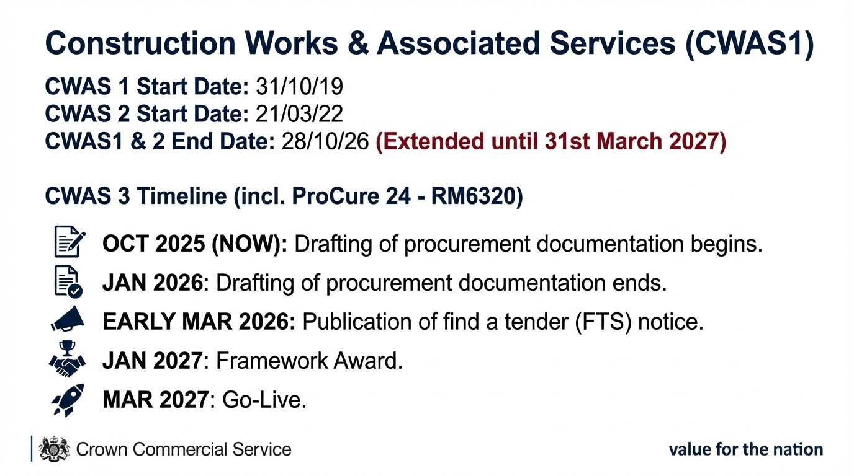

Notes:
Martin
To give you a little background on the framework’s progression, Construction Works and Associated Services launched in October 2019 and achieved success very quickly. This rapid growth soon necessitated the launch of CWAS2 in 2022, primarily because the £80 million-plus lot reached its capacity much faster than we anticipated.
With the launch of CWAS2, we were also able to incorporate NHS England’s ProCure framework, which is the preferred route for their large construction projects, or any health-related construction projects, for that matter. I haven’t touched on CWAS2 mainly because lots 1 - 3 are primarily for NHS England, lot 4 airfields and lot 5 projects over 80 million. CWAS 2 will now expire at the same time as CWAS1 and both frameworks along with Offsite Construction will become CWAS3.
In terms of actual spend going through the framework its currently around £2.5bn a year
Looking ahead, the new iteration, CWAS3 is set to be the world's biggest value construction framework to date at its launch and we anticipate the award taking place in January 2027 as long as we hit all the dates starting with the ITT release

Slide 6
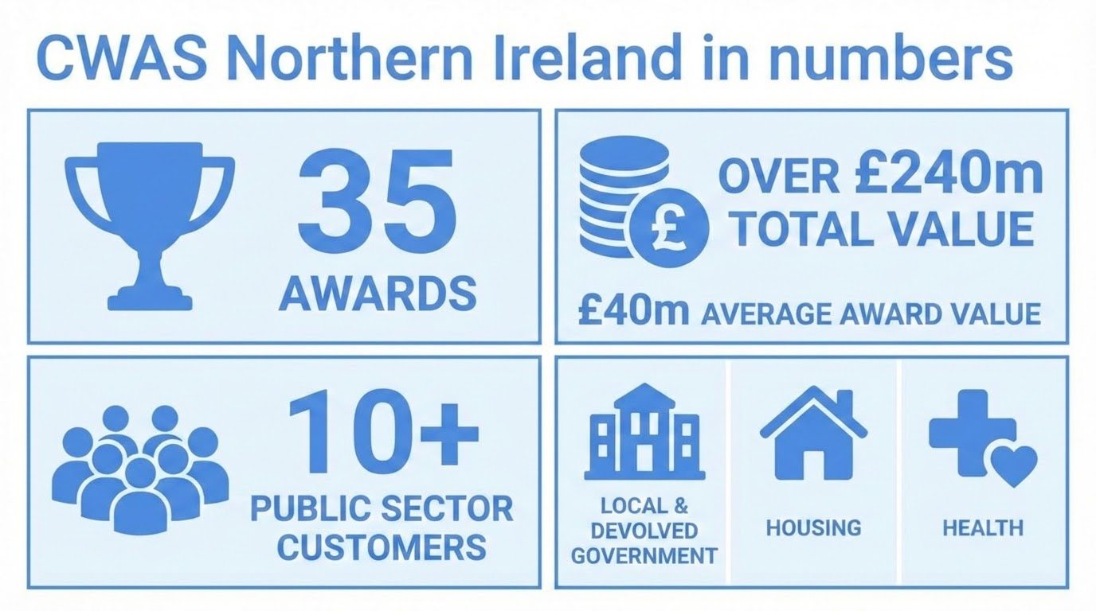
Notes:
Martin
As you can see on the screen, the data displayed highlights the significant traction we've gained in Northern Ireland since the launch of the first Construction Works and Associated Services framework back in 2019
However, while these numbers are positive, they also clearly indicate the substantial growth and further opportunities that lie ahead for us.
A key factor in unlocking this potential growth is strengthening our supplier representation, and this is where all of you come in - as some customers are more inclined to use the framework if some of the contractors here today are represented.
Hand over to Damian

Slide 7
CWAS3
Devolved
Notes:
Damian 7 - 12
Thank you. Now, let’s move our focus from the current framework to the exciting CWAS3 Framework and the opportunities it represents, specifically in Northern Ireland.
This new iteration is a huge step forward, and we're keen to outline the potential benefits for everyone involved.

Slide 8
CWAS3 Framework Considerations
Framework length & type (Value) | 8 year Closed framework agreement (£120bn)
Lotting structure | Value & regionally driven sub-lots / thematic options led by customers Scope of service broad across all Lots, with client / sector Lots tailored to specific requirements
Framework indexation | 1 year intervals (1 year from framework start date)
T&Cs | FAC-1 Standardisation and Procurement Act updates Liability, insurances and exclusions Call off conditions - Standard NEC/JCT/PPC/SBCC
Specification | Merged and simplified into one single document. Supporting Annexes for client specific requirements
Pricing | Construction - Fee % and Design, management and Labour shift rates. Offsite - Fee %, £m2 and £/Unit purchase and hire rates Project level / in-contract pricing determined by the customer under call-off contract
Insurances and accreditations | Employers Liability: £10m (all) Public & Product Liabilities: £10m construction / £5m offsite Professional Indemnity: £3m construction contracts <up to £5m & £10m construction contracts >£5m / all offsite contracts
Financial | Use of FVRAs. These levels may vary based on Lot value
Success Measures | Framework level success measures Quality, Cost, Time, and some Social Value. Customers can also develop their own project specific success measures.
Notes:
Damian
Transition to CWAS3: We are moving into the CWAS3 framework, building on the success of CWAS 1 and 2. And I want to highlight some of key features and considerations
Framework length - 8 year closed framework - est value £120bn
Merged with our Offsite framework - to bring more choice and flexibility to our customers
Retained regional value banded lots, but broken down into smaller regions - will show in a moment. Bigger focus on the civils - and we will also retain thematic based lots as well - for example defence and health.
Framework is based on the Framework Alliance Contract again - and call off terms will be standard forms of contract NEC/JCT/PPC as well as SBCC.
In terms of pricing - remains the same as before with fee% and rates for management and labour for construction as well as Fee %, £m2 and £/Unit purchase and hire rates
The slide also shows the annual requirements in those areas that suppliers are required to have & maintain;
Procurement Flexibility: As with the current CWAS framework, supporting all procurement routes (direct award/further competition) and tendering methods to meet diverse client needs.
Lets now look at the annual requirements of you.

Slide 9
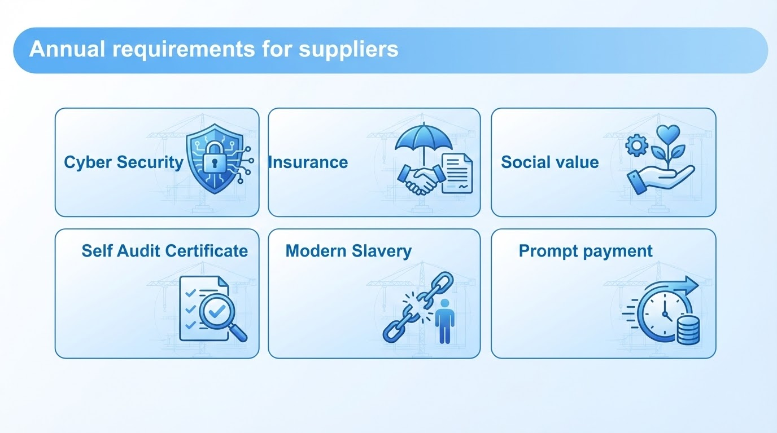
Notes:
Framework alliance members are required to have & maintain;
cyber essentials (Basic) certificate, an enhanced or plus version for defence lots
Professional Indemnity, Public Liability and Employer Liability insurance to specific values and they will be proportionate to company size
PPN 002 - Suppliers across all lots will be required to complete and submit an annual social value return
Suppliers must prepare and submit an annual self audit and assurance certificate.
PPN 02/23 Suppliers must provide CCS with an annual report stating the steps the organisations has taken to prevent slavery and
human trafficking within its supply chain. This is done via a portal
PPN 10/23 - Applies to central government contracts over £5 million. Bidders to demonstrate they are paying
95% of invoices within 60 days (90% with an action plan), and also paying all their invoices within an average of 55 days

Slide 10
CWAS3 Lot Structure
Lot 1 - Construction Works - General Construction
Lots Places
1.1 <£5m 12 UK sub regions 8-12
1.2 £5 - £20m 6 UK sub regions 12
1.3 £20 - 40m 6 UK sub regions 15
1.4 £40 - 100m 3 UK Sub regions 15-20
1.5 £100M - £250m 1x UK Delivery 15
1.6 >£250M 1x UK Delivery 15
Lot 4 - ProCure 24
Lots Places
4.1 < £50m 1x England 20
4.2 £50 - £150m 1x England 15
4.3 £150m > 1x England 10
Lot 5 - Defence
Lots Places
5.1 General Defence <£20m 15
5.2 General Defence £20m> 12
5.3 General Defence SW Region 5
5.4 Maritime 1x UK Delivery 6
5.5 Airfields 1x UK & Overseas 5
5.6 USVF 1x UK Delivery 6
5.7 Defence Nuclear 1x UK Delivery 8
Lot 2 - Civil Engineering & Infrastructure
Lots Places
2.1 <£5m 12 x UK sub regions 8-12
2.2 £5 - £20m 6 x UK sub regions 12
2.3 £20 - 40m 6 x UK sub regions 15
2.4 £40 - 100m 3 x UK sub regions 15-20
2.5 £100M - £250m 1x UK Delivery 15
2.6 >£250M 1x UK Delivery 15
2.7 Demolition 1x UK Delivery 15
Lot 3 - Offsite Solutions
Lots Places
3.1 <£10m Built Estate 1x UK Delivery 15
3.2 >£10m Built Estate 1x UK Delivery 15
3.3 Hire 1x UK Delivery 15
3.5 Health 1x UK Delivery 12
3.5 Justice 1x UK Delivery 12
3.6 Defence 1x UK Delivery 12
3.7 Education (Hire) 1x UK Delivery 12
Lot 6 - International
Lots Places
6. International Lot 1x Overseas Locations Uncapped
Lot 7 - Nuclear
Lots Places
7. Nuclear Projects 1x UK Delivery 12
Notes:
Damian
This is the CWAS3 lot structure and will got out to market like this next week.
As you can see there are seven main lots within CWAS3
Construction, Civils, Offsite Solutions, ProCure24 which is the NHS Engalnd lot, Defence, International and Nuclear

Slide 11
Lot 1
Construction Works - General Projects
Sub-Lots and Number of Suppliers | Project Value Regional sub-lots No. of Suppliers <£5m 12 UK sub regions 15 each £5 - £20m 6 UK sub regions 15 each £20 - 40m 6 UK sub regions 15 each £40 - 100m 3 UK Sub regions 20 each £100M - £250m UK Delivery 20 >£250M UK Delivery 20 Demolition (CIVILS) UK Delivery 15
Scope of Services
Commercial Model
Lot 2
Civil Engineering & Infrastructure
Notes:
Damian
For the purposes of this event we will be focussing on Lots 1 which is Construction works with Lot 2 being Civils
Almost the same structure for both with Civils having one different lot which is the demolition sub lot.
The Construction scope is the Provision of construction projects and programmes linked to the built estate including new build, refurbishments / extensions / alterations / maintenance of existing estate.
Anticipated to support Heritage/historic buildings, structures and minor associated project infrastructure. This can be through traditional and modern methods of construction.
Whereas the Civils scope is the Provision of civil engineering and infrastructure projects and programmes linked to design, construction and maintenance of transportation network and associated operations, water and environmental management, urban infrastructure and energy related management. This could also include minor associated general estate projects when connected to a civils project of programme.
The Commercial Model is a Fee percentage & Design, management and labour shift rates.
This will be subject to a Median Evaluation at assessment stage

Slide 12
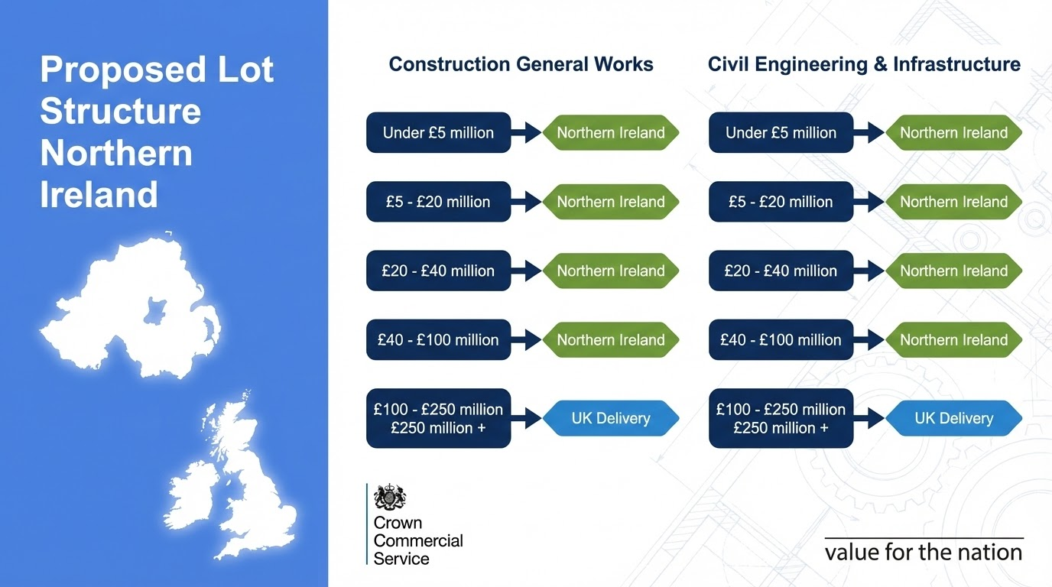
Notes:
Damian
For both Construction and Civil Engineering, we have replicated this structure across three value bands:
Projects under £5 million.
Projects between £5 and £20 million.
Projects between £20 and £40 million.
Moving up in value, we have a national lot for Northern Ireland covering £40 to £100 million for both Construction and Civils.
Finally, at the highest values, we have two UK-wide lots covering £100 to £250 million and £250 million plus in both Construction and Civils.
This comprehensive structure results in a significant number of opportunities. There is a potential for 94 places for suppliers to be appointed.
Now, I’ll hand over to Shelley to take us through the details of the procurement process and the next steps

Slide 13

About the Procurement &
Next Steps
Notes:
Shelley 13 - 15
Thank you. We’ve covered the framework's history, current success, and the specific opportunities in Northern Ireland, including Lots 1 and 2 of the new CWAS3 framework. Now, as the slide title suggests, I will take you through the details of the procurement process, including the key requirements for suppliers, and outline the important next steps for moving forward.

Slide 14
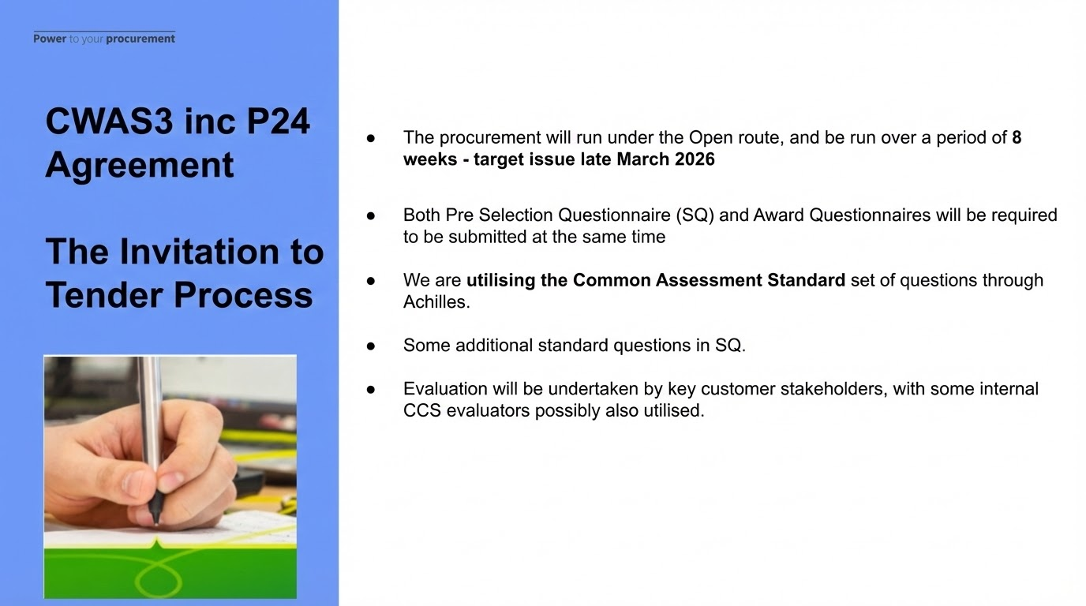
CWAS3 inc P24 Agreement
The Invitation to Tender Process
Notes:
Shelley
The timelines for CWAS 3 are as you can see, an 8 week tender period which has a target issue of March 20th 2026.
The clarification period where you can ask questions ends six weeks after ITT issue.
Selection & Award questionnaires are to be submitted at the same time.
Quality is worth 70% of the evaluation marks and there will be a range of questions per sub-lot, each with a defined percentage score. A range of themes will also be tested at this stage including social Value, Net Carbon Zero, Supply Chain Management, Quality Management, Continuous Improvement, collaboration, Construction/Manufacturing Life cycle and Security management etc.
There will be a character limit and we will not accept attachments or diagrams
Commercial is 30% of the tender evaluation score and this is the same for all lots.

Slide 15
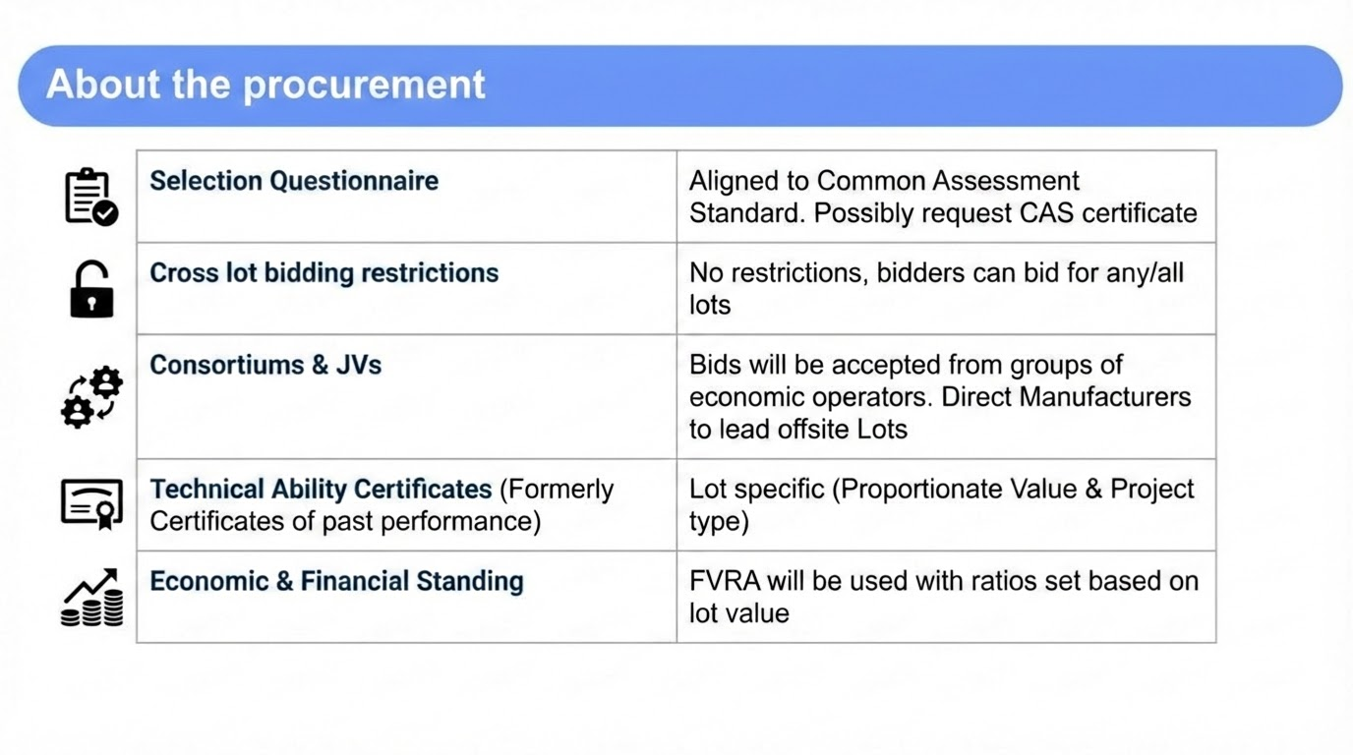
About the Procurement &
Next Steps
Notes:
Shelley
The selection questionnaire is the common assessment standard
Whilst there are no restrictions on what lots you can apply to be on, you will be asked to give a preference as there are a finite number of places on each lot.
As per the previous framework, Consortiums and Joint ventures are permissible. We don’t restrict what those consortiums look like……..
On the Technical Ability Certificates - these will be lot specific and proportionate based on project value and type
And on Economic and financial standing - All bidders will undergo a financial viability risk assessment to ensure the financial stability of all Supplier Alliance Members
The FVRA tool will be used to collect and review the financial information of bidders (3 years information required for the Gold FVRA and 2 years for the Silver FVRA). The assessment will result in one of the following outcomes:
Acceptable
Acceptable with mitigating actions - via guarantor
Unacceptable
The tool provides provides transparency as to how and what CCS will assess and allows bidders to see their risk classifications as they complete the financial assessment

Slide 16
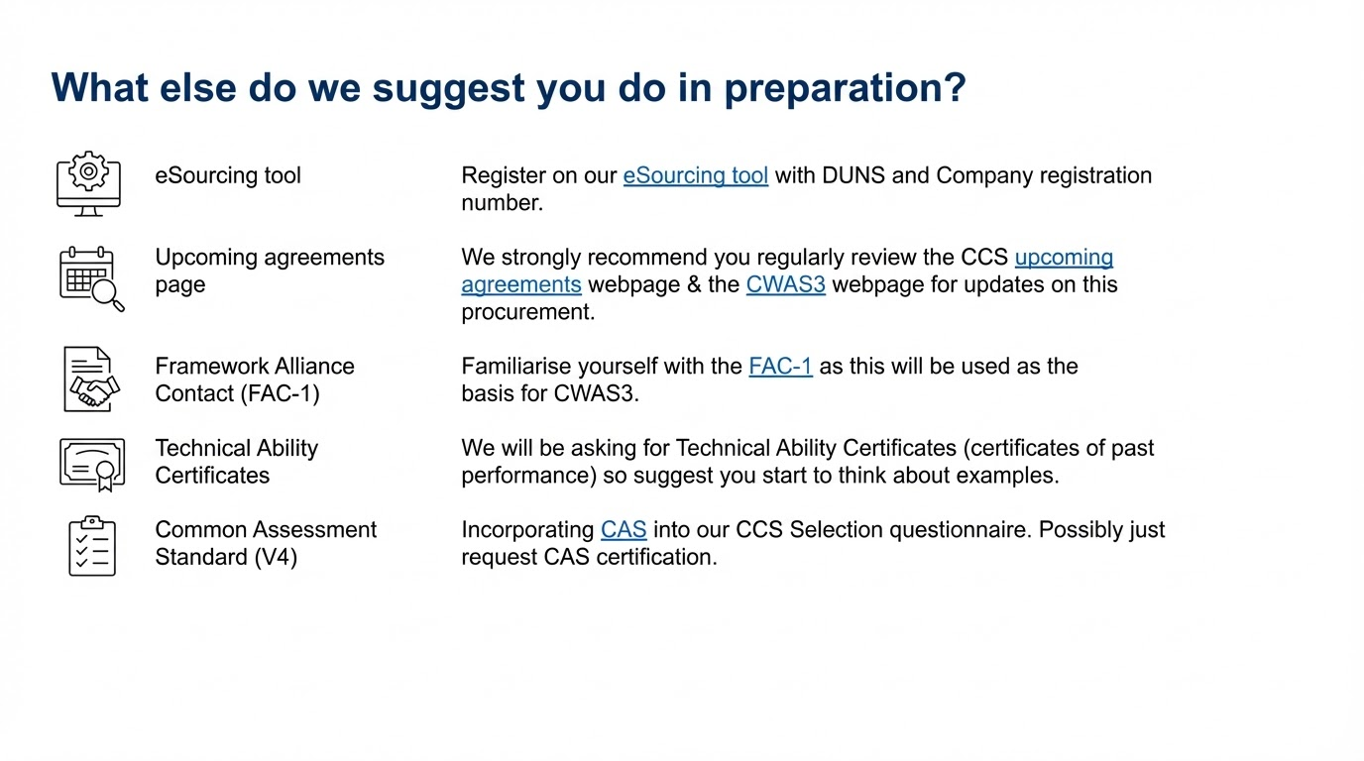
CCS Supplier Registration Link
Notes:
Damian
if you are interested in bidding to be a part of the framework I’d ask you to regularly review the links in the first box which will take you to the CWAS3 webpage. There you will also find past presentations and information in regards to the framework. We will ensure you receive a copy of this presentation with the links I mentioned
FAC will be the contract for the framework so would be worthwhile familiarising yourself with that
We are incorporating the Common Assessment Standard into the selection questionnaire so again would be worth taking a look at this and the link is included in this slide
Method of collection
Achilles will gather the CAS data
This is in line with reinforcing the government's commitment to a standardised and efficient pre-qualification process.
All lots except the international lot will require CAS certification
CAS themes are
Identity, Corporate and Professional Standing, Health and Safety, Environmental, Quality, Building Safety, Information Security and Information Management

Slide 17
INDEXATION
Construction Output Price Index All New Works & Maintenance published by ONS
Framework rates become maximums
Fee percentages are fixed for the duration of the Framework
Hourly Rates and other unit rates are fixed until March 2028.
First indexation applied and rates adjusted in April 2028 (using Jan 2027 to Jan 2028 Indices published in Feb 2028).
Annual adjustment in April every year.
Note: These dates are currently tentative and can change.
CWAS3 Agreement
Award Phase
Commercial
Notes:
Damian
Whilst the slide speaks for itself just to run through……..
INDEXATION
Construction Output Price Index All New Works & Maintenance published by ONS
Framework rates become maximums
Fee percentages are fixed for the duration of the Framework
Hourly Rates and other unit rates are fixed until March 2028.
First indexation applied and rates adjusted in April 2028 (using Jan 2027 to Jan 2028 Indices published in Feb 2028).
Annual adjustment in April every year.
Note: These dates are currently tentative and can change.

Slide 18
Constructing the
Gold Standard
Notes:
Clare 18 - 20
Moving onto the ‘Constructing the Gold Standard' in public sector construction. This framework is deliberately structured to align with this standard, a key differentiator from previous frameworks. Let’s move to the next slide where we’ll explore what this Gold Standard is and what it means for our projects.

Slide 19
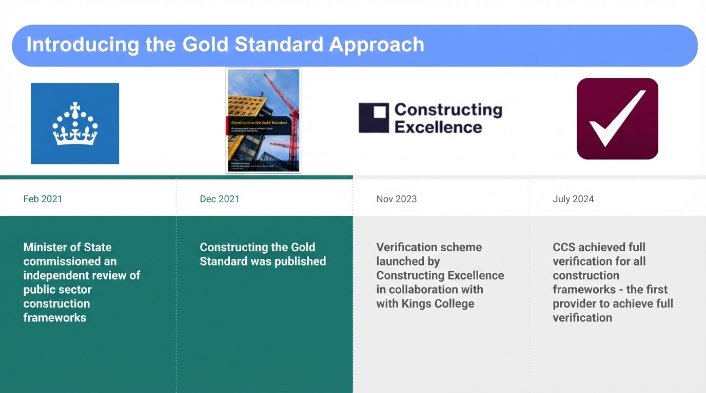
Notes:
Clare
The framework aligns with the UK Government Construction Playbook, which sets out key policies and guidance on how projects and programmes should be assessed, procured, and delivered. The core philosophy of the Playbook is encapsulated in its focus on "getting projects and programmes right from the start." This early intervention and focus on best practice are key to its success. The document contains 14 key policies, with notable examples being the emphasis on longer-term contracting, promoting Early Supply Chain Involvement, and advocating for more effective contracting strategies. These policies collectively aim to drive better value, efficiency, and sustainability across the public works sector.
The Construction Playbook then endorsed Constructing the Gold Standard.
Introduction to the Gold Standard and why its important to CCS
In February 2021 Lord Agnew - Minister of State at the Cabinet Office (at the time) commissioned Professor David Mosey to lead an independent review of public sector construction frameworks. Recognising construction frameworks as ‘power engine rooms’ to the industry
Within the 2000 frameworks currently active - the review found evidence of ‘waste, confusion and duplication’ in processes ­as well as’ too strong a focus on achieving the lowest price, rather than best value’.
As a result in December 2021 Constructing the Gold Standard was published which is endorsed by The Construction Playbook. The Gold Standard set out 24 recommendations with supporting actions to help improve outcomes of construction frameworks
In November 2023 - Construction Excellence alongside Kings College London launched a Gold Standard verification scheme - called ‘Constructing the Gold Standard’. This scheme is a system for recognising and supporting framework providers who adopt gold standard frameworks, framework contracts and action plans.
In July 2024 CCS achieved full verification for all of our construction frameworks and we’re really honoured to have been the first construction framework to have passed the verification scheme.

Slide 20

Maintaining the ‘Gold Standard’
CCS remain a member of the Gold Standard Taskforce and are committed to ensuring the continued success of the Gold Standard
Our Gold Standard Action plan will feed into Core Group activity to ensure we all have accountability for delivering a Gold Standard Framework that delivers Gold Standard calls off and Projects
Typical examples of Core Group activity that feed into Gold Standard will include;
  Reviewing Success Metric data and identifying areas for shared learning and improvement
  Sharing lessons learned and innovative ways of working through Case Studies and Toolbox Talks
Notes:
Clare
Since then CCS remains a member of the taskforce and remain committed to ensuring the success of the Gold Standard continues.
Our Gold Standard Action plan is linked to Core Group activity. The Core Group is made up of suppliers, customers and us and effectively governs the framework. The Core Group and our suppliers will be responsible for implementing key aspects of it.
Examples of this activity include success measures development and review of data, or lessons learned and innovative ways of working through Case Studies and Toolbox Talks
We rely on our customers and also our suppliers to support us to continue to collectively improve the framework performance and in turn improve industry outcomes. The scale of this framework - gives an opportunity to really make an impact and we’re excited to work with you to achieve this.

Slide 21
Finally……
www.crowncommercial.gov.uk/agreements/RM6320
cwas3@crowncommercial.gov.uk
Future Opportunity Notice (Contracts Finder)
Future Opportunity Notice (Find a Tender)
Notes:
Clare
no questions - Marting did mention at the beginning
check out FAQ’s on the link - FAq’s will be updated ASAP. Lots of questions around Achilles and how the TACs work so bear with us you will get answers to those questions
To conclude, this slide provides all the essential information you need to keep in touch and follow the progress of CWAS3. You can visit the dedicated webpage, reach out to us via the team email address, and keep an eye on the Future Opportunity Notices on both Contracts Finder and Find a Tender. We look forward to your engagement with the framework
Register as a supplier on CWAS 3 page for any further updates

