Slide 1
An Introduction to Human Factors
Compiled by the Human Factors Programme Team
Feb 2022

Slide 2






What is Human Factors?
There are many definitions of Human Factors, such as:
"Human factors refer to environmental, organisational and job factors, and human and individual characteristics, which influence behaviour at work in a way which can affect health and safety" -HSE
“Human factors is multidisciplinary effort to generate and compile information about human capabilities and limitations and apply that information to equipment, systems, facilities, procedures, jobs, environments, training, staffing, and personnel management for safe, comfortable, and effective human performance” – FAA
“One of the objectives is making it easier for being to do the right thing, difficult to do the wrong thing and almost impossible to do the catastrophic thing” - ICAO
Understanding Organisations
Leadership
Reviewing incidents
Understanding people
Learning
Optimising Human Performance

Slide 3
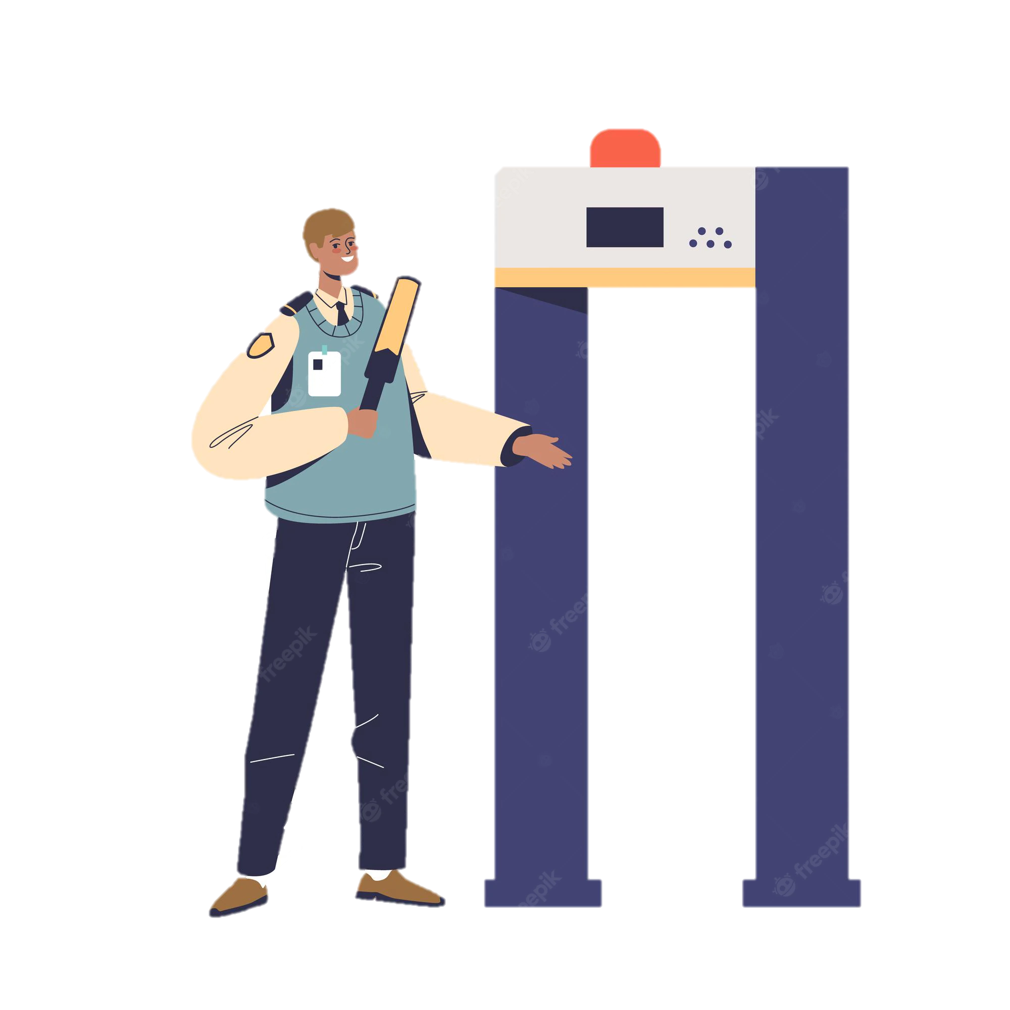


What is Human Factors?
We are all human - yet different people have differing knowledge, skills, experience, attitudes, and abilities. We can all be influenced by our environment and the people around us, some get tired, some get distracted and some people think they can crack on and get the job done!
Human Factors (HF) has been studied for a long time, the more we learn about humans and the performance influencing factors (PIFS) that shape us, the safer the working environment can be. HF spans across a wide range of different and diverse industries such as; aviation, rail, healthcare and chemical engineering.
The study of Human Factors looks at:
The human
The job
The working environment
The organisation
Human Factors is about getting the best out of humans and making the workplace a safer place for everyone.

Slide 4


What does Human Factors involve?
Average behaviours
Communication
Decision making
Linguistics
Automation
Crew Resource Management
Error
Stress
Understanding
Cognitive engineering
Skills
Workload
Work psychology
Cognitive psychology
Situation
awareness
Cultural issues
Education psychology
Fatigue
Spatial disorientation
Teaching techniques
Human Machine Interaction
Medicine
Anthropometrics
Social psychology
Perception
Smells
Physiology
Cosmic effects
Health & safety
Ergonomics
Conditioning
Sociology
Neuro psychology
Social
collective
Individual
biological
Psychiatric
Psycho pathology
Clinical psychology
Counselling Psychology
Pathological behaviours

Slide 5

The Performance zone
The performance zone is a great tool when visualising all the things around us that affect our behaviour, they can both effect us in good and bad ways.
Here is Sam, they come to work everyday and perform to the best of their ability, yet they are surrounded by performance influencing factors (PIFS). Just look at all the things around Sam that may influence their performance!
Complacency
Organisational – the PIFs that are introduced by the organisation.
Personal – the PIFs that we build throughout our lives at work and at home. We cannot leave these PIFS at home and they may affect us at work.
It is important to remember that we may not be able to fix some of the PIFS around Sam, sometimes just acknowledging them can help.
Noise
Training
Fatigue
Managers
Team mates
Mobility
Complex systems
Equipment
Vision
Stress
Temperature
Communication
Past experiences
Alcohol/Drugs
Time pressures
Lighting
Situational Awareness
Distractions
Human Factors is about getting the best out of humans and making the workplace a safer place for everyone.

Slide 6



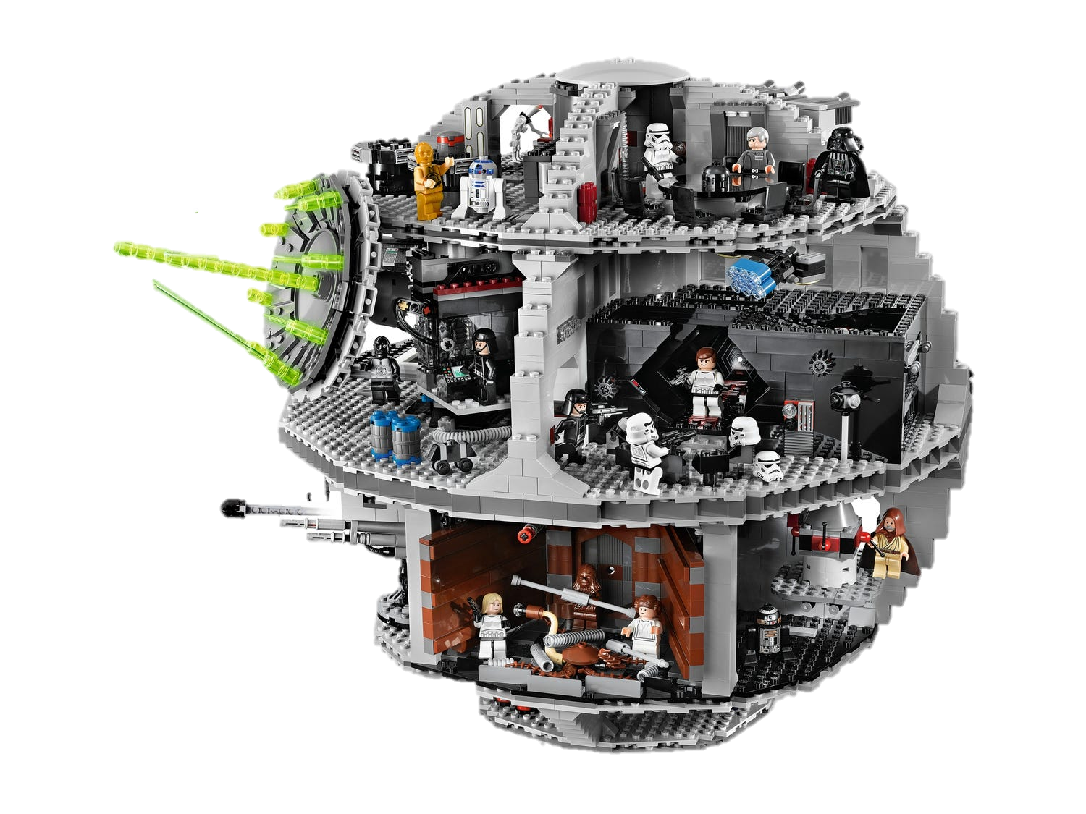
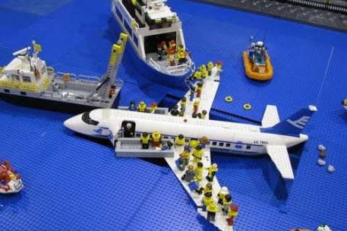
ICAO 5 Principles of Human Performance
The International Civil Aviation Organisation has highlighted five key aspects of Human Performance
1: People’s performance is shaped by their capabilities and limitations
2: People perform in ways that make sense to them
Human Performance
5: People’s performance is influenced by interactions with other people
4: People assess risk and make trade-offs all the time
3: People adapt to the demands of a complex and dynamic work environment

Slide 7



Why is Human Factors important?
Due to the risks associated with building, maintaining, supporting and operating within the aviation system, it is vital we understand how Human Factors (HF) can affect the people involved in the system at all levels.
To reduce the HF risk, we must influence attitudes and behaviours across the industry and apply a HF approach and Systems Thinking into our work.
By taking this approach, we aim to improve aviation safety and keep the interests of the consumer at the heart of our work.

Slide 8
Useful Links
https://ergonomics.org.uk/
https://www.icao.int/safety/OPS/OPS-Normal/Pages/HP.aspx
https://www.hf.faa.gov/
https://sma.nasa.gov/sma-disciplines/human-factors
https://www.aerosociety.com/get-involved/specialist-groups/safety/human-factors/
https://www.hse.gov.uk/humanfactors/introduction.htm

