Slide 1
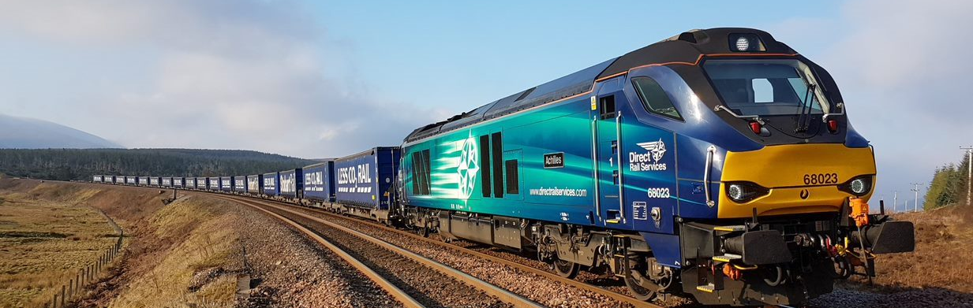

Freight Safety Improvement Programme (FSIP)
Control Period 7 (CP7) Investment Criteria

Slide 2


Investment Criteria
The FSIP investment criteria sets the guidelines to define how FSIP funding can be accessed, how investment decisions will be made and the requirements for governance and assurance processes. In response to lessons learned from Control Period 6 (CP6), this has been updated to enable a more considered approach to schemes considered for funding in CP7, in line with our strategic intent to deliver a greater proportion of exploit/innovate schemes. Scheme proposers must agree to/demonstrate the following criteria in order for their scheme to be considered for funding.
Investment Principles
Proposal Content
Proposals can be made by operators, end users, Network Rail (NR) regions or routes or central functions including Freight & Customer (FNPO) (includes joint funding initiatives between NR and 3rd parties)
Cannot be an activity that maintenance should already be undertaking
Should be for new/enhanced assets
Must use the standard proposal documentation
Investment proposals must have a detailed breakdown of costs, Programme of Works (POW) with completed milestones, lead person responsible and points of contact for delivery and completion dates
Must agree to comply and provide assurance in line with FSIP Assurance criteria
Safety Benefits
Entry Into Service
Must have a clearly defined safety benefit on the network that will last more than 12 months
Safety benefits must align with Freight Safe Group safety priorities to ensure alignment of FSIP with industry
Must identify and specify a measurable success criteria (e.g. reduce falls by 20%)
All proposals must have an agreed maintenance commitment and once completed, handed back into operational use
Initial approval from Route Asset Managers (RAMs)/maintainers must be sought before authority is granted

Slide 3


Investment Criteria Checklist
Proposal is a request from NR/FOC/3rd party?
Proposals should be a request from Network Rail Regions or Routes or central functions including FNPO, operators and end users. If the proposal is not a Network Rail request, the proposal should be a joint funding initiative between Network Rail and a third party, otherwise should be funded externally.
MEASURABLE TARGETS EXAMPLES
Successful delivery will reduce trips in this area by X%.
Proposal is not Maintenance Business As Usual (BAU)?
Proposals should not replace or cater for day-to-day maintenance obligations that the proposer is otherwise responsible for.
Proposal is for new/enhanced asset(s)?
Proposals should be for new or enhanced assets and must not be for BAU activities. Investment will primarily be spent on safety improvements for Network Rail assets; however, this may also include shared systems, or connected infrastructure immediately adjacent to Network Rail’s, belonging to a third party.
Successful delivery will result in no H&S incidents associated with work in this area.
Network Safety benefits are clear and sustainable?
Proposals must outline a clearly defined safety benefit on the network. Proposals must clearly align with Freight Safe Group safety priorities. If they do not, a justification must be provided. FPB will ensure that approved funding aligns with strategic objectives with regard to classification of schemes.
Successful delivery will reduce the number of derailments at the site by X%.
Success criteria and outcome sought by scheme is specified?
Proposals must specify a success criteria, outlining specific targets that can be used to measure long-term benefits. This ensures that funding aligns with industry aims and objectives, while providing a deliverable KPI to measure schemes against. These should incorporate local measures where possible, however if unavailable, they should tie into national measures (e.g. using information provided in Operations & Safety Scorecards, Incident Reports or RSSB Reports).
Successful delivery will reduce time taken for incident investigation by X minutes.
Proposal has initial RAM / Maintenance / Stakeholder support?
All remit proposals must have initial maintenance support to avoid risks of the asset not being accepted into maintenance upon completion. This should be provided through written confirmation, however if unavailable, verbal confirmation is sufficient at this stage. All investment proposals must have an agreed maintenance commitment, detailed in the investment paper, and once completed, be handed back into operational use.
Successful delivery will reduce the risk of trips occurring at this site from X to Y.
Proposer agrees to comply with FSIP assurance process?
Scheme proposers are required to agree to comply with FSIP assurance process to ensure we are able to effectively monitor progress and ensure that schemes are progressing once funding has been authorised.
Proposals must be submitted using the standard proposal documentation. Investment proposals must have a completed and detailed breakdown of costs, programme of works with completion milestones, lead person responsible and points of contact for delivery and completion dates.

