Slide 1

Module 2
The 10 Principles of Active Design in Detail
A deep dive into the principles of Active Design
Notes:
The objective of this module is to develop participants’ understanding of the 10 principles of active design.

Slide 2
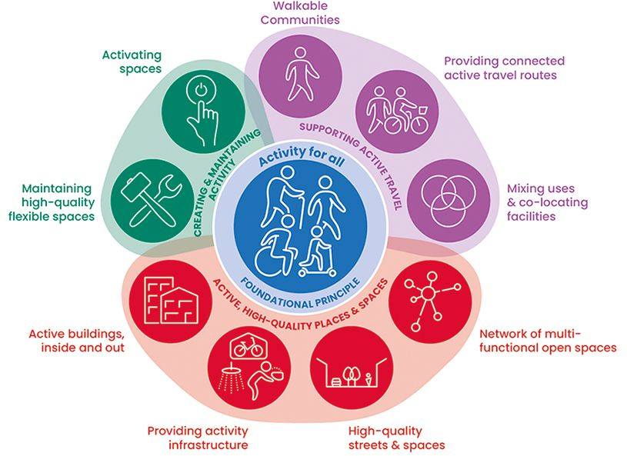
The three themes of Active Design
Theme 3:
Creating and maintaining activity
Theme 1:
Supporting active travel
Theme 2:
Active, High-Quality Places and Spaces
Notes:
The diagram on the screen depicts the overall active design themes and principals which are centred by the foundational principal of Activity For All.
At the centre of the diagram the foundational principle ‘activity for all’ underpins all of the principles and then the remaining 9 principles of active design are grouped under three main themes which are:
Theme 1: Supporting Active Travel
Theme 2: Active, High-Quality Places and Spaces
Theme 3: Creating and Maintaining Activity
These can be seen by the three segregating colours on the diagram.
The 10 Active Design Principles are:
Activity for all
Walkable communities
Providing connected active travel routes
Mixing uses and co-locating facilities
Networks of multi-functional open spaces
High quality streets and spaces
Providing activity infrastructure
Active buildings inside and out
Maintaining high quality flexible spaces
Activating spaces

Slide 3

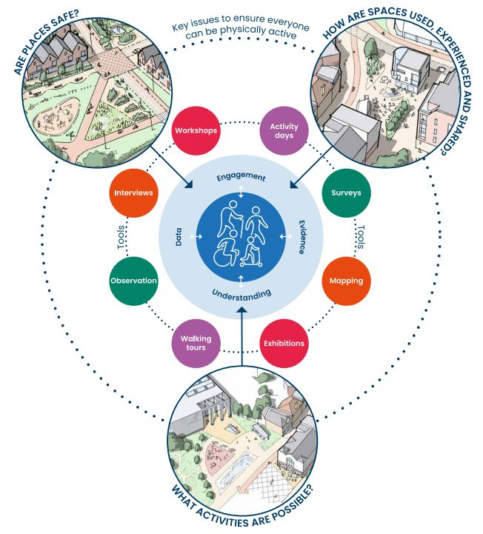
Foundational Principle: activity for all
Supporting physical activity for all.
Must consider issues that affect physical activity participation.
We must therefore understand the needs of all individuals.
We can do this through an effective consultation process.
Notes:
[Note to presenter – this repeats slide 10 of module 1]
The foundational principle of Active Design is to support physical activity for all ages, ethnicities, genders and abilities.
As a collective, we must therefore consider issues that affect physical activity participation. In particular, whether places are safe, whether a wide range of activities can take place and the different experiences of using spaces.
To be able to achieve this, it is important that an exercise of learning and listening is undertaken to properly understand the needs that are sought to be addressed.
To do this, those leading on consultations need to:
Understand different experiences.
Engage and listen actively.
Use local data and evidence.

Slide 4
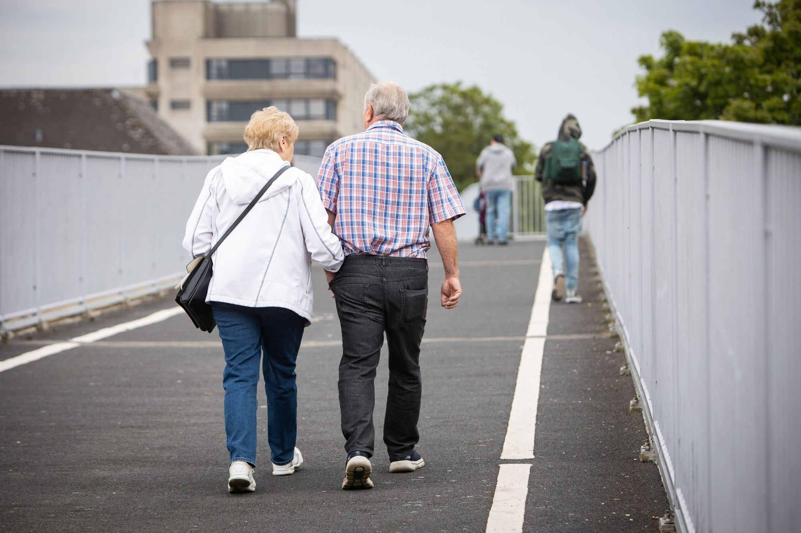
Foundational Principle: activity for all (continued)
To create active environments for everyone we must:
Understand different experiences.
Engage and listen actively.
Use local data and evidence.
Image@In-Press Photography
Image: © Sport England
Notes:
To create active environments for everyone:
1. Understanding different experiences
It is important to consider the different experiences of people to ensure that spaces will be used actively by all members of society and the community.
The different experiences people may have, may relate to safety, the types of activities they enjoy, or affordability. These experiences could at present be shaped by an unconscious bias or a lack of infrastructure to support mobility, amongst other reasons.
2. Engaging and Listening Effectively
To ensure that places provide activity for all, it is important for those leading on consultations to use effective and creative engagement techniques to ensure inclusive and equitable spaces and facilities are provided. A really good example of how this can be done is the Voice of Opportunity Power toolkit. https://voiceopportunitypower.com/ This is a free online resource which provides practical guidance on how to involve young people between the ages of 11-18 in the way that places get built and managed. More details on this can be found in the guidance document.
Even the most well-informed design team or project owner will have ‘blind spots’ in knowledge and experience. It is important to listen to a wide range of groups, especially those who are often left out of the planning process, as part of setting the brief for a project. The Her Barking example demonstrates designing for women and girls effectively by engaging specific groups to overcome design issues.
It is therefore important to listen to a wide range of groups to ensure complete inclusivity and this may require adapting engagement techniques depending on the demographic of the community.
For example, if the demographic of the area is made up in part by those who work during the day, then consultation events should be held outside of these times. Similarly, consultation events should be accessible to all, including those who may not have access to the internet.
Effective engagement should continue throughout the design process to test ideas and refine concepts through the detailed design and delivery.
3. Use of local data and evidence.
To retrieve local data and understand the inequalities in people’s physical activity in the area, those leading on consultations could contact local active partnerships or local authority public health teams. Alternatively, data can be retrieved from Sport England’s Active Lives, the Public Health Outcomes Framework or an upper-tier Council’s (such as a County Council) Joint Strategic Needs Assessments.
The data gathered should seek to understand the barriers and opportunities for different genders, ages, socio-economic groups, ethnicities, physical sensory and mental abilities and neurodiversity.
This work should make reference to the Equalities Act and the Public Sector Equality Duty.

Slide 5

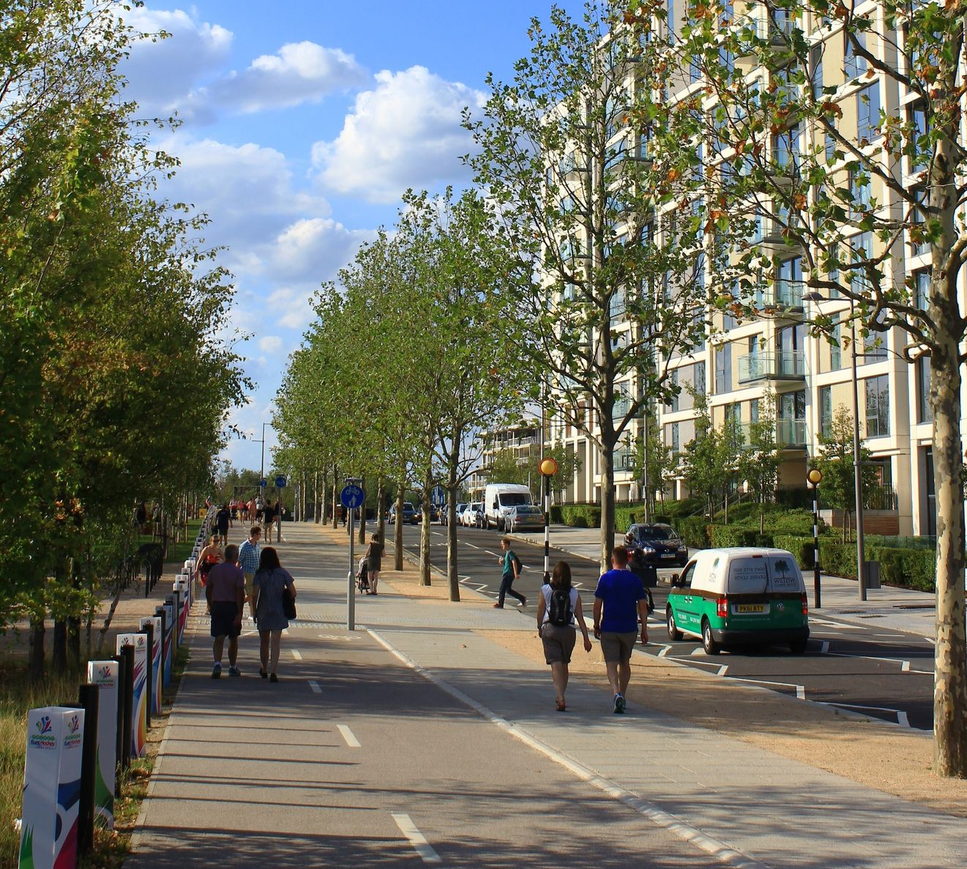
Principle 2: walkable communities
Aim: facilities for daily essentials and recreation should be within easy reach of each other by active travel means, making it more likely that people will make the journey by using active travel modes.
Image: © David Lock Associates
Image: © Sport England
Notes:
Principle 2 aims for facilities for daily essentials and recreation to be within easy reach of each other by active travels means, providing people a choice to make between different active travel modes and making it more likely that people will make the journey by using active travel modes.

Slide 6
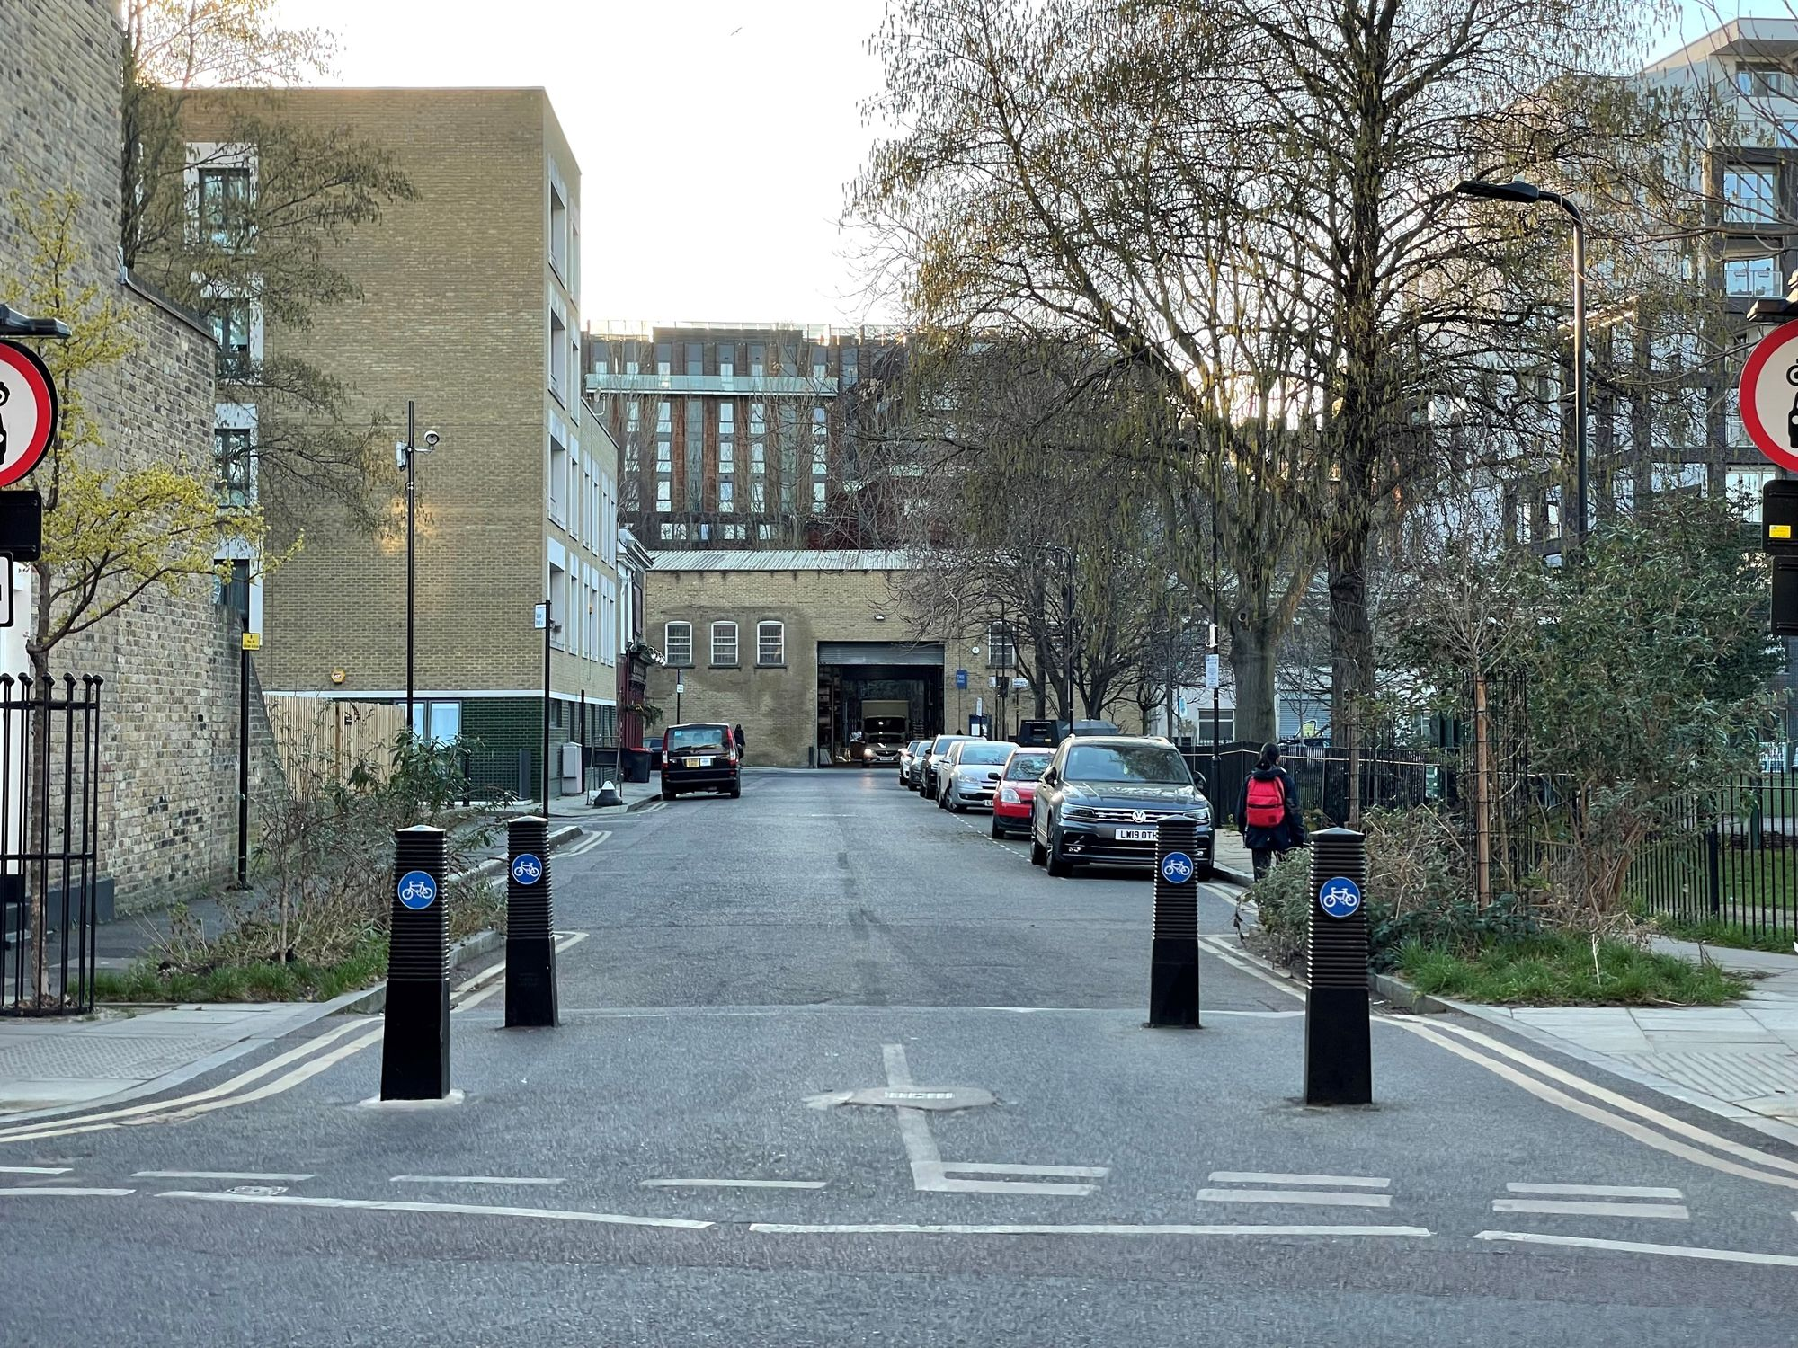
Principle 2: walkable communities (continued)
2.1 Locating facilities jobs and homes close to each other.
2.2 Promoting the active travel choice.
2.3 Using filtered permeability to make it easier to use active travel rather than driving.
2.4 Utilising residential and employment travel planning.
Image: © David Lock Associates
Notes:
Design considerations which can aid in the delivery of principle 2.
Part 2.1 looks at “Locating facilities, jobs and homes close to each other” active design guidance recommends that:
day-to-day facilities will be within 800m of all homes.
employment and commercial spaces be included within communities.
developments should secure the early delivery of community facilities to ensure active travel becomes a habit at an early stage.
existing communities with a lack of facilities should be identified and prioritised through local plan policies to bring forward proposals that could fill gaps.
Part 2.2 looks at the promotion of active travel choice, active design guidance recommends that:
developments promote a hierarchy of travel with pedestrians, cyclists and other active travel users considered first during the design to ensure there is a genuine choice of ways of getting about.
the user of the journey should be considered in the development of plans. It should examine when and why people would travel on routes. This should be evolved as part of the consultation process.
Active travel routes should be direct, clear, safe and prioritised at junctions.
Part 2.3 looks at using filtered permeability. "Filtered permeability” describes the design of our streets and urban realm that allows through journeys for selected modes of transport, typically walking and cycling (but sometimes also buses), but removes it as a through route for motor traffic."
To do this, active design guidance recommends:
Active travel routes form a continuous and connected grid in a development.
Bus connections through communities are direct and uninterrupted, with bus gates used to provide an advantage over private vehicle traffic.
Existing communities can reduce through traffic by retrofitting filtered permeability measures.
Part 2.4 looks at “utilising residential and employment travel planning”, active design guidance recommends:
Travel plans should be provided to new residents as they can help make active travel part of daily lives.
Travel plans should audit existing travel patterns and travel culture.
Details of active travel options should be provided in welcome packs or travel plans.
Employers can help employees have a more sustainable range of choices to get to work, including implementation of a cycle to work scheme.

Slide 7
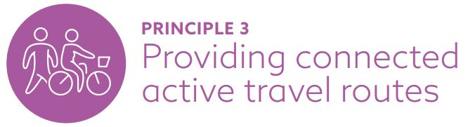
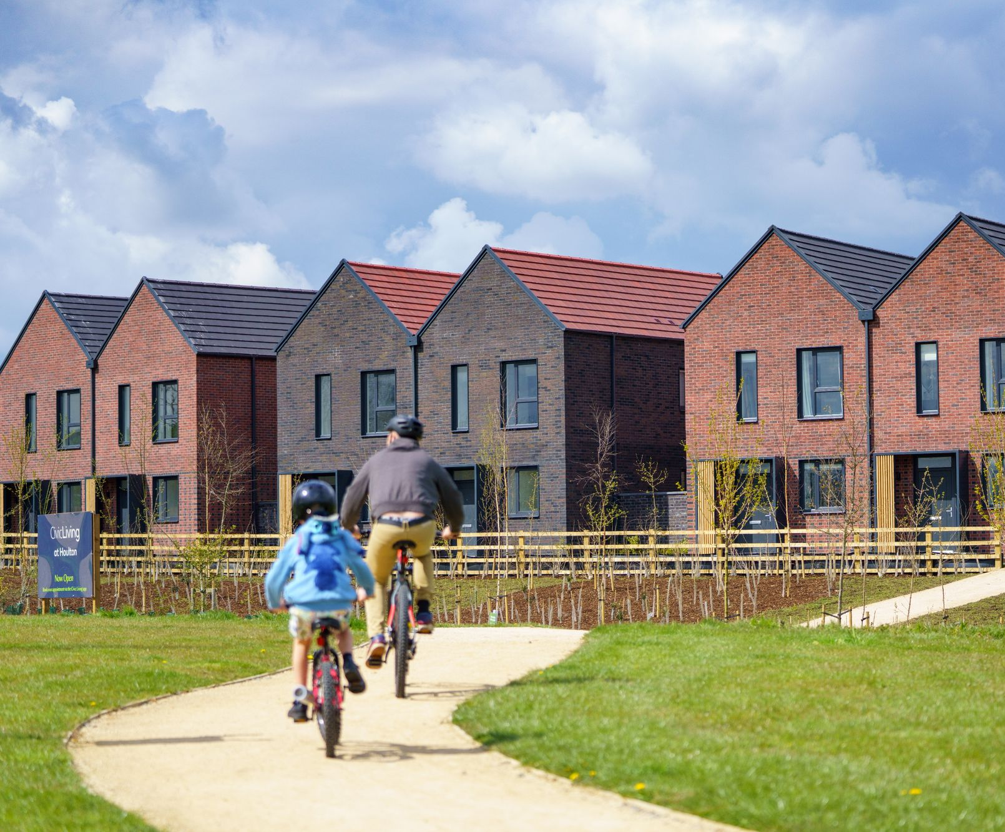
Principle 3: providing connected active travel routes
Aim: to create a seamless and easy-to-navigate network that promotes active travel.
This involves connecting places in a way that’s safe, convenient, and appealing to people of all ages and abilities.
Image: © Urban & Civic
Notes:
Principle 3 aims to create a seamless and easy to navigate network that promotes active travel. This involves connecting places in a way that’s safe, convenient, and appealing to people of all ages and abilities.
The next slides show how this can be done.

Slide 8
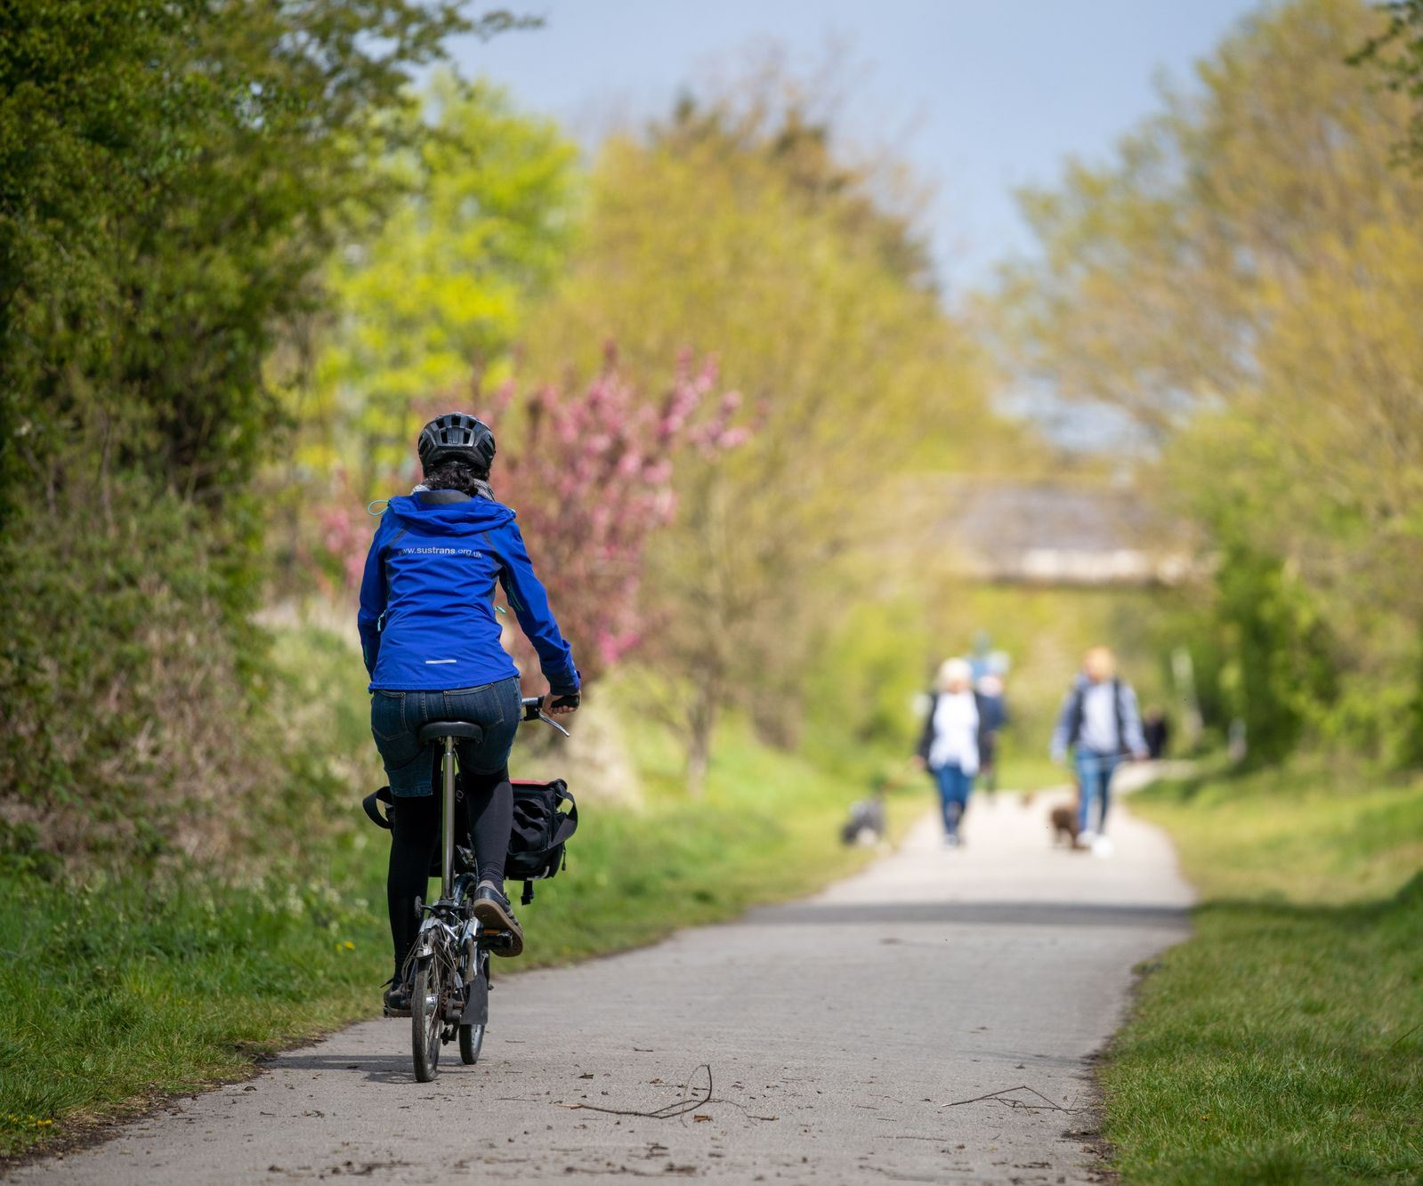
Principle 3: providing connected active travel routes (continued)
3.1 Create a direct network of routes which connect to places, along routes people want.
3.2 Provide high-quality, safe routes with a clear role and purpose.
3.3 Enable interchange between active modes and onward sustainable travel.
3.4 Include wayfinding signage aimed at active travel modes and consider digital approaches.
3.5 Look beyond the boundary of a site and connect to the wider area.
Image: © Urban & Civic
Notes:
Design considerations which can aid in the delivery of principle 3.
Part 3.1 looks at creating a direct network of routes which connect to places, along routes people want. To achieve this, active design guidance recommends that:
Proposals for new places create networks of active travel routes within a development site, clearly connecting to nearby places and routes.
Network connections are created beyond the development site, including connecting to existing public rights of ways.
Desire lines should be used to inform the design of public spaces and help define spaces where people will move through and where people can stay and linger.
Leisure routes should be included, with signage for activities of different lengths.
Part 3.2 looks at providing high quality and safe routes with a clear role and purpose. Active design guidance recommends:
Routes have suitable widths, treatments and topography which reflect their function and purpose.
Routes should be safe for all users, including vulnerable pedestrians.
A hierarchy approach should inform the design of streets and routes.
Routes to schools should ensure they are safe and usable by children and young people through reductions in vehicle traffic, use of dropped kerbs and continuous footways, verges or green infrastructure to separate carriageways from footways.
Dog walking routes should be integrated within open space networks.
Part 3.3 looks at enabling interchanges between active modes and onward sustainable travel. To do this, active design guidance recommends:
Bus stops and other interchanges should provide ample, secure and visible cycle parking.
All bus stops and interchanges are provided with shelter and seating and aim to provide real-time timetable information and lighting.
Part 3.4 looks at including wayfinding signage aimed at active travel modes and the consideration of digital approaches. To do this, Active Design guidance recommends:
Wayfinding signage should be sensitively sited to ensure it does not contribute to street clutter. It should be concentrated at key nodes in networks. Colours, numbers or lines used for the signage can be provided on the surfaces of routes, indicating the time and distance to key locations.
Digital wayfinding can be tailored for different audiences and needs.
On street traffic signing and road markings must comply with the traffic sign regulations and general directions
Part 3.5 encourages people to look beyond the boundary of a site and connect to the wider area. To do this, Active Design guidance recommends:
Identifying active travel connections to likely popular destinations and surrounding networks should be the first stage of any design and should inform the layout of proposals to make active travel distances and gradients as small as possible.
Should include active travel connections from developments to the surrounding countryside.
Providing active travel connections through existing adjoining residential areas to access destinations beyond a development and to integrate with existing communities.

Slide 9

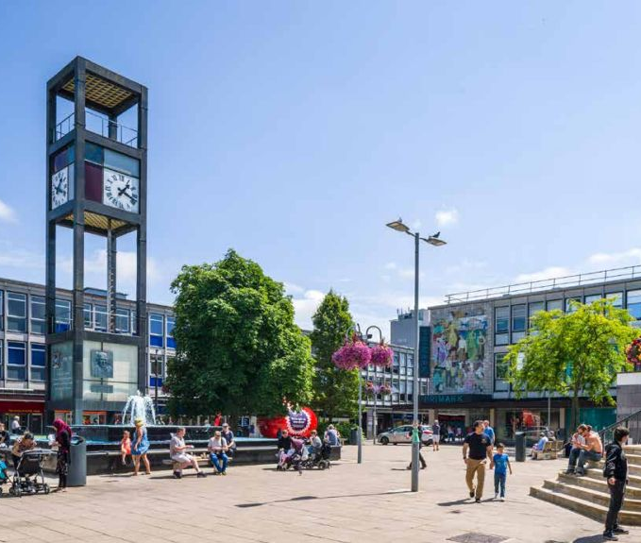
Principle 4: mixing uses and co-locating facilities
Aim: people are more likely to combine trips and use active travel to get to destinations with multiple reasons to visit.
Places with more variety, higher densities and a mix of uses also reduce the perception of distance when travelling through spaces and generate the critical mass of travel demand to better support public transport services.
Image: © David Lock Associates
Notes:
Principle 4 - places to include more variety, higher densities and a mix of uses as it is more likely that people will combine trips and use active travel to get to destinations with multiple reasons to visit. This also reduces the perception of distance when travelling through spaces and helps to generate the critical mass of travel demand to better support public transport services.

Slide 10
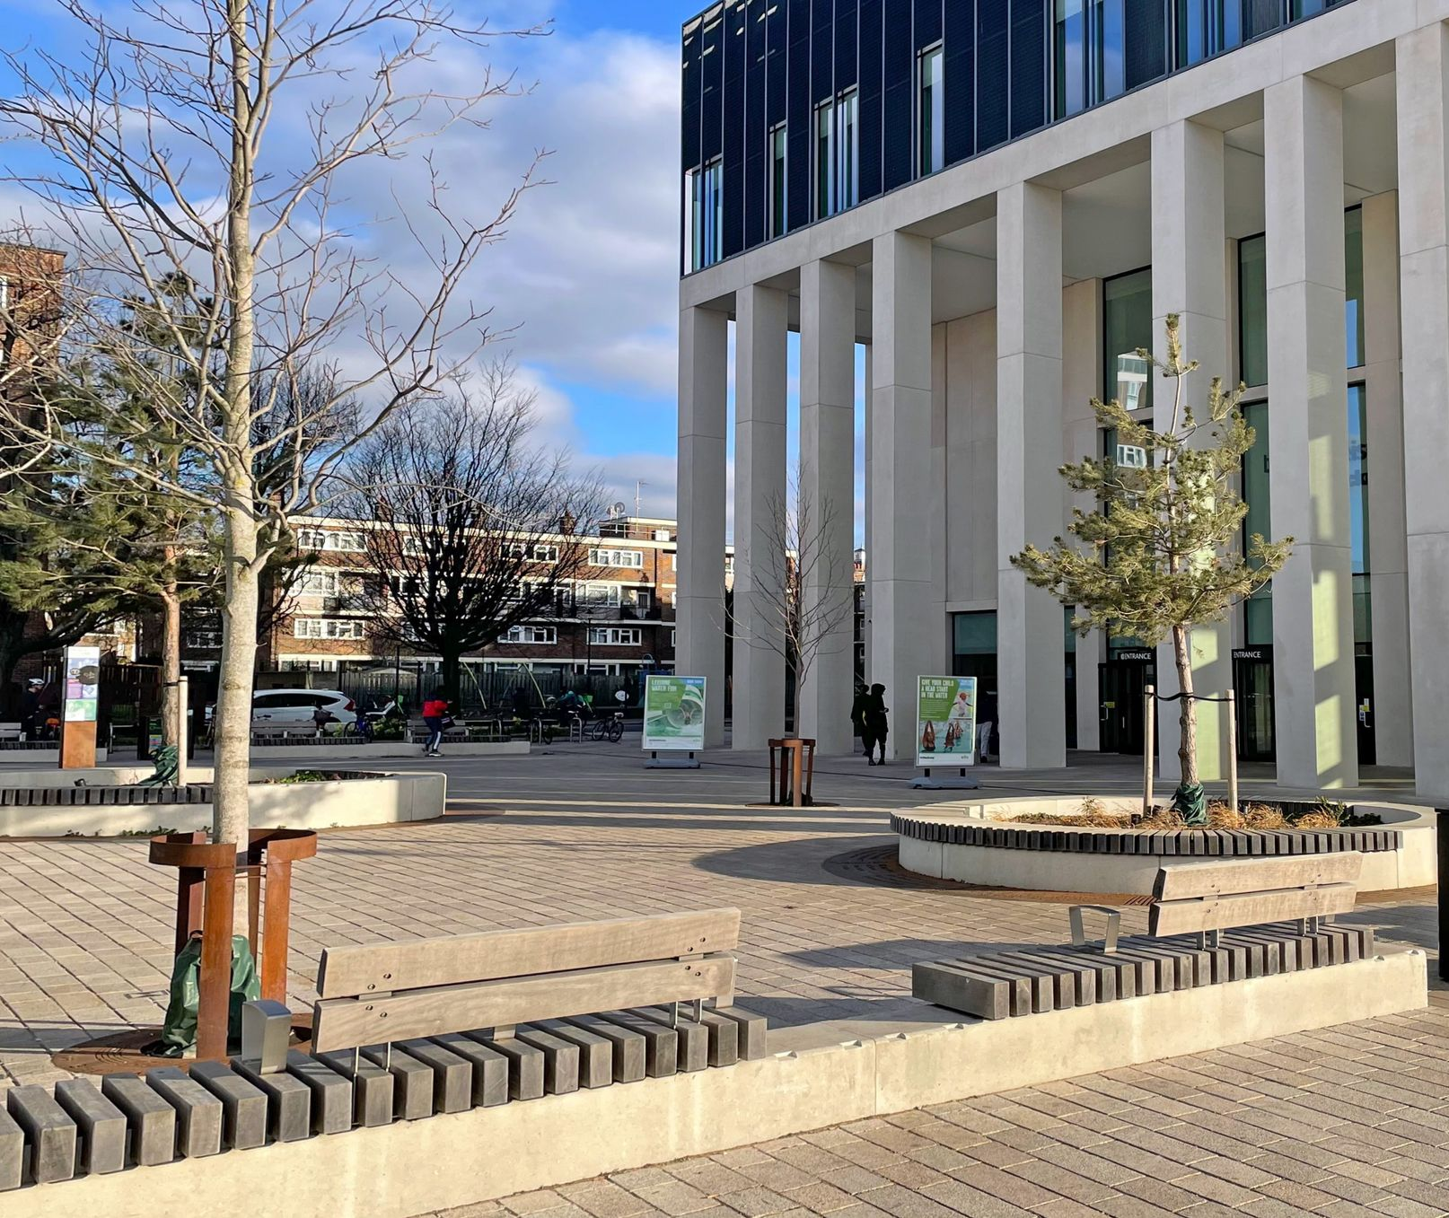
Principle 4: mixing uses and co-locating facilities (continued)
4.1 Avoid uniform zoning of large areas to single uses.
4.2 Create mixed-use, connected focal points in prominent places within a community.
4.3 Co-locate sport and recreation facilities alongside complementary uses.
4.4 Use the public realm to create informal activity at sports and recreation facilities.
Image: © David Lock Associates
Notes:
Design considerations which can aid in the delivery of principle 4.
Part 4.1 looks at avoiding uniform zoning of large areas to single uses. To achieve this, Active Design guidance recommends:
Land uses are successfully mixed considering active travel networks and the accessibility of locations.
The guidance seeks to ensure that conflicts between land uses are successfully mitigated or prevented.
High density residential schemes can generate a large amount of active travel movements and therefore opportunities for co-locating other uses should be explored.
Part 4.2 looks at creating mixed use, connected focal points in prominent places within a community. To achieve this, Active Design guidance recommends:
Locations where lots of active travel routes meet should be the focus of where key community facilities are located as they are likely to be highly accessible.
Intensification of mixed land uses within existing places should be in locations with the highest accessibility.
The time dimension in co-locating uses to bring day-long activity to streets and spaces should be considered.
The form of traditional mixed-use streets is considered as a way of designing spaces. These can maximise accessibility to surrounding places and encourage movement along them.
Part 4.3 looks at co-locating sport and recreation facilities alongside complementary uses. To achieve this, Active Design guidance recommends:
Playing fields and sport pitches are integrated amongst green infrastructure and open space networks.
Careful design through subdividing spaces, seating and other approaches should ensure the uses of more formal sports pitches in multi-functional open spaces do not dominate the whole space.
Design should ensure that informal surveillance is implemented so that sport and recreational facilities can be used by diverse groups.
Facilities that are required to support sports should be designed where appropriate to be multi-functional so that they can support other physical activities on open spaces. For example, cafes in pavilions.
Good design should avoid potential conflicts between nearby residents or other uses of open space.
For some sports and activities, integrating more frequent smaller scale provisions amongst, streets, homes and other uses may be a better way of increasing people’s access to physical activity opportunities in some contexts, rather than larger combined facilities.
Part 4.4 looks at using the public realm to create informal activity at sports and recreation facilities. To achieve this, Active Design guidance recommends:
Designs should make the public realm, connections and greenspace a part of the facility, enabling their use for informal physical activity such as outdoor gyms, nature or trim trails.
Co-location of sport facilities with community facilities can help with combining use of the public realm outside a building as it encourages a range of activities at a location.
Creative re-imagining of playing fields can make them more social spaces, including the consideration of facilities that are not fenced in which can be more welcoming for many, especially girls.

Slide 11
Theme 1 recap
What makes this a good example of active design?
Image: © David Lock Associates
Notes:
Lets recap on Theme 1. This image was used on one of the earlier slides. What features can you spot in this image which make it a good example of active design?

Slide 12
Width of paths –hierarchy of travel
Clear segregation between footpath and cycle paths
Uncluttered
Sensitive planting
Lighting?
Overall attractive environment
Image: © David Lock Associates
Image: © David Lock Associates
Notes:
Width of paths. In this image the combined width of the footpath and cycle lanes is equal to the road. This demonstrates a hierarchy of travel that prioritises active travel modes above the motor vehicle.
Clear segregation of the cycling and footpaths. Here the footpath is slightly raised. The cycle lanes and footpath are made from different materials and are of different colours. Clear segregation between the cyclist and pedestrian makes it safer for all.
The routes are also clear of obstruction e.g. signs are limited, no bins on the routes. The trees do not overhang or impact on the use of the active travel routes. The canopy is not overly dense so it lets light through which helps in regards to safety.
Safety - Opportunities are taken to incorporate lighting – for example there is a light incorporated into the blue walking and cycling sign. Perhaps more lighting could be included though!
The flats also help provide natural surveillance which helps improve safety.

Slide 13

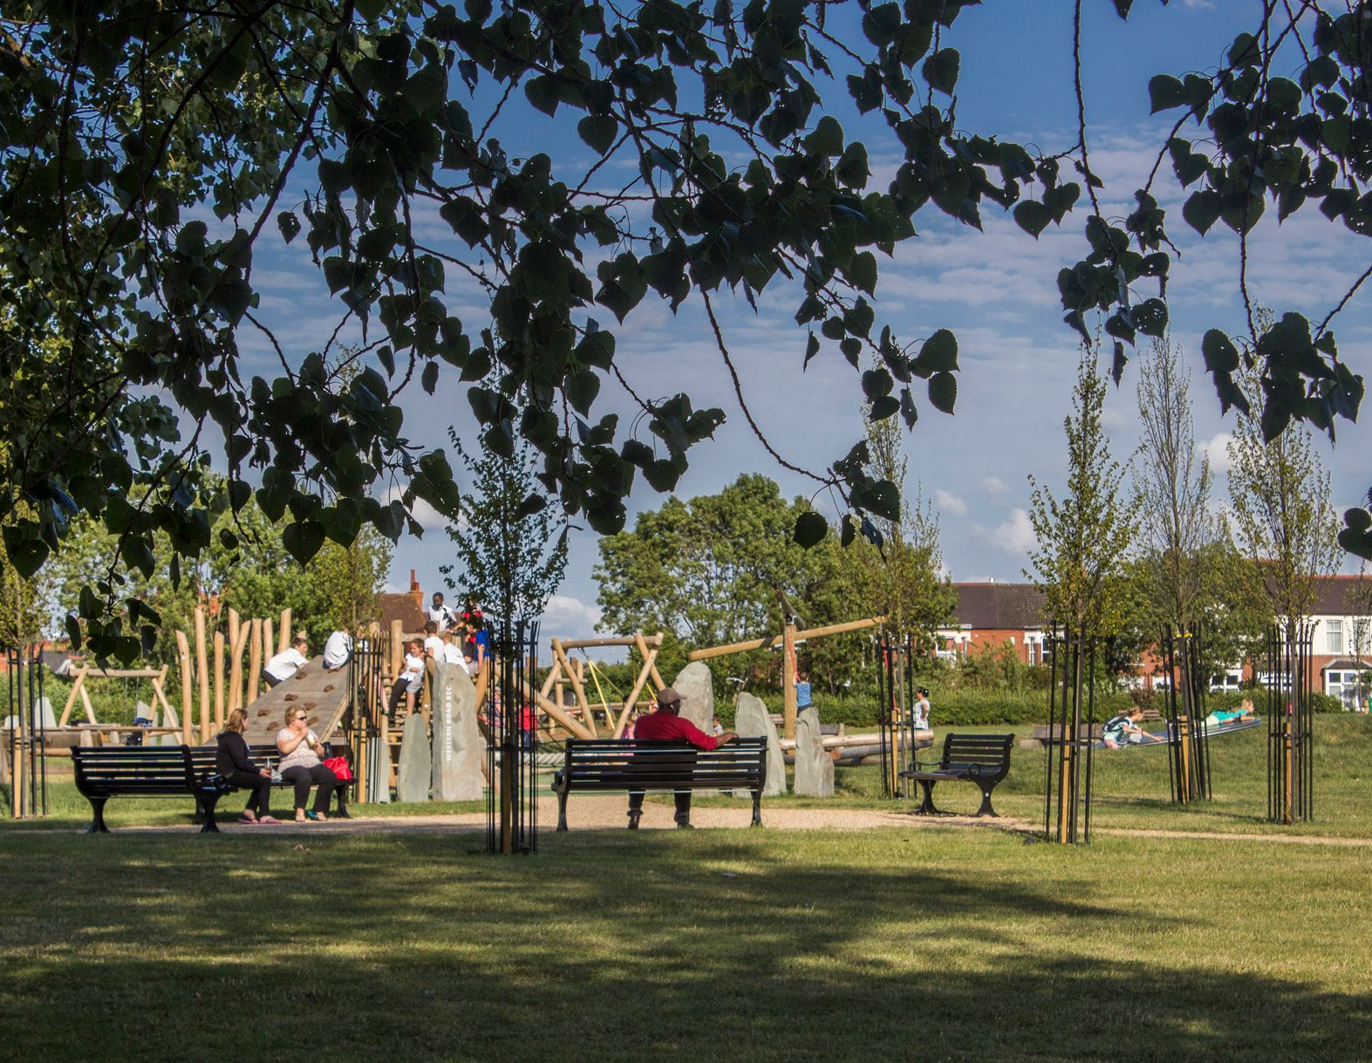
Principle 5: network of multi-functional open spaces
Aim: accessible and high-quality open space should be promoted across cities, towns and villages to provide opportunities for sport and physical activity, as well as active travel connections and natural or civic space for people to congregate and enjoy.
Image: © David Lock Associates
Notes:
Principle 5 - accessible and high-quality open space to be promoted across cities, towns and villages to provide opportunities for sport and physical activity, as well as active travel connections and natural or civic spaces for people to congregate and enjoy.
The next slides show how this can be done.

Slide 14
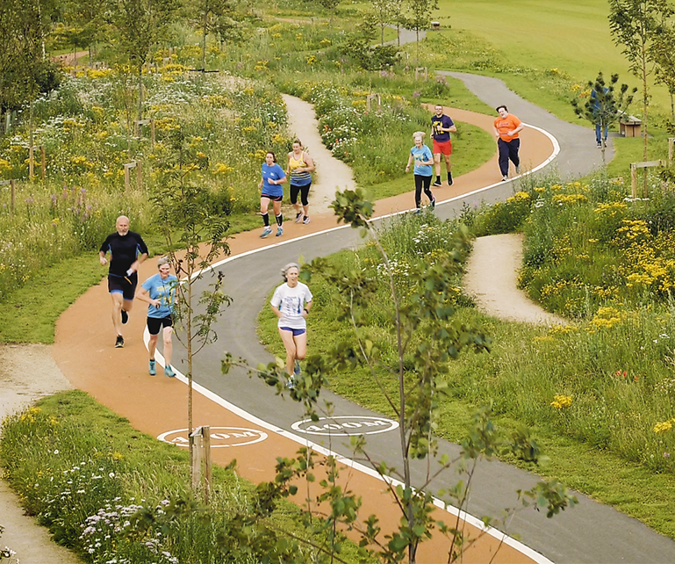
Principle 5: network of multi-functional open spaces (continued)
5.1 Create a variety of open spaces.
5.2 Link open spaces together within and beyond a site.
5.3 Plan and design for a wide range of activities.
5.4 Integrate a diversity of natural habitats to make environments where people want to be outdoors and active.
Image: © North Yorkshire Council
Notes:
Design considerations which can aid in the delivery of principle 5.
Part 5.1 looks at creating a variety of open spaces. To achieve this, Active Design guidance recommends:
Open spaces including civic space with hard landscaping, play areas, informal amenity, natural and semi-nature places where nature dominates, allotments, formal gardens and pocket parks.
Accessibility should be considered in the surfacing materials, as grassed spaces can be less accessible during the winter.
Small and large spaces are needed for different activities, functions and uses.
Spaces should include active travel networks, leisure cycling networks, natural habitats and other facilities.
Open spaces should be multi-functional with the potential to incorporate sustainable drainage systems.
Where single large spaces are being created their design should be carefully considered so that they can potentially incorporate smaller, more easily occupied spaces and a variety of activities can be enjoyed.
Part 5.2 looks at linking open spaces together within and beyond a site. To achieve this, Active Design guidance recommends:
Opportunities to connect to wider open spaces, looking beyond the site boundary are taken.
Open spaces should be integrated with nearby active travel networks.
Utilisation of clear and distinctive wayfinding in open spaces, together with promotion and awareness raising activities to enhance local knowledge of the networks.
Include and promote the use of nearby blue infrastructure such as rivers, for water recreation activities.
Part 5.3 looks at planning and designing for a wide range of activities. To achieve this, Active Design guidance recommends:
Formal and informal sport can be integrated throughout the public realm, utilising and creating physical activity opportunities. These spaces should be co-designed with the local community. Opportunities should include creating age appropriate play space.
Research on the usage of different type of facilities by different groups can help identify if there is imbalanced provision and can support interventions.
Formal sports pitches should be integrated within the networks of open space to provide variety, vitality and focal points.
Part 5.4 looks at integrating a diversity of natural habitats to make environments where people want to be outdoors and active. To achieve this, Active Design guidance recommends:
Children and young people need space to be active in the public realm and open space and their presence often activates spaces.
When children have space to play outside, they are naturally active.
Formal play spaces should be accessible and convenient to those they are providing for and ideally integrated as part of destinations and local centres.
Play spaces should be designed to be accessible for all children.
Different groups of children should also be considered, including children with special education needs and disabilities.

Slide 15

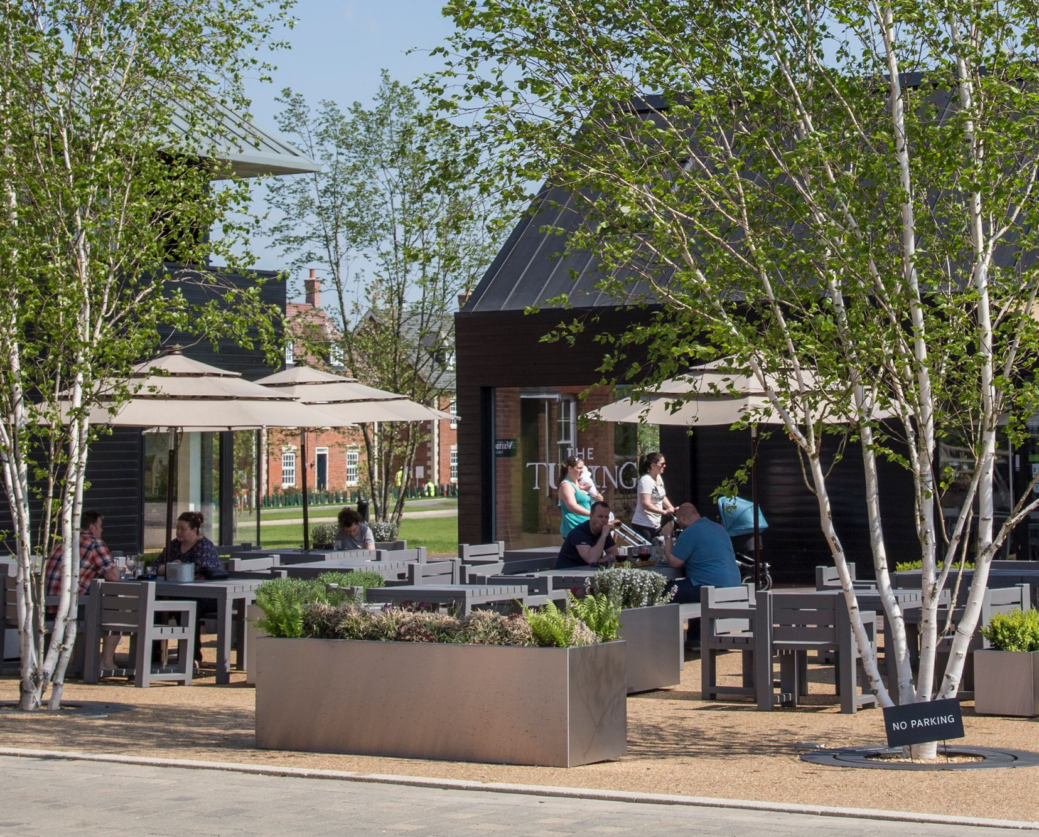
Principle 6: high-quality streets and spaces
Aim: streets and outdoor public spaces should be active environments in their own right. They should be safe, attractive, functional, prioritise people and able to host a mix of uses, with durable, high-quality materials, street furniture in the right places and easy-to-use signage. High-quality streets and spaces encourage activity, whereas poor-quality streets and spaces are much less likely to be used to the same degree.
Image: © David Lock Associates
Notes:
The aim of principle 6 is for streets and outdoor public spaces to be active environments in their own right. They should be safe, attractive, functional, prioritise people and able to host a mix of uses, with durable, high-quality materials, street furniture in the right places and easy-to-use signage. High quality streets and spaces encourage activity.
The next slides show how this can be done.

Slide 16
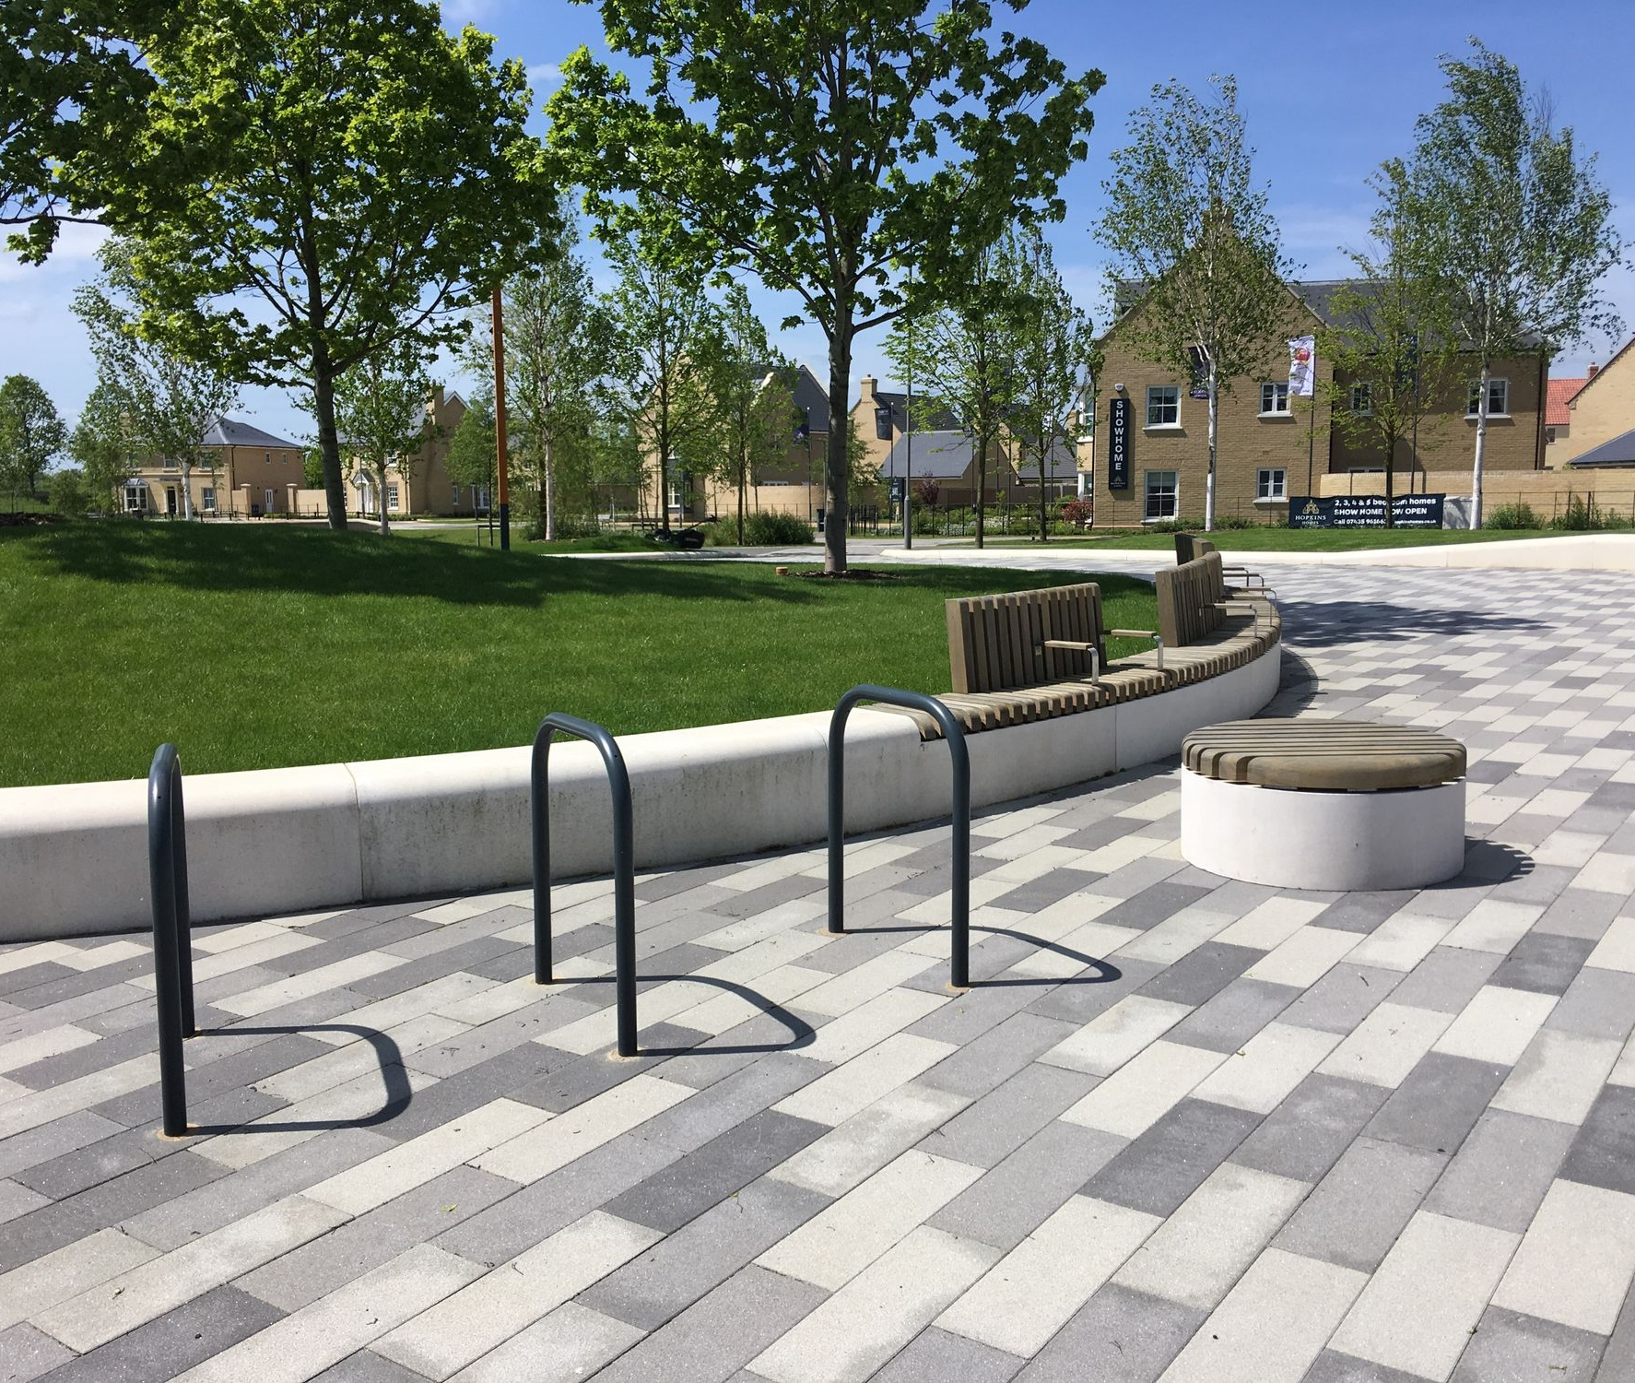
Principle 6: high-quality streets and spaces (continued)
6.1 Design streets as places, not movement corridors.
6.2 Design streets and spaces of high quality, utilising appropriate and durable materials.
6.3 Create and support safe, flexible spaces which can support multiple forms of activity.
6.4 Create resilience spaces that can be active in all seasons.
Image: © Sport England
Image: © Sport England
Notes:
Design considerations which can aid in the delivery of principle 6.
Part 6.1 looks at the design of streets as places, not movement corridors. To achieve this, Active Design guidance recommends:
Streets are treated as more than vehicular through-routes or highways dominated by vehicular traffic. The role of streets as places should be prioritised above their role as movement corridors.
Separation of active travel activity from vehicular use can be an effective way to improve the quality of a street.
Footways and cycleways should be uninterrupted and direct.
Residential and minor streets should be made clear to drivers that the streets are for people.
Appropriate ground floor uses with active frontages animate a street helping to make it a place.
Car parking should not be prioritised over other uses and users.
Part 6.2 looks at designing high quality streets and spaces, utilising appropriate and durable materials. To achieve this, Active Design guidance recommends:
All streets and spaces should be fit for purpose to encourage movement by active travel and utilise high quality and durable materials which can provide grip in all weathers.
Surface materials should be used to define space clearly and can help to slow vehicles.
Ensuring a space is safe and feels safe is an essential part of securing design quality.
The choice of materials and design of key spaces should make reference to and take inspiration from the surrounding landscape and historic context to make a place feel distinctive and rooted in its local environment.
In existing places, opportunities to retrofit and improve existing infrastructure should be taken.
Part 6.3 looks at creating and supporting safe, flexible spaces which can support multiple forms of activity. To achieve this, Active Design guidance recommends:
Public spaces should be multi-functional, allowing for numerous activities and events to be able to take place.
Within public spaces such as parks and civic spaces, subdividing the space into a variety of different environments can provide an opportunity for people to meet, talk, exercise, move through and take part in activities.
Spaces and streets should include seating at appropriate locations. A mix of social seating and solitary seating can provide a place for a mix of people to feel comfortable in a space.
Part 6.4 looks at creating resilient spaces that can be active in all seasons. To achieve this, Active Design guidance recommends:
The use of tree planting, shelters, sustainable drainage systems and rain gardens improves the street scene and plays a role in extending the outdoor season through improving drainage, offering cover and regulating air temperature.
Street trees can play a large role in offering shade and natural cooling throughout summer.

Slide 17
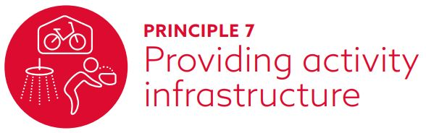
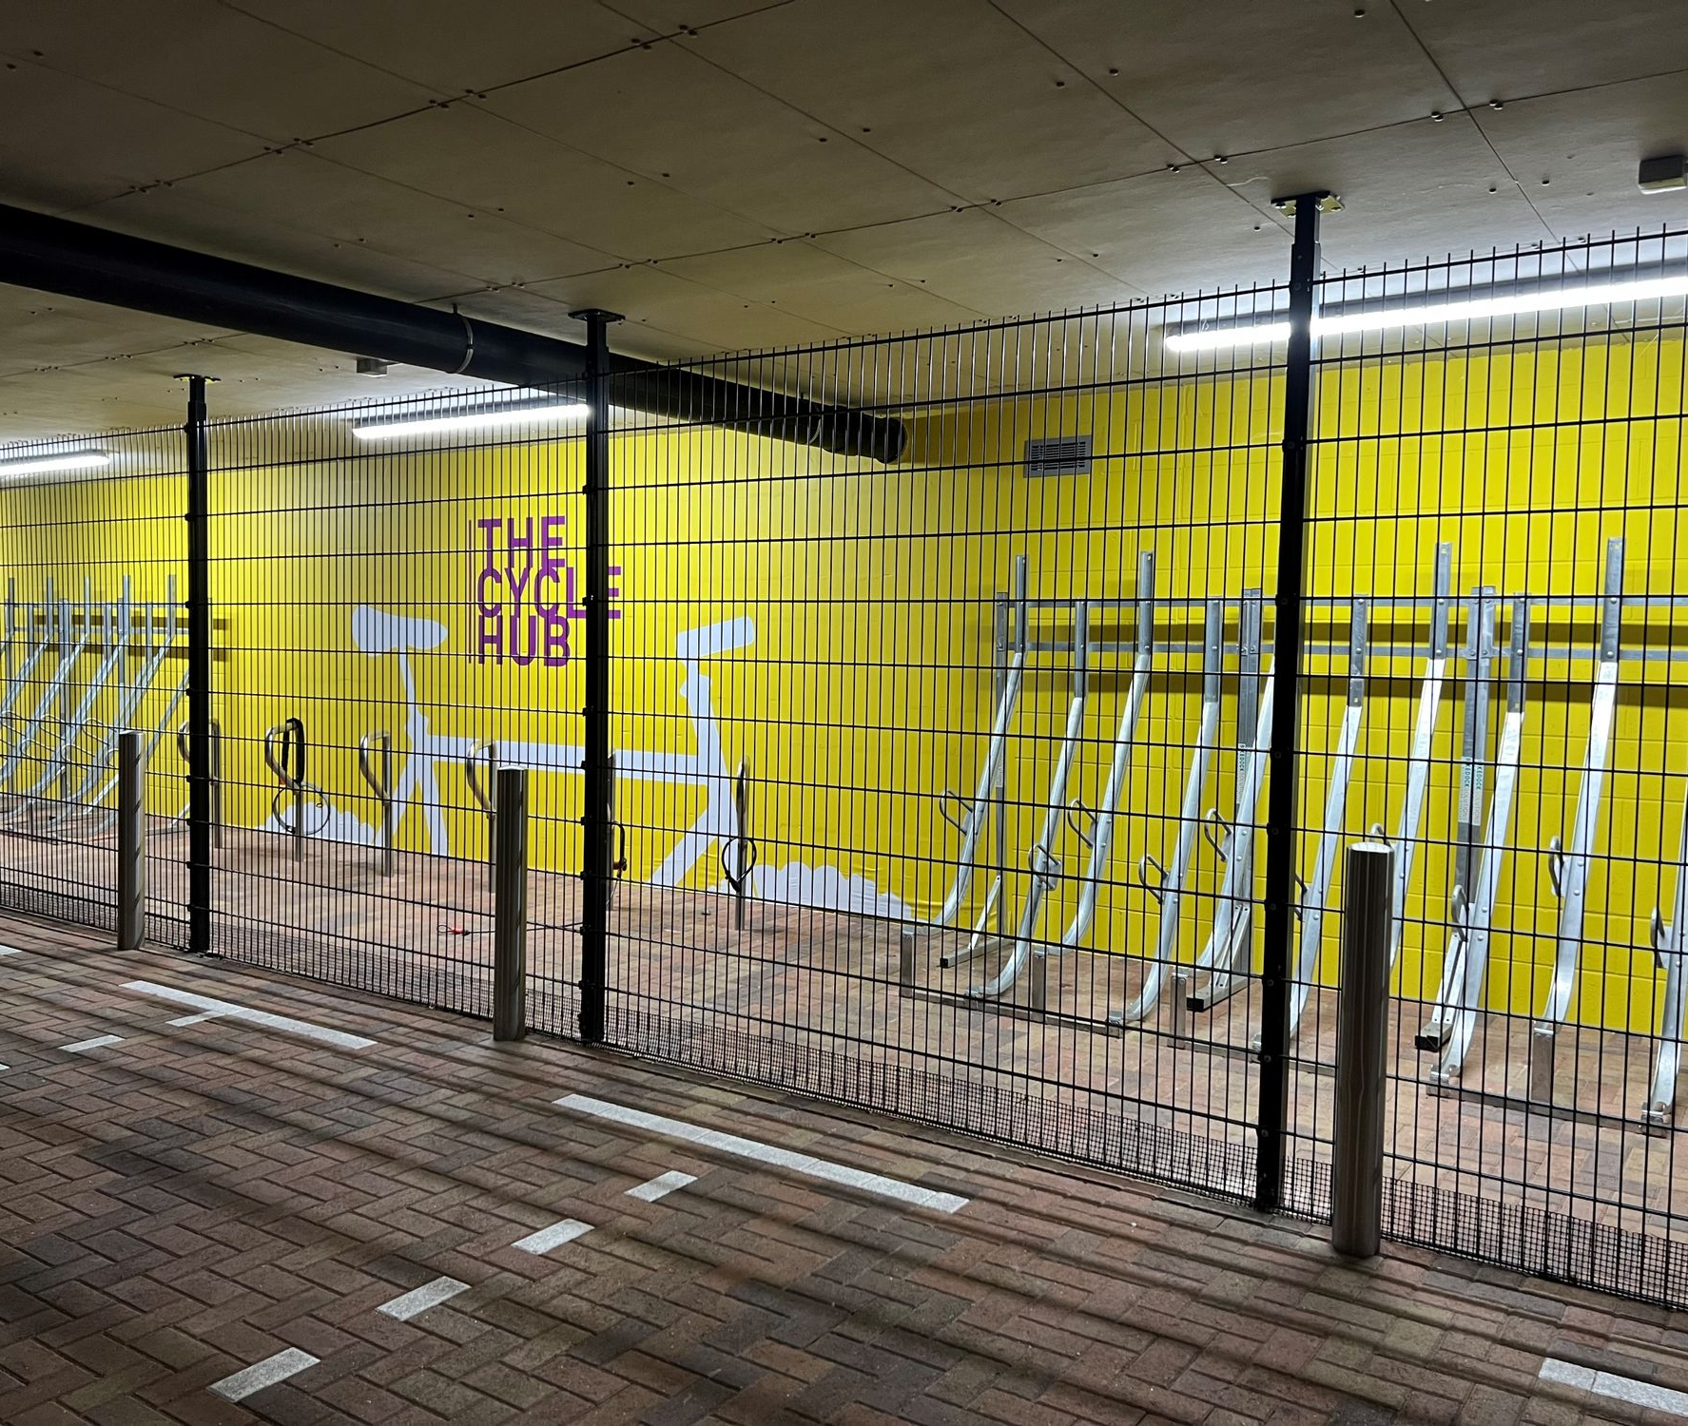
Principle 7: providing activity infrastructure
Aim: infrastructure to enable sport, recreation and physical activity to take place should be provided across all contexts including workplaces, sports facilities and public space, to facilitate activity for all.
Image: © David Lock Associates
Notes:
Principle 7 aims for infrastructure which enables sport, recreation and physical activity to be provided across all contexts including workplaces, sport facilities and public space, to facilitate activity for all.
The next slides show how this can be done.

Slide 18
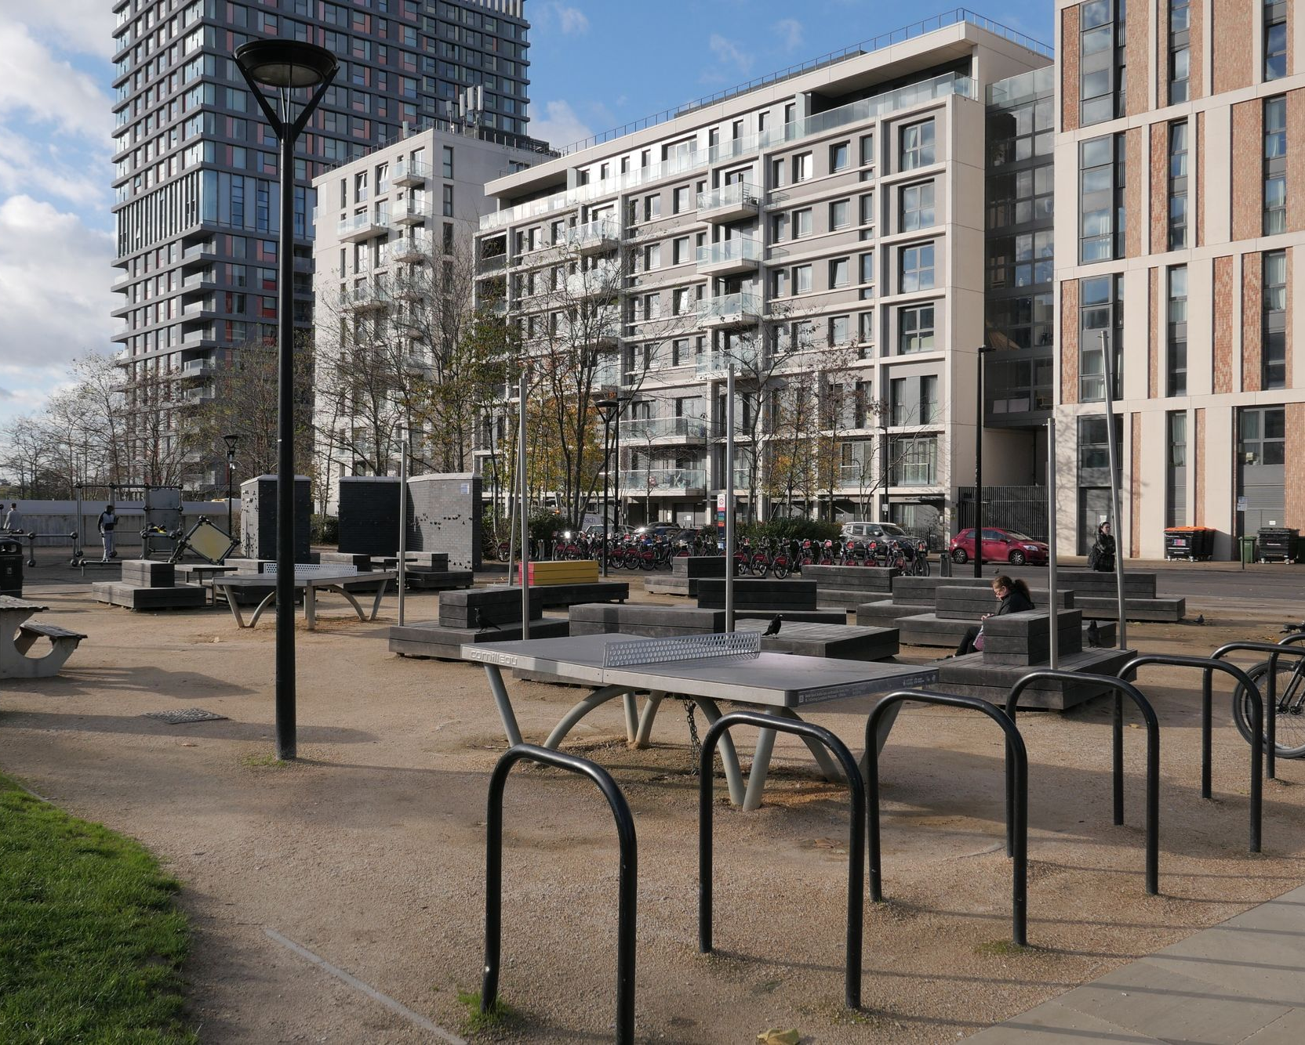
Principle 7: providing activity infrastructure (continued)
7.1 Provide infrastructure which supports and enables active travel.
7.2 Provide infrastructure which supports physical activity.
7.3 Provide supporting infrastructure which enables people to utilise spaces flexibly.
7.4 Integrate and utilise innovative digital technology in spaces and places.
Image: © David lock Associates
Notes:
Design considerations which can aid in the delivery of principle 7.
Part 7.1 looks at providing infrastructure which supports and enables active travel. To achieve this, Active Design guidance recommends:
A broad range of infrastructure is delivered to encourage activity for the full range of potential users e.g. public toilets, drinking fountains.
Provision should be safe, within prominent locations and ensure it meets the needs of the local population.
Accessibility of the routes and destinations for all groups should be provided through appropriately sized and provisioned infrastructure.
Provide access to toilets as part of public spaces which are free to use.
Safe and secure cycle parking should be provided at all locations.
Part 7.2 looks at providing infrastructure which supports physical activity. To achieve this, Active Design guidance recommends:
High quality, well-placed and well-maintained outdoor gym and informal sport equipment can play multiple roles in general activity.
Include appropriately designed and sited storage facilities and electrical power points for equipment that might be used for public events.
Provide connections or expand public rights of way to encourage linkages.
Part 7.3 looks at providing supporting infrastructure which enables people to utilise spaces flexibly. To achieve this, Active Design guidance recommends:
Frequent opportunities for people to stop and sit should be provided across public spaces, streets and active travel routes.
Cafes, street tables, well-designed outdoor space and other local services can be used to support and enable activity by encouraging a wider range of users and people to stop and linger.
Dedicated space for dogs to be let off lead should be provided to prevent conflict with other open space users.
Part 7.4 looks at integrating and utilising innovative digital technology in spaces and places. To achieve this, Active Design guidance recommends:
Consider how micro-mobility systems such as e-bikes can be accommodated without conflict with other users.
Wayfinding apps, or those which seek to encourage physical activity can be effective in getting those who are less active to become active.
Providing opportunities for free Wi-Fi can encourage people to utilise a space and provides the infrastructure to enable other digital interventions.
When creating digital technology, consideration should be had to how wider groups might be able to access the information.

Slide 19

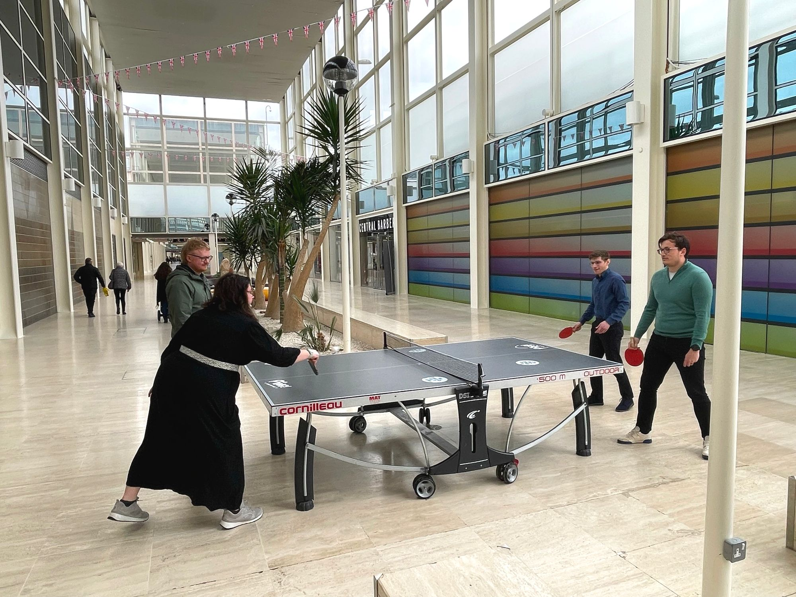
Principle 8: active buildings, inside and out
Aims: promote the design of buildings to provide opportunities for physical activity at the forefront, where the arrival experience, internal circulation, opportunities to move about and making the building an active destination are considered.
Image: © David Lock Associates
Notes:
Principle 8 aims to promote the design of buildings to provide opportunities for physical activity at the forefront, where the arrival experience, internal circulation, opportunities to move about and making the building an active destination are considered.
The next slides show how this can be done.

Slide 20
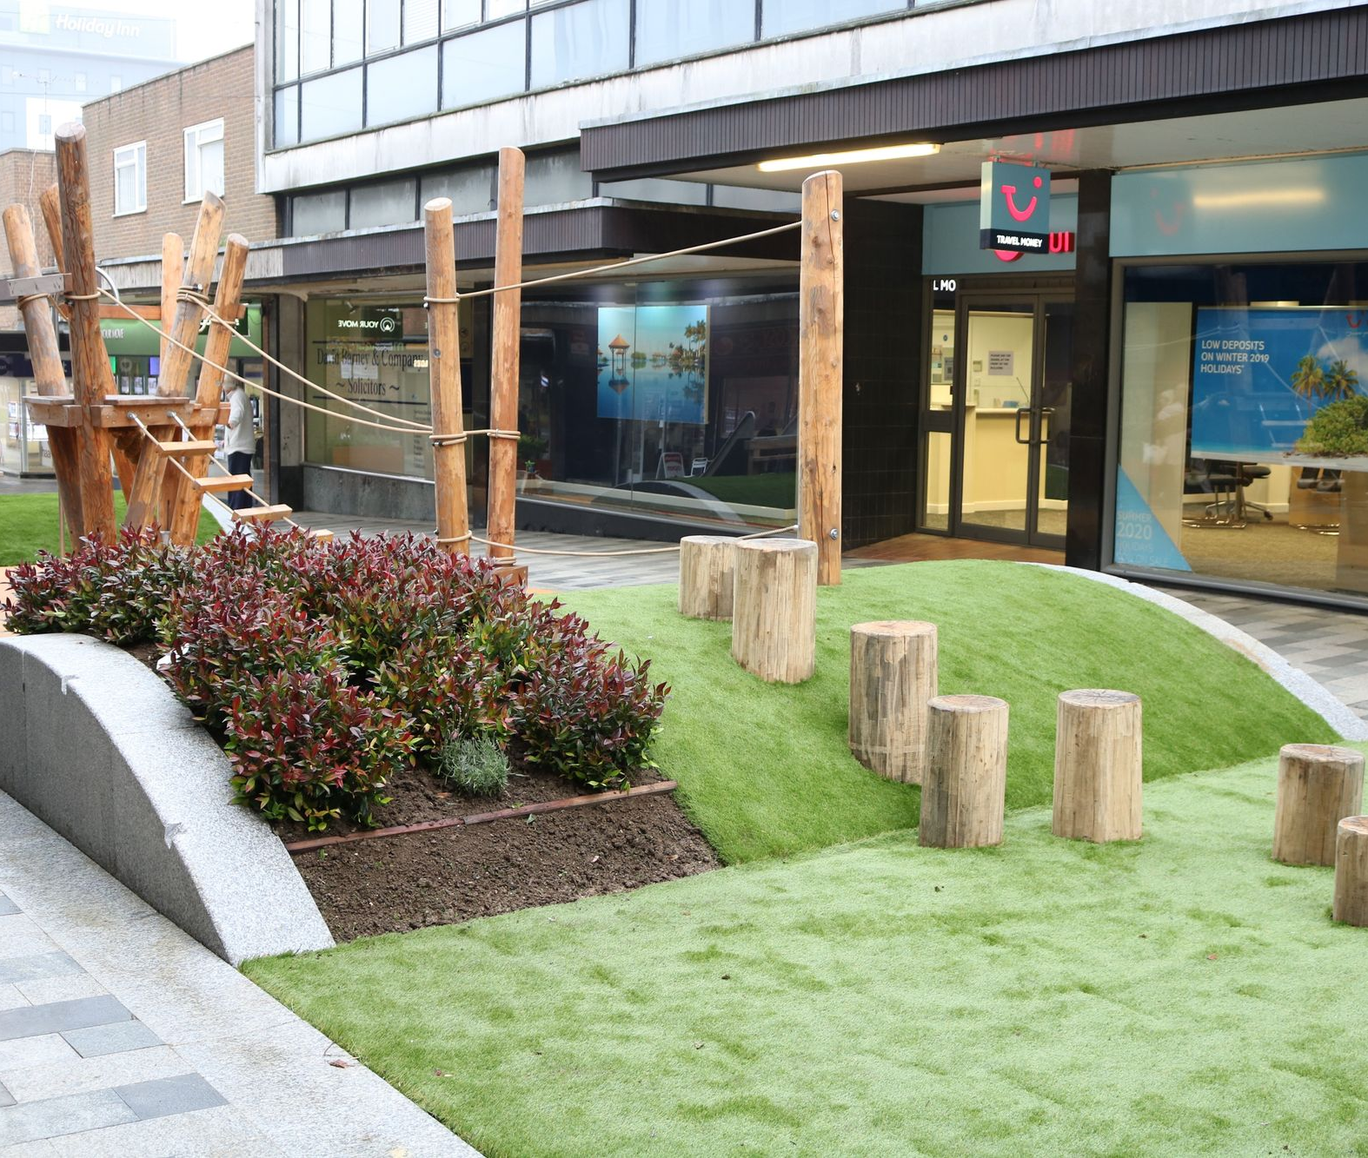
Principle 8: active buildings, inside and out (continued)
8.1 Orientate and design buildings to encourage activity.
8.2 Provide activity infrastructure inside and outside buildings.
8.3 Utilise areas within and around buildings to support activity.
8.4 Consider how to repurpose valued local assets into new physical activity destinations.
Image: © David Lock Associates
Notes:
Design considerations which can aid in the delivery of principle 8.
Part 8.1 looks at orientating and designing buildings to encourage activity. To achieve this, Active Design guidance recommends:
Ensuring buildings visually and physically engage with streets, and place prominent pedestrian entrances facing the streets.
Provision of cycle parking and storage for mobility options should be visible, covered, and securely and conveniently located.
Access for those with limited mobility should be level and easily accessible through the main entrance.
Car parking, when necessary, should be discreetly located to the rear, side, or underneath the building, with clear and safe footways directing users to the main entrance.
Stairways should be prominent while elevators are conveniently located but less conspicuous, with an encouragement of stair use through thoughtful design.
Part 8.2 looks at providing activity infrastructure inside and outside buildings. To achieve this, Active Design guidance recommends:
Provision of secure cycle parking at key destinations, with the inclusion of showers, lockers, bike maintenance equipment, and changing spaces.
Convenient cycle storage in homes to encourage cycling over driving, and the provision of parking for pushchairs and children’s scooters to promote active transportation for families.
All buildings should incorporate features such as wider doors, wheelchair-friendly spaces, handrails, adequate circulation space for those with limited mobility, and effective lighting.
Part 8.3 looks at utilising areas within and around buildings to support activity. To achieve this, Active Design guidance recommends:
Develop informal areas to host a variety of physical activities.
A well-designed landscape plan can identify areas for outdoor gatherings, equipped with seating, planting, and pathways.
Covered spaces and shelters to extend the usability of outdoor areas throughout the year.
Consideration of office spaces to promote movement through features like standing desks and meeting rooms.
Part 8.4 looks at considering how to repurpose valued local assets into new physical activity destinations. To achieve this Active Design guidance recommends:
Transforming heritage buildings into valuable assets that encourage people to get out and be more physically active by creating heritage or art trails or new community spaces.
Repurposing old department stores as leisure destinations in town or city centres to save local landmarks.
Address accessibility issues in older buildings by making sensitive interventions to adapt them and their surroundings to modern requirements, supporting active travel without compromising their character.

Slide 21
Theme 2 recap
How much money each year does Public Health England estimate could be saved if everyone in England had good access to greenspace?
£20 million
£200 million
£2 billion
What type of infrastructure does Principle 7 primarily focus on providing?
Infrastructure for passive activities
Infrastructure for digital connectivity only
Infrastructure to support active travel and physical activity
Infrastructure for exclusive use by certain groups
SAMPLE IMAGE
Which of the following is NOT how new buildings should be oriented and designed to promote active travel?
Utilise areas around building to support further activity
Provide activity infrastructure inside and outside
Create opportunities for movement
To prioritise aesthetics over functionality
Which of these principles are not covered under theme 2?
Providing activity infrastructure
Maintaining high quality flexible spaces
Network of multi functional open spaces
Notes:
A short quiz which covers principles 5, 6, 7 and 8 which sit within theme 2 of the active design.

Slide 22
Answers
Theme 2
How much money each year does Public Health England estimate could be saved if everyone in England had good access to greenspace?
£20 million
£200 million
£2 billion
What type of infrastructure does Principle 7 primarily focus on providing?
Infrastructure for passive activities
Infrastructure for digital connectivity only
Infrastructure to support active travel and physical activity
Infrastructure for exclusive use by certain groups
Which of the following is NOT how new buildings should be oriented and designed to promote active travel?
Utilise areas around building to support further activity
Provide activity infrastructure inside and outside
Create opportunities for movement
To prioritise aesthetics over functionality
Which of these principles are not covered under theme 2?
Providing activity infrastructure
Maintaining high quality flexible spaces
Network of multi functional open spaces
SAMPLE IMAGE
Notes:
The correct answers are:
A (£2.1 billion)
B
C
D

Slide 23

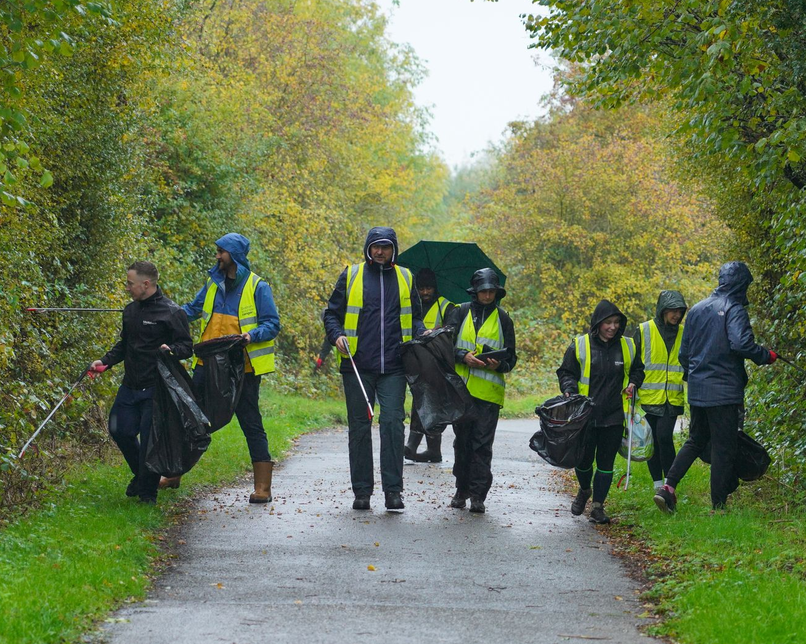
Principle 9: maintaining high-quality flexibly spaces
Theme 3
Aim: spaces and facilities should be effectively maintained and managed to support physical activity. These places should be monitored to understand how they are used and flexible so that they can be adapted as needed.
Image: @ Urban & Civic
Notes:
Principle 9 aims for spaces and facilities to be effectively maintained and managed to support physical activity. These places should be monitored to understand how they are used and are flexible so they can be adapted as needed.
This can be achieved by:
The next slides show how this can be done.

Slide 24
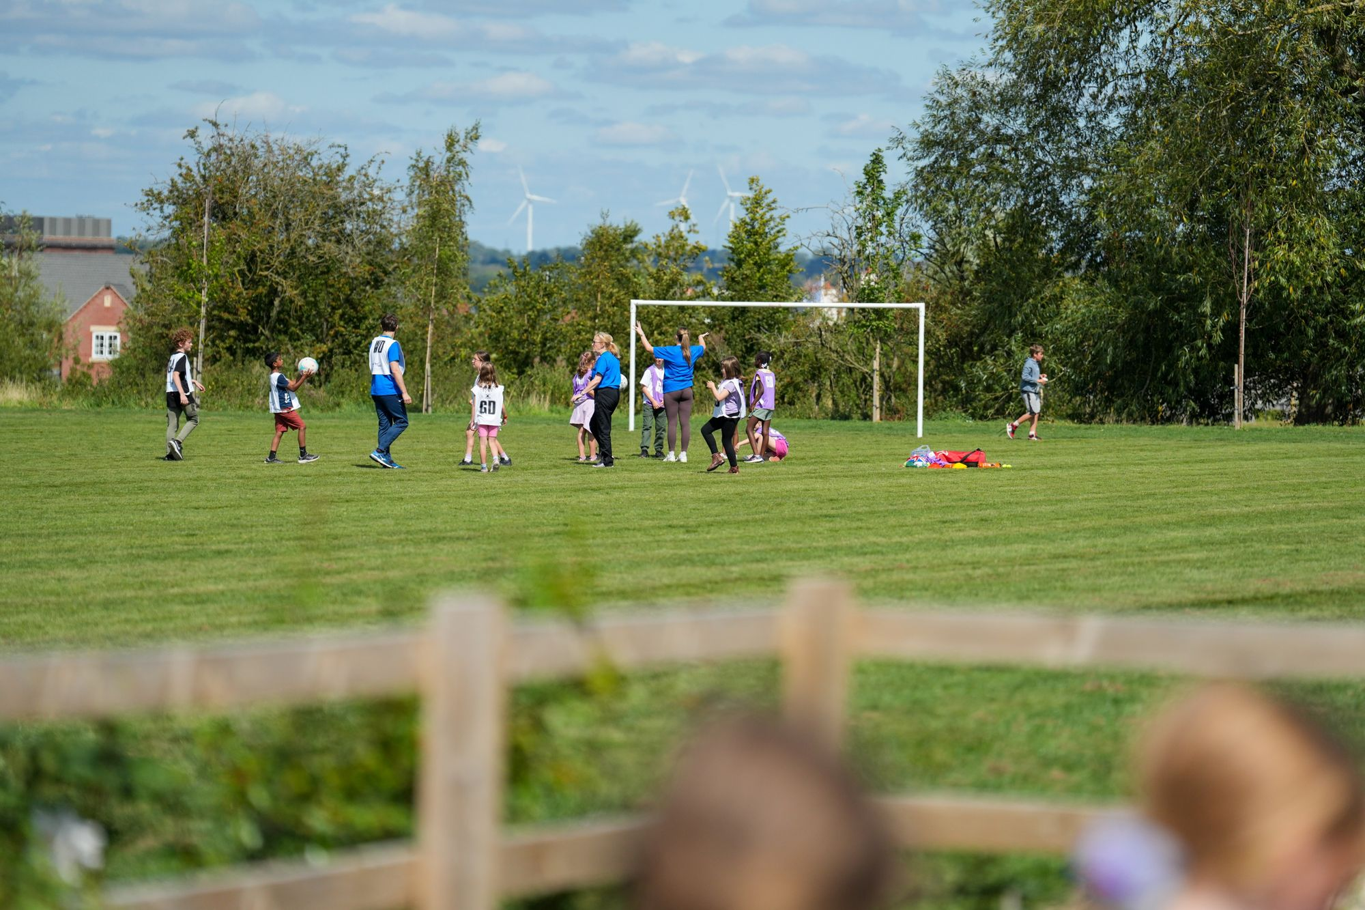
Principle 9: maintaining high-quality flexibly spaces (continued)
Theme 3
9.1 Manage and maintain spaces to enable effective and efficient use.
9.2 Monitor the effectiveness of Active Design interventions and be prepared to makes changes if circumstances have changed.
9.3 Consider management and monitoring and how it will be funded at an early stage.
Image: @ Urban & Civic
Notes:
Design considerations which can aid in the delivery of principle 9.
Part 9.1 looks at managing and maintaining spaces to enable effective and efficient use. To achieve this, Active Design guidance recommends:
Ensuring the attractiveness and safety of space to encourage people to engage in physical activities.
Optimise space management to target a diverse range of users.
Leverage school sports facilities for community use beyond school hours.
Part 9.2 looks at monitoring the effectiveness of active design interventions and the ability to make changes if circumstances have changed. To achieve this, Active Design guidance recommends:
The evaluation of the effectiveness of active design interventions for their effectiveness and efficiency, making adjustments as need to accommodate users’ needs and address unintended usage.
Flexible spaces that can be modified based on monitoring outcomes.
Ongoing evaluation to provide insights into long-term health impacts and the evolving characteristics, health profile, and demographic needs of the community.
Part 9.3 looks at the consideration of management and monitoring and how it will be funded at an early stage. To achieve this, Active Design guidance recommends:
Spaces should be adaptable to changing community needs and highlights the incorporation of monitoring outcomes into the design process.
Funding management and maintenance outcomes into the design process, including monitoring physical activity interventions, should be secured early on. For example, through Section 106.
Explore alternatives to local authority management, such as involvement of sports clubs or developers.
Ongoing monitoring is recommended to ensure that the design continues to meet the needs of the targeted groups, with support from earlier engagement.

Slide 25

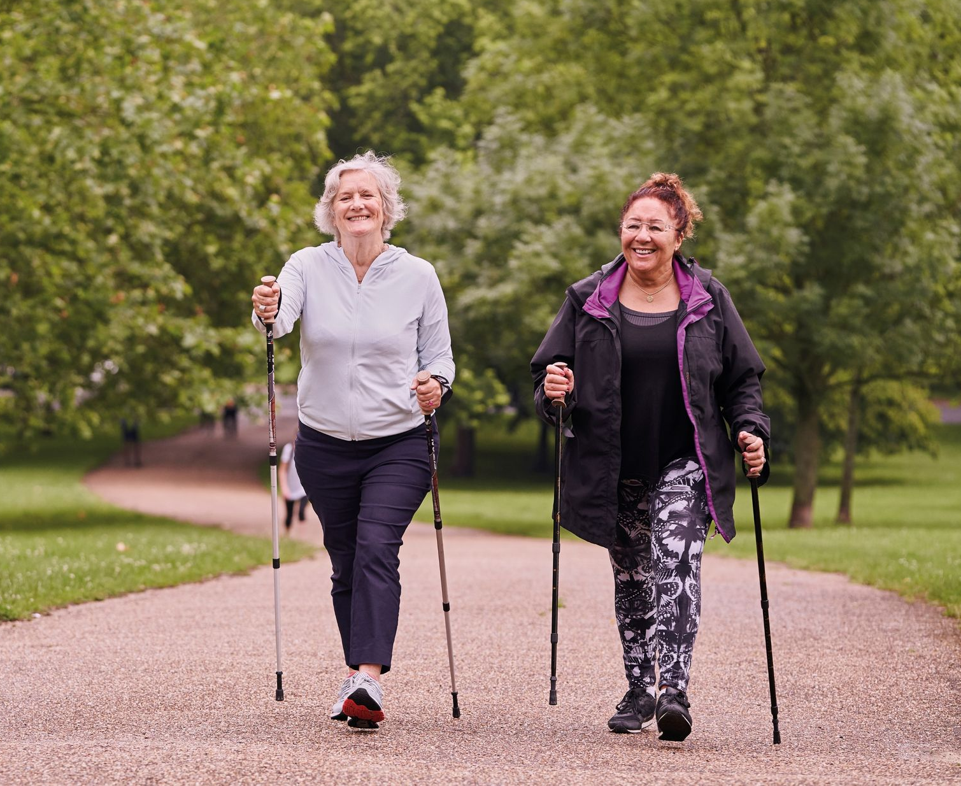
Principle 10: activating spaces
Theme 3
Aim: the provision of spaces and facilities which can help to improve physical activity should be supported by a commitment to activate them, encouraging people to be more physically active and increasing the awareness of activity opportunities within a community.
Image: © Sport England
Notes:
Principle 10 aims for the provision of spaces and facilities which can help to improve physical activity should be supported by a commitment to activate them, encouraging people to be more physically active and increasing the awareness of activity opportunities within a community.
This can be achieved by:
Providing investment into activity promotion as well as provision itself
Make spaces social to form connections around physical activity.
Use digital technology to promote and activate, as well as more traditional methods.
Encourage temporary uses and testing of ideas.

Slide 26
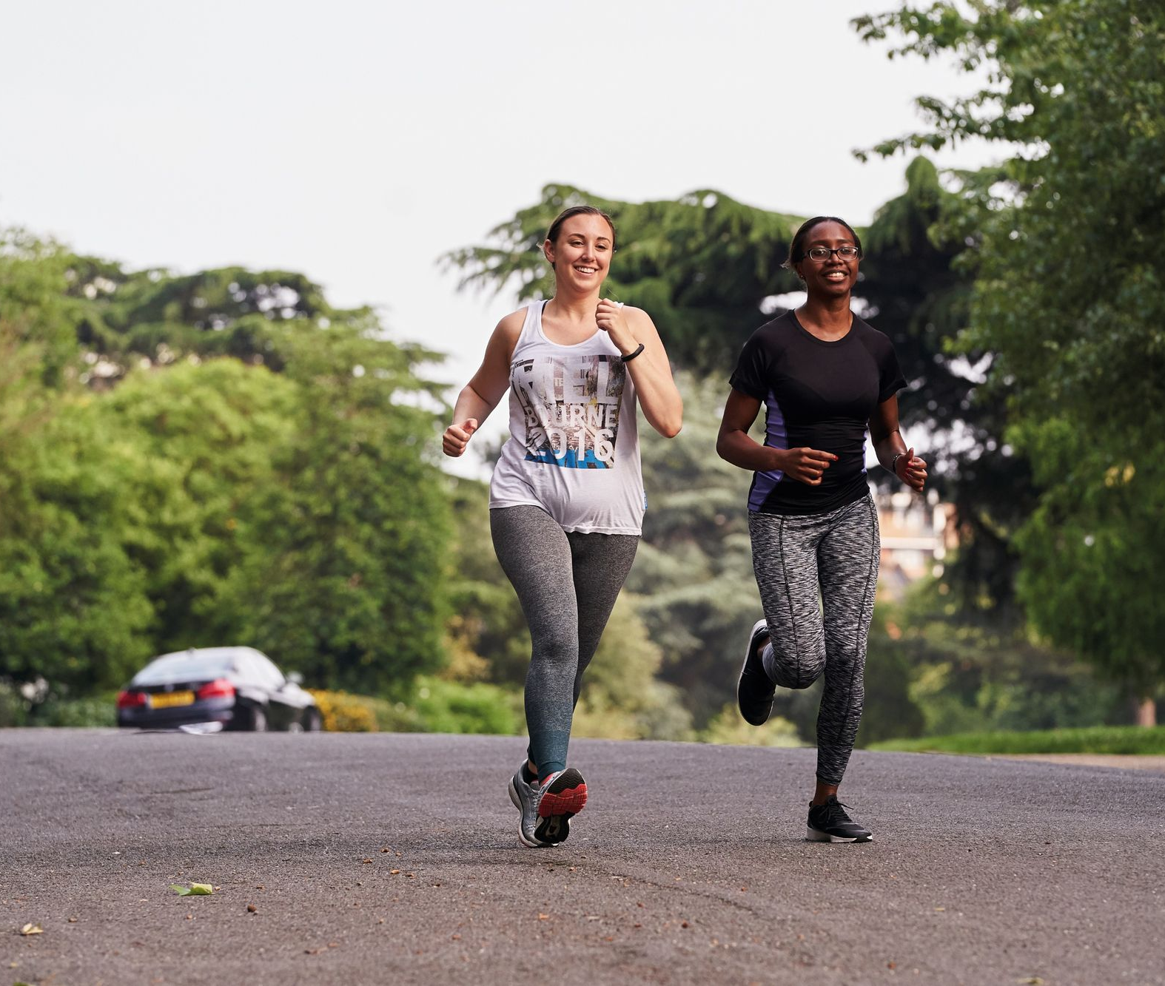
Principle 10: activating spaces (continued)
Theme 3
10.1 Provide investment into activity promotion as well as provision itself.
10.2 Make spaces social to form connections around physical activity.
10.3 Use digital technology to promote and activate, as well as more traditional methods.
10.4 Encourage temporary uses and testing of ideas.
Image: © Sport England
Notes:
Design considerations which can aid in the delivery of principle 10.
Part 10.1 looks at providing investment into activity promotion as well as provision itself. To achieve this, Active Design guidance recommends:
Considering the initial functioning of a space, using capital investment efficiently through programming, and engaging local stakeholders for activity programs.
Securing investment in projects through stewardship programs tied to major residential developments.
Part 10.2 looks at making spaces social to form connections around physical activity. To achieve this, Active Design guidance recommends:
Sharing physical activity experiences with others can be a good way to make or maintain social connections which can help to reduce loneliness and foster community cohesion.
Space should be designed, and activity promoted with this in mind, providing spaces for people to gather, sit and chat before and after the activities.
Part 10.3 looks at using digital technology alongside traditional methods to promote physical activity. To achieve this, Active Design guidance recommends:
Leveraging technology and social media for easy communication and encouragement of physical activity.
Fitness and health tracking apps are highlighted to support informal activities, both individually and in groups.
Consider those without digital access for promoting local physical activities.
Part 10.4 looks at encouraging temporary uses and testing of ideas. To achieve this, Active Design guidance recommends:
The temporary use of spaces to promote specific sports or activities.
Exploring temporary initiatives, such as prototyping and piloting, to effectively demonstrate the benefits of physical activity interventions without requiring significant investments.

Slide 27
Theme 3 recap
Theme 3
Which of the following are important things to consider before an active design intervention has been implemented:
  Monitoring
  Promotion
  Management
  Funding
Which of the following words could be used to describe temporary uses?
  Expensive
  Flexible
  Risky
Notes:
A short quiz which covers principles 9 and 10 which sit within theme 3 of the active design guidance.

Slide 28
Theme 3 answers
Theme 3
Which of the following are important things to consider before an active design intervention has been implemented:
  Monitoring
  Promotion
  Management
  Funding
Which of the following words could be used to describe temporary uses?
  Expensive
  Flexible
  Risky
The beauty of temporary uses is that they can implemented quickly and cheaply and are reversible if they don’t achieve want you want them to!
All of them!
Notes:
The correct answers are as follows:
All of these need to be considered at the outset to ensure an active design intervention is successful.
B. The beauty of temporary uses is that they can implemented quickly and cheaply and are reversible if they don’t achieve want you want them to!

