Slide 1
Vaccination against measles, mumps, rubella and varicella
Notes:
This resource is designed to be used by anyone involved in advising on or delivering an MMR-containing vaccine as part of the national vaccination programme.
If this slide set is to be used for the delivery of training, not all slides will be required. Trainers should select slides depending on audience background, their role in the vaccination programme and the length of training session.

Slide 2
Notes for users
this slide set contains a collection of core slides for both individual use and for use or adaptation during for the delivery of training about measles, mumps, rubella and varicella vaccination
trainers should select the slides required depending on the background and experience of the healthcare practitioners they are training and according to the role they will have in delivering the MMRV or MMR vaccine
the information in this slide set was correct at time of publication
  updates to the slide set may be required in the future, for example in response to changing epidemiology or vaccination recommendations - please check online to ensure you are using the latest version of these slides
the next slide contains information about the contents, which can be used to select which section(s) you require

Slide 3
Contents
programme overview of the MMR and MMRV vaccination programme
information about measles, mumps, rubella and varicella infections
vaccine effectiveness of MMR and MMRV
scheduling information
information about the MMR and MMRV vaccines
MMR and MMRV vaccine administration
contraindications and possible adverse reactions
MMR COVER data
measles and rubella elimination in the UK
achieving high immunisation uptake and addressing health inequalities
key messages and sources of information

Slide 4
Aims of resource
the aims of this resource are to:
refresh the knowledge base of healthcare practitioners regarding MMRV and MMR vaccine and the diseases against which they protect
support those who advise on or administer MMRV and MMR vaccine by providing evidence-based information
promote high coverage of vaccine against measles, mumps, rubella and varicella in those eligible by providing examples of initiatives to increase vaccine uptake
ensure healthcare practitioners are aware of the recent changes to the MMR/MMRV vaccination programme

Slide 5
Learning outcomes
on completion of this resource, users should be able to:
describe the cause, transmission, clinical presentation, course and possible complications of measles, mumps, rubella and varicella infections
understand the impact of reduced vaccination uptake
describe the available MMR-containing vaccines, their possible side effects and the precautions and contraindications to their administration
explain the dose, schedule and eligibility for MMRV and MMR vaccines
understand the importance of promoting, and providing evidence-based information about MMR/MMRV vaccination to the public, and be confident about doing so
identify additional professional resources and sources of public-facing information
Notes:
On completion of this resource, users should meet the stated learning outcomes. They should also be able to access the sources of additional information and know how to keep up to date with any programme changes.

Slide 6
MMR and MMRV vaccination programme overview
MMR vaccine was introduced as a routine single dose schedule in 1988 and became a two-dose schedule in 1996
from 1996, the first dose of MMR vaccine was offered to children from 12 months of age with a second dose offered at 3 years and 4 months
over the last 30 years, uptake of the MMR vaccine varied substantially
low uptake of the MMR vaccine has resulted in numerous outbreaks of measles and mumps which, as well as affecting young children, have often affected older children and young adults, who missed out on MMR vaccination as a child
as a result of this low uptake, in addition to the routine programme, there have been many selective campaigns which have targeted individuals who have an incomplete MMR vaccination history

Slide 7
MMR and MMRV vaccination programme overview (continued)
from 1 July 2025 major changes were made to the childhood vaccination programme, introduced in two phases
the changes in phase two, starting from 1 January 2026, involved a change in timing to when the second dose of an MMR-containing vaccine is administered from 3 years and 4 months to 18 months of age
in addition, the vaccine used for protection against measles, mumps and rubella changed to the quadrivalent MMRV vaccine to also offer protection against varicella (chickenpox)
from 1 January 2026, all children are being offered the combined MMRV vaccine at 12 and 18 months of age
older children born from 1 January 2020 without a history of chickenpox will be offered a dose of MMRV in a catch-up programme to help accelerate control and further reduce transmission of chickenpox in the population
for children born before 1 January 2020 and adults who have an incomplete measles, mumps and rubella vaccination history, MMR should be offered

Slide 8
Aims of MMR and MMRV vaccination
the aims of the vaccinating with MMR and MMRV are to:
  interrupt the spread of measles, mumps, rubella and varicella
  reduce the incidence and severity of these diseases
  eliminate measles and rubella from the UK population
achieving high coverage of 2 doses of MMR-containing vaccine is the most effective way to control measles, mumps and rubella
adding varicella protection by offering MMRV vaccine to eligible children should prevent severe cases of varicella and other serious complications from the infection, which while rare, may result in hospitalisation or other serious outcomes
the burden of these diseases fall disproportionately on under-served communities and addressing health inequalities is therefore a key element of any drive to improve uptake and eliminate measles and rubella

Slide 9
Measles

Slide 10
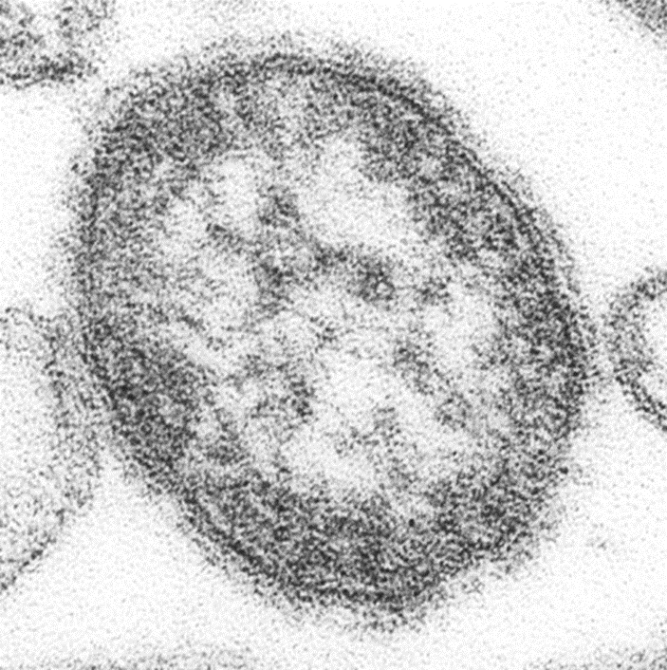
Measles: carriage, transmission, infectivity and incubation
measles is an acute viral illness caused by a morbillivirus of the paramyxovirus family
measles is one of the most highly infectious diseases in the world: one person with measles can infect 9 out of 10 people around them if they are not immune
measles is spread very easily from person to person by respiratory droplets which may persist in the air for several hours
individuals are infectious from when the first symptom appears to 4 days after the appearance of the rash. The risk assessment for exposure includes 4 days prior to rash onset
the incubation period is about 10 days (ranging between 7 and 18 days) with a further 2 to 4 days before the rash appears
Electron micrograph of measles virus. Image courtesy of CDC/ Cynthia S. Goldsmith; William Bellini

Slide 11
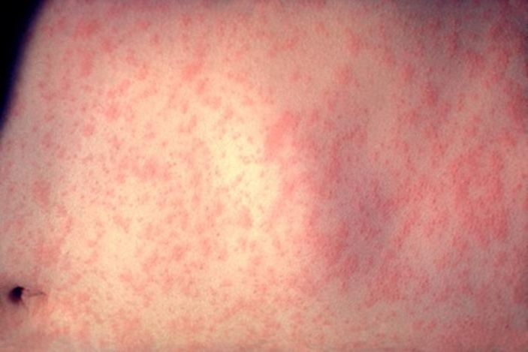
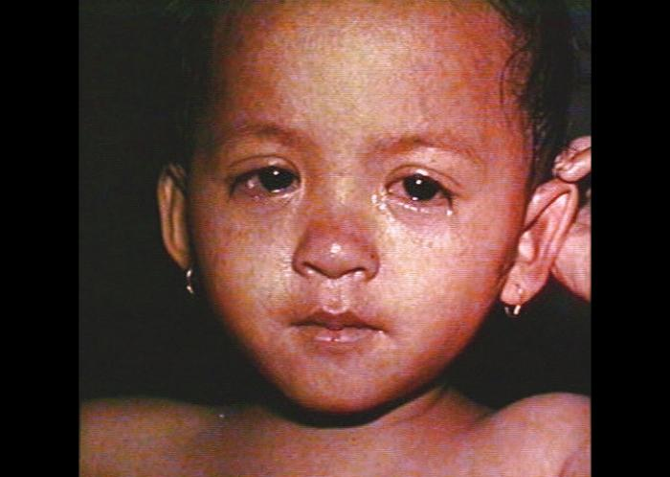
Measles: clinical presentation
the first symptoms to appear (prodromal stage) are fever, malaise, coryza, conjunctivitis and cough
a few days later, a red maculopapular rash appears, starting at the head and spreading to the trunk and limbs over 3 to 4 days
most people will feel better after 7 to 10 days, however measles can lead to complications such as ear and chest infections, fits and diarrhoea and dehydration in younger children
around one in every 15 children with measles will develop more serious complications which may include:
  Otitis media (7 to 9 in 100)
  Convulsions (1 in 200)
  Pneumonia (1-6 in 100)
  Encephalitis (1 in 1000)
  Sub-acute sclerosing panencephalitis (SSPE) (1 in 25,000)
  Death (1 in 1000-5000)
Measles rash. Image courtesy of CDC/ Heinz F Eichenwald, MD
Measles rash and conjunctivitis. Image courtesy of CDC/ Barbara Rice
Notes:
Sub-acute sclerosing panencephalitis (SSPE) is a rare, but fatal, late complication of measles occurring in 1 in 25,000 cases of measles. It occurs at a higher rate in individuals who had measles infection very young. The risk is 16 times greater for measles under the age of one, compared with measles at 5 years or older. Measles is more severe in adults and neonates.
In high-income regions of the world, such as Western Europe, measles still causes death in about 1 in 5000 cases. In the poorest regions, as many as 1 in 100 may die. In the 21st century, in England and Wales, there have been nine acute deaths due to measles. Five of these cases occurred in individuals who rely solely on herd immunity for protection as they had underlying immunological problems and so would not have been able to be vaccinated themselves.

Slide 12
Measles epidemiology
since the introduction of the measles vaccine in 1968, more than 20 million measles cases and 4,500 deaths have been prevented in the UK
however, uptake of the routine childhood vaccinations including MMR has declined in England over the last decade and is well below the 95% target set by the World Health Organization (WHO) in order to prevent outbreaks and achieve elimination
due to this sub-optimal uptake, since 2023 there has been a resurgence of measles in the UK
in 2024 alone there were around 3000 laboratory confirmed measles cases in England, the highest number recorded annually since 2012
the vast majority of cases in this resurgence have been in unvaccinated children under the age of 10 years with many outbreaks linked to nurseries and schools
more than 1 in 10 eligible children under the age of 5 in England haven’t had MMR vaccine or are only partially vaccinated
ensuring children receive MMR-containing vaccine is a priority in order to prevent further measles cases and outbreaks
Notes:
Since the autumn of 2023, regional outbreaks and an overall national exceedance in measles cases led the UK Health Security Agency (UKHSA) to declare a national standard incident. Initially focussed on populations within the West Midlands, outbreaks have occurred in other regions (such as London). Outbreaks and sporadic cases across the country have resulted in the highest number of measles cases in England since 2012 with 63% of cases in children aged 10 years old and under.
More information available at: What is measles and why is it so important we’re all up to date with our MMR vaccine? – UK Health Security Agency and Measles | UKHSA data dashboard

Slide 13
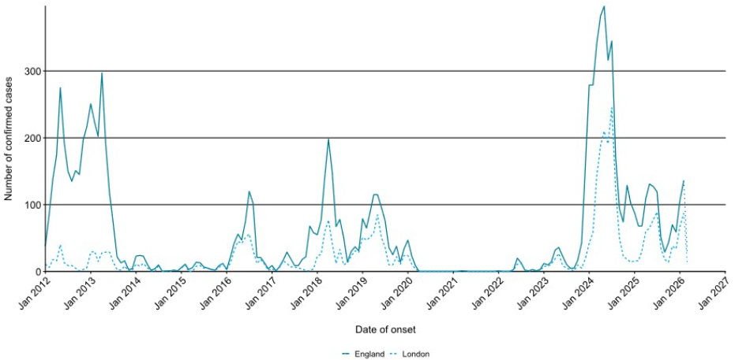
Laboratory confirmed cases of measles by month of onset of rash or symptoms reported
London and England: 1 January 2012 to 16 March 2026

Slide 14
Mumps

Slide 15
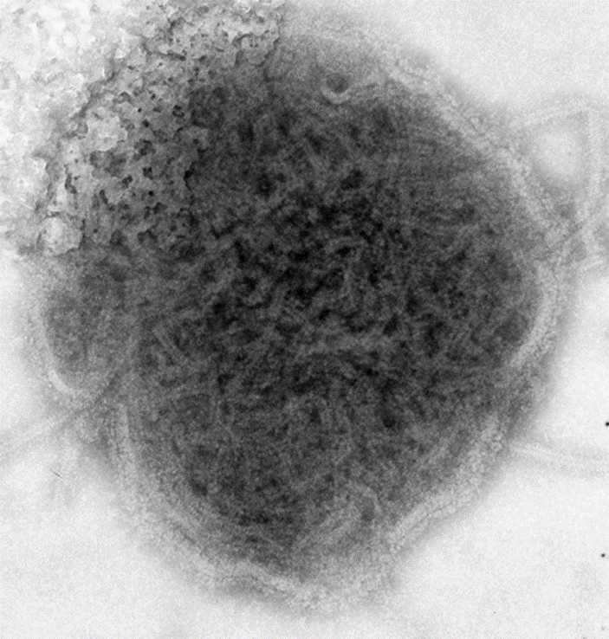
Mumps: carriage, transmission, infectivity and incubation
mumps is an acute viral illness caused by a paramyxovirus
spread through respiratory droplets and close contact
incubation period is around 16 to 18 days (range: 14 to 25 days)
individuals with mumps are infectious from about a week before the onset of parotid swelling to several days after it appears
Electron micrograph of mumps virus.
Image courtesy of CDC/ Dr FA Murphy

Slide 16
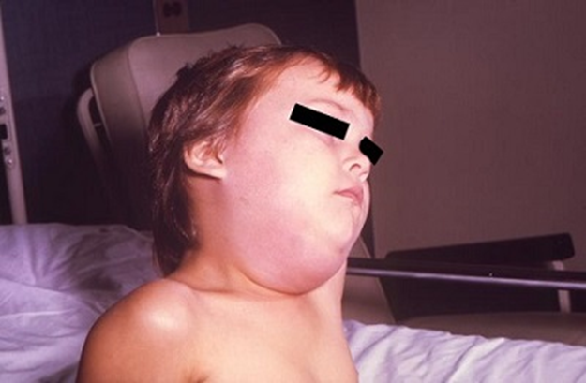
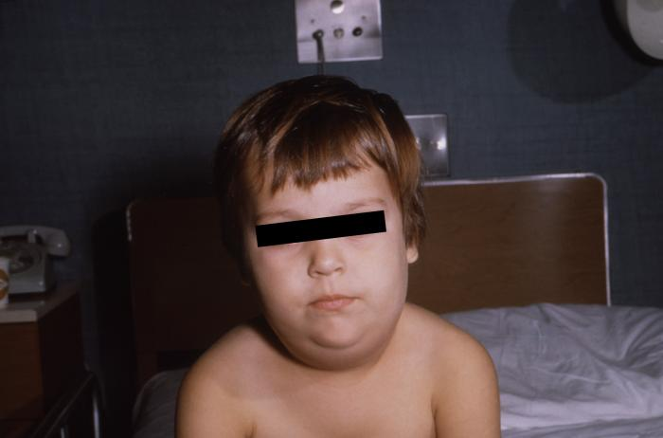
Clinical presentation of mumps
before MMR vaccine was introduced in 1988, mumps caused around 1200 hospital admissions each year in England and Wales and was the most common cause of both viral meningitis and acquired deafness in children
asymptomatic mumps infection is common (20 to 40% of cases), particularly in children. In individuals who do develop symptoms, these may include:
  bilateral or unilateral swelling of the parotid glands at the side of the face just under ears
  fever
  headache
  malaise
  myalgia
  anorexia
mumps can lead to a wide range of complications, including:
  meningitis: 5 in 100
  encephalitis: 1 in 1000
  epididymo-orchitis 15 to 30 in 100
  transient hearing loss: 4 per 100
  oophoritis (inflammation of the ovaries): 5 per 100
  pancreatitis: 4 per 100
  death: 5 per year in pre-vaccine era (mainly due to encephalitis)
Swelling of the salivary glands in child with mumps.
Images courtesy of CDC/Dr. Charles N. Farmer

Slide 17
Mumps epidemiology
before the MMR vaccine was introduced in 1988, about 80% of the population in the UK developed mumps
high coverage of MMR vaccine resulted in a substantial reduction in mumps transmission in the UK
from 1989, mumps cases dramatically declined in all age groups
since then, there have been several large outbreaks of mumps over the years, with the largest seen in 2005 (with over 43 000 notifications) and more recently in 2019 (with 5042 notifications)
many of these cases were seen in young adults who missed out on the MMR vaccine when they were children due to unfounded concerns about the vaccine or because they didn't have the vaccine as part of the catch-up campaigns or only had one dose
in comparison with years prior to 2020, there have been very few cases of mumps in the past 5 years

Slide 18
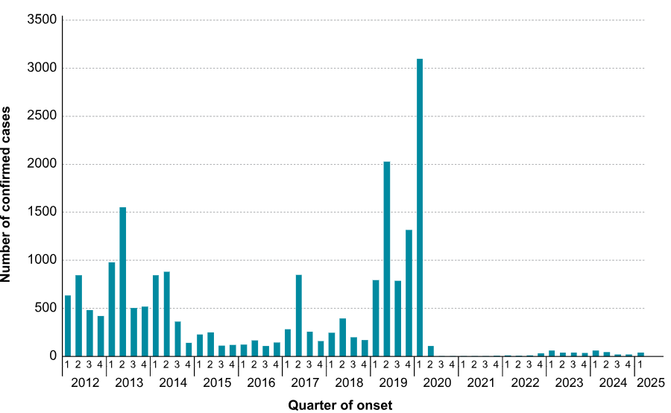
Laboratory confirmed cases of mumps by quarter, England: January 2012 to March 2025

Slide 19
Rubella

Slide 20
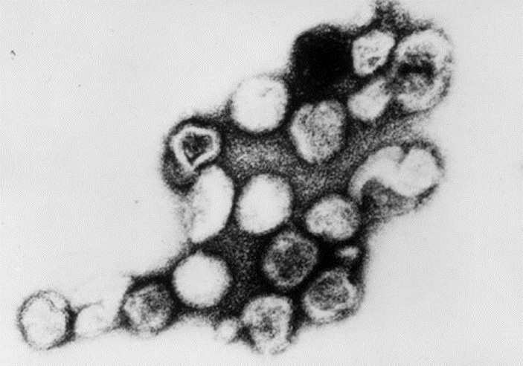
Rubella: carriage, transmission, infectivity and incubation
rubella is caused by a virus in the Togavirus family
transmission is by direct contact or droplet spread
incubation period is 14 to 21 days, with the majority of individuals developing a rash 14 to 17 days after exposure
infectious period is a week before to a week after onset of the rash
Electron micrograph of rubella virus.
Image courtesy of CDC/ Dr Erskine Palmer

Slide 21
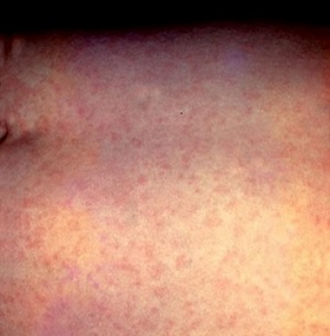
Clinical presentation of rubella
rubella is often asymptomatic with no more than a fleeting rash. If symptomatic, it is usually mild. Symptoms can include:
  mild fever
  cold-like symptoms
  feeling generally unwell
  conjunctivitis
  an erythematous rash, mostly seen on the face and neck
transient arthralgia or arthritis sometimes occurs in adults and adolescents, especially in women and girls
rare complications include idiopathic thrombocytopenic purpura (low platelets) and encephalitis
if a pregnant woman contracts rubella, the foetus can be severely damaged resulting in congenital rubella syndrome (CRS) which can present with one or more of the following:
  cataracts and other eye defects
  deafness
  cardiac abnormalities
  microcephaly
  intra-uterine growth retardation
  inflammatory lesions of brain, liver, lungs and bone marrow
infection in the first 10 weeks of pregnancy is associated with a 90% risk of damage to the developing foetus
Rubella rash.
Image courtesy of CDC

Slide 22
Rubella epidemiology and overview
before the introduction of rubella immunisation, rubella occurred commonly in children, and more than 80% of adults had evidence of previous rubella infection
rubella immunisation was introduced in the UK in 1970 for pre-pubertal girls and non-immune women of childbearing age to prevent rubella infection in pregnancy and congenital rubella syndrome (CRS) in their babies
universal immunisation against rubella using the MMR vaccine was introduced in 1988 with the aim of interrupting circulation of rubella among young children, thereby protecting susceptible adult women from exposure
the introduction of MMR brought a considerable decline in rubella in young children, with a concomitant fall in rubella infections in pregnant women: from 167 in 1987 to 1 in 2003
from 1970 to 2017 it is estimated that rubella vaccination has averted 1,300 CRS births and 25,000 terminations.
the childhood rubella vaccination programme alone is estimated to have averted 1.4 million cases of rubella in the UK
the WHO confirmed that the UK achieved rubella elimination in 2016 and there are now very few confirmed cases of rubella in the UK

Slide 23
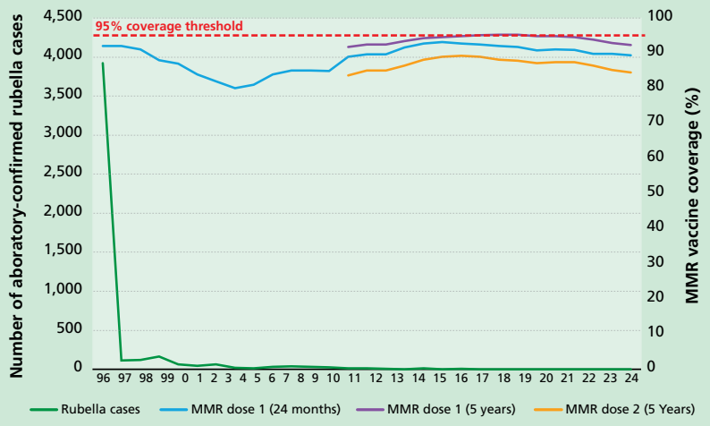
Number of UK laboratory-confirmed rubella cases, 1996 – 2024; MMR dose 1 coverage at 24 months, 1996 – 2024; and MMR dose 1 coverage at 5 years, 2009 – 2024; and MMR dose 2 coverage at 5 years, 2009 – 2024

Slide 24
Varicella (chickenpox)

Slide 25
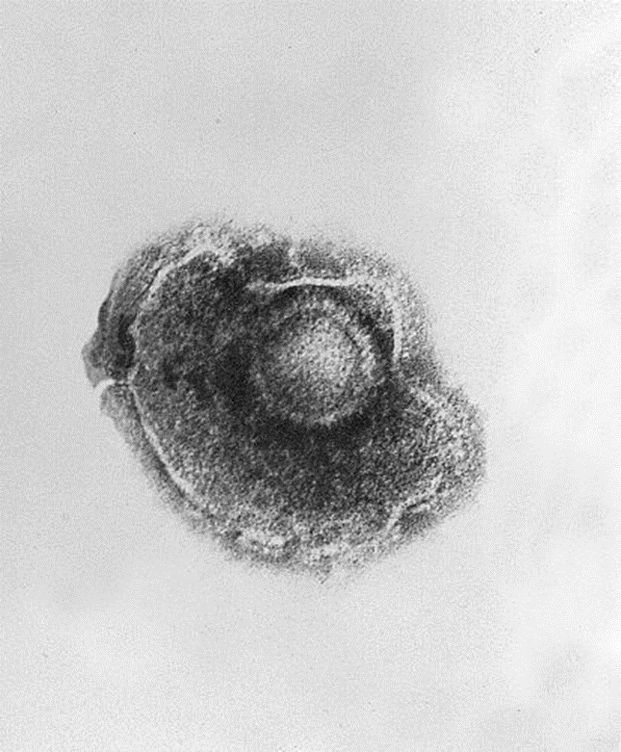
Chickenpox: transmission, infectivity and incubation
chickenpox is a highly infectious disease caused by the varicella zoster virus
the virus is spread by direct contact with the fluid-filled vesicles or inhalation of aerosols generated from vesicular fluid
the incubation period for chickenpox is 14 to 16 days (range 10 to 21 days)
individuals with chickenpox are infectious from up to 24 hours before the rash appears until spots have scabbed over
the secondary infection rate from household contact with chickenpox is approximately 71%
Electron micrograph of the chickenpox virus
Image courtesy of CDC/Dr. Erskine Palmer; B.G. Partin.

Slide 26
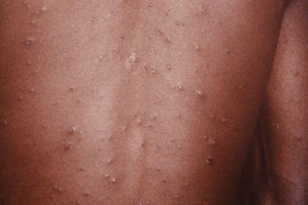
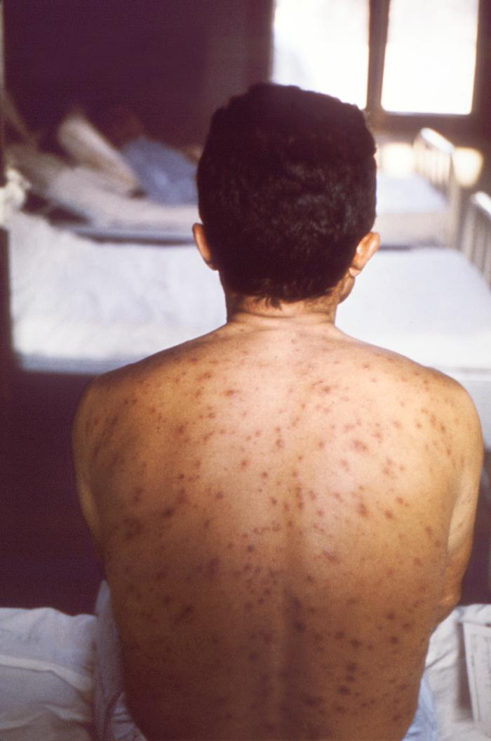
Clinical presentation of chickenpox
infection is characterised by an itchy rash with fluid-filled spots which starts on the face and spreads to the trunk before starting to scab over after 3 to 4 days
there may be a prodrome of fever and malaise 1-2 days prior to rash onset
in most children the disease is unpleasant but has no lasting effects other than scarring at the site of the vesicles, especially if they have been scratched
some individuals have very few spots whilst others have so many they merge together
potential complications of varicella infection include:
  pneumonia
  secondary bacterial infection of the skin with Group A Streptococcus or Staphylococcus aureus; either of these can lead to septicaemia
  encephalitis and ataxia
if a pregnant woman is infected, depending on gestational stage, the baby may develop congenital varicella syndrome (CVS)
CVS can include limb hypoplasia, microcephaly, cataracts, growth retardation and skin scarring or the baby may develop severe varicella; either could result in death
Chickenpox rash on the trunk
Image credit: NHS digital UK
Chickenpox rash to back, head and shoulders
Image courtesy of CDC/John Noble

Slide 27
Chickenpox overview
chickenpox is very common and affects most children during childhood, although it can be caught for the first time at any age
the incidence of chickenpox is seasonal and classically reaches a peak from March to May
90% of individuals raised in the UK are immune by the age of 15 years
most chickenpox cases in children are relatively mild and self-limiting
some children develop complications from varicella which can result in hospitalisation and very rarely may result in death
Varicella zoster virus can reactivate later in life, causing herpes zoster (shingles)

Slide 28
MMR and MMRV vaccine effectiveness

Slide 29
MMR vaccine effectiveness
    vaccine effectiveness of a single dose of MMR vaccine is around 95%
    a second dose protects those who do not respond to the first - protection then increases to well above 95%
    primary vaccine failure is rare, however it can occur, particularly after a single dose as not everyone will make a response to all 3 components
    in settings with high levels of close interpersonal contact, such as large households or school settings, controlling measles outbreaks requires a high coverage of 2 doses of MMR vaccine

Slide 30
MMRV vaccine effectiveness
approximately 87% of children develop antibodies against varicella, and more than 90% develop antibodies against measles, mumps, and rubella following the first dose of MMRV vaccine
following the second dose, seroconversion improves further, reaching approximately 99% for all four viruses
protection is long-lasting:
  a review of studies found vaccine effectiveness against varicella after 2 doses of MMRV or MMR + V in children aged 11 to 22 months was 95% in a 10 year follow-up
  25 years of surveillance in the US has shown no decrease in vaccine effectiveness over time when using a 2 dose schedule
although breakthrough infection can occur, varicella disease is milder in vaccinated children, with fewer lesions and less fever
one dose of varicella vaccine is extremely effective in protecting against severe varicella disease
two doses offer superior and durable immunity

Slide 31
Experience of varicella vaccination in other countries
varicella vaccination is included in the routine vaccine schedules of several countries, either as a 2-dose or single-dose strategy, including the USA, Canada, Australia and Germany.
countries that have introduced varicella vaccine programmes have observed significant impact on cases of varicella and resulting hospitalisations
since the varicella vaccination programme was introduced in the USA in 1995, it is estimated that more than 91 million varicella cases, 238 000 hospitalisations, and almost 2000 deaths have been averted
in countries introducing a 2-dose schedule, younger cohorts not eligible for vaccination have also seen reduced incidence because of reduced community transmission
there is no evidence of increased rates of infection among those ineligible for vaccination due to their age following introduction of a vaccination programme

Slide 32
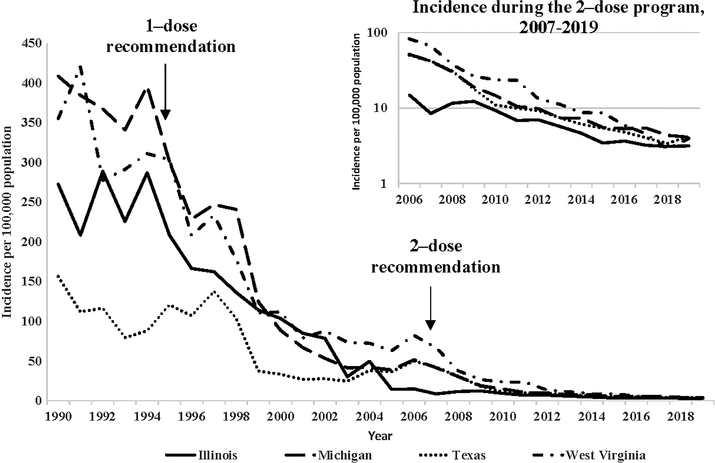
Decline in varicella cases in the USA since varicella vaccination programme introduced
Varicella incidence in 4 US states
1990 to 2019
From: Marin et al. Monitoring Varicella Vaccine Impact on Varicella Incidence in the United States: Surveillance Challenges and Changing Epidemiology, 1995–201.The Journal of Infectious Diseases, Volume 226, Issue Supplement_4, 1 November 2022, Pages S392–S39

Slide 33
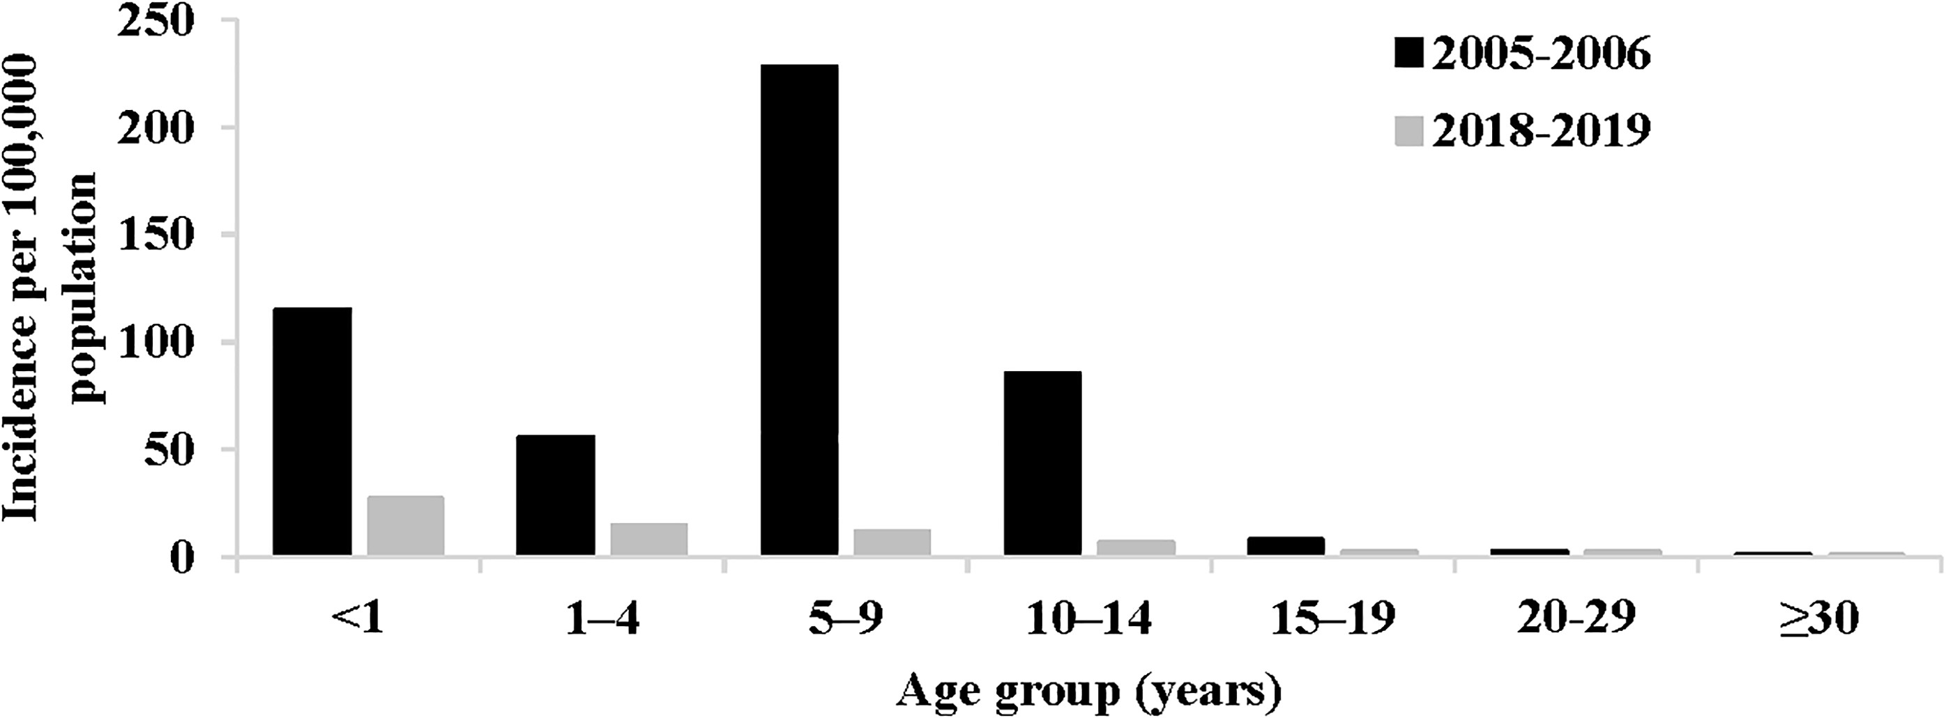
Decline in varicella cases in the USA since 2 dose vaccination programme introduced
Reported varicella incidence, by age group—United States, National Notifiable Diseases Surveillance System data, 2018–2019 compared with 2005–2006
Marin et al. Monitoring Varicella Vaccine Impact on Varicella Incidence in the United States: Surveillance Challenges and Changing Epidemiology, 1995–201.The Journal of Infectious Diseases, Volume 226, Issue Supplement_4, 1 November 2022, Pages S392–S39
Notes:
This graph demonstrates that in the USA, after introducing a 2-dose schedule, the under 1year age group who are not eligible for vaccination have also seen reduced incidence because of reduced community transmission.
It also shows that there is no evidence of increased rates of infection among those not eligible for vaccination (in the older age groups) following introduction of a varicella vaccination programme

Slide 34
MMR and MMRV vaccination scheduling

Slide 35
Scheduling of routine MMRV programme from
1 January 2026
two doses of MMRV offered to children aged under one year old on 31 December 2025 (DOB on or after 01 January 2025): dose 1 at one year, and dose 2 at the new 18-month appointment
two doses of MMRV offered to children aged from one year up to 18 months on 31 December 2025 (DOB on or after 01 July 2024 to 31 December 2024) at the new 18 month appointment and at the 3 year 4 month routine appointment. These children should have already received dose 1 of MMR at one year
one dose of MMRV offered to children aged from 18 months up to 3 years 4 months on 31 December 2025 (DOB on or after 01 September 2022 to 30 June 2024) at their 3 year 4 month routine appointment (instead of MMR). These children should have already received dose 1 of MMR at one year

Slide 36
Scheduling of selective MMRV programme
A one-dose MMRV selective catch-up programme will be delivered between 01 November 2026 to 31 March 2028:
one dose will be offered to any children aged from 3 years 4 months to under 6 years on 31 December 2025 (DOB on or after 01 January 2020 to 31 August 2022) with no history of chickenpox disease or two doses of varicella vaccination
children presenting for the selective catch-up do not require MMRV vaccine if parents volunteer that the child has had previous chickenpox infection or two prior varicella-containing vaccines
there is no requirement for practices to check the history for those who respond to the catch-up offer
there are no safety concerns with giving the vaccine to a child who has already had chickenpox infection or previous varicella vaccination

Slide 37
MMRV vaccination eligibility by date of birth
Date of Birth | Age on 31 December 2025 | New Programme from 01 January 2026 | Child’s full schedule for MMR/MMRV
01/01/2025 or later | Under 1 year | Two doses of MMRV at 12m and 18m | 12m – MMRV 18m – MMRV
01/07/2024 to 31/12/2024 | 1 year to under 18m | Two doses of MMRV at 18m and 3y4m This cohort was eligible to receive dose 1 of MMR at 12m | 12m – MMR 18m – MMRV 3y4m – MMRV
01/09/2022 to 30/06/2024 | 18m to under 3y4m | One dose of MMRV at 3y4m | 12m – MMR 3y4m – MMRV
01/01/2020 to 31/08/2022 | 3y4m to under 6y | Selective catch-up from 01 Nov 2026 to 31 Mar 2028 for those who have not yet had chickenpox infection or two doses of varicella vaccination There is no requirement for practices to check the history for those who respond to the offer | 12m – MMR 3y4m – MMR MMRV catch-up offer
31/12/2019 or before | 6y and older | Not eligible | 12m – MMR 3y4m – MMR
Notes:
The right hand column shows what a child who has been completely vaccinated for age according to the previous and current routine vaccine schedules will have/will receive. If they have missed a dose of MMR, there is no need to give this now – they should be offered MMRV instead so that they receive at least 2 doses of MMR-containing vaccine.
It does not matter that some children will receive 3 MMR-containing vaccines. If they have already made antibodies to measles, mumps or rubella following a previous dose, these antibodies will neutralise the vaccine virus in subsequent doses.

Slide 38
Older children and adults
MMR vaccine will no longer be available for the NHS routine childhood programme from 01 January 2026
MMR vaccine will be available for administration outside of the routine childhood programme e.g. for catching up older individuals (DOB on or before 31 December 2019) who have not received two doses of MMR and are not eligible for MMRV
children born on or before 31 December 2019 and adults are not eligible for MMRV vaccination via the routine NHS MMRV programme: if not fully vaccinated, they should be offered MMR vaccine
some older children and/or adults may be eligible for varicella-only vaccine outside of the national schedule (those who are non-immune healthy susceptible close household contacts of immunocompromised individuals or non-immune healthcare workers)
if MMRV is the only vaccine available at the time an unimmunised individual born on/before 31 December 2019 presents, MMRV should be given if it is felt that the individual would not return if asked to wait until MMR vaccine was available or if immediate protection is required

Slide 39
General principles
from 1 January 2026, MMR vaccine will only be offered to older children (born before 1 January 2020) and adults who have an incomplete MMR vaccination history
the exception is that MMR can still be given to young children (from 6 months of age but under 12 months) if urgent protection against measles is required, for example during an outbreak or for travel
if given before 12 months of age, a sub-optimal response may be made due to persistence of maternal antibodies so any doses given before 1st birthday should be discounted and the routine schedule followed at the recommended ages and interval
children born on or after 1 January 2020 who require MMR catch-up should be offered this using MMRV
individuals with uncertain or incomplete immunisation histories should be brought up to date at the earliest opportunity using the incomplete immunisation status algorithm
anyone who has missed out on their two doses of MMR vaccine can be brought up to date at any age: there are no negative effects from vaccinating people who are already immune to one or more components of the vaccine
those born before 1970 are likely to have immunity from natural infection as this age group was highly exposed to measles before the number of cases started to decline, but they can still be vaccinated if requested as there is no upper age limit for MMR vaccine

Slide 40
Timing of dose administration
    to maintain good control of measles, a two dose MMR-containing vaccine schedule is required to offer protection to those who did not respond to the first dose and to prevent accumulation of a pool of susceptible individuals that could otherwise re-establish measles transmission
    a full course consists of two doses of MMR-containing vaccine with a minimum interval of four weeks between doses
    if an individual has only previously received one dose of MMR-containing vaccine, they should receive a second dose at a minimum interval of four weeks from the first - it does not matter if the first dose has been administered many years earlier
    if an individual can’t recall whether they have received MMRV, MMR, MR or single vaccines, or the exact number of doses they have received, they should receive additional MMR-containing doses up to a total of two documented doses with an interval of at least four weeks between doses
    as MMR and MMRV vaccines are live vaccines, the risk of adverse reactions falls with each subsequent dose (if antibodies made to the first dose, these will neutralize the vaccine viruses in a subsequent dose)
Notes:
There is no upper age limit for MMR vaccine
There is no limit to the number of MMR-containing vaccinations an individual can receive. The risk of adverse reactions falls with increasing number of doses of MMR or MMRV (unlike inactivated vaccines such as tetanus) so the benefit of ensuring protection outweighs any risk of an additional dose of MMR or MMRV.

Slide 41
Making Every Contact Count
    Making Every Contact Count (MECC): practitioners should opportunistically check MMR/MMRV status of every individual and bring them up to date where appropriate
    individuals who may benefit from a review of their immunisation history include:
      newly registered individuals including young people joining a practice when they move for college or university, and those who have newly migrated to the UK
      members of the Charedi orthodox Jewish communities, traveller communities, anthroposophic (Steiner and Campbell) communities, and migrants - as these groups may have suboptimal vaccine uptake
      those with an occupation or medical condition that might make them at higher risk from infection or the consequences of infection
    other opportunities to offer catch up doses of MMR-containing vaccine include entry into primary or secondary school, higher education, enlistment into the armed forces, prior to foreign travel, or employment or study in the healthcare sector
    practitioners should ensure the correct MMR-containing vaccine is used when catching up individuals as, depending on their date of birth, some may be eligible for MMRV
Notes:
Where a child is behind schedule with their MMR or MMRV vaccination status, healthcare professionals should use the guidance within the MMRV information for healthcare practitioners' document to determine what vaccine should be used to ‘catch a child up’. Essentially, children born on or after 01/01/2020 and who require MMR catch-up should be offered this using MMRV. This is the cohort of children who are eligible for at least one dose of MMRV through either the routine schedule or the selective catch-up campaign.

Slide 42
Frontline health and social care workers
    Although there is no evidence that HCWs have lower MMR uptake than the general population, as they are in close contact with individuals receiving care, they are at increased risk of both catching measles and spreading it to them and to colleagues.
    all frontline health and social care workers with direct patient/service user contact should be checked for either two recorded doses of measles containing vaccine or for a positive measles and rubella IgG antibody test.
    this includes staff in all NHS trusts, general practices, care homes, and domiciliary care
    Employers are encouraged to:
    commission a service which makes access to the vaccine easy for all staff
    encourage staff to get vaccinated
    The definitions in the Green Book Chapter 12 should be used to identify those eligible as part of the frontline and social care workers’ programme
outstanding doses of MMR vaccine can be provided by the individual’s GP
where a healthcare worker requires MMR vaccine but is also varicella naïve, it may be more appropriate to offer MMRV

Slide 43
Women of childbearing age
    as MMR vaccine is a live vaccine, it is not recommended it is administered during pregnancy due to a theoretical risk of vaccine virus transmission to the unborn baby
      however, where MMR has been inadvertently administered in pregnancy there are no safety concerns, either for the mother or the baby
      those who have been inadvertently immunised with MMR in pregnancy can be reassured, see the following guidance for more detail: MMR (measles, mumps, rubella) vaccine: advice for pregnant women - GOV.UK
    unvaccinated women of childbearing age should be offered vaccine before becoming pregnant. Following vaccination, pregnancy should be avoided for one month
      if it is not possible to vaccinate before pregnancy, vaccination should be deferred until the woman is no longer pregnant
    services accessed by women including contraceptive services, fertility services, post natal appointments, 6-8 week maternal check appointments and cervical screening appointments and are all opportunities to remind women of their eligibility if they have not already been vaccinated
    rubella antibody levels do not need to be tested before commencing fertility treatment

Slide 44
MMR and MMRV vaccines

Slide 45
MMR vaccines
    there are two MMR vaccines currently available for use: Priorix and MMRvaxPro
    both vaccines contain live, modified strains of measles, mumps and rubella viruses
    each of the three strains in the vaccines are cultured separately and then mixed before being freeze dried (lyophilised)
    the vaccines are considered clinically equivalent and interchangeable
    MMR vaccines:
      do not contain thiomersal or any preservatives
      are supplied as a freeze dried vaccine that consists of a powder and solvent and require reconstitution
    MMR vaccines are centrally procured and can be ordered free of charge via ImmForm (ImmForm is a UKHSA website used to provide vaccine ordering facilities for the national immunisation programme https://portal.immform.ukhsa.gov.uk/)
    practices who serve communities who prefer porcine gelatine free products should order Priorix preferentially via Immform
Notes:
MMR vaccines should be stored and prepared in accordance with manufacturers instructions and shaken well before they are administered.

Slide 46
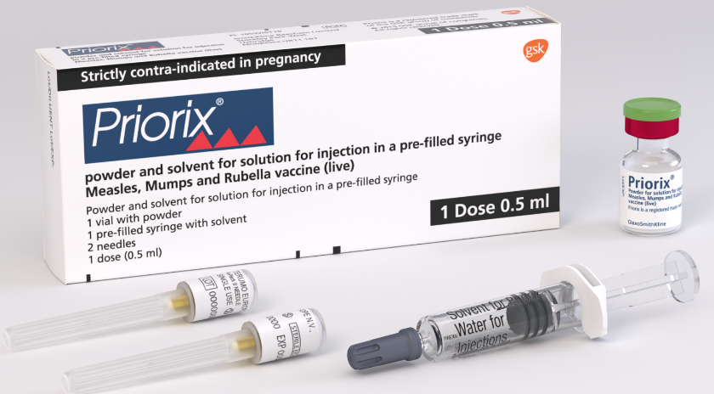
Priorix
Priorix is provided in singles dose packs: 1 x pre-filled syringe containing solvent + 1 vial of powder + 2 unattached needles
the solvent is water for injections
reconstituted vaccine may vary in colour from clear peach to fuchsia pink
one reconstituted dose is 0.5mL
Priorix does not contain porcine gelatine
  This MMR vaccine should be offered to individuals who do not wish to receive a vaccine containing porcine gelatine
Priorix is licensed for use in those aged 9 months or older. It may be offered, from the age of 6 months, as post-exposure prophylaxis; this is an off-label indication
Notes:
Priorix vaccine Summary of Product Characteristics
Priorix powder and solvent for solution for injection in a pre-filled syringe - Summary of Product Characteristics (SmPC) - (emc) (medicines.org.uk) www.medicines.org.uk/emc/product/1159/smpc

Slide 47
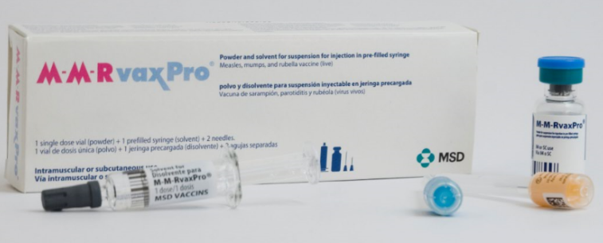
MMRvaxPro
MMRvaxPro is provided in single dose packs: 1 x pre-filled syringe containing solvent + 1 vial of powder + 2 unattached needles
one reconstituted dose is 0.5mL
the solvent is water for injections
reconstituted vaccine is clear yellow
MMRvaxPro contains porcine gelatine
  Priorix should be offered to individuals who do not wish to receive a vaccine containing porcine gelatine
MMRvaxPro is licensed for use in those aged 12 months or older. It may be offered, from the age of 6 months, as post-exposure prophylaxis; this is an off-label indication
Notes:
MMRvaxPro vaccine Summary of Product Characteristics
MMRVAXPRO - Summary of Product Characteristics (SmPC) - (emc) (medicines.org.uk)
www.medicines.org.uk/emc/product/6307/smpc

Slide 48
MMRV vaccines
two MMRV vaccines are available for the routine immunisation programme: ProQuad (MSD) and Priorix-Tetra (GSK)
ProQuad and Priorix-Tetra are live attenuated vaccines which contain weakened forms of the viruses that cause measles, mumps, rubella, and varicella
as the vaccine virus is ‘weakened’ it does not cause the disease itself, but it does cause the immune system to respond in the same way it does to natural infection, thereby promoting a full, long-lasting antibody response
both vaccines have been licensed for a number of years and are used in several other countries including Australia, Canada and Germany
the vaccines are considered clinically equivalent and interchangeable
the MMRV vaccine offers the same level of protection against measles, mumps and rubella as the MMR vaccine but also protects against varicella
a ‘varicella-only’ vaccine is not being offered in the NHS routine or selective catch-up programmes

Slide 49
Priorix-Tetra
Priorix-Tetra is provided in 10 dose packs: 10 x single dose powder in a vial and 10 x single dose diluent (solvent) in a pre-filled syringe
the solvent is water for injections
Priorix-Tetra does not contain porcine gelatine
this MMRV vaccine should be offered to children whose parents/carers do not wish them to receive a vaccine containing porcine gelatine
Priorix-Tetra is licensed for use in those aged 11 months or older. It may be offered, from the age of 9 months, as post-exposure prophylaxis; this is an off-label indication
Notes:
Priorix-Tetra vaccine Summary of Product Characteristics
Priorix Tetra Powder and solvent for solution for injection in pre-filled syringe - Summary of Product Characteristics (SmPC) - (emc) | 101321
www.medicines.org.uk/emc/product/101321/smpc
Please note that whilst it states ‘1 dose 0.5ml’ in the bottom right corner of the box and on the side of the box, this refers to the volume of vaccine (0.5ml) which should be given per dose. The box itself contains 10 doses of MMRV vaccine. Ensure that the cardboard tabs inside the box are removed to reveal the vials of powder.

Slide 50
Preparation and administration of Priorix-Tetra
Priorix-Tetra is presented as a powder in a vial with a solvent for solution in a pre-filled syringe
before reconstitution, the powder is a whitish to slightly pink coloured cake, a portion of which may be yellowish
the solvent is a clear colourless liquid
the vaccine is reconstituted by adding the entire contents of the pre-filled syringe of solvent to the vial containing the powder
the reconstituted vaccine should be visually inspected; its colour may vary from clear peach to fuchsia pink due to minor variations of its pH
it may contain translucent product-related particulates which is normal for this vaccine but if the vaccine presents with other colouration or contains other particulate matter do not administer
one reconstituted dose is 0.5mL

Slide 51
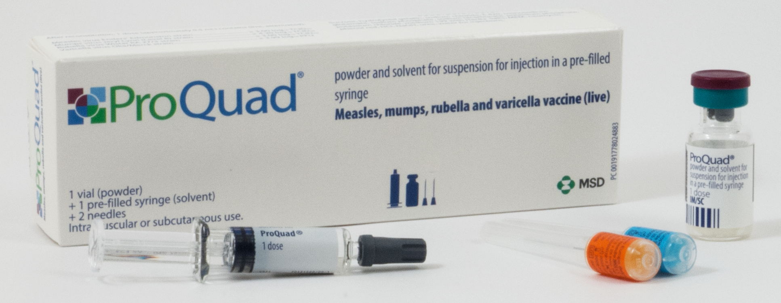
ProQuad
ProQuad is provided in single dose packs: 1 x pre-filled syringe containing solvent + 1 vial of powder + 2 unattached needles
one reconstituted dose is 0.5mL
the solvent is water for injections
ProQuad contains porcine gelatine
  Priorix-Tetra should be offered to children whose parents/carers do not wish them to receive a vaccine containing porcine gelatine
ProQuad is licensed for use in those aged 12 months or older. It may be offered, from the age of 9 months, as post-exposure prophylaxis; this is an off-label indication
Notes:
ProQuad vaccine Summary of Product Characteristics
ProQuad powder and solvent for suspension for injection in a pre-filled syringe - Summary of Product Characteristics (SmPC) - (emc) | 101444
www.medicines.org.uk/emc/product/101444/smpc

Slide 52
Preparation and administration of ProQuad
ProQuad is presented as a powder in a vial with a solvent for solution in a pre-filled syringe
before reconstitution, the powder is a white to pale yellow compact crystalline cake, a portion of which may be yellowish
the solvent is a clear colourless liquid
the vaccine is reconstituted by adding the entire contents of the pre-filled syringe of solvent to the vial containing the powder
gently agitate the vial to dissolve completely
when completely reconstituted, the vaccine is a clear pale yellow to light pink liquid
the reconstituted vaccine should be visually inspected for any foreign particulate matter and/or abnormal physical appearance prior to administration. In the event of either being observed, discard the vaccine
one reconstituted dose is 0.5mL

Slide 53
MMR and MMRV vaccine administration

Slide 54
Dose and scheduling
both the MMR and MMRV vaccines should be given as 0.5ml intramuscular injections
the routine schedule is 2 doses
doses should be given as per the routine schedule but where given to catch up a child behind schedule, they can be given a minimum of 4 weeks apart
some children will be eligible to receive three MMR-containing vaccines; there are no safety concerns with this approach
MMR and MMRV can be given at the same time as, or at any interval before or after, other live and inactivated vaccines (except for Yellow Fever vaccine where a 4 week interval is required)
if varicella vaccine is required at the same time as MMR vaccine, it must be given on same day or 4 weeks apart (better to give MMRV)

Slide 55
MMR and MMRV vaccine storage and administration
Storage
MMR and MMRV vaccines should be stored in a vaccine refrigerator between +2°C and +8°C
they should be stored in their original packaging to
  protect them from light
  ensure that the component parts are kept together
  retain the batch number and expiry date for the entire product which is printed on the outer vaccine carton
Administration
once reconstituted, they should be administered immediately
although they can be administered via the intramuscular route (IM) or subcutaneously (SC), for the national immunisation programme, it is recommended they are administered IM
they can be administered into the deltoid area of the upper arm or the anterolateral aspect of the thigh

Slide 56
Legal authorisation
all vaccines are classified as prescription only medicines (POMs)
this means that they are subject to legal restrictions and there needs to be an appropriate legal framework in place before they can be supplied and or administered
any person who supplies and administers a vaccine must have a legal authority to do so
this legal authority may be in the form of a written patient specific prescription, a Patient Specific Direction (PSD) or a Patient Group Direction (PGD)
the UK Health Security Agency (UKHSA) has developed and published MMR and MMRV PGDs which are available to download from the Immunisation PGD templates collection webpage
the UKHSA immunisation PGD templates require further authorisation in Section 2 of the PGD document before they can be used as the PGDs are not legal or valid without signed authorisation

Slide 57
Contraindications and possible adverse reactions

Slide 58
Contraindications and precautions
The MMR and MMRV vaccines should not be given to:
those who are immunosuppressed (see the Green Book Contraindications and special considerations chapter and measles, mumps, rubella and varicella chapters for more detail)
pregnant women (and pregnancy should be avoided for one month following the last dose of MMR vaccine)
those who have had
  a confirmed anaphylactic reaction to a previous dose of the vaccine
  a confirmed anaphylactic reaction to any component of the vaccine, including neomycin or gelatine
Immunisation of individuals who are acutely unwell with a fever should be postponed until they have recovered fully
this is to avoid confusing the diagnosis of any acute illness by wrongly attributing any sign or symptoms to the adverse effects of the vaccine
the presence of a minor illness, such as the common cold, is not a contraindication to immunisation
Notes:
There are very few individuals who cannot receive the MMR or MMRV vaccines. When there is doubt, appropriate advice should be sought from a consultant, the local screening and immunisation team, or consultant in public health rather than withholding the vaccine

Slide 59
Adverse reactions
    adverse reactions following the MMR vaccine (except allergic reactions) are due to effective replication of the vaccine viruses with subsequent mild illness. These typically occur :
    six to 11 days post-vaccination (due to measles component)
    two to three weeks post-vaccination (mumps and rubella components)
    three to four weeks post-vaccination (varicella component)
    the most common adverse reactions to MMR and MMRV include injection site reactions (such as pain/tenderness, redness and swelling), and fever, irritability, and rash (including a measles- or varicella-like rash)
    individuals with a varicella-like rash post-vaccination may be infectious to others but individuals with other vaccine-associated symptoms are not
    overall rates of adverse reactions after MMR and MMRV vaccines are similar or lower in second and subsequent doses compared to first doses
    all serious suspected reactions following MMR or MMRV vaccination should be reported to the Medicines and Healthcare products Regulatory Agency using the Yellow Card scheme http://yellowcard.mhra.gov.uk/

Slide 60
Post-vaccination varicella rash
some individuals may develop a varicella vaccine-associated rash around the site of the injection
children can attend childcare and educational settings but vesicles should be kept covered as a precaution
very rarely, children may develop a varicella-like rash either disseminated or localised away from the site of the injection within 1 month of vaccination
a disseminated rash is more likely to be due to natural varicella infection than the vaccine virus; children should be reviewed by a clinician and recent exposure considered
Transmission
transmission of varicella vaccine virus from immunocompetent vaccinees to susceptible close contacts is possible but the risk is very low
transmission of vaccine virus in absence of a post-vaccination rash has not been documented
if a localised vaccine-related rash develops away from the site of injection, lesions should be covered to further reduce the risk of transmission
if rash is disseminated, the risk is higher, and immunosuppressed people with significant exposure to the vaccinated child should be offered post-exposure prophylaxis in line with guidance
immunocompetent pregnant contacts can be reassured that the risk of infection is very low
Notes:
Full guidance can be found at: www.gov.uk/government/publications/post-exposure-prophylaxis-for-chickenpox-and-shingles

Slide 61
Febrile convulsions
Febrile convulsions
can occur when a child develops a high temperature caused by any typical childhood illness;
are self-limiting with no long-term consequences
most common between 6 months to 6 years of age; 2 to 5% of children will experience febrile convulsions before the age of 5
Risk following MMRV
small increase in risk of febrile convulsions in the 5 to 10 days following 1st dose of MMRV
risk estimated to be approximately 1 per 1,000 doses in the 7 to 10 days following vaccination; this is slightly higher than following the first dose of MMR
risk following vaccination is much lower than the risk following measles infection (1 per 43 cases)
parents should be advised of this low but possible risk and advised to seek medical attention if their child has a febrile convulsion
as fever following vaccination with MMRV vaccine may occur at any point within 2 weeks of vaccination, there is no need for the child to be offered prophylactic paracetamol prior to administration of the MMRV vaccine
children can receive paracetamol if they develop any post-vaccine related symptoms
no increased risk of febrile convulsions associated with 2nd dose

Slide 62
Encephalitis
encephalitis is a known complication of wild-type varicella and measles infections, associated with approximately 2 to 3 in 100,000 cases and 100 in 100,000 cases respectively
post-marketing surveillance of varicella-containing vaccines has found a small number of cases of encephalitis which occurred after vaccination but an association has not been quantified
15 years of surveillance of adverse events following varicella vaccination in the USA recorded 22 cases of encephalitis following MMRV: 0.06 cases per 100,000 doses
varicella zoster virus was detected in 1 of these cases, but was not strain-typed
the risk of encephalitis associated with natural varicella and measles infections is far greater than the risk following vaccination

Slide 63
Idiopathic thrombocytopenic purpura (ITP)
ITP is a blood disorder when the immune system attacks and destroys platelets (which are required for blood clotting)
ITP may occur following MMRV vaccination and is most likely due to the rubella component
this usually occurs within six weeks and resolves spontaneously
ITP occurs in about 1 in 22,300 children who are given a first dose of MMR in the second year of life and this is likely to be similar following MMRV
the risk of developing ITP after MMRV vaccination is much less than the risk of developing it after infection with wild measles or rubella virus
children with previously diagnosed ITP do not have an increased risk of ITP following MMR-containing vaccination
there is no evidence of an association between ITP and the second MMR dose; there is insufficient data on outcomes following the second dose for children who experienced ITP following the first dose
if ITP occurs following the first dose of MMRV then blood should be tested for measles antibodies before a second dose is given
if the results suggest a lack of protection against measles, then a second dose of MMRV is recommended
serological testing for the mumps, rubella, and varicella components is not recommended

Slide 64
MMR vaccine COVER data

Slide 65
Data collection: Coverage of Vaccination Evaluated Rapidly (COVER)
“the ability to reliably measure vaccine coverage plays an essential role in evaluating the success of a vaccination programme, identifying susceptible populations for further interventions and informing future vaccine policy decisions; this is dependent on having an accurate estimate for the eligible population (denominator) and a robust method of ascertaining the number of those eligible individuals who have received a particular vaccine dose (numerator).” (Amirthalingam, G. et al 2012)
the COVER data collection and analysis programme has operated in the UK since 1987 and is nationally mandated
local authority and GP practice level immunisation coverage data for the pre-school vaccination programmes are extracted from Child Health Information Systems (CHISs) and submitted to NHS Digital’s Strategic Data Collection Service (SDCS) on a quarterly basis
the UKHSA analyses this data and produces/publishes quarterly (official statistic) and, jointly with NHS Digital, annual (national statistic) reports
COVER measures “the proportion of children aged 12 months, 24 months and 5 years who have completed courses of each routine childhood immunisation”
How COVER works (with specific reference to MMR):
first dose coverage is measured at age 2 years and again at age 5 years, and second dose coverage is measured at age 5 years
Denominator: Total number of children for whom the local healthcare system/Local Authority is responsible on the last day of a defined quarter whose second or fifth birthday falls within that quarter
Numerator: Total number of children who have completed immunisation at any time by their second or fifth birthday
Tightly defined dose/course: one dose of MMR/MMRV by 24 months; one and two doses of MMR/MMRV by five years
Important: 1st doses given before age 1 year (too early) and after the 2nd and 5th birthday, and 2nd doses given after the 5th birthday are not included, however, two doses of MMR-containing vaccine are required for full, long-term protection and children should continue to receive any missed dose(s)
Notes:
Amirthalingam, G., J. White, and M. Ramsay. 2012. “Measuring Childhood Vaccine Coverage in England: The Role of Child Health Information Systems.” Eurosurveillance 17 (16): 20149. https://doi.org/10.2807/ese.17.16.20149-en
.

Slide 66
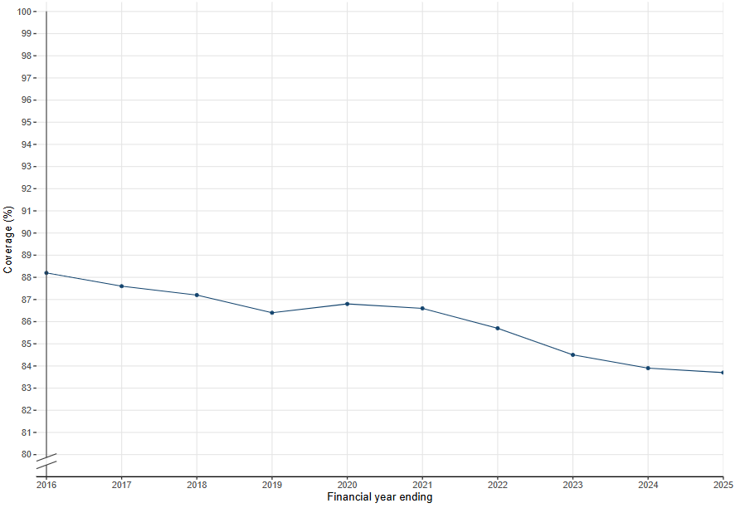
Coverage of two doses of MMR vaccine in England in children aged 5 years March 2016 to March 2025
In England over the last 10 years:
coverage for the 1st dose of MMR vaccine by 5 years of age peaked at 91.9% in 2015 to 2016, falling to 88.9% in 2024 to 2025
coverage for the 2nd dose of MMR vaccine by 5 years of age peaked at 88.2% in 2015 to 2016 and has continued to fall since then to 83.7% in 2024 to 2025
measles is so highly infectious that a 95% vaccination rate is required to achieve herd immunity and prevent outbreaks
uptake in England is below the level required to stop transmission and protect individuals who cannot be vaccinated

Slide 67
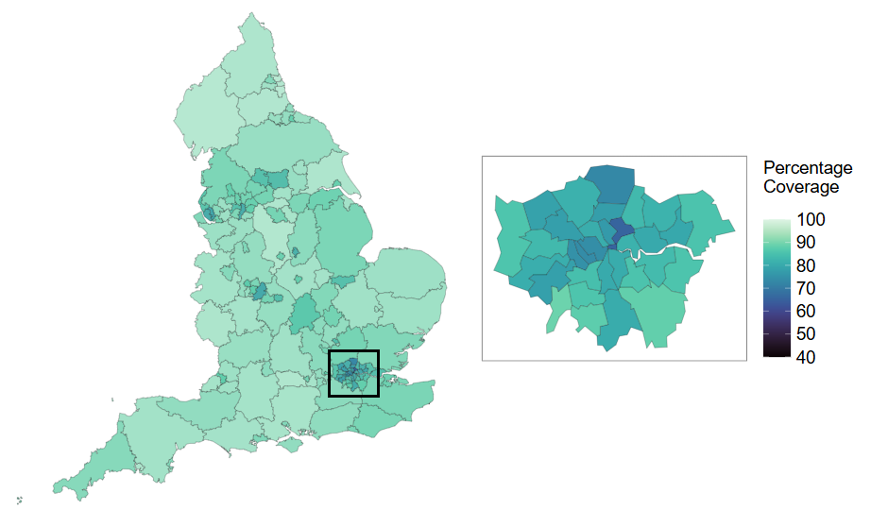
Geographical variation
The infographic shows coverage of the 1st dose of MMR vaccine in children aged 24 months in England for 2024 to 2025 by upper-tier local authority
Coverage varies by geography – it is consistently lowest in London

Slide 68
Impact of the COVID-19 pandemic: population immunity gaps
due to the COVID-19 pandemic, vaccine uptake rates for routine childhood programmes have fallen globally
coverage for the measles, mumps and rubella (MMR) vaccination programme in the UK has also fallen to the lowest level in a decade:
  uptake for the first dose of the MMR vaccine in children aged 2 years in England is 85.6%
  uptake of 2 MMR doses at age 5 years is 85.5%
  this is below the 95% target set by the World Health Organization (WHO) as necessary to achieve and maintain elimination
UKHSA has been working closely with the NHS and other partners to support the recovery of the routine childhood immunisation programme and to catch-up children who missed out on their vaccinations during the COVID-19 pandemic.
the UK Measles and Rubella Elimination Strategy sets out key recommendations for action including the development of local action plans that address specific population needs
in London, a polio and MMR catch-up campaign targeting unvaccinated or partially vaccinated children aged 1 to 11 years is being rolled out through GP practices, primary schools and community vaccination clinics
Notes:
HPR volume 17 issue 7: news (14 July 2023)
Updated 14 July 2023
HPR volume 17 issue 7: news (14 July 2023) - GOV.UK (www.gov.uk) www.gov.uk/government/publications/health-protection-report-volume-17-2023/hpr-volume-17-issue-7-news-14-july-2023
Quarterly vaccination coverage statistics for children aged up to 5 years in the UK (COVER programme): January to March 2023
Updated 27 June 2023
Quarterly vaccination coverage statistics for children aged up to 5 years in the UK (COVER programme): January to March 2023 - GOV.UK (www.gov.uk) www.gov.uk/government/statistics/cover-of-vaccination-evaluated-rapidly-cover-programme-2024-to-2025-quarterly-data/quarterly-vaccination-coverage-statistics-for-children-aged-up-to-5-years-in-the-uk-cover-programme-january-to-march-2025

Slide 69
Your role in improving data quality
we all have a role to play in improving data quality which helps ensure we can generate more accurate estimates of vaccine coverage and public health risk
it is important that all vaccines are recorded in the GP record and for children also in the Child Health Information System (CHIS) record accurately
using the correct SNOMED codes will ensure the individual is categorised as immunised, fully immunised or partially immunised for age correctly on a data extract
this is especially important for movers in and newly registered patients, particularly new migrants coming into the country

Slide 70
Measles and rubella elimination in the UK

Slide 71
Measles and rubella elimination in the UK
all member states of the European region of the World Health Organisation (WHO), including the UK, are committed to eliminating measles and rubella from their countries
elimination is the absence of endemic measles and rubella cases for a period of at least 12 months from the last known case, due to complete interruption of endemic virus transmission, in the presence of a high-quality surveillance system that is sensitive and specific enough to detect, confirm and classify all suspected cases, and genotyping evidence that supports the interruption of endemic transmission
  in 2015, the UK achieved elimination status for rubella
  in 2016, the UK had eliminated measles based on data from 2014-2016
  in 2018, the UK lost its measles elimination status when re-establishment of virus transmission occurred
  in 2021, the UK regained elimination status based on the interruption of transmission of measles during the COVID-19 pandemic
  in 2024, the UK lost its measles elimination status when re-establishment of virus transmission occurred
Notes:
Measles and rubella elimination UK indicators
Measles and rubella elimination UK indicators - GOV.UK (www.gov.uk) https://www.gov.uk/government/publications/measles-and-rubella-elimination-uk
UK measles and rubella elimination indicators and status
UK measles and rubella elimination indicators and status - GOV.UK (www.gov.uk) https://www.gov.uk/government/publications/measles-and-rubella-elimination-uk/uk-measles-and-rubella-elimination
Endemic transmission - continuous transmission of indigenous or imported measles or rubella virus that persists for a period of 12 months or more in a defined geographical area
Interrupted endemic transmission - the absence of endemic measles or rubella cases in a defined geographical area for a period of at least 12 months, in the presence of a well-performing surveillance system. Regional elimination can be declared after 36 or more months of the absence of endemic measles or rubella in all Member States

Slide 72
Achieving and maintaining elimination status
to achieve and maintain elimination status, the WHO recommends 95% vaccine uptake with two doses of an MMR- containing vaccine by 5 years of age
UKHSA analysis suggest that population immunity levels are well below those required to interrupt measles transmission in many birth cohorts
  the number of susceptible individuals is higher in young people born between 1998/99 and 2003/04
measles and rubella remain endemic in many other countries and, with large measles outbreaks occurring across Europe and in multiple countries in South Asia and Africa, imported infections pose a very real threat to the UK’s recent achievements (see slides 14 and 15 for the latest epidemiology)
current UK performance for the second dose needs to be improved to attain and maintain 95% uptake by age five years
Recommendations on actions that need to be taken across the system to achieve and maintain measles elimination are captured in the UK Measles and Rubella elimination strategy published in 2019: Measles and rubella elimination UK strategy - GOV.UK (www.gov.uk)

Slide 73
Predicting outbreaks – UKHSA modelling
Risk assessment of measles resurgence in the UK – published July 2023
  current MMR uptake levels lowest in a decade
  during pandemic - increased pool of susceptibles in younger children - around 1 in 10 children starting school at risk of measles
  highest susceptibility in ‘Wakefield cohorts’ born between 1998-1999 and 2003-2004, now aged 19 to 25 years
  London remains most vulnerable region (also most likely to get importations) – could sustain large outbreaks 40,000 - 160,000 cases
  high risk of imported cases leading to outbreaks in:
    under vaccinated communities e.g. migrant populations, traveller communities, and ultra-orthodox Jewish communities
    geographies (inner-city areas) with some risk of limited spread to the wider community

Slide 74
Measles resurgence from 2023
in 2023 a resurgence of measles in England was seen. From 1 January to 31 December 2023 there were 367 laboratory confirmed measles cases. The rapid increase in cases in late 2023 was driven by a large outbreak in Birmingham
there were subsequent rises in London and small clusters in other regions in the first half of 2024. Case counts decreased from mid-July with small, localised outbreaks in the second half of the year. There were 2,911 laboratory confirmed measles cases in 2024
between 1 January 2025 and 31 December 2025 there were 959 laboratory confirmed measles cases in England.
  51.4% (493/959) of these cases were in London, 14% (134/959) in the North West, and 7.9% (76/959) in the East of England
  the majority (655 of 959, 68.3%) of these cases were in children aged 10 years and under and 25.4% (244 of 959) in young people and adults aged 15 years and over. Median age was 5 years
  2.7% (26/959) were vaccinated with one dose and 1.9% (18/959) were vaccinated with two doses. The remaining cases either had no vaccination recorded, were too young to be vaccinated, or had MMR as pre or post exposure
  one acute measles death was reported
in 2026, based on data submitted in 2024, the UK lost its measles elimination status
Notes:
Measles epidemiology 2023 to 2026 - GOV.UK www.gov.uk/government/publications/measles-epidemiology-2023
Immunisation - GOV.UK www.gov.uk/government/collections/immunisation#measles,-mumps-and-rubella-(mmr)
What is measles and why is it so important we’re up to date with our vaccines to protect against it? – UK Health Security Agency https://ukhsa.blog.gov.uk/2026/01/22/what-is-measles-and-why-is-it-so-important-were-up-to-date-with-our-vaccines-to-protect-against-it/

Slide 75
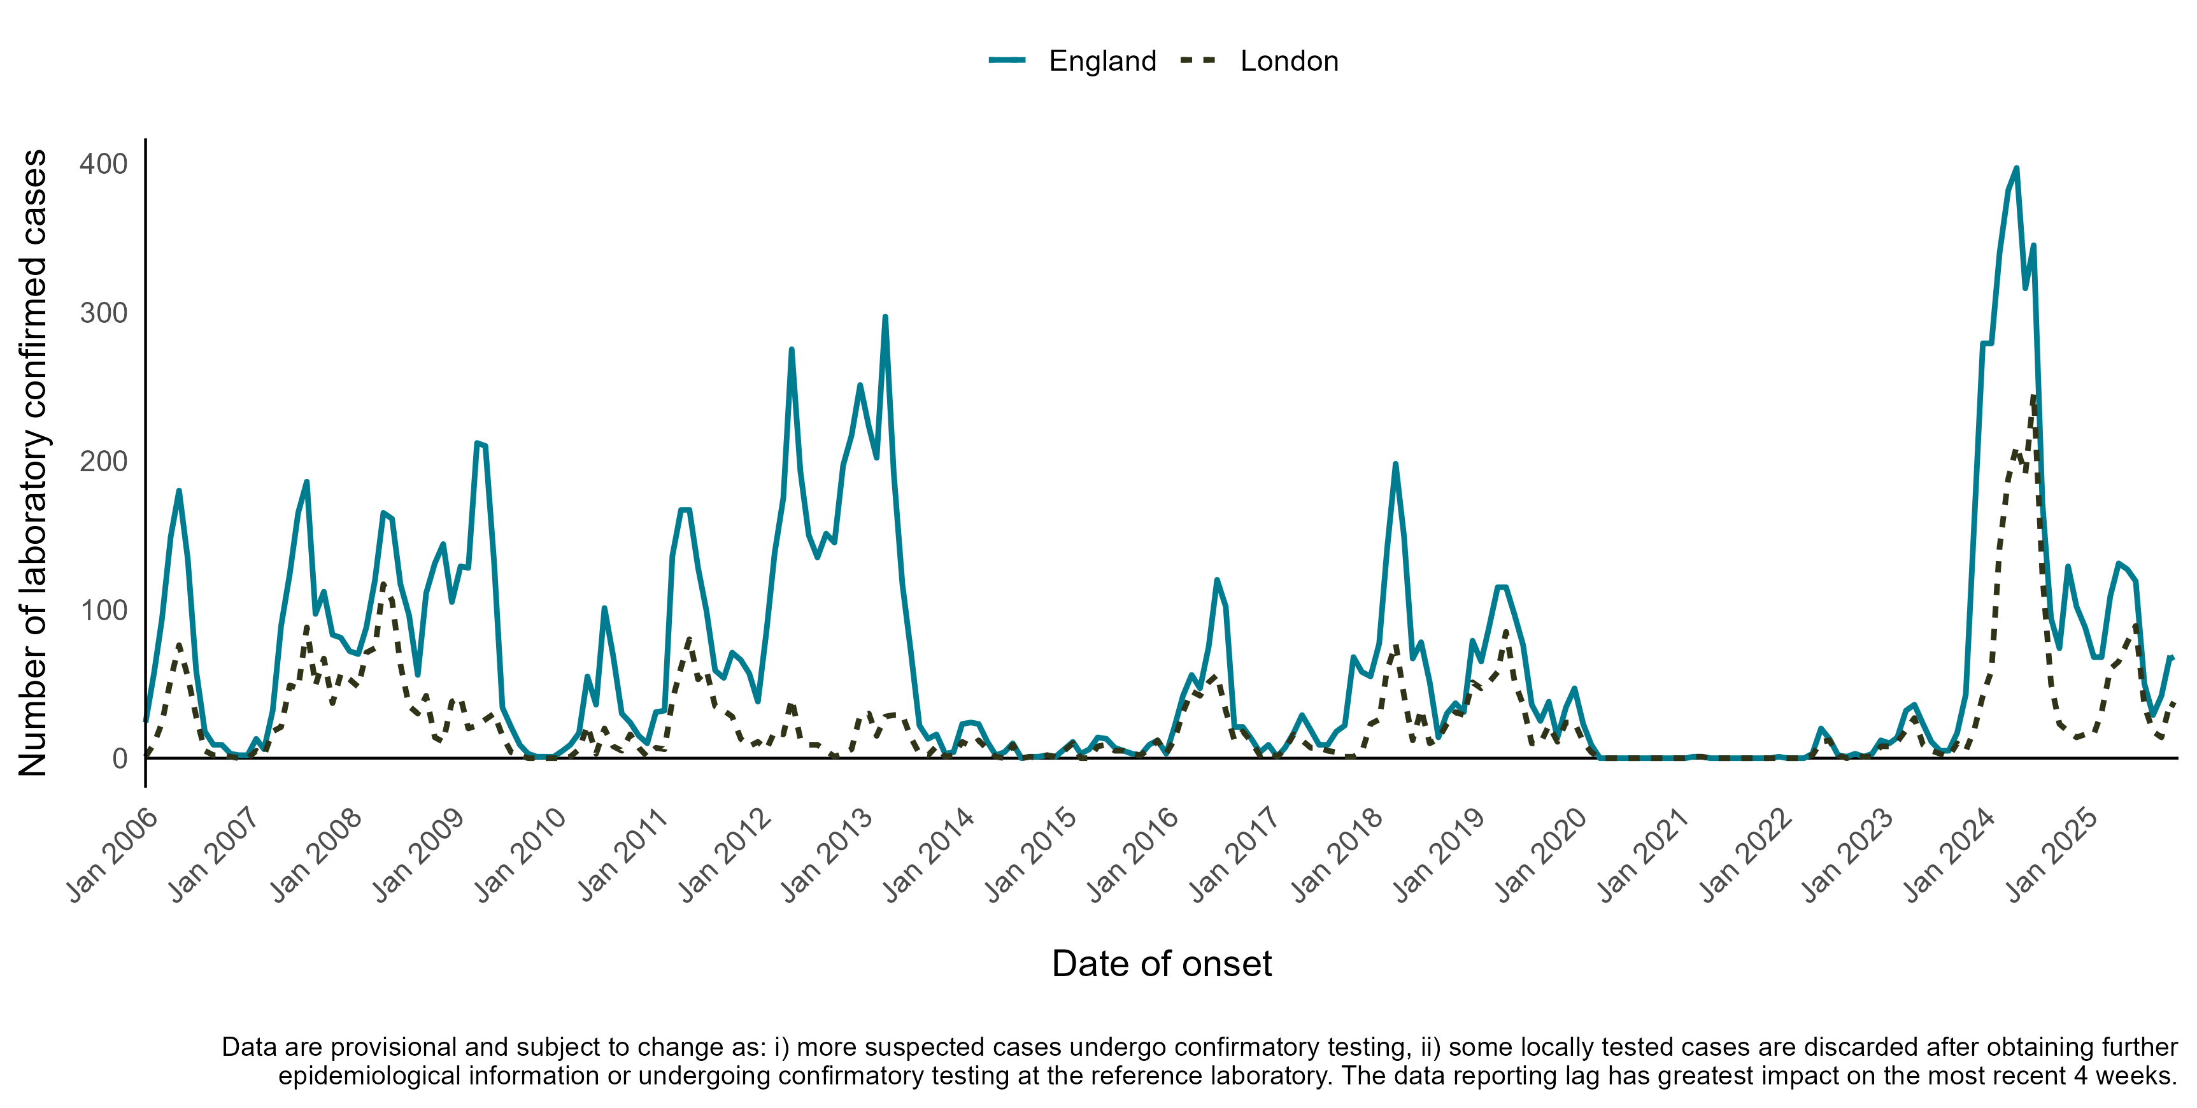
Measles epidemiology
Total laboratory confirmed measles cases in London and England, January 2006 to December 2025
Data extracted on 09/03/2026
Source: Enhanced National Measles Linelist
OFFICIAL SENSITIVE

Slide 76
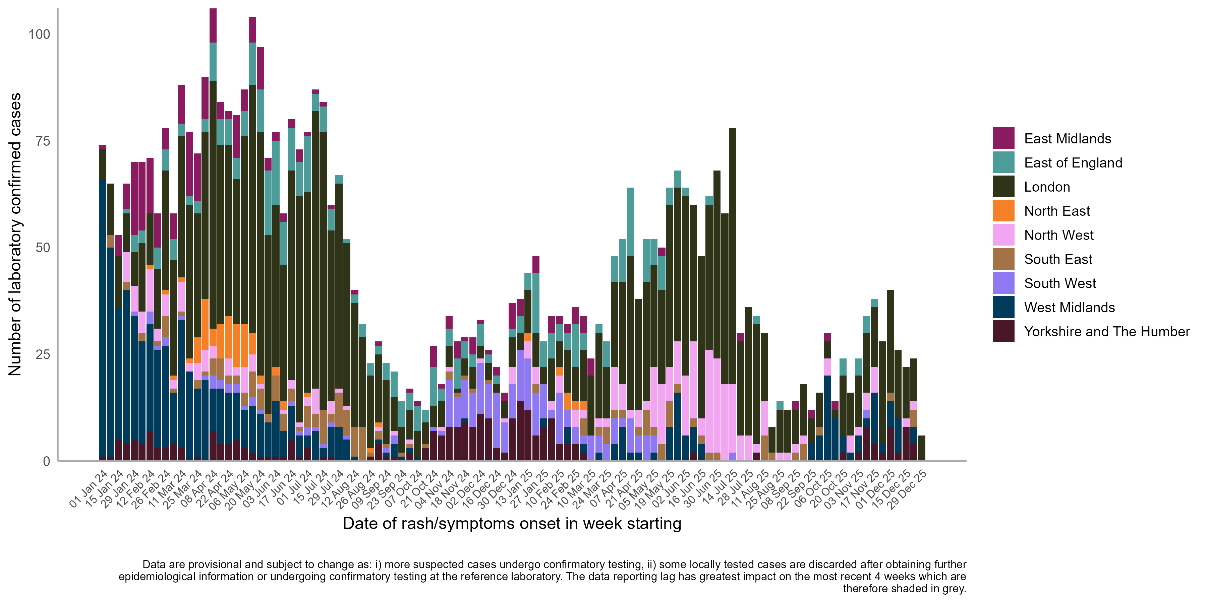
Measles epidemiology
Weekly laboratory confirmed measles cases from 1 January 2024 to 31 December 2025, by week of onset and region, England
Data extracted on 09/03/2026
Source: Enhanced National Measles Linelist
OFFICIAL SENSITIVE

Slide 77
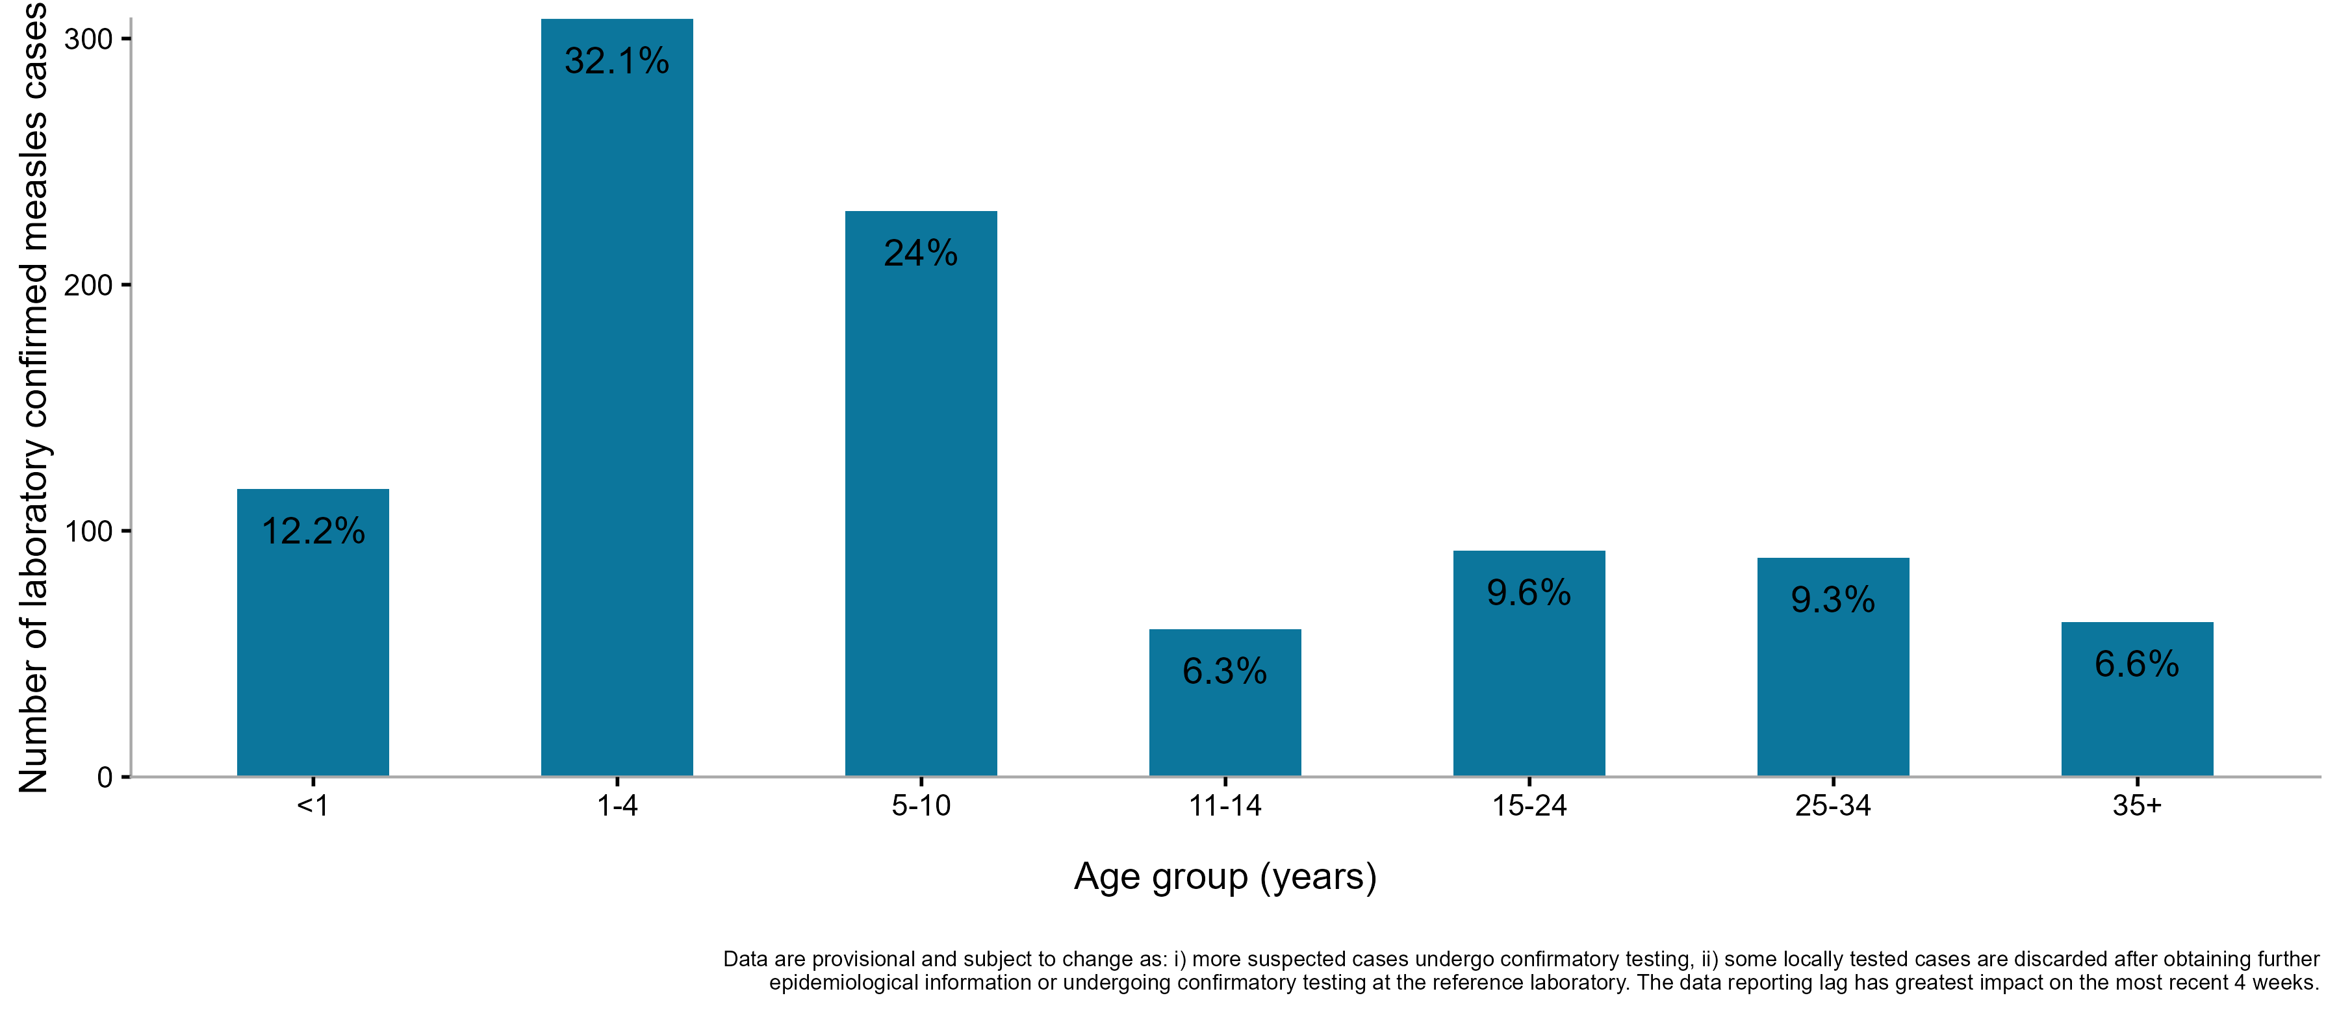
Measles epidemiology
Confirmed measles cases by age group (years), 1 January 2025 to 31 December 2025, England
44.3% of the confirmed measles cases (with onset dates since 1 January 2024) were less than 5 years of age at time of illness, and 68.3% aged 10 years or younger. This age distribution is broadly seen across England, with over half of cases aged 10 years or younger seen across most regions, except South East (41.2% cases under 10 years).
Data extracted on 09/03/2026
Source: Enhanced National Measles Linelist

Slide 78
Achieving high immunisation uptake and addressing health inequalities

Slide 79
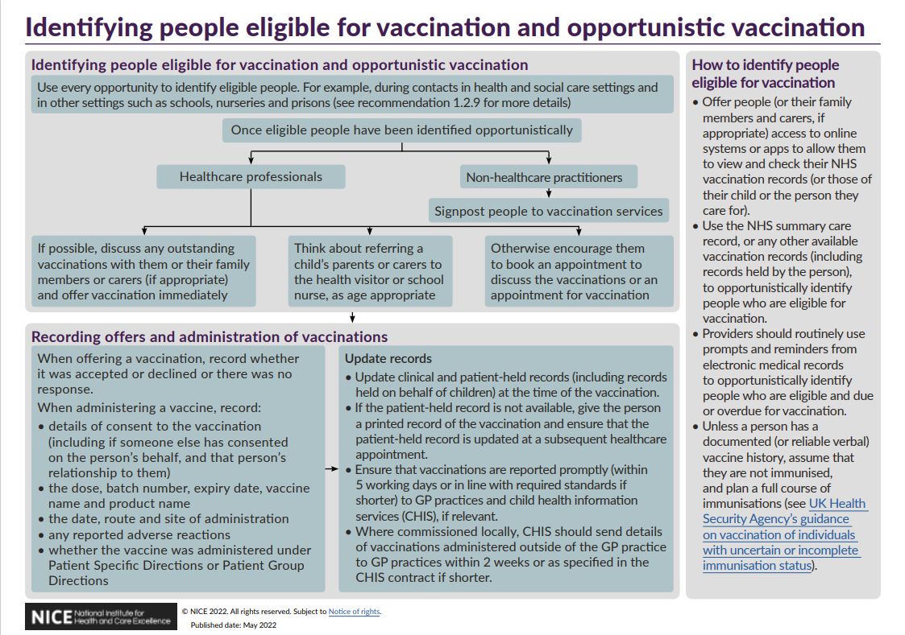
NICE guidance
NICE guideline 218 published 17 May 2022, includes recommendations on:
service organisation
identifying eligibility, giving vaccinations and recording vaccination status
invitations, reminders and escalation of contact
and supports the aims of the NHS Long Term Plan, which includes actions to improve immunisation coverage by GPs and support a narrowing of health inequalities
supporting tools and resources include:
visual summaries on the recommendations (identifying people eligible
for vaccination and opportunistic vaccination; invitations, reminders
and escalation of contact for different age-groups)
Quality Standard Vaccine uptake in under 19s (QS145)
audit template
Immunisation | Topic | NICE
Notes:
General guidance that should be followed on improving uptake that applies to all vaccinations including MMR

Slide 80
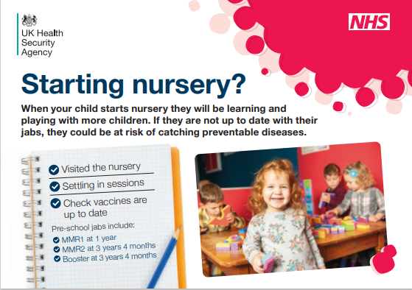

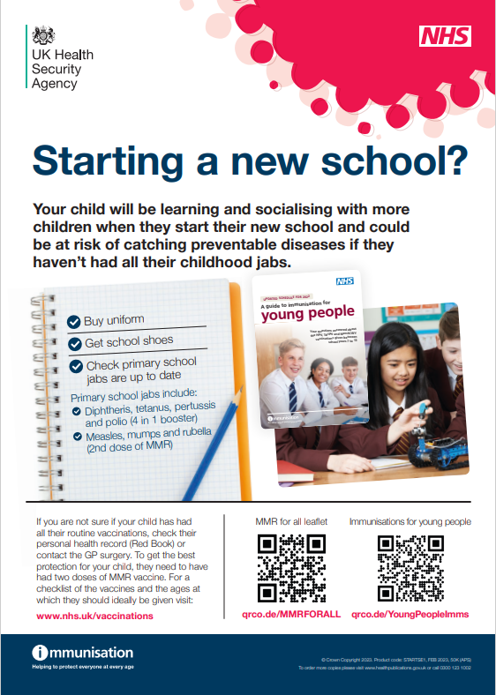
Use every opportunity to identify eligible people: Schools
remind/ discuss/ offer/ signpost:
starting/returning to nursery
before starting primary school
school entry – reception/year 1 age 4 – 5
school transition – year 6/7 age 10/11
‘back to school’ – before each school year
teen health review
adolescent immunisation programme – HPV, MenACWY,
Td/IPV (school leavers’ booster)
Guidance: Supporting immunisation programmes - GOV.UK (www.gov.uk)
Resources for starting or returning to nursery or school (postcards/posters as shown)
see also: Immunisation - GOV.UK (www.gov.uk)
Notes:
Guidance is part of Health protection in children and young people settings, including education - GOV.UK (www.gov.uk)

Slide 81
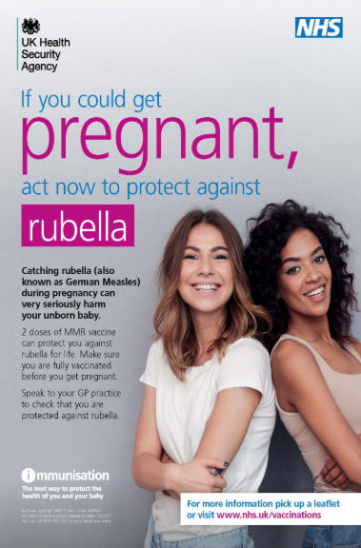
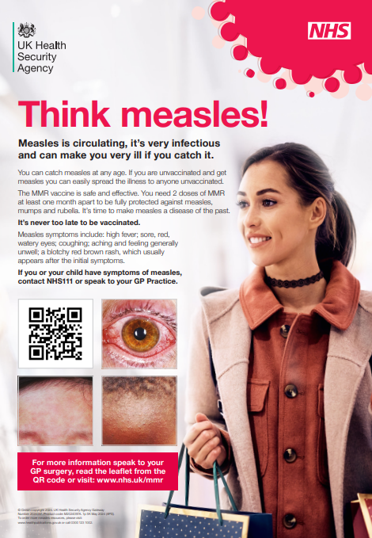
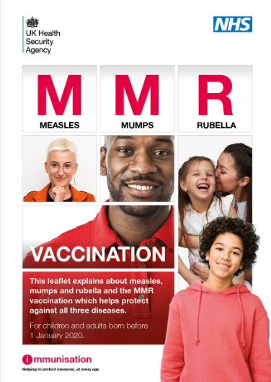
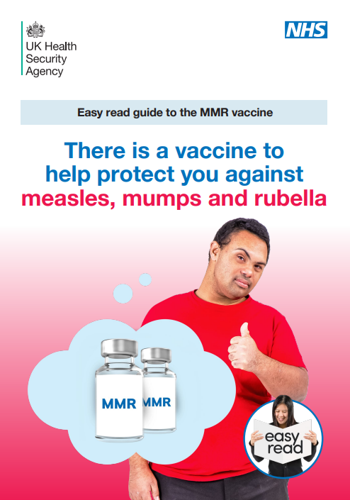
Achieving high MMR-containing vaccine uptake across the life course
a variety of measles and MMR leaflets, posters, social media banners and other digital resources are available free to order and/ or download in several different languages and for different eligible groups, see Immunisation - GOV.UK (www.gov.uk) and Find public health resources - GOV.UK
Notes:
Discuss MMR vaccination pre-, ante- and post-natally; offer vaccination pre-natally (advise to avoid pregnancy for 1 month) and post-natally if the woman has not received 2 doses of MMR-containing vaccine

Slide 82
Training for immunisers
a high level of knowledge and a positive attitude to immunisation in healthcare practitioners are widely acknowledged as being important determinants in achieving and maintaining high vaccine uptake
it is important that immunisers are confident, competent, knowledgeable and up to date
UKHSA have published national training standards and a core curriculum for immunisers, which together with other resources published by the UKHSA – the Green Book, Vaccine Update, training slide sets and an e-learning module - support the delivery of a high quality programme
National Minimum Standards and Core Curriculum for Vaccination Training Immunisation - GOV.UK (www.gov.uk)

Slide 83
Addressing health inequalities
there are inequalities in vaccine uptake by ethnicity, deprivation and geography and the burden of measles and varicella falls disproportionately on some communities
UKHSA’s Immunisation Equity Strategy 2025-2030 aims to maximise vaccination uptake overall while closing the gap between different communities and across different vaccine-preventable disease programmes in line with the duties contained in The Health and Social Care Act of 2012 and using the Core20PLUS approach
UKHSA’s Health Equity Audit for the National Immunisation Programme was published in March 2026
the UK Measles and Rubella elimination strategy was published in 2019 Measles and rubella elimination UK strategy - GOV.UK (www.gov.uk); the document includes case-studies that highlight some of the issues and challenges faced by a number of under-vaccinated communities such as the Charedi Orthodox Jewish Community, the Anthroposophic Community, the Traveller community and new migrants
the WHO/Europe developed the Guide to Tailoring Immunization Programmes (TIP) TIP: tailoring immunization programmes (who.int) to assist health care professionals, public health authorities and decision-makers to better diagnose the factors influencing vaccination intentions, decisions and behaviours and to enable tailoring of services to optimise uptake in under-served communities. The TIP approach helps immunisation programme teams to:
    identify populations susceptible to VPDs
    diagnose supply- and demand-side barriers and motivators to vaccination
    recommend evidence-informed responses to sustain vaccination

Slide 84
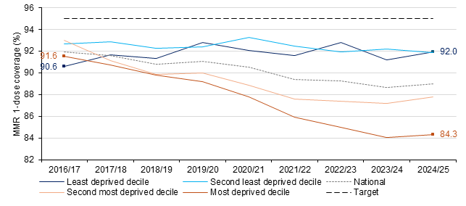
Findings from UKHSA health equity audit:
MMR1 by deprivation
Figure 2: MMR vaccine one-dose coverage at age 24 months from 2016/17 to 2023/24, by Upper Tier Local Authority IMD decile. (Source: Public Health Outcomes Framework indicator D03j)

Slide 85
Findings from UKHSA health equity audit: determinants of vaccination uptake
Facilitators
Convenient, well-trusted access points
Discussing concerns with a trusted professional
Tailored information for specific populations
Social and interpersonal influences
Direct recommendation by a trusted professional
Localised and collaborative approaches
Barriers
Difficulty navigating health system
Indirect / non-financial costs e.g. time off work
Exposure to misinformation
Social and interpersonal influences
Scepticism over vaccine efficacy / safety
Distrust in authorities / pharma
Difficulties identifying vaccination needs
Resource limitations & missed opportunities
Factors are listed in no particular order (i.e. order does not indicate strength of evidence)

Slide 86
Key messages and information resources

Slide 87
Key messages
from 1 January 2026, all children are being offered the combined MMRV vaccine at 12 and 18 months of age
for older children and adults (born before 01 January 2020) who have an incomplete measles, mumps and rubella vaccination history, MMR should be offered
measles, mumps and rubella are highly infectious viral infections, and immunisation is the most effective way to protect against these diseases
measles, rubella and varicella can lead to serious complications particularly in infants, pregnant women, and in immunosuppressed individuals
MMR-containing vaccination also contributes to reduction of risk of secondary bacterial infections and the need for antibiotics therefore contributing to the prevention of antibiotic resistance
the burden of disease and falls disproportionately on under vaccinated communities, and therefore addressing inequalities is key in order to prevent measles importations leading to outbreaks
local place-based activity to understand the needs of communities and barriers to immunisation is essential to ensure effective tailored interventions can address these inequalities.

Slide 88
MMR and MMRV resources
measles, mumps and rubella resource collection: www.gov.uk/government/collections/immunisation#measles,-mumps-and-rubella-(mmr)
Measles, mumps, rubella and varicella (MMRV) vaccination programme - GOV.UK
Green Book: Immunisation against infectious disease - GOV.UK
MMRV programme: information for healthcare practitioners - GOV.UK
MMR and MMRV PGDs: Immunisation patient group direction (PGD) templates - GOV.UK

Slide 89
Public Health management guidance
National measles guidance on the public health management of cases and contacts: www.gov.uk/government/publications/national-measles-guidelines
Measles Post Exposure Prophylaxis guidance: www.gov.uk/government/publications/measles-post-exposure-prophylaxis
Guidelines on post-exposure prophylaxis (PEP) for varicella or shingles: www.gov.uk/government/publications/post-exposure-prophylaxis-for-chickenpox-and-shingles/guidelines-on-post-exposure-prophylaxis-pep-for-varicella-or-shingles-january-2023
Viral rash in pregnancy guidance: www.gov.uk/government/publications/viral-rash-in-pregnancy

