Slide 1
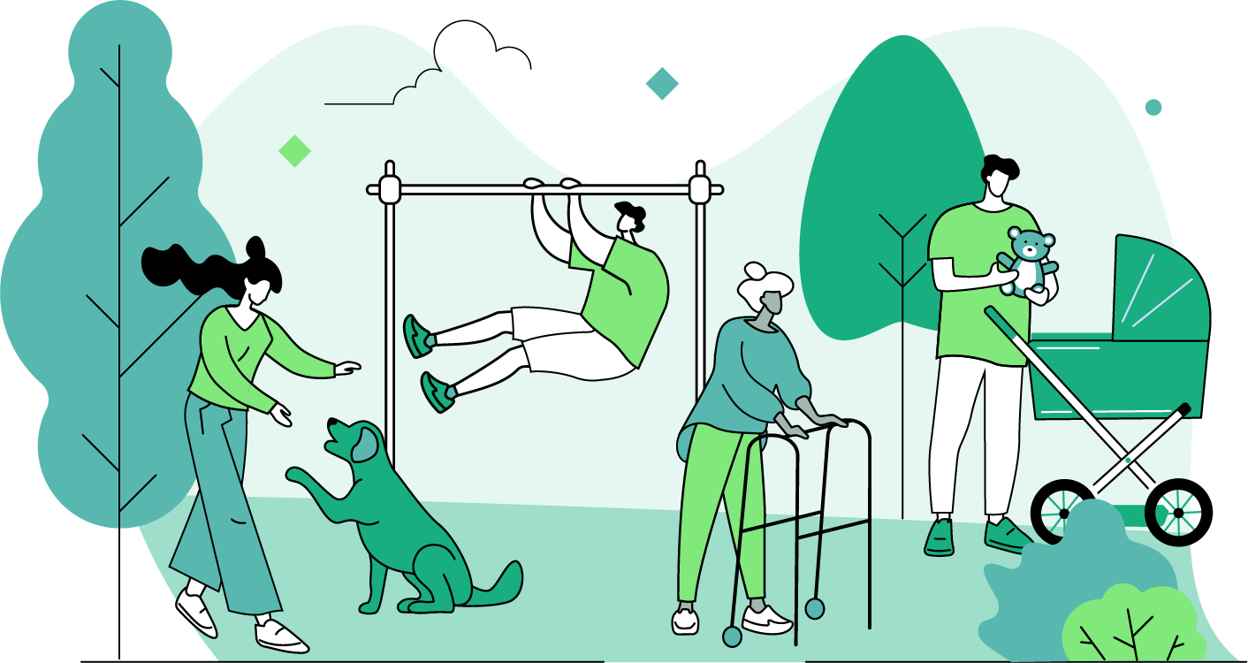
The Adults’ People and Nature Survey for England
02.10.2024
The Adults’ People and Nature Survey for England (A-PaNS) provides information on how adults experience, think about, and engage with the natural environment.
The Accredited Official Statistics in this publication are based on continuous online data collection between the 1st of April 2023 and the 31st of March 2024.
The weighted percentages shown are representative of the population of England. Each slide will outline the relevant sample size.
The following slides present some of the headline findings. Further information, the project report and data are available here:
Read the full report

Slide 2
GREEN PLACES VISITED
Dataset from April 2023 – March 2024
More than six in ten people had visited green and natural spaces in the previous 14 days*
67%
22%
of adults had visited a green and natural space in the last 14 days
of adults reported having not visited a green and natural space in the last 14 days†
Notes:
For detailed information on the answer options for this question, click on the link for the questionnaire content in the final slide, download the updated questionnaire pdf, and find question ‘No_Of_Visits’. You can also check out breakdowns for this question in our data viewer (link on the final slide) – the question ‘Any_Visits_14’ can be found in the dropdown box for ‘Visits Taken (M2A)’.

Slide 3
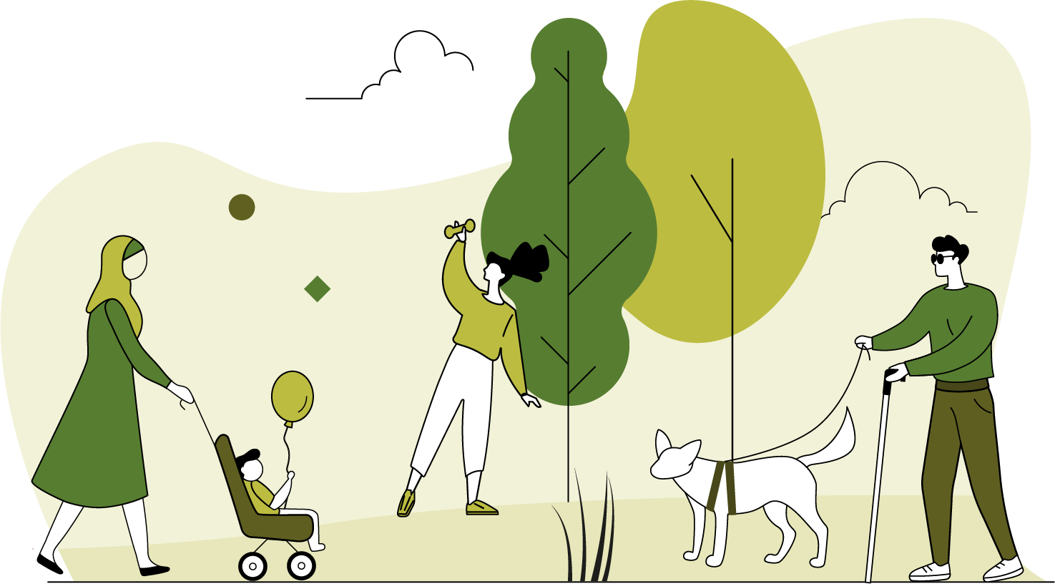
GREEN PLACES VISITED
Dataset from April 2023 – March 2024
Green and natural places that people visit†.
    Percentage of adults.
Urban green spaces (such as a park, field, or playground) were visited by five in ten people in the last month*
Notes:
For detailed information on the answer options for this question, click on the link for the questionnaire content in the final slide, download the updated questionnaire pdf, and find question M1_Q2. You can also check out breakdowns for this question in our data viewer (link on the final slide) – the question M1_Q2 can be found in the dropdown box for ‘General Experiences (M1)’.

Slide 4
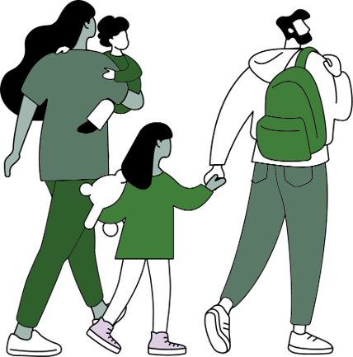
LOCAL GREEN SPACES
Dataset from April 2023 – March 2024
66% of people agreed that local green spaces were within easy walking distance*
STRONGLY DISAGREE
DISAGREE
NEITHER AGREE
NOR DISAGREE
AGREE
STRONGLY AGREE
23%
66%
DISAGREE
AGREE
Notes:
For detailed information on the answer options for this question, click on the link for the questionnaire content in the final slide, download the updated questionnaire pdf, and find question M1_Q5 a)

Slide 5
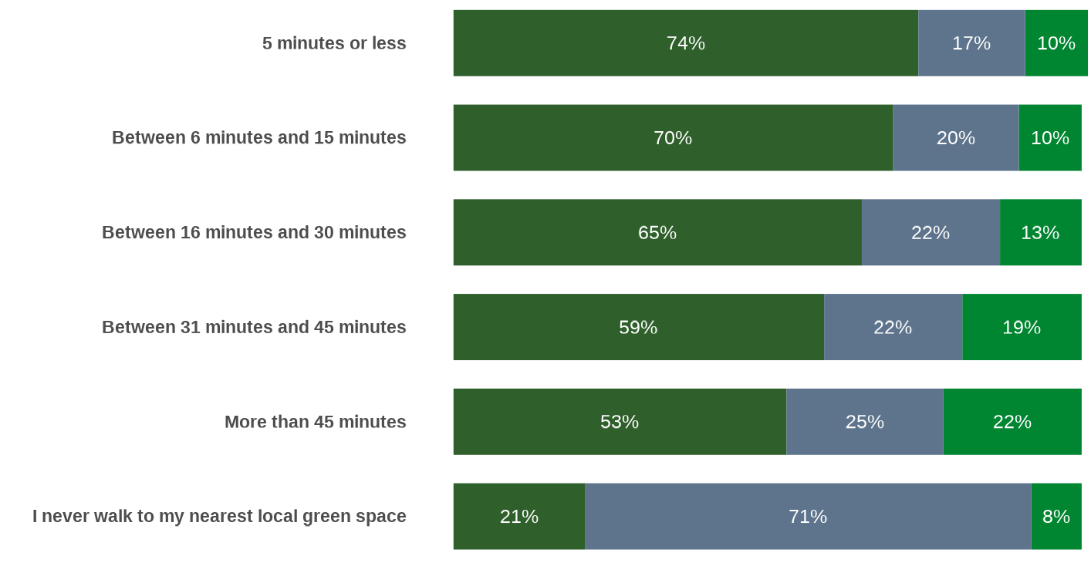
LOCAL GREEN SPACES
Dataset from April 2023 – March 2024
More people visit green spaces when local green spaces are a short walk away*
Any visits
No visits
Don’t know/
Prefer not to say

Slide 6

QUALITY OF LOCAL GREEN SPACES
Dataset from April 2023 – March 2024
23%
REDUCED QUALITY
42%
More people thought the quality of local green and natural spaces had improved rather than reduced*
IMPROVED QUALITY
35%
NO CHANGE
Notes:
For detailed information on the answer options for this question, click on the link for the questionnaire content in the final slide, download the updated questionnaire pdf, and find question M1_Q3

Slide 7
TRAVEL TO GREEN & NATURAL SPACES
Dataset from April 2023 – March 2024
More than two in three journeys (69%) to a natural space were below three miles in travel distance
Distance travelled to green and natural space*
45%
<1 Mile
23%
1-2 Miles
21%
3-10 Miles
11%
>10 Miles
69%
Notes:
For detailed information on the answer options for this question, click on the link for the questionnaire content in the final slide, download the updated questionnaire pdf, and find question M2A_Q6

Slide 8
TRAVEL TO GREEN & NATURAL SPACES
Dataset from April 2023 – March 2024
The mode of transportation switched from mostly active travel to mostly passive travel* between two- and three-miles travel distance
Distance travelled to green and natural space, and mode of travel*
45%
<1 Mile
23%
1-2 Miles
21%
3-10 Miles
11%
>10 Miles
90% active
64% active
36% active
13% active
Active travel (on foot, by bike, or by mobility aid)
Passive travel (by car, van, motorbike or by public transport)
Notes:
Question about distance travelled (M2A_Q6) broken down by the main form of transport used question (M2A_SUB_Q1).

Slide 9
REASONS FOR VISITING GREEN SPACES
Dataset from April 2023 – March 2024
Reasons for visiting green and natural space†
Getting fresh air and physical health and exercise were the main reasons for people taking a visit to a green and natural space*
57%
49%
To get fresh air
For physical exercise
Notes:
For detailed information on the answer options for this question, click on the link for the questionnaire content in the final slide, download the updated questionnaire pdf, and find question M2A_SUB_Q5.

Slide 10
BENEFITS OF VISITING GREEN AND NATURAL SPACES
Dataset from April 2023 – March 2024
For people who had visited a green and natural space in the last 14 days:
92%
89%
agreed that spending time outdoors was good for their physical health*
agreed that spending time outdoors was good for their mental health *
Notes:
For detailed information on the answer options for this question, click on the link for the questionnaire content in the final slide, download the updated questionnaire pdf, and find question M2A_Q9 a) and b)

Slide 11

BARRIERS TO VISITING GREEN AND NATURAL SPACE
Dataset from April 2023 – March 2024
The most common reason cited for not spending free time outside was bad/poor weather*
Reasons for not visiting green and natural space in the last 14 days†
WEATHER
HEALTH
BUSY AT HOME
BUSY AT WORK
COVID
43%
Bad / poor weather
25%
Poor physical health
24%
Too busy at home
21%
Too busy with work/family commitments
3%
To stop coronavirus spreading/ Government restrictions
Notes:
For detailed information on the answer options for this question, click on the link for the questionnaire content in the final slide, download the updated questionnaire pdf, and find question M2B_Q2.

Slide 12

BARRIERS TO VISITING GREEN AND NATURAL SPACE
Dataset from April 2023 – March 2024
The top five concerns or worries about visiting green and natural spaces for people that had not visited green and natural spaces in the previous 14 days*
Top five concerns about visiting green and natural space†
FACILITIES
DARK
ASB
CRIME
ISOLATED
25%
Lack of facilities
24%
Visiting after dark
24%
Anti-social behaviour
18%
Fear of crime
15%
Being on my own/ isolated
Notes:
For detailed information on the answer options for this question, click on the link for the questionnaire content in the final slide, download the updated questionnaire pdf, and find question M2B_Q4A.

Slide 13
PROTECTING THE ENVIRONMENT
Dataset from April 2023 – March 2024
Actions people take to protect the environment†
People undertook a range of household, gardening, and broader lifestyle behaviours that are positive for the environment
81%
81%
76%
Recycled
Brought own shopping bags
Switched off appliances
Notes:
For detailed information on the answer options for this question, click on the link for the questionnaire content in the final slide, download the updated questionnaire pdf, and find question M4_Q11

Slide 14
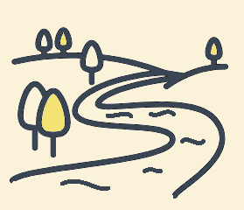

PROTECTING THE ENVIRONMENT
Dataset from April 2023 – March 2024
Environmental issues people are most concerned about†
Most people ranked climate change, water pollution, and the decline or extinction of animal and plant life as the environmental issues they are most concerned about*
47%
40%
38%
Climate change
Pollution of rivers, lakes, and ground water
Extinction of animal & plant life
Notes:
For detailed information on the answer options for this question, click on the link for the questionnaire content in the final slide, download the updated questionnaire pdf, and find question M4_Q7

Slide 15
Where to find out more?
The following slides present some of the headline findings. Further information, the project report and data are available here:
Read the full report
Links to further information
More background on A-PaNS:
The People and Nature Surveys for England - GOV.UK (www.gov.uk)
For the full content of the questionnaire (the actual questionnaire questions asked):
The People and Nature Survey For England - PANS001 (naturalengland.org.uk)
For the data viewer:
natural-england.shinyapps.io/People_and_Nature_Data_Viewer/
User Hub:
Welcome to the People and Nature Survey (arcgis.com)
If you have questions about The People and Nature Surveys for England, contact people_and_nature@naturalengland.org.uk.

