Slide 1
Information Asset Owner Training
Chapter 4: Information
Asset Register

Slide 2
Information
Asset Register
What is an Information Asset Register (IAR) overview
What are the contents of the IAR and scope?
Why is the IAR important?
The IAR ensures implementation of the following
01
Who is involved in the register?
02
How to maintain the register
03
Review cycles
04
4
05
06
07

Slide 3

What is an information asset register (IAR)?
Overview
The Information Asset Register (IAR) is a useful tool providing an IAO with a comprehensive overview of the organisation’s information assets. It serves as an inventory to manage and assess risks by mapping information assets to business needs. How assets are recorded and the information captured may vary in different organisations.
The IAR is typically maintained electronically (such as on a SharePoint site, M365 List or Excel) and is completed or reviewed regularly by the relevant IAM within their respective business areas. The organisation can have a single IAR for the whole organisation, or one per IAO.

Slide 4
What are the contents of the IAR and scope?
Internal IAR | Public IAR
Reviewed and updated regularly (such as biannually or annually) | Updated annually or as required
Ownership of Assets | Published on gov.uk
Name and description | High-level consolidated view of access held
Access and sharing | Name and description only
Security classification and controls
Review and retention
Business value and risk
Personal data
Public register mapping
The IAR includes details such as the name, description, data/business ownership, purpose, classification, sensitivity, associated risks, and whether personal data is contained within each information asset.
The IAR includes all information assets held in hardcopy, digital files and information stored in databases, and it specifies classification, access permissions, the lifecycle of information assets and describes measures in place for protection of the assets.

Slide 5

Why is the IAR important?
An IAR helps the IAO fulfil their duties, providing a detailed view of the organisation’s information landscape. It enables the organisation to implement best practices around information governance, legal and regulatory compliance, and HMG policies.
It is essential the IAR is up to date and accurately reflects the information assets held by the IAOs area
of responsibility.

Slide 6
The IAR ensures implementation of the following (1)
Legal Compliance – The ICO advises all government bodies
to maintain an updated IAR, including documenting the basis for all personal data processing activities and the Record of Personal Processing Activity (RoPA) to comply with UK GDPR.
Responding to Subject Access Requests - Knowing what personal data is retained and where it is located allows the organisation to manage requests from individuals for access to their information more efficiently in compliance with UK GDPR.
Responding to FOI and EIR requests – Supporting requests for information in line with the Freedom of Information Act 2000, and Environmental Information Regulations 2004.
Policies & guidance – The Cabinet Office advises government organisations to use an IAR for management of their IAs. The organisation is expected to have relevant information governance policies. Use of the IAR helps ensure required compliance is met.
Information asset review & identification – IARs help an IAO undertake an assurance review; understand and locate valuable and sensitive information for secure and effective use and support with business outcomes and decision making.

Slide 7
The IAR ensures implementation of the following (2)
Risk Assessment – IARs help identify the assets with the highest risks associated with the information, confirming where to focus efforts on implementing controls.
Access control – IARs ensure information assets are monitored and access to them are applied correctly, based on the ‘need to know’ business requirements.
Data Sharing/3rd Parties – IARs enable the organisation to easily identify data sharing, internally and externally and highlight third-party data processing. This may include details of agreements or contract clauses which specify what data can be shared and how.
Supports Strategy and Policy – IARs provide a comprehensive understanding of the organisation’s information assets which can significantly enhance exploitation, usage and development of policy and strategy.
Knowledge Management – acts as a central repository identifying duplication of assets and ensures enforcement of information retention schedules.

Slide 8
Who is involved in the register? (1)
The IAO is the senior leader accountable for ensuring that their area of responsibility within the organisation regularly conducts activities to develop, maintain, and review the IAR.
This living document is maintained by designated Information Asset Managers authorised by the IAO.
Information Asset Manager – is responsible for the direct management of information assets. Oversees asset entries in the IAR and addresses internal inquiries. Conducts regular reviews and updates of IAR entries to add, amend, or remove assets.
Assurance and Compliance team - Various roles and responsibilities are involved across individual organisations, contributing to the IAR, for example, validation of entries, obtaining approval for and publishing the public information asset register and providing support to IAOs and IAMs throughout the review process.

Slide 9

Who is involved in the register? (2)
Technical Teams (Knowledge and Information Management, Digital and Data, Cyber, Security – roles vary by organisation)
Understand the platform/systems containing information assets
Evaluate capabilities and limitations of platforms/systems
Provide advice on access control and audit logs
if requested
Implement content movement/manipulation requests
Identify technical risks and opportunities related to stability, longevity, effectiveness, and cost of hosting assets
The IAO must ensure all delegated responsibilities are understood and that all duties are undertaken for a comprehensive assurance process. This requires full collaboration and co-ordination between the various disciplinary and technical teams.

Slide 10

How to maintain the register
IAMs are part of the team that manages information assets on a day-to-day basis, from granting access to assets for new joiners to removing access from leavers.
Other responsibilities required to maintain the IAR include working with other teams to keep it accurate and updated as required, in advance of the formal regular review and assurance period:
New assets & risk identified and included in the register
Information assets no longer required etc. Archiving/deletion
Please see your organisation’s guidance for specific instructions on how to remove information assets from your IAR or seek guidance from the Departmental Records Officer (DRO).

Slide 11

Review cycles
IAOs are responsible for establishing regular review processes internally, to verify the composition of information assets, ensuring alignment with core elements of information security, legislation, and compliance. As an IAO, It is important that you understand your organisation’s process for recording changes relating to information assets.
The review process helps to assess whether individual business areas are managing information assets appropriately aligned to information governance policy and procedures, supporting Information Asset Managers in fulfilling their roles and responsibilities.
Organisations need to establish a formal process with relevant assurance teams, to complete the regular review and assurance process.
The review should be conducted biannually or at least annually, providing formal reports on information asset status.

Slide 12
Elements of the assurance process should include checks on the following (1)
(This list is not exhaustive)
All information assets that the IAO is accountable for, how and where it is stored and the business activity it supports
Who is accessing the assets and why, and what are the risks and risk ratings
Under the UK GDPR, a record of processing activities (ROPA) is in place
Ensure that personal information is not unlawfully exploited
Record the asset classification; sensitive assets and personal data should be identified
Understand what physical and organisational measures are in place to ensure that the information held in your assets is processed and protected properly
Ensure the asset is fit for purpose and used ethically
Ensure that information is only kept for as long as it is required to carry out business, or to comply with statutory responsibilities and legislative requirements

Slide 13
Elements of the assurance process should include checks on the following (2)
(This list is not exhaustive)
Ensure compliance with information sharing agreement requirements
That retention schedules are applied, and end-of-life information is considered for transfer to the National Archives or securely destroyed when there is no further requirement for it, helping compliance with Public Records Act obligations
Record in what format assets are held i.e. in systems, digital electronic and hardcopy information – and how they are controlled, retained and exploited
Ensure a record of breaches and incidents is kept & maintain incident management reports relating to the asset
A record of information assets handled by third parties/suppliers, risks – controls & measures in place for protection
Ensure guidance & training is available and undertaken by IAMs
Ensure measures are in place so that all staff are aware of their responsibility to handle information securely
Be aware of business continuity and emergency plans to reduce or prevent interruptions to business activities due to significant disruptions to information assets

Slide 14
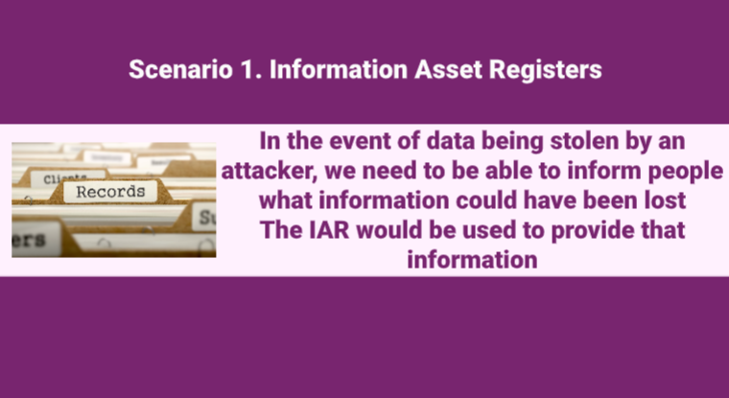
Scenario 1:
Video
Click on the image to play the Video.
If the video doesn't open in full screen automatically, click the full screen icon (⛶) in the bottom-right corner of the video player to enlarge it.
Once you have finished viewing the video click outside the image to move to the next slide.

Slide 15
You have completed this chapter
Please start chapter 5

